Slide 1
Problem Statement Worksheet (Hypothesis Formation)
How Big Mountain resort can increase revenue or decrease total costs based on it’s facilities compared to other resorts in the US to make it profitable by at least 10% in their market
segment
H
1
Context
4
Constraints within solution space
Big Mountain resort offers view of Glacier national park and Flathead national forest in Montana. The current premium ticket charging does not specify importance of some facilities compared to others and new strategy required to determine ticket price. By having model to predict ticket price, Big mountain resort will be able to understand each variable effect on revenue or total costs.
Current ticket price does not specify importance of some facilities compared to others.
The predicted model can not specify the role of operating costs in predicting ticket price.
2
Criteria for success
5
Stakeholders to provide key insight
Criteria to success would be increasing resort profit by 10% in the upcoming season .
Ski resort owners & employees, people who use resort every year, data science team
3
Scope of solution space
6
Key data sources
The project scope just included resort equipment & variables like vertical drop, skiing area or snow making facilities. It does not include operating costs for equipment.
Database on facilities and equipment in 330 resorts around US
H
D
E
I
P
Notes:
Hypothesis: Create a Hypothesis with an emphasis on SMART principles. (S – Specific, M – Measurable, A – Achievable, R – Realistic, T – Timebound). If you cannot do this, you do not have a good grasp on the business problem.
Context: With context, we have clearly identified the problem at hand and have elucidated on how our initiative may solve this problem, alongside the commercial implications this will have on the business.
Criteria for Success: Clearly defining the criteria for success ensures that the scope of your work is clearly defined and understood. Otherwise, if this isn’t defined – your work will never end which will result in mismatched expectations.
Scope of Solution Space: Scoping out the solution space ensures that the business initiative is SPECIFIC for a certain segment or area. This prevents solutions that have been developed being scaled and applied for all other business units that the solution may not be responsible or scalable for.
Constraints within Solution Space: Looking forward, what are the foreseeable problems we are likely to encounter? Could this be stakeholder resistance? Could this be we don’t have access to the right data?
Stakeholders to provide key insight: Who are the people I need to speak to, to get the answers I need for my data analysis?
What key data sources are required?
Based off my discussions with the key stakeholders – can we clearly list out all the data sources we need so we can make a highly targeted request as opposed to a scatter-gun approach where we ask for a bit of everything?

Slide 2
Recommendation & Key Findings
What are the key findings in the analysis?
The predicted ticket price by RandomForest model is $13.4 higher than the current ticket price.
The most important features in evaluating the ticket price included: vertical drop, snow making area, total chairs, fast quads, number of runs, longest miles distance, trams and skiable terrain area
My Recommendations:
Increasing vertical drop by 150 feet (including adding one run and one chair) will increase the revenue by $3500000 during the season.
Closing down the 9 runs, can harm the revenue by $3000000.
Adding snowmaking areas by 100 acres along with increasing vertical drop by 150 feet, can increase the season revenue by $10000000 but the operating costs should be evaluated as well.

Slide 3
Which models were used to predict ticket Price?
Linear Regression Model:
The R2 score was around 0.7.
The average of mean absolute error was $10.49.
The standard deviation of mean absolute error was $1.62.
Random Forest Regression Model:
The R2 score was around 0.7.
The average of mean absolute error was $9.65.
The standard deviation of mean absolute error was $1.34.
Random Forest model selected because of less mean absolute error and less variability

Slide 4
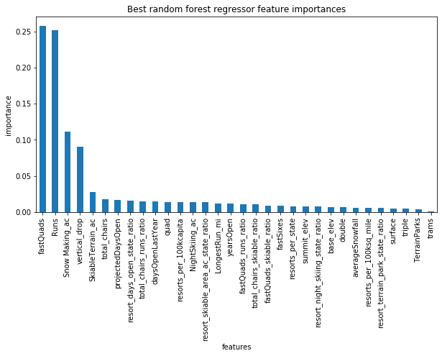
Which Features were the important in predicting the ticket price?
Fast quads, runs, snowmaking areas, vertical drop and skiable terrain areas were most important features in predicting the ticket price.

Slide 5
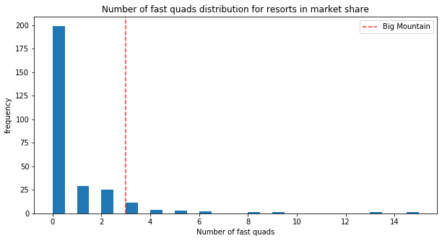
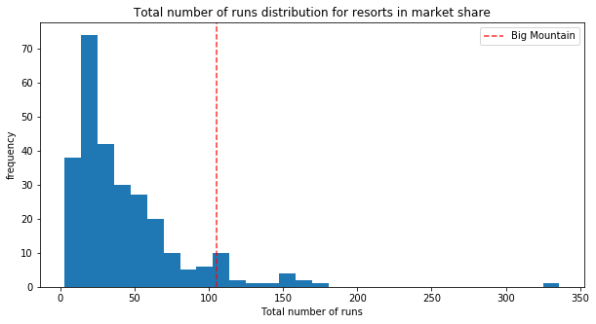
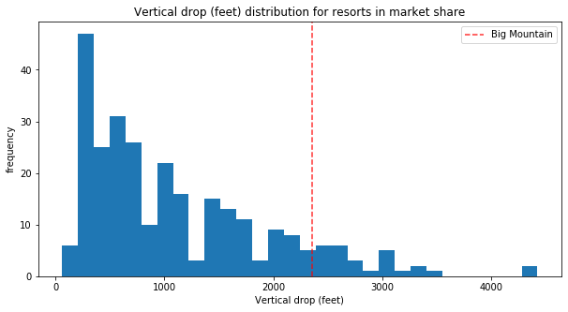
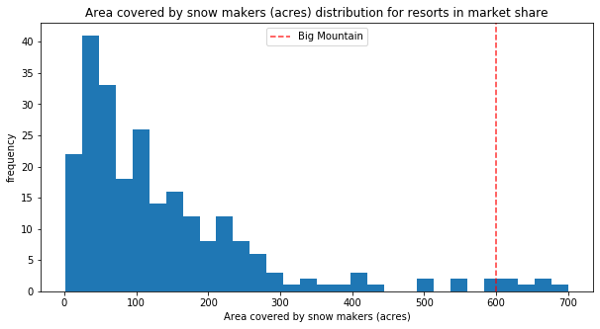
Where is Big Mountain Resort in Market Context?
Big mountain resort is high ranked in most important features like fast quads, number of runs, vertical drop and snowmaking areas
Red line shows Big Mountain resort

Slide 6
Summary & Conclusion
RandomForest model predicts the ticket price better than the linear regression model
The predicted ticket price by RandomForest model is $13.4 higher than the current ticket price.
The most important features in evaluating ticket price included: vertical drop, snow making area, fast quads, number of runs and skiable terrain area
The most effective way to increase the season revenue is increasing vertical drop which might be less costly as increasing snowmaking areas
Future Steps:
Operating costs should be considered in the model
Marketing team should provide information regarding how the resort should approach the potential customers

