Slide 1


Electric Circuits
Twelfth Edition, Global Edition
Chapter 4 – Part 1
Techniques of Circuit Analysis
© 2024 Pearson Education Ltd. All Rights Reserved.
Notes:
If this PowerPoint presentation contains mathematical equations, you may need to check that your computer has the following installed:
1) Math Type Plugin
2) Math Player (free versions available)
3) NVDA Reader (free versions available)

Slide 2
Chapter 4 – techniques of circuit analysis (1 of 26)
Objectives:
4.1 Know how to use the node voltage method to solve a circuit
4.2 Know how to use the mesh current method to solve a circuit
4.3 Be able to choose the appropriate circuit analysis method to use for a particular circuit
4.4 Know how to use source transformation to simplify a circuit
4.5 Be able to calculate the Thevenin and Norton equivalents for a circuit
4.6 Understand and be able to use the condition for maximum power transfer to a load

Slide 3
Chapter 4 – techniques of circuit analysis (2 of 26)
Terminology:
Node – a point where two or more circuit elements are joined
Essential node – a point where three or more circuit elements are joined
Loop – a path whose ending node is the same as its starting node, and does not contain any intermediate nodes more than once
Mesh – a loop that does not contain any other loops

Slide 4
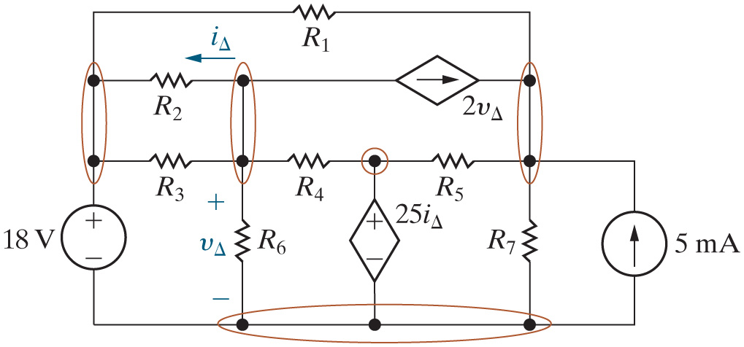
Chapter 4 – techniques of circuit analysis (3 of 26)
Identify all of the nodes in this circuit.

Slide 5
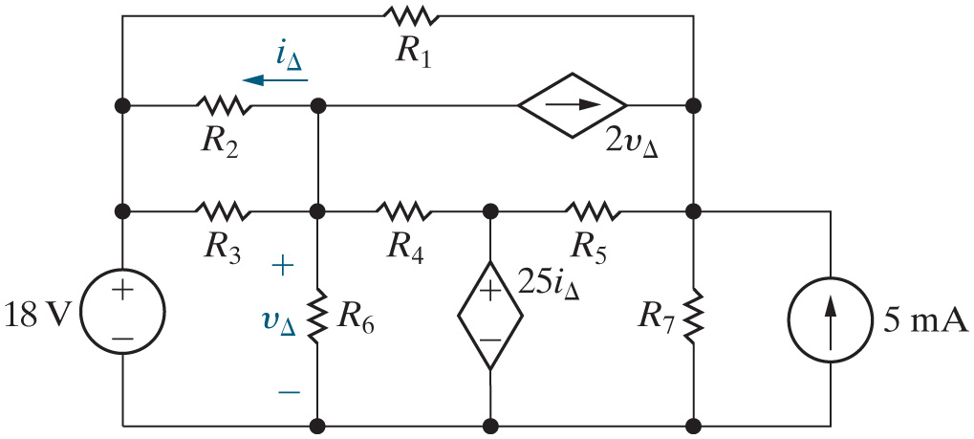


Chapter 4 – techniques of circuit analysis (4 of 26)
How many essential nodes does this circuit have?
A. 4
B. 5
C. 7
D. 10

Slide 6








Chapter 4 – techniques of circuit analysis (5 of 26)
Identify all of the loops in this circuit.
dep. source,
Dep. Source,
dep. source,
Etc

Slide 7
Chapter 4 – techniques of circuit analysis (6 of 26)
How many meshes does this circuit have?
A. 4
B. 5
C. 7
D. 10

Slide 8
Chapter 4 – techniques of circuit analysis (7 of 26)
Node voltage method:
  Based on writing K C L equations at essential nodes
  Solves for node voltages
  Analysis Method 4.1
    Identify each essential node.
    Pick and label a reference node; then label the node voltages at the remaining essential nodes.
    Write a K C L equation for every nonreference essential node.
    Solve the equations to find the node-voltage values.
    Solve the circuit using node voltages from Step 4 to find component currents, voltages, and power values.

Slide 9
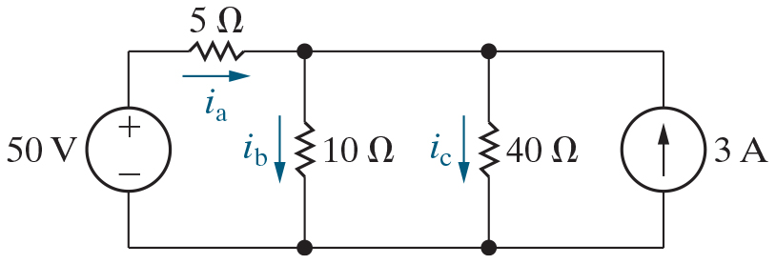
Chapter 4 – techniques of circuit analysis (8 of 26)
Use the node voltage method to find the currents shown in this circuit.

Slide 10
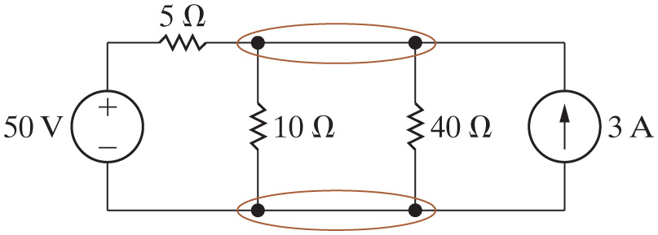
Chapter 4 – techniques of circuit analysis (9 of 26)
Node voltage method:
  Step 1 – Identify each essential node.

Slide 11
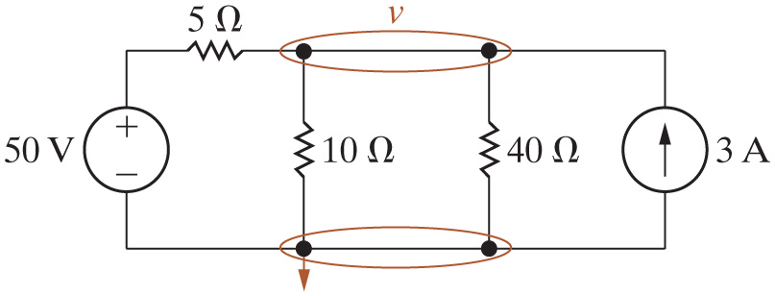
Chapter 4 – techniques of circuit analysis (10 of 26)
Node voltage method:
  Step 2 – Pick and label a reference node; then label the node voltages at the remaining essential nodes.

Slide 12
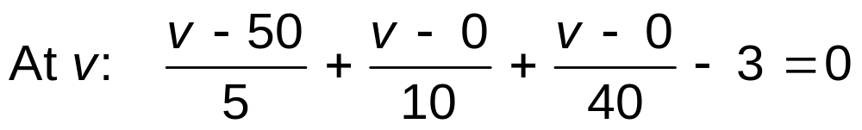
Chapter 4 – techniques of circuit analysis (11 of 26)
Node voltage method:
  Step 3 – Write a K C L equation for every nonreference essential node.

Slide 13
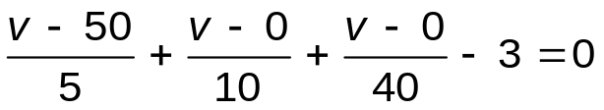
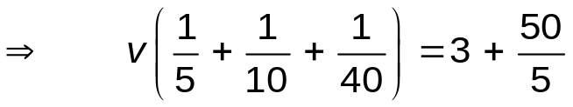
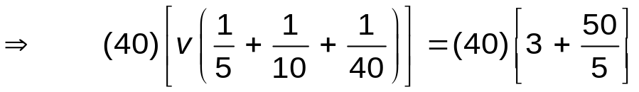

Chapter 4 – techniques of circuit analysis (12 of 26)
Node voltage method:
  Step 4 – Solve the equations to find the node-voltage values.
Notes:
Long Description:
Forward arrow, Open Parenthesis 40 Close Parenthesis Open Square Bracket v Open Parenthesis StartFraction 1 over 5 End Fraction plus StartFraction 1 over 10 End Fraction plus StartFraction 1 over 40 End Fraction Close Parenthesis Close Square Bracket equals Open Parenthesis 40 Close Parenthesis Open Square Bracket 3 plus StartFraction 50 over 5 End Fraction Close Square Bracket.

Slide 14
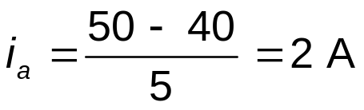
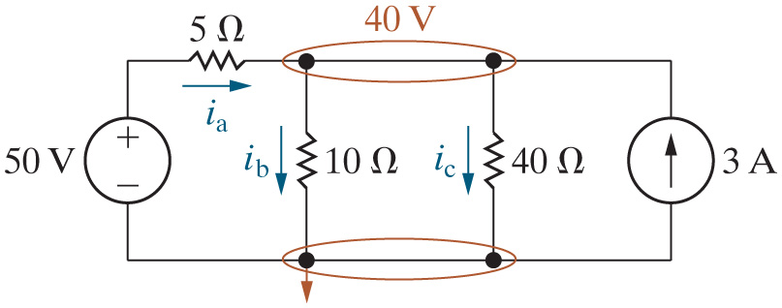
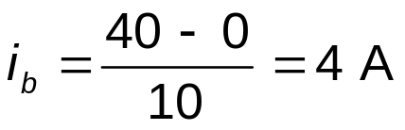
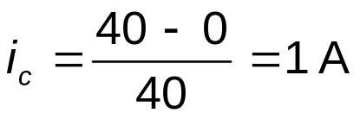
Chapter 4 – techniques of circuit analysis (13 of 26)
Node voltage method:
  Step 5 – Solve the circuit using node voltages from Step 4.

Slide 15
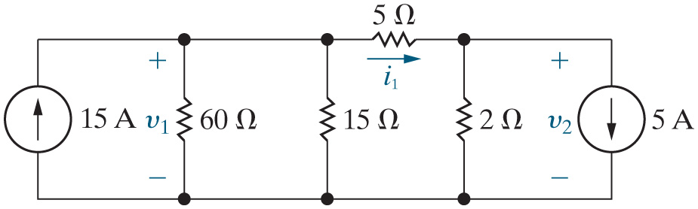
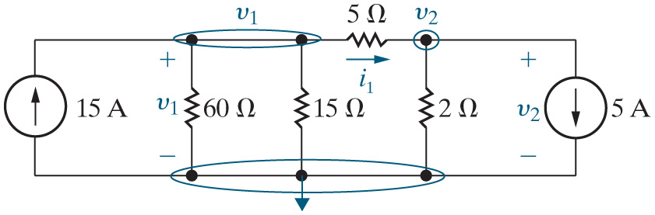
Chapter 4 – techniques of circuit analysis (16 of 26)
Node voltage method:
  Find the two voltages and the current indicated.
Step 1 – Identify each essential node.
Step 2 – Pick and label a reference node; then label the node voltages at the remaining essential nodes.

Slide 16

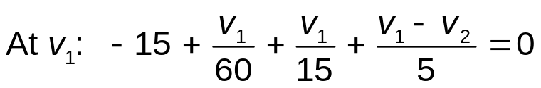
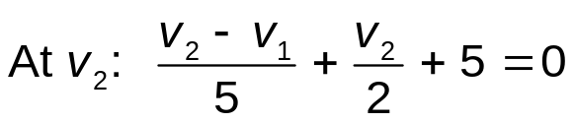
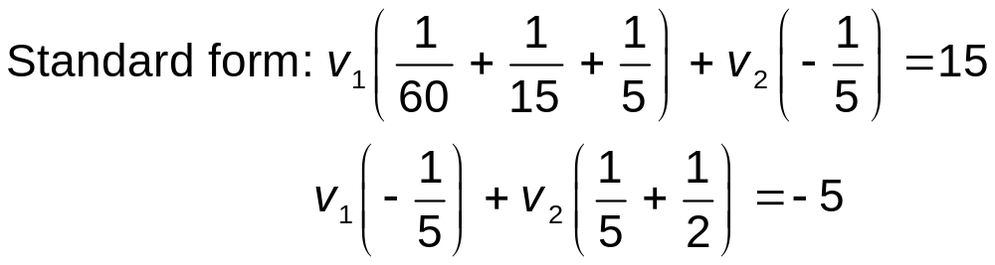
Chapter 4 – techniques of circuit analysis (17 of 26)
Node voltage method:
  Step 3 – Write a K C L equation for every nonreference essential node.
  Step 4 – Solve the equations to find the node-voltage values.
Notes:
Long Description 1:
At v subscript 1 BaseLine: negative 15 plus StartFraction v subscript 1 BaseLine over 60 End Fraction plus StartFraction v subscript 1 BaseLine over 15 End Fraction plus StartFraction v subscript 1 BaseLine minus v subscript 2 BaseLine over 5 End Fraction equals 0.
Long Description 2:
v subscript 1 BaseLine Open Parenthesis 1 divided by 60 plus 1 divided by 15 plus 1 divided by 5 Close Parenthesis plus v subscript 2 BaseLine Open Parenthesis negative 1 divided by 5 Close Parenthesis equals 15.
v subscript 1 BaseLine Open Parenthesis negative 1 divided by 5 Close Parenthesis plus v subscript 2 BaseLine Open Parenthesis 1 by 5 plus 1 by 2 Close Parenthesis equals negative 5.

Slide 17
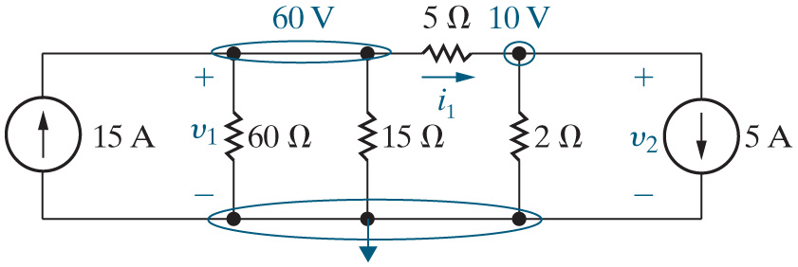

Chapter 4 – techniques of circuit analysis (18 of 26)
Node voltage method (continued):
  Step 5 – Solve the circuit using node voltages from Step 4.

Slide 18
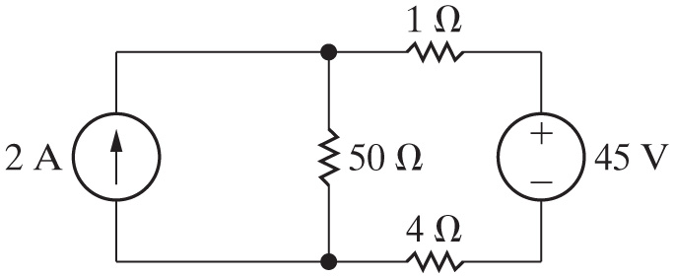
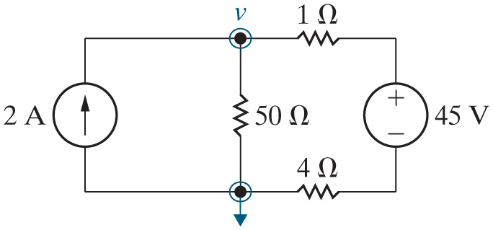
Chapter 4 – techniques of circuit analysis (22 of 26)
Node voltage method:
  Find the power associated with the current source.
Step 1 – Identify each essential node.
Step 2 – Pick and label a reference node; then label the node voltages at the remaining essential nodes.

Slide 19
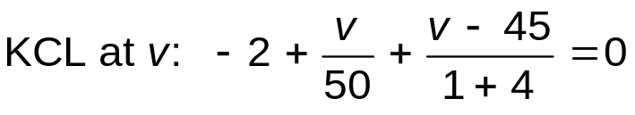


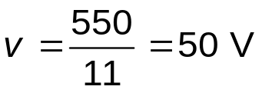
Chapter 4 – techniques of circuit analysis (23 of 26)
Node voltage method:
  Step 3 – Write a K C L equation for every nonreference essential node.
  Step 4 – Solve the equations to find the node-voltage values.
Notes:
Long Description:
Open Parenthesis 50 Close Parenthesis Open Square Bracket v Open Parenthesis StartFraction 1 over 50 End Fraction plus StartFraction 1 over 5 End Fraction Close Parenthesis equals 2 plus StartFraction 45 over 5 End Fraction Close Square Bracket, forward arrow, v Open Parenthesis 1 plus 10 Close Parenthesis equals 100 plus 450, therefore.

Slide 20
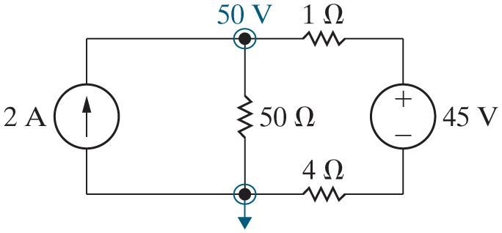

Chapter 4 – techniques of circuit analysis (24 of 26)
Node voltage method:
  Step 5 – Solve the circuit using node voltages from Step 4.
Power for the current source:

Slide 21
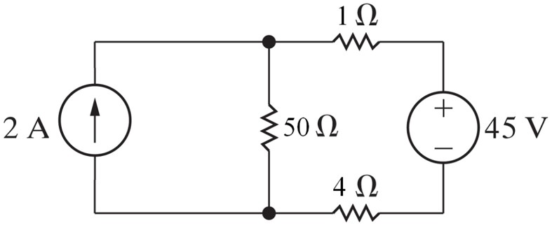
Chapter 4 – techniques of circuit analysis (25 of 26)
The current source is absorbing power.
A. True
B. False

Slide 22
Chapter 4 – techniques of circuit analysis (25 of 26)
The current source is absorbing power.
A. True
B. False

