Slide 1



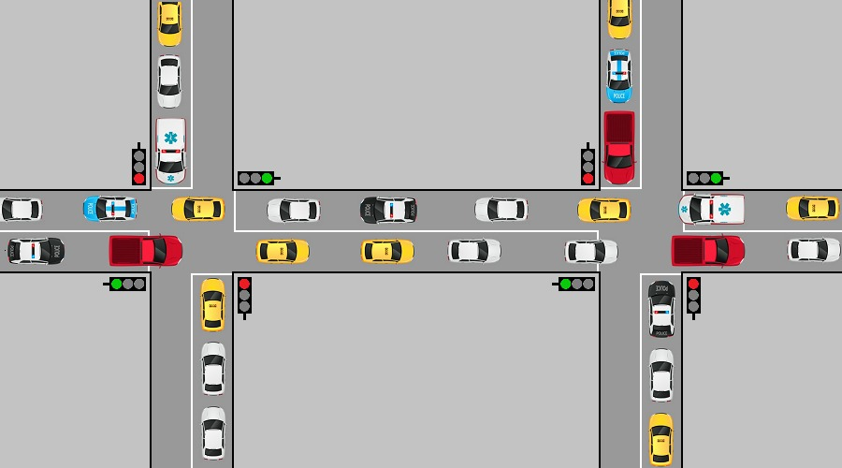


Smart traffic light 1.0
Maxim Marmer and Netanel Davidov
Supervisor: Dr. Dan Ofir
Introduction
Road traffic is constantly changing, the number of cars on the road depends on the time of day, weather conditions and other factors, but traffic lights do not take these facts into account. Therefore, the goal of our project was to create a smart traffic light that will work taking into account the current situation on the road in order to reduce the waiting time at traffic lights and distribute traffic more thoughtfully.
Stages of project development
1. Define the problem - people often stand at a red traffic light, while in the other direction there is no traffic due to the lack of cars or traffic jams that do not move.
2. Define the task - the goal of the project is to dynamically change the state of the traffic light so that the optimal number of cars can cross the intersection.
3. Define the objects - in our case, to solve road problems, we needed to create the following objects: traffic lights, time distribution, toads, cars, intersections, information about intersections, state.
4. Define the result - a positive result is a decrease in the total waiting time and an increase in the throughput of intersections depending on the state of traffic.
5. Choice of algorithm - for correct operation and identification of positive results, it is necessary to choose and implement the algorithm correctly.
6. Development of a graphical interface - a graphical interface will provide the user with the ability to track changes in the traffic light in the provided area.
More specifically
1. Analyst - Can enter data simply by selecting an EXCEL file from its file system or selecting existing simulations in its existing database.
Can enter data manually such as: a certain amount of cars and their speeds, roads, speed limit on roads, intersections, traffic lights, traffic light colors, etc.
Can choose to enter data randomly.
2. Observer - Can enter data only from the database in the same way as an Analyst.
All data is subjected to extensive testing and the system informs the user of errors of any kind.
When the user clicks on the run, the data from the UI scoop switches to the Scheduling Algorithm's scoop in which the traffic lights color timing decision is made according to the current traffic situation in the system, the algorithm will consider:
The traffic light colors, the car queues of those traffic lights, the turnaround times of the current color change in traffic lights, the average speed on each road and other variables. The algorithm will update the current traffic data to the new data and return its decision to the user interface so that the user can visually see the algorithm's decision, so this process is repeated until the simulation ends.
The final results that the scheduling algorithm decided throughout the simulation will allow users to see at the end of the process in the form of average times, average amount of cars passing on a fixed time, and relatively average speed.
Stage Of Operation – Two Modes
The software is written in JAVA language and uses a local database (SQL). Its users must run it through the IDE eclipse. There are two types of users that the system can use: observer and analyst. The basic actions that any user type can do are entering the traffic data at intersections data in some form (will be described below), running the simulation (traffic light timing algorithm), viewing the simulation results, saving to the database/ deleting without saving / exiting.
Analyst
Observer

