Slide 1

QuizCracker
By dharm bhaveshkumar patel

Slide 2
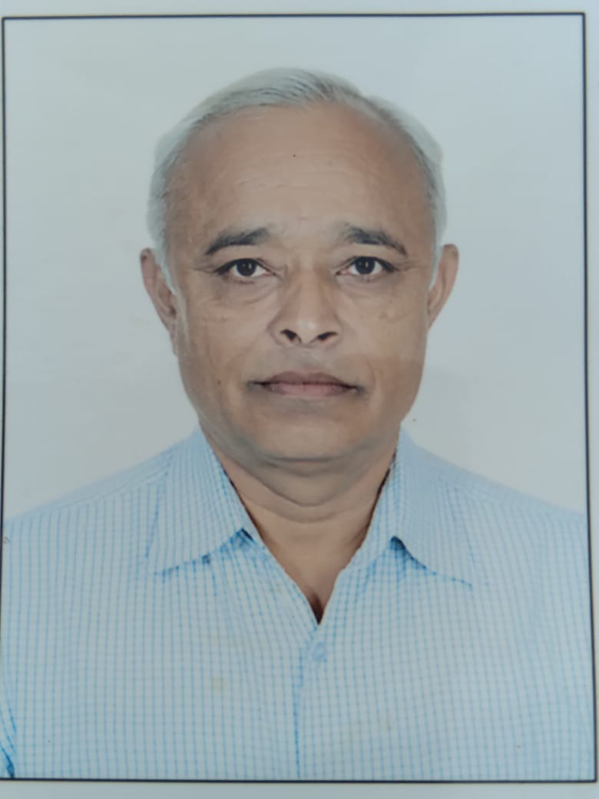
QuizCracker
Junior Scientist: Dharm Bhaveshkumar Patel
Guide: Rajendrkumar D. Patel
Junior Scientist
Guide

Slide 3
QuizCracker
Theme: Technology & Toys
Sub-theme 3: Interective Software

Slide 4
QuizCracker
Objectives:
Teacher can assess students by online mode.
Time consumption of teacher is very less.
It is online mode so it saves paper and saves environment.

Slide 5
QuizCracker
Principle: This webapp is made from Python Django framework and jQuery and Designing of this app is done using Bootstrap4.

Slide 6
QuizCracker
Use: This app is can be used by teacher to set question paper and student can use this app to take test. After test given by students, Teacher can check result of students and summarizes details.

