Slide 1
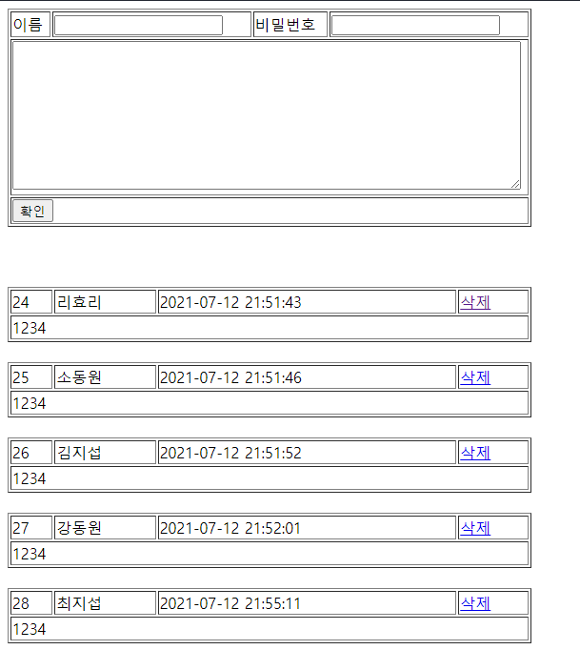
guestbook2 개요 및 분석
01
Rqeust(요청)
분석 - addList
Request header
파라미터: action=addList
Request body
Tomcat
http://localhost:8088/guestbook2/gbc?action=addList
guestbook2
contoller(servlet)객체
guestDao 객체
rquest
addList일 때
getGuestbookList()
Response(응답)
response
Response header
Response body (html)
*포워드
rquest
addList.jsp
객체
response
Rqeust(요청)
Request header
파라미터: action=addList
Request body
어트리뷰트: “gList”, guestList
DB
Response(응답)
Response header
Response body (html)

Slide 2
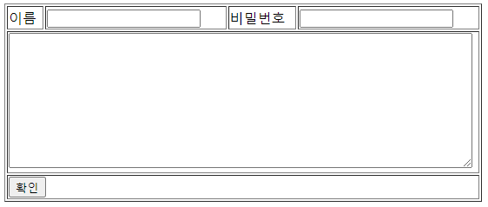
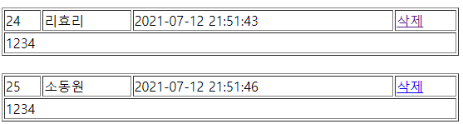
guestbook2 개요 및 분석
01
action=insert&name=이효리&pw=1234&content=안녕하세요
분석 - insert
Rqeust(요청)
Tomcat
http://localhost:8088/guestbook2/gbc?action=insert
Request header
Request body
(파라미터)
guestbook2
contoller(servlet)객체
guestDao 객체
rquest
insert일 때
insert()
response
리스트 요청
Response(응답)
Response header
Response body (리다이렉트코드)
DB
http://localhost:8088/phonebook2/pbc?action=addList

Slide 3

guestbook2 개요 및 분석
01
Rqeust(요청)
분석 - deleteForm
Request header
파라미터: action=dform
no = 3
Request body
Tomcat
http://localhost:8088/guestbook2/gbc?action=dform
guestbook2
contoller(servlet)객체
rquest
dform일 때
Response(응답)
response
Response header
Response body (html)
*포워드
rquest
deleteForm.jsp
객체
response
Rqeust(요청)
Request header
파라미터: action=dform
Request body
어트리뷰트: “no”, no
Response(응답)
Response header
Response body (html)

Slide 4
guestbook2 개요 및 분석
01
분석 - delete
Rqeust(요청)
Tomcat
http://localhost:8088/guestbook2/gbc?action=delete
Request header
파라미터: action=delete
pass=1
Request body
guestbook2
contoller(servlet)객체
guestDao 객체
rquest
delete일 때
delete()
response
리스트 요청
Response(응답)
Response header
Response body (리다이렉트코드)
DB
http://localhost:8088/guestbook2/gbc?action=addList

