Slide 1
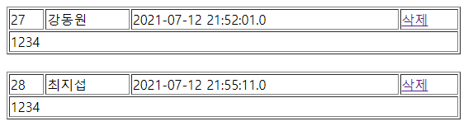
addList
web.xml
spring-servlet.xml
Handler Mapping
“guestbook3/addList” get/post
=> GuestController.addList()
no=
name=
pw=
content=
reg_date=
GuestDao
getGuestList()
REQUEST
Front Controller
DispatcherServlet
Controller
GuestController /addList
RESPONSE
addList.jsp
Model
“gList” gList
View
return “addList.jsp”
guestbook3/addList
DB
View Resolver
View
addList.jsp

Slide 2
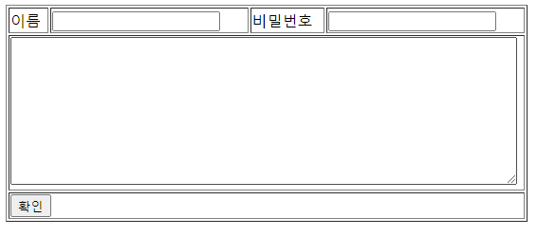
add
web.xml
spring-servlet.xml
Handler Mapping
“guestbook3/add” get/post
=> GuestController.add()
REQUEST
name=
pw=
content=
name=
pw=
content=
GuestDao
insert(Vo)
Front Controller
DispatcherServlet
Controller
GuestController /add
RESPONSE
redirct:/addList
ModelAndView
guestbook3/add?
name=&pw=&content=
DB
View Resolver
View
return “rediret:/addList”

Slide 3

deleteForm
web.xml
spring-servlet.xml
Handler Mapping
“guestbook3/deleteForm” get/post
=> GuestController.deleteForm)
REQUEST
no=5
Front Controller
DispatcherServlet
Controller
GuestController /deleteForm
RESPONSE
deleteForm.jsp
Model
“no” no
View
return deleteForm.jsp”
guestbook3/deleteForm?no=5
View Resolver
View
deleteForm.jsp

Slide 4
delete
web.xml
spring-servlet.xml
Handler Mapping
“guestbook3/delete” get/post
=> GuestController.delete()
no=
pw=
GuestDao
delete(no, pw)
REQUEST
no=
pw=
Front Controller
DispatcherServlet
Controller
GuestController /delete
RESPONSE
redirct:/addList
ModelAndView
guestbook3/delete?no=&pw=
DB
View Resolver
View
return “rediret:/addList”

