Slide 1
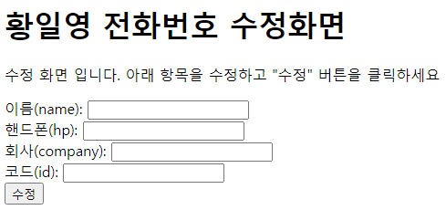
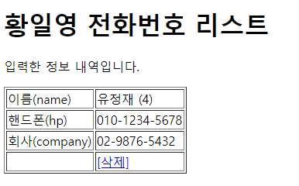
phonebook2 개요 및 분석
01
분석-수정
Rqeust(요청)
Tomcat
http://localhost:8088/phonebook2/pbc?action=update
Request header
파라미터: action=update
id=1
Request body
phonebook2
contoller(servlet)객체
phoneDao 객체
rquest
update일 때
update()
response
리스트 요청
Response(응답)
Response header
Response body (리다이렉트코드)
DB
http://localhost:8088/phonebook2/pbc?action=list

Slide 2
phonebook2 개요 및 분석
01
분석-삭제
Rqeust(요청)
Tomcat
Request header
파라미터: action=delete
id=1
Request body
phonebook2
http://localhost:8088/phonebook2/pbc?action=delete
contoller(servlet)객체
phoneDao 객체
rquest
delete일 때
delete()
response
리스트 요청
Response(응답)
Response header
Response body (리다이렉트코드)
DB
http://localhost:8088/phonebook2/pbc?action=list

Slide 3
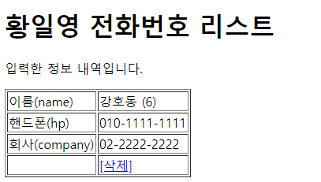
phonebook2 개요 및 분석
01
Rqeust(요청)
분석-수정폼
Request header
파라미터: action=uform
Request body
Tomcat
http://localhost:8088/phonebook2/pbc?action=uform
phonebook2
contoller(servlet)객체
phoneDao 객체
rquest
uform일 때
getPersonList()
[수정]
Response(응답)
response
Response header
Response body (html)
*포워드
rquest
updateForm.jsp
객체
response
Rqeust(요청)
Request header
파라미터: action=uform
Request body
어트리뷰트: “pList”, personList
DB
Response(응답)
Response header
Response body (html)

