Slide 1
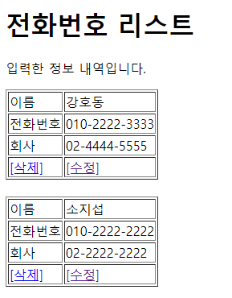
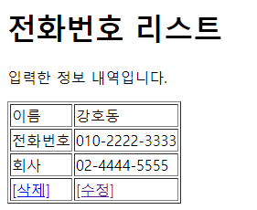
Delete
web.xml
spring-servlet.xml
Handler Mapping
“phonebook3/delete” get/post
=> PhoneController.delete()
REQUEST
person_id = 5
PhoneDao
delete(5)
Front Controller
DispatcherServlet
Controller
PhoneController /delete
person_id = 5
RESPONSE
redirct:/list
ModelAndView
phonebook3/delete?id=5
DB
View Resolver
View
return “rediret:/list”

Slide 2
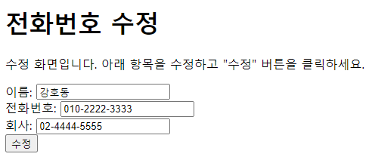
modifyForm
web.xml
spring-servlet.xml
Handler Mapping
“phonebook3/modifyForm” get/post
=> PhoneController.modifyForm()
PhoneDao
getPerson(5)
REQUEST
person_id = 5
Front Controller
DispatcherServlet
Controller
PhoneController /modifyForm
person_id = 5
person_id=5
name=강호동
hp=010
cp=02
RESPONSE
modifyForm.jsp
Model
“onePerson” onePerson
View
return “modifyForm.jsp”
phonebook3/modifyForm?id=5
DB
View Resolver
View
modifyForm.jsp

Slide 3
Modify
web.xml
spring-servlet.xml
Handler Mapping
“phonebook3/modify” get/post
=> PhoneController.modify()
REQUEST
person_id = 5
name=강호동
hp=010
cp=02
person_id=5
name=강호동
hp=010
cp=02
PhoneDao
update(5)
Front Controller
DispatcherServlet
Controller
PhoneController /modify
person_id=5
name=
hp=
cp=
RESPONSE
redirct:/list
ModelAndView
phonebook3/modify?
id=5&name=강호동&
hp=010&cp=02
DB
View Resolver
View
return “rediret:/list”

