Slide 1

Characterizing shops for effective partnership expansion Saving Food: Harnessing Data for a Sustainable Future
Group 8
Nedzhib Ahmed, Lorenzo Marogna, Josep Martí, Matteo Naccarato

Slide 2
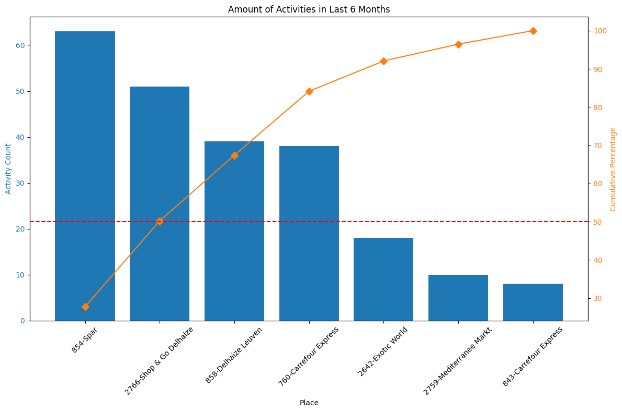
Last 6 months of activities
Notes:
Last 6 months: 227 activities, 7 stores

Slide 3
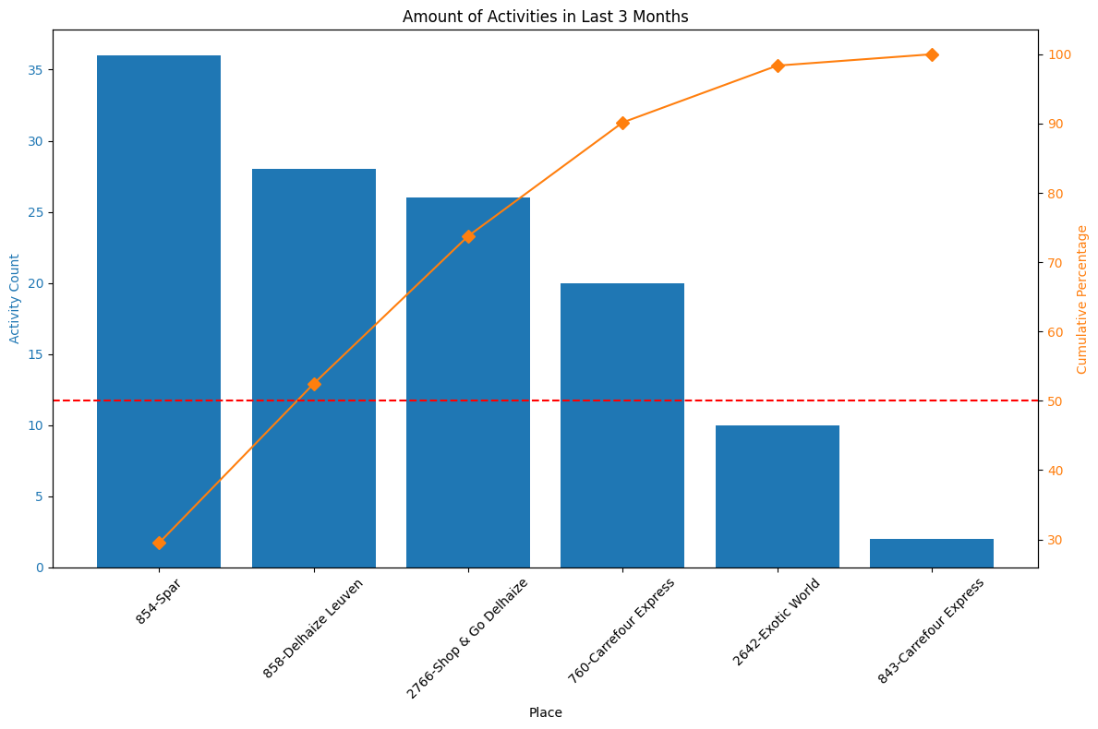
Last 3 months of activities
Notes:
Last 3 months: 122 activities, 6 stores
Just Spar and Delhaize Leuven amount to 64 activities
Big activity loss if these are lost

Slide 4
Proposed solution
Quality store expansion
Potential stores to push expansion selected through feedback
Desirable characteristics identified

Slide 5
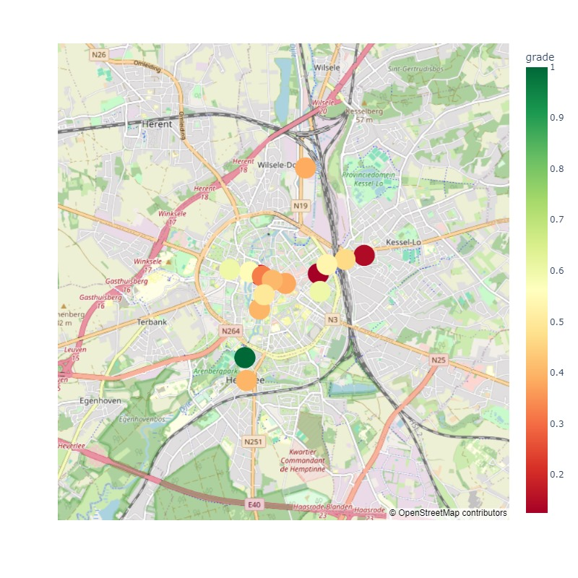
Shop & feedback distribution

Slide 6
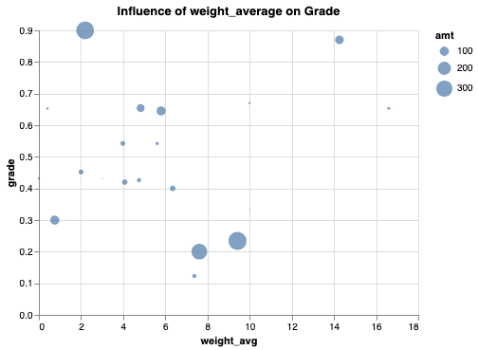
Desirable characteristics - Weight

Slide 7
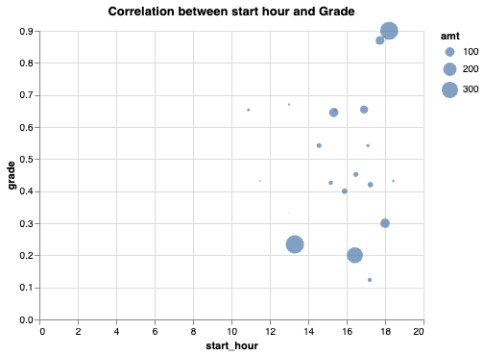
Desirable characteristics - Starting hour

Slide 8
Limitations
Feedback used is mixed.
Different categories could have different feedback.

Slide 9
Further improvements
Break down feedback into different categories.
More advanced sentiment analysis would be needed.
Integration of data exploration into Power BI or similar.

