Slide 1
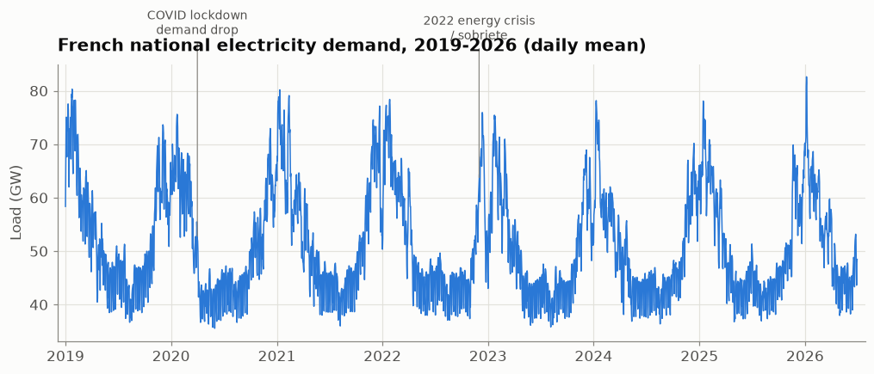
Day-ahead forecasting of French electricity demand
Can we beat the national grid's own forecast?
Marouane Housni · Mastère Data & AI for Finance · Time Series

Slide 2
The problem
• Every day D, before the 12:00 market auction, we must state the demand for all 24 hours of day D+1
• Electricity is bought in advance: every MWh wrong is settled later at imbalance (penalty) prices
• Errors hurt most on cold winter evenings, when demand and prices peak
• Task: forecast tomorrow's 24 hourly demands using only what is known by noon today

Slide 3
Objective & the 3 questions
• Objective: an honest day-ahead forecaster, benchmarked against RTE's public forecast
• Q1 – Can we beat RTE, honestly measured?
• Q2 – How uncertain is the forecast, and when does it fail?
• Q3 – What should we deploy, and what are the risks?
• Rule: no data from after the noon cutoff is ever used (no leakage)

Slide 4
The data
• National: 65,712 hourly rows, 2019-01 → 2026-06 (UTC)
• Columns: load_mw (target), rte_forecast_d1_mw (benchmark), temperature_c, calendar
• Regional: 12 regions, hourly, 2023–2026 (367,752 rows), used for bottom-up models

Slide 5
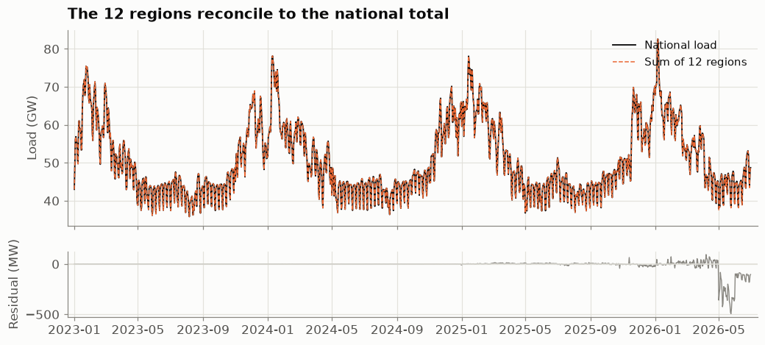
Data preparation
• National: only 7 missing values (0.011%), all at the autumn DST change, interpolated
• Regional: 36 gaps imputed
• Regions reconcile to the national total within ~16 MW (0.03%)

Slide 6
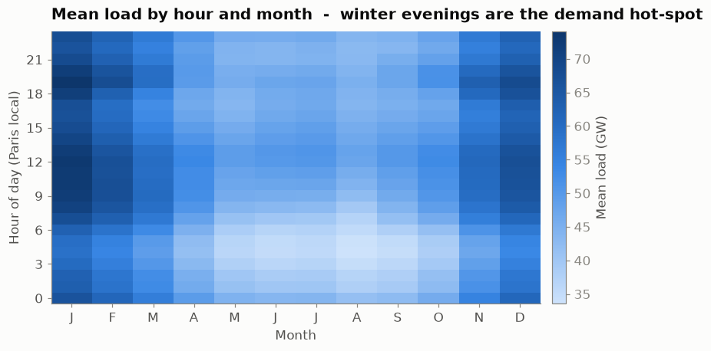
Demand has strong, learnable structure
• Three nested cycles: daily (24 h), weekly (168 h), yearly
• Peaks: winter evenings ~19:00; troughs: summer nights
• Weekends several GW below weekdays

Slide 7
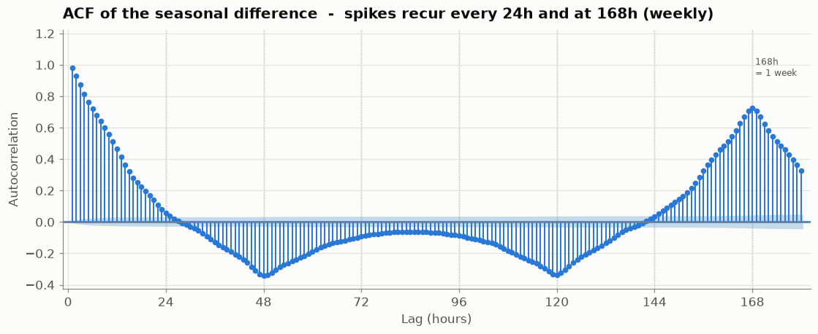
Statistical backing
• Ljung-Box p ≈ 0 at lags 1, 24, 168: strong hourly/daily/weekly memory
• Raw series non-stationary (KPSS rejects)
• Stationary after seasonal (lag-24) differencing → justifies (S)ARIMA

Slide 8
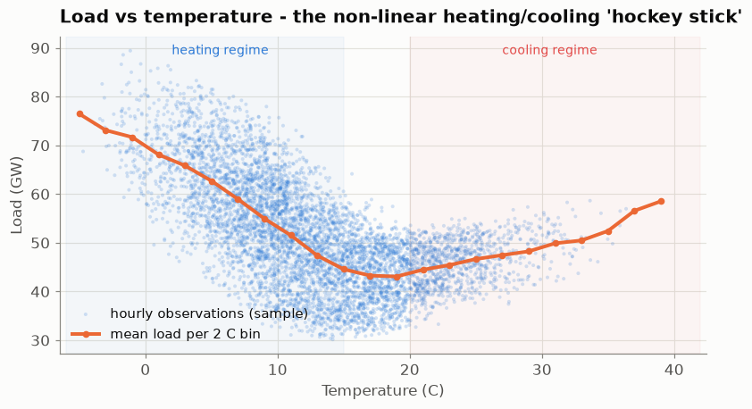
Temperature: the dominant driver
• Non-linear 'hockey stick': heating below ~15 °C, light cooling above ~20 °C
• Raw r = −0.60; heating-degree-day transform → r = +0.72
• France is heating-dominated (cooling r ≈ −0.12)

Slide 9
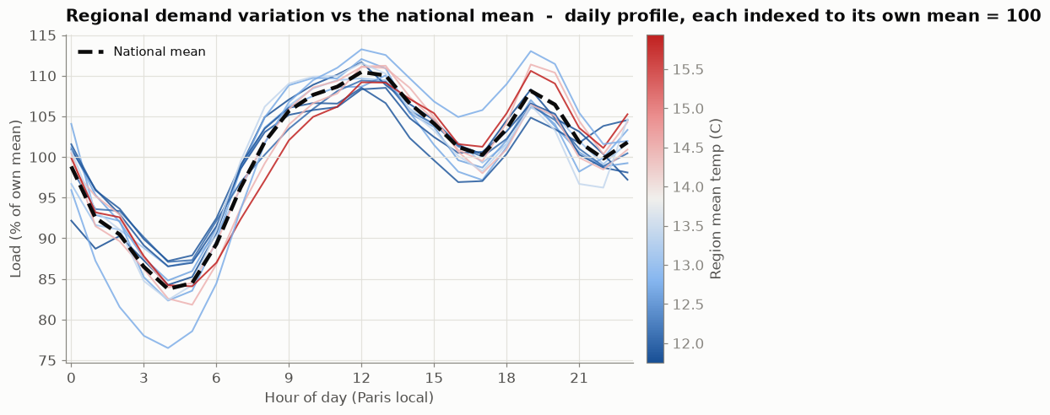
Regions differ
• Same rhythm, but some regions have steeper evening peaks / deeper night troughs
• A per-region bottom-up model can exploit this (used in ML/DL)

Slide 10
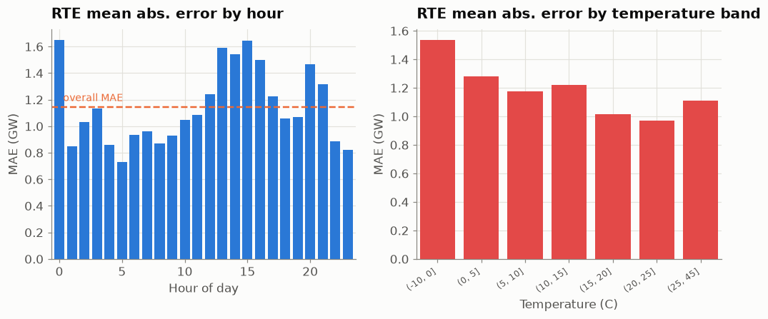
The benchmark to beat: RTE
• MAE ≈ 1.14 GW · RMSE ≈ 1.49 GW · MAPE ≈ 2.25%
• Under-forecast bias +0.67 GW (t-test p ≈ 0); residuals autocorrelated at 24/168 h
• Fails most on evening peaks and temperature extremes

Slide 11
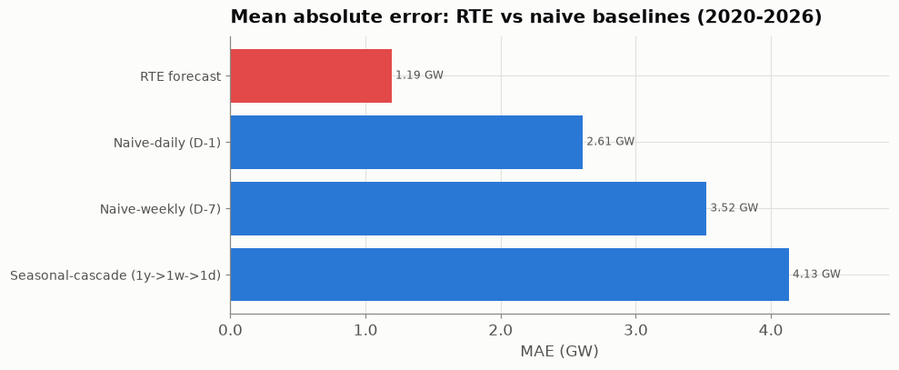
The floor: naive baselines
Forecast | MAE (GW) | MAPE | × vs RTE
RTE | 1.19 | 2.4% | 1.0
Naive-daily (lag 24) | 2.61 | 5.2% | 2.2× worse
Naive-weekly (lag 168) | 3.52 | 6.5% | 3.0× worse
Seasonal-cascade (1y→1w→1d) | 4.13 | 7.8% | 3.5× worse
• RTE is 2–3.5× better than any naive rule

Slide 12
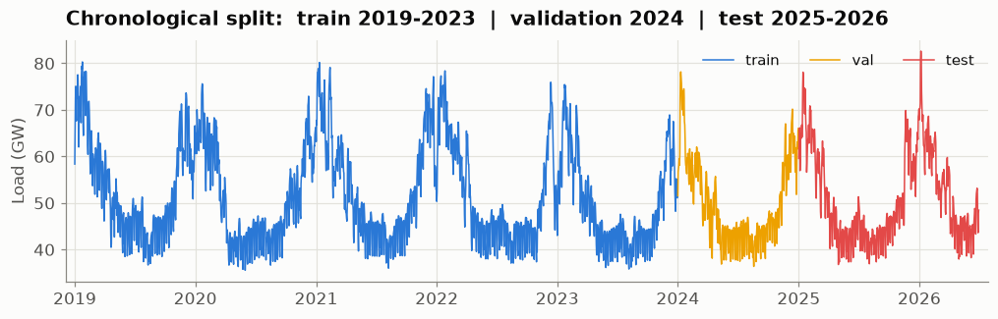
Evaluation protocol
• Chronological split: train 2019–2023 · validation 2024 · test 2025 – 2026-06
• Decision at 12:00 on day D, forecast all of D+1 with pre-cutoff information only

Slide 13
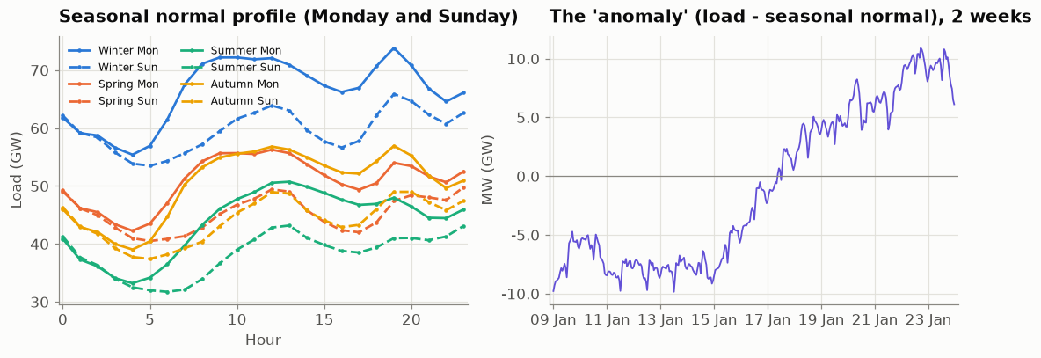
ARIMA: normal + anomaly
• Seasonal ARIMA on 65k points is intractable
• Load = seasonal normal (season × weekday × hour) + anomaly
• ARIMA on the anomaly, then load = normal + forecast anomaly

Slide 14
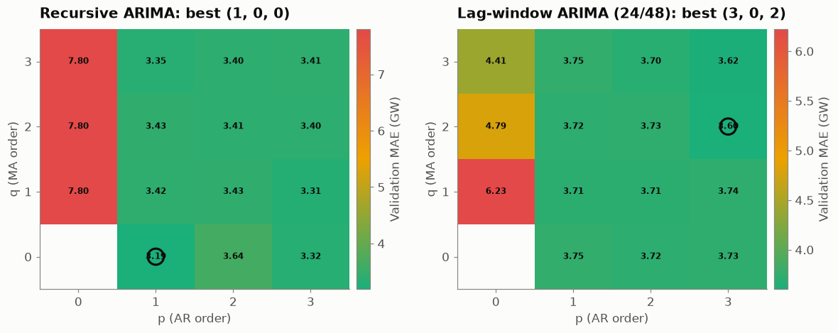
Two ARIMA forecasts & order selection
• Recursive: rolls its own predictions across the day
• Lag-window: one ARIMA per hour, lag 24 (00–11 h) / lag 48 (12–23 h)
• (p,q) grid on validation MAE: recursive ARIMA(1,0,0), lag-window ARIMA(3,0,2)

Slide 15
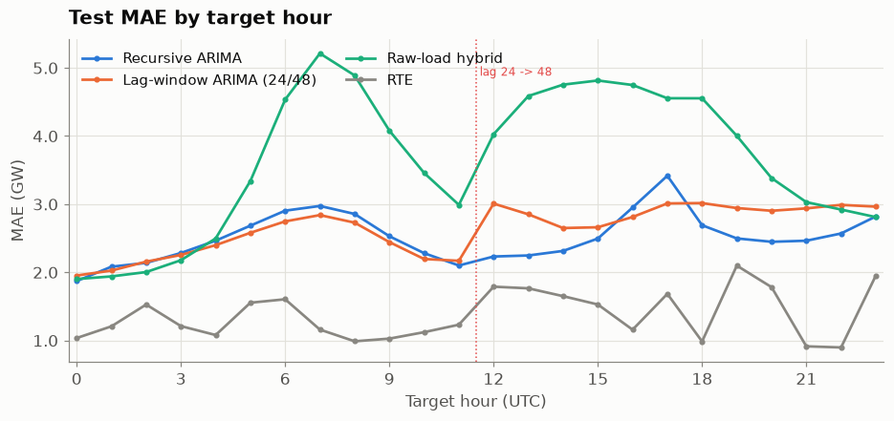
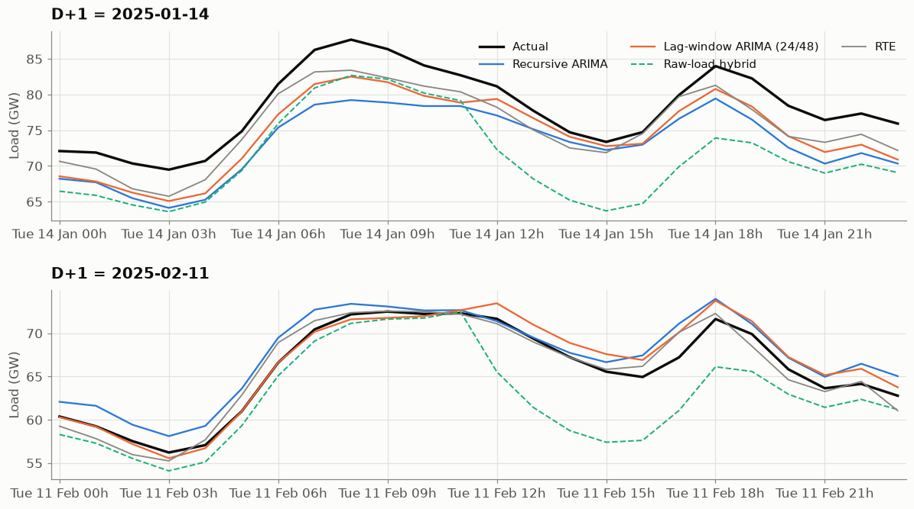
ARIMA results vs RTE (56-day test)
Model | MAE (GW) | RMSE (GW) | MAPE
Recursive ARIMA(1,0,0) | 2.51 | 3.58 | 4.0%
Lag-window ARIMA(3,0,2) | 2.64 | 3.77 | 4.2%
Raw-lag hybrid (no fit) | 3.63 | 4.74 | 5.7%
RTE | 1.37 | 1.71 | 2.1%
• ARIMAs tie (p = 0.64), beat raw lag (p = 1e-4), still trail RTE: no weather

Slide 16
Feature engineering (34 features)
• Demand history (≥ 48 h): lag_48 … lag_336, 7-day level roll7, recent (hybrid 24/48)
• Weather: noised temperature forecast, HDD = max(16−T,0), CDD = max(T−20,0), temp_lag48
• Calendar: hour, weekday, month, weekend, holiday, season
• Identity: 12 region one-hots
• All features knowable at the noon cutoff

Slide 17
Design: global regional, bottom-up
• One model trained on all 12 regions stacked (region as a feature)
• Predict each region, then sum the 12 → national forecast
• Four tree models (Decision Tree, Random Forest, XGBoost, LightGBM) vs RTE on 2025–2026

Slide 18
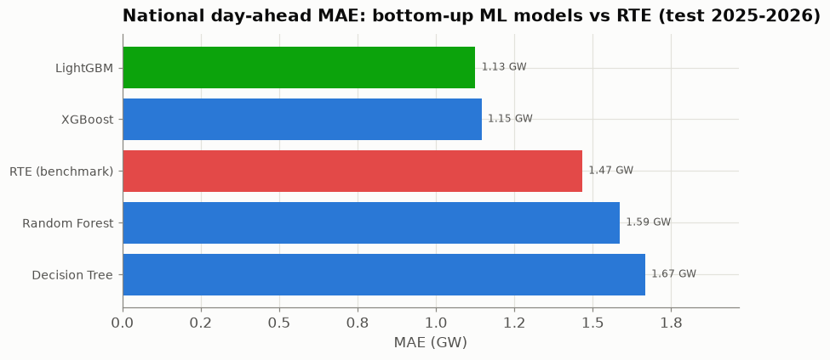
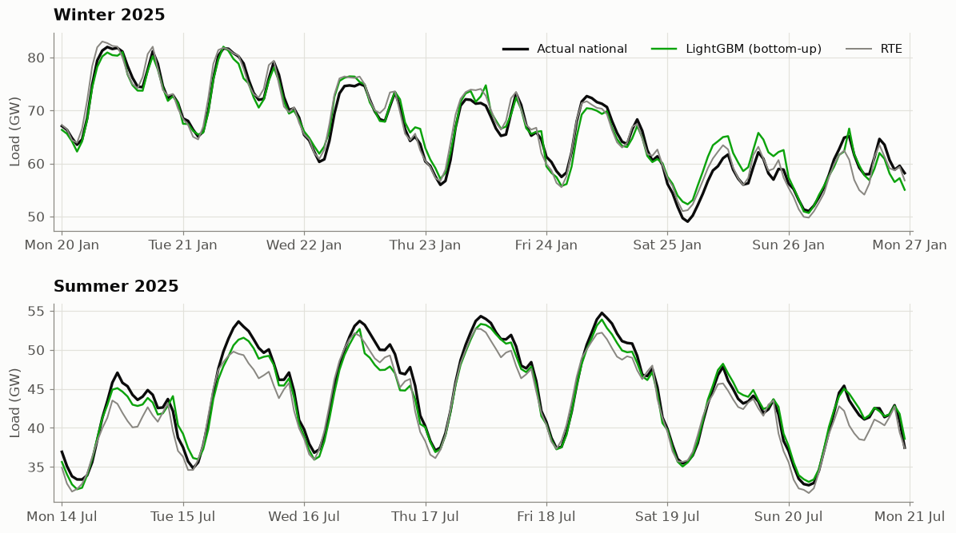
ML results: first model to beat RTE
Model | MAE (GW) | MAPE | vs RTE
LightGBM | 1.13 | 2.1% | −23%
XGBoost | 1.15 | 2.2% | −22%
RTE | 1.47 | 2.9% | —
Random Forest | 1.59 | 3.0% | +8%
Decision Tree | 1.67 | 3.2% | +14%
• LightGBM −23% vs RTE (Wilcoxon p ≈ 6e-26)
• Caveat: relies on an idealised noised-weather input

Slide 19
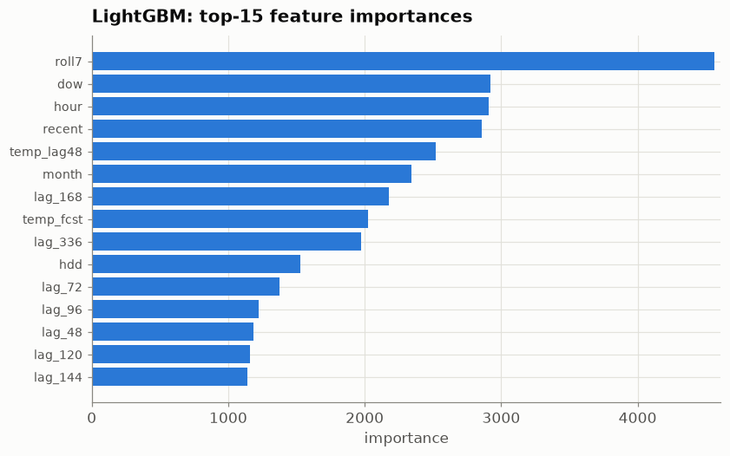
Feature influence
• By gain: recent 76% + lag_168 18% → demand history ≈ 97%
• Essentially a smart persistence model; weather, calendar and region fine-tune it

Slide 20
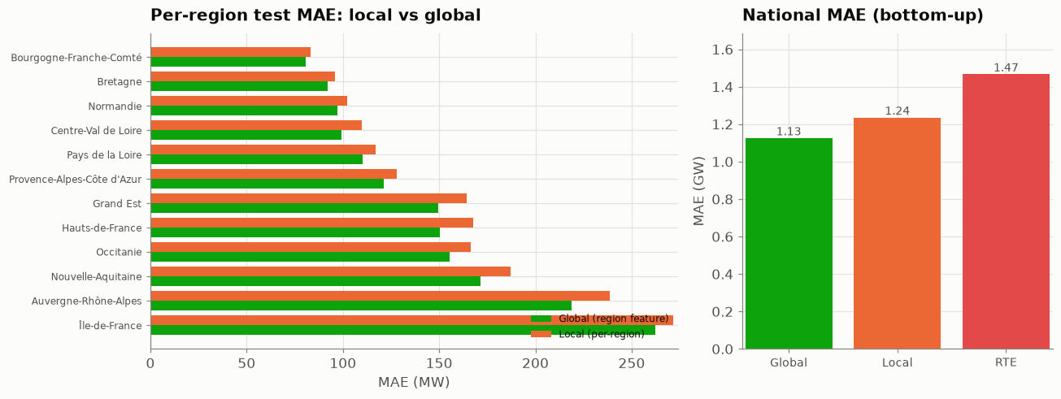
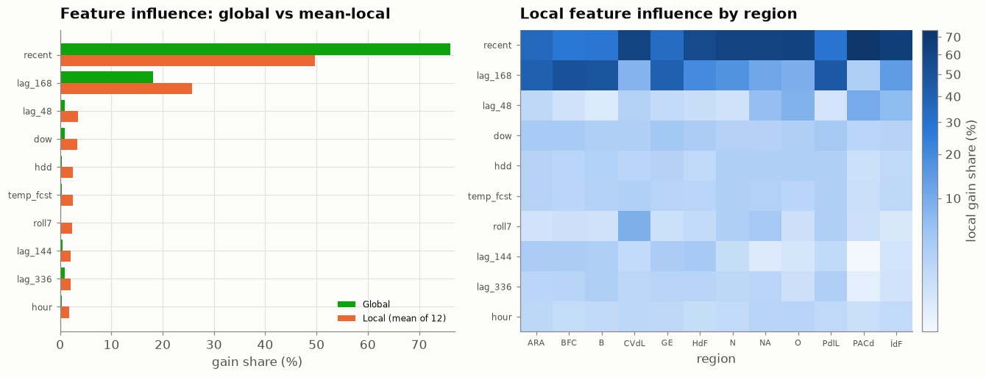
Local vs global models
• Global wins in all 12 regions
• National MAE 1.13 vs 1.24 GW (p = 3e-9); both beat RTE
• Pooling gives ~12× more data than 2 years per region

Slide 21
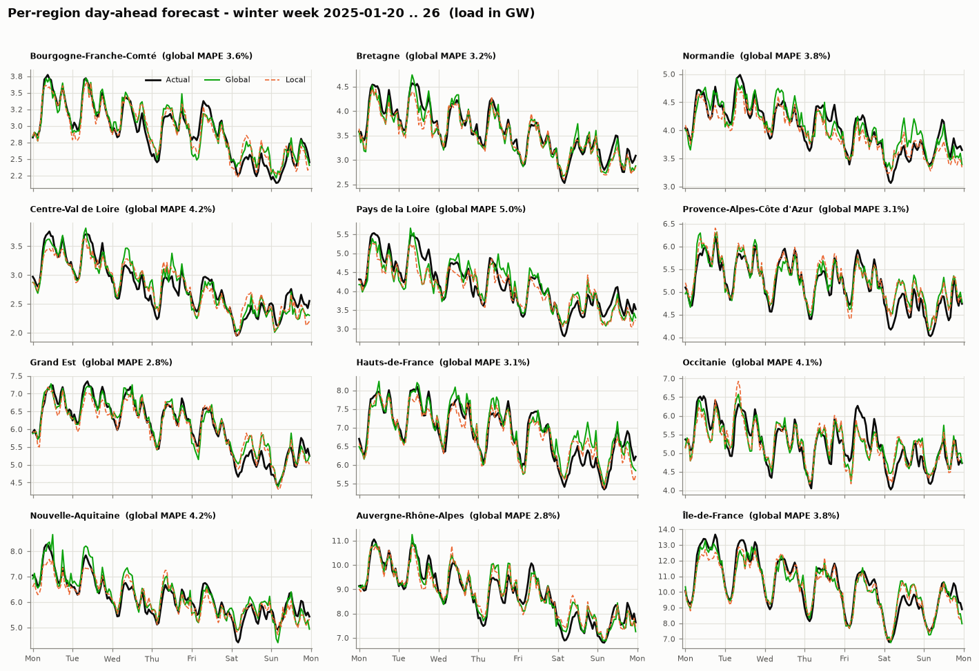
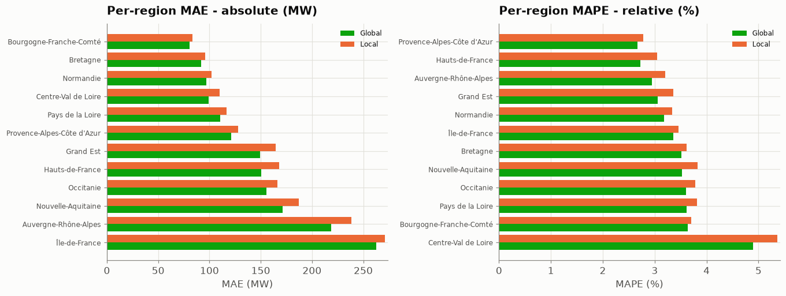
Per-region forecasts & errors
• MAE tracks region size (Île-de-France largest)
• MAPE: best PACA / Hauts-de-France (~2.7%), worst Centre-Val de Loire (4.9%)

Slide 22
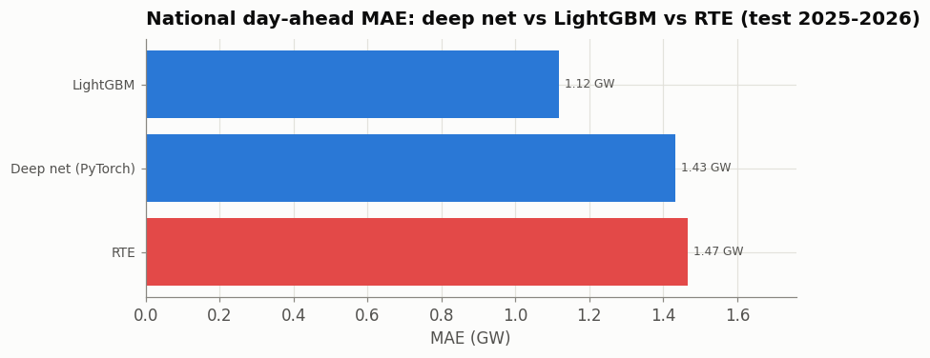
Global deep forecaster (PyTorch MLP)
Model | MAE (GW) | MAPE
LightGBM | 1.12 | 2.1%
Deep MLP | 1.43 | 2.8%
RTE | 1.47 | 2.9%
• 12 regions, 76 features, bottom-up
• Ties RTE, does not beat the trees

Slide 23
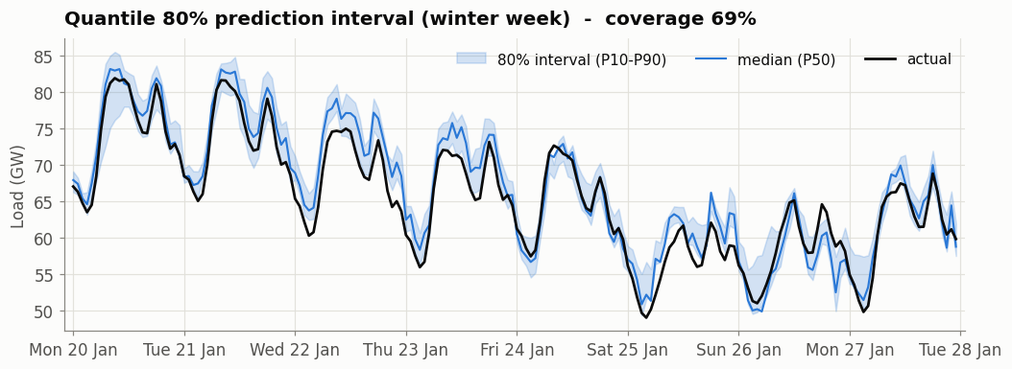
Forecasts with uncertainty (80% interval)
Method | Coverage | Width | Winkler
Quantile (LightGBM) | 69% | 3.31 GW | 5,953
Split conformal | 78% | 3.98 GW | 6,645
• Quantile: sharper but over-confident
• Conformal: well-calibrated

Slide 24
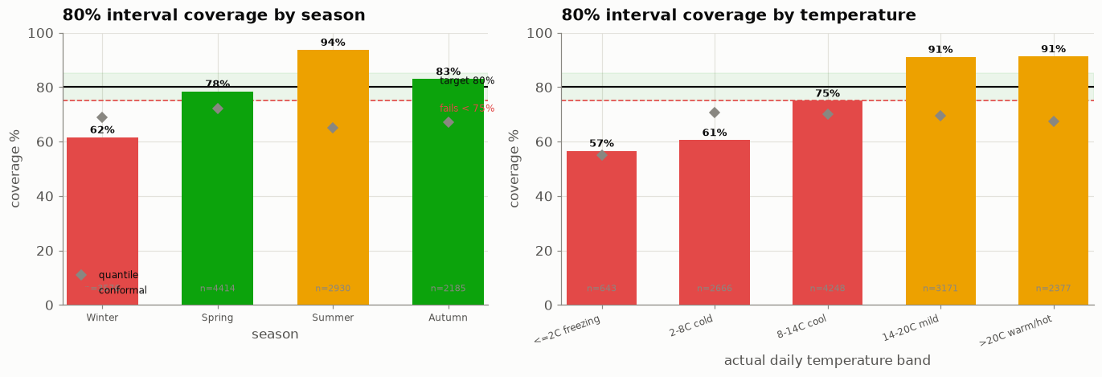
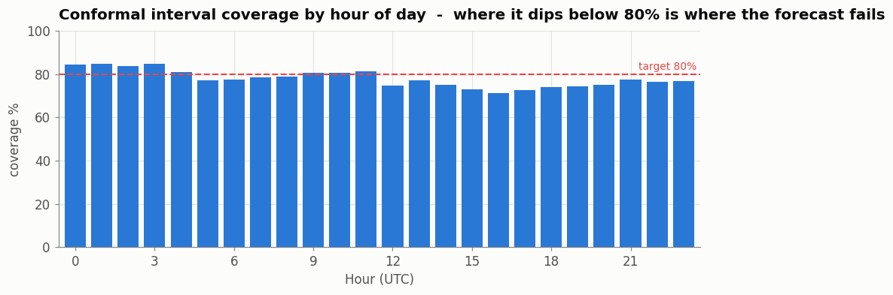
Where the 80% interval fails: season & temperature
• 80% interval = actual demand lands inside it ~80% of the time (a coverage promise, not point confidence)
• Overall 78%, but a fixed ±1.99 GW band cannot adapt to conditions
• FAILS in winter (62%) and below 8 °C (57–61%): over-confident on cold peaks
• Over-covers in summer (94%); fix = conditional per-season radius

Slide 25
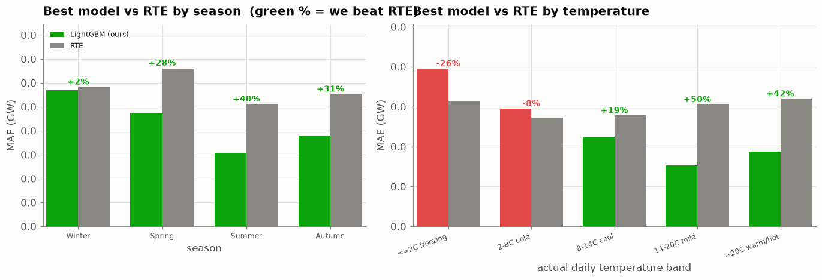
Where can we trust the model vs RTE?
• Best model (LightGBM) MAE vs RTE, split by season and temperature
• Beats RTE in every season (+28–40%), and in cool / mild / warm conditions
• RTE still WINS on cold days: −8% at 2–8 °C, −26% below 2 °C (freezing)
• Deploy rule: trust our model by default, fall back to RTE below ~8 °C

Slide 26
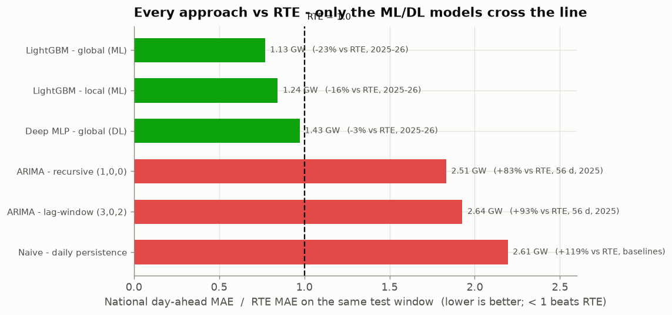
Every approach vs RTE
• MAE ÷ RTE MAE on each model's own test window (< 1 beats RTE)
• Naive ~2.2× → ARIMA ~1.8–1.9× → Deep MLP ~0.98× → LightGBM 0.77×

Slide 27
Answers to the three questions
• Q1 – Beat RTE? Yes: LightGBM bottom-up, −23% MAE (p ≈ 6e-26), under the noised-weather assumption
• Q2 – Uncertainty? Conformal 80% interval, 78% coverage; reliability dips on evening peaks
• Q3 – Deploy? LightGBM point forecast + conformal interval, frequent retraining, RTE as fallback

Slide 28
Risks
• The ~23% edge partly rests on an idealised independent noised-weather input
• Realistic correlated weather errors would shrink it, mostly on extremes
• Regional training limited to 2023–2024

Slide 29
Conclusion & next steps
Model (national day-ahead) | MAE (GW) | vs RTE
LightGBM — bottom-up (deploy) | 1.13 | −23% ✓
Deep MLP (global) | 1.43 | ~tie
RTE benchmark | 1.47 | —
ARIMA (recursive) | 2.51 | ~1.8× worse
Naive-daily (D-1) | 2.61 | ~2.2× worse
• Only the ML/DL models reach or beat RTE; LightGBM wins by −23% (p ≈ 6e-26)
• Delivered: clean data → statistics → ARIMA → ML (beats RTE) → DL + calibrated uncertainty
• Next: walk-forward validation, weather stress-test, SARIMAX, hierarchical reconciliation

