Slide 1

CofeeCat OnlineShop
Adrian Beilharz
Fanni Marosi

Slide 2

Project
Show a list of products
Add products to shopping cart
Change amount after adding poduct to the shopping card
Service discovery
REST API
Angular
front-end
User Service
Shoppingcart Service
Product Service
CRUD

Slide 3
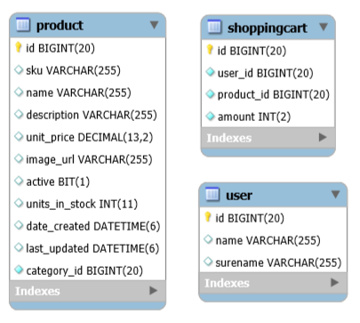
Database
Mysql
Database Shema
Dependencie: MysqlDriver

Slide 4
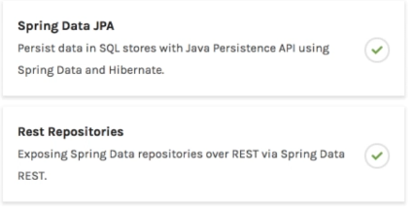
Repository
Spring Data REST will scan the project for CRUDRepository (or JPARepository)
Expose REST APIs for each entity type for CRUDRepository
By default, Spring Data REST will create endpoints based on entity type

Slide 5

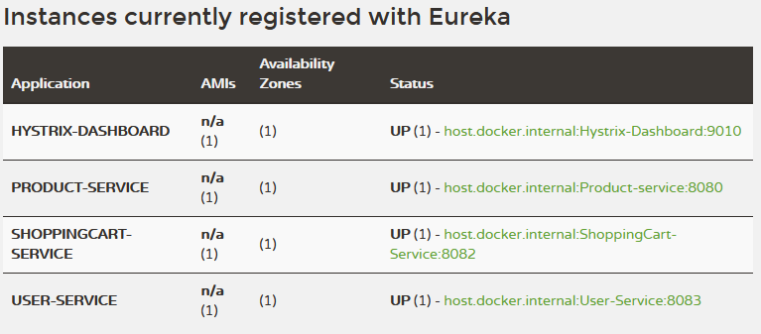
Service Discovery - Eureka
AWS Service registry for resilient mid-tier load balancing and failover.

Slide 6
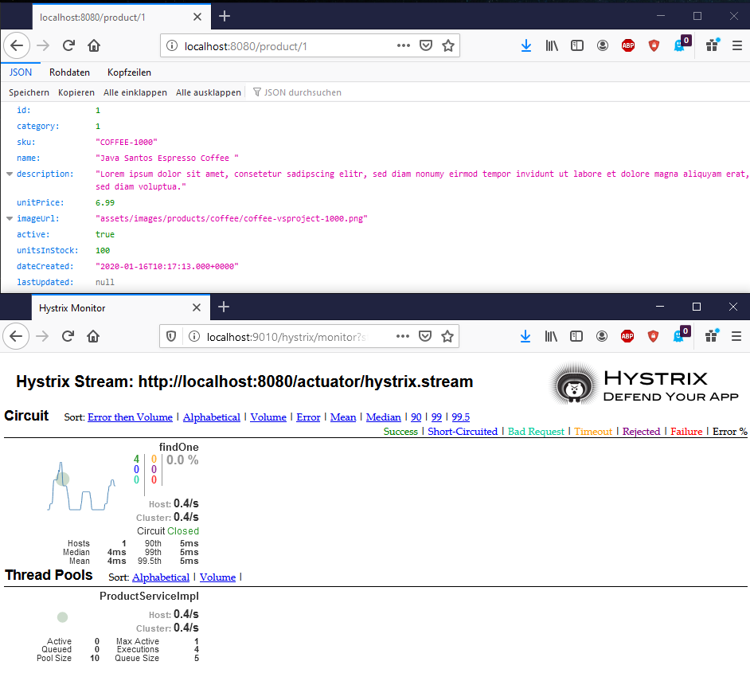

Hystrix
Hystrix is a library developed by Netflix. It is a fault tolerance library and is used as strategy against failures in a service-layer.
Hystrix can be used in situations where the application depends on remote services. In case one or more remote services are down we can handle the situation by using a circuit breaker in the application.

Slide 7
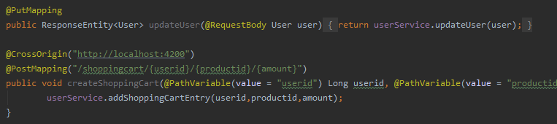
Spring Controller
PostMapping
PutMapping

Slide 8
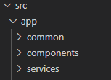
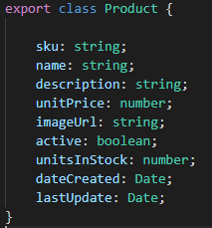
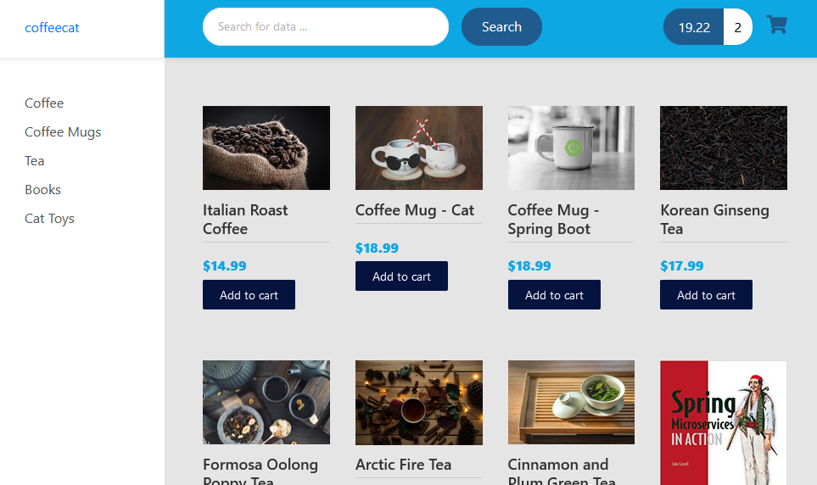
Frontend - Angular
Angular Service to call REST APIs
TypeScript Class for the entities
Angular Components for display
-> CrossOrigin Support : web browsers will not allow (java) script code to call APIs not on same origin( same origin policy)

Slide 9
CofeeCat OnlineShop
Thank you for your kind attention

