Slide 1
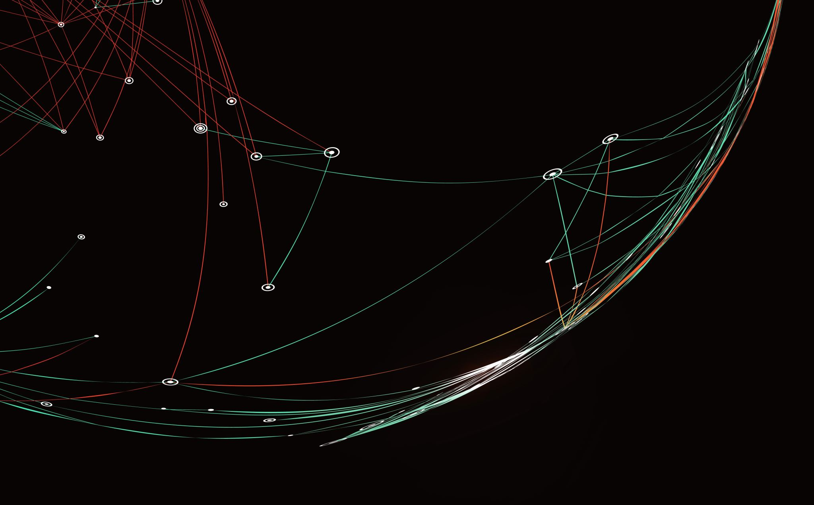
IPFS File Sharing Application
Author: Maroš Bednár
Supervisors: F. Freitag, R. Baig

Slide 2
Why This Project?
Theory ⇄ Practice gap in IPFS courses
Need a tangible demo that shows “real” node behaviour
Build & analyse a **browser‑based IPFS client**
Measure IPFS speed, resilience, security

Slide 3
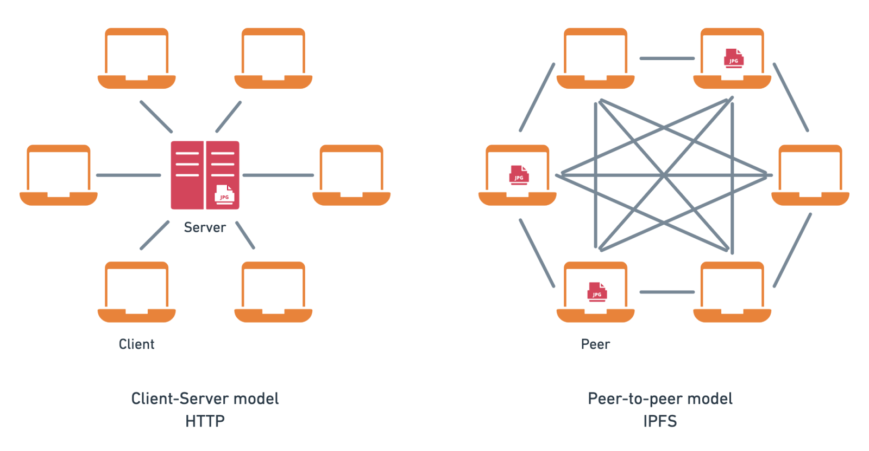
What Is IPFS
Content‑addressed storage - files = CIDs
Merkle‑DAG - fast diffing, deduplication
Peer‑to‑peer retrieval via libp2p DHT
Resulting in no single point of failure, verifiable data

Slide 4
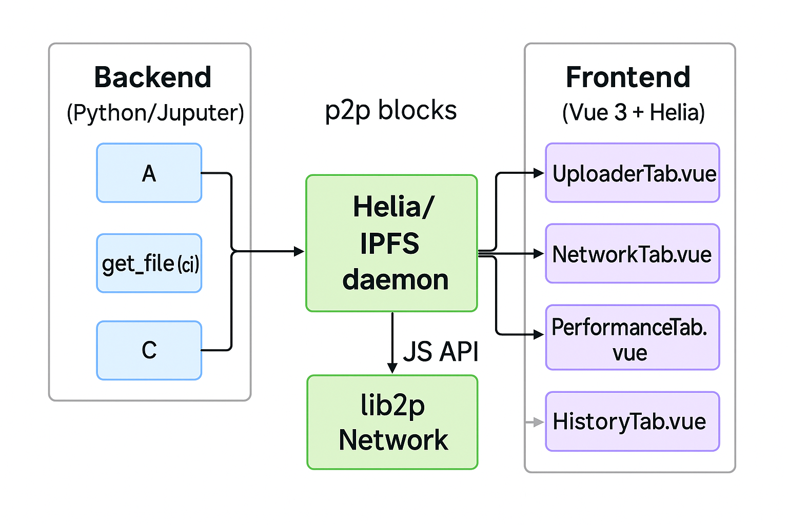
High‑Level Architecture
Python FastAPI server
Browser (Vue + Helia)
WebRTC/DataChannels & HTTP gateway fallback
LocalStorage for logs, Web3.storage for pinning

Slide 5
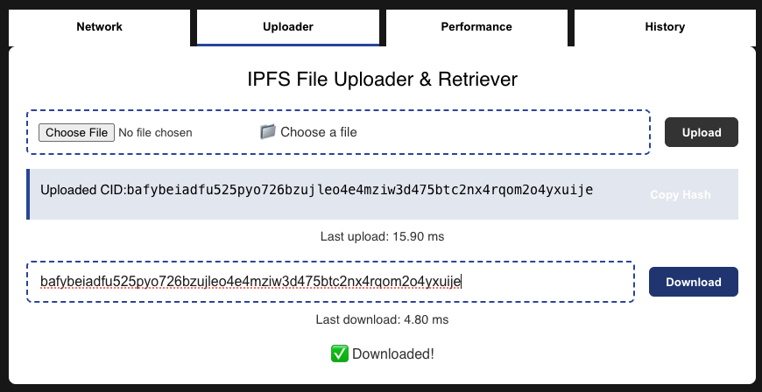
Application Walk‑Through
Network tab - peer ID, live peer table
Uploader tab - drag‑&‑drop, CID copy, ms timer
Performance tab - sortable log, filters, charts, CSV export
History tab - persistent CID list

Slide 6
Performance Results
Performance tests were conducted using the performance tab
Simulating various file sizes and network conditions
Results are growing linearly
IPFS is very reliable
File Size | Our Application Upload Time (ms) | Our Application Download Time (ms) | External Upload Time (ms) | External Download Time (ms)
100 KB | 12 | 10 | 15 | 12
1 MB | 45 | 38 | 50 | 42
5 MB | 210 | 180 | 220 | 190
10 MB | 430 | 390 | 450 | 400
50 MB | 2,100 | 1,800 | 2,200 | 1,900
100 MB | 4,300 | 3,900 | 4,500 | 4,000
500 MB | 21,500 | 19,500 | 22,000 | 20,000
1 GB | 43,000 | 39,000 | 45,000 | 40,000

Slide 7
Reliability Experiments
Single‑node crash
other peers served the data
Network drop
transfer paused & resumed
Concurrent stress (20 ops/s)
0 data loss, minor queueing

Slide 8
Security Takeaways
+ CID hashing tamper‑evident
+ No central server to compromise
– Public by default… need E2E encryption for sensitive files
– Malicious content persists once published… moderation layer needed

Slide 9
Comparison: IPFS vs. Classic HTTP
Feature | IPFS | Traditional Methods
Architecture | Decentralized | Centralized
Scalability | High (peer-to-peer) | Limited by server capacity
Reliability | High (redundant nodes) | Dependent on server uptime
Security | Content-addressed, requires user-managed encryption | Server-managed security protocols
Performance | Efficient for distributed access | Efficient for centralized access

Slide 10
Lessons Learned
Implementing a full Helia node in the browser is feasible
Real‑world IPFS speeds align with published studies (~5 % deviation)
Decentralization adds robustness but needs UX polish
Logging & visual analytics hugely aid debugging

Slide 11
Future Work
End‑to‑end encryption & access control
Chunked / parallel uploads for >1 GB
Mobile‑first UI & drag‑and‑drop
Smart‑contract‑based audit trail
Docker‑compose testbed for scripted node failures

Slide 12
Conclusion
I started with theory, built a working app, measured it and proved to myself why IPFS matters
It is verifiable, resilient, scalable file sharing protocol
Source code & report: www.github.com/Marosko123/ipfs-file-sharing-app

Slide 13
Time for Questions

