Slide 1

PHISHING AWARENESS TRAINING
CODEALPHA CYBER SECURITY INTERNSHIP — TASK 2
STUDENT NAME: KACHROUD MAROUA
AUGU 2026
PRESENTATION

Slide 2
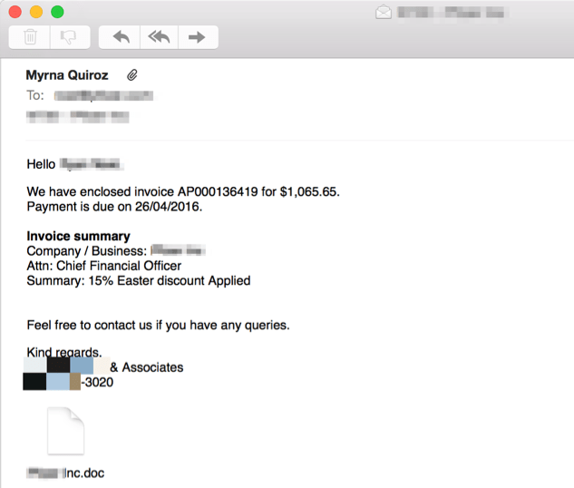
1
What Is Phishing?
Phishing is a form of social engineering designed to trick people into revealing information, clicking harmful links, or opening malicious files.
Attackers often impersonate trusted organizations, colleagues, services, or people.
Common goals include stealing credentials, financial information, or gaining access to systems.
2
3
4
5
6
7

Slide 3





1
2
Why Does Phishing Work?
Urgency: “Act now” messages reduce the time people spend checking details.
Authority: attackers may impersonate banks, managers, IT teams, or government services.
Fear or curiosity: warnings about account closure, invoices, security alerts, or unusual activity.
Trust: attackers use information found online to make messages look personal and believable.
3
4
URGENCY
AUTHORITY
FEAR OR CURIOSITY
TRUST
5
6
7

Slide 4
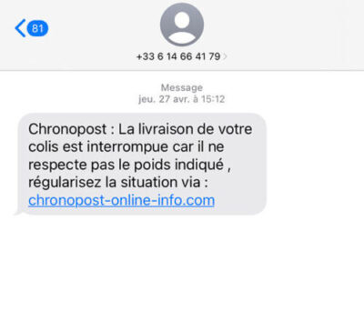

3
Common Types of Phishing
Spear phishing — targeted messages designed for a specific person or organization.
Whaling — attacks targeting high-value or senior individuals.
Smishing — phishing delivered through SMS or messaging apps.
Vishing — phishing through voice calls or conversations.
Business Email Compromise (BEC) — impersonation or account compromise used to request money or sensitive actions.
4
5
6
7

Slide 5
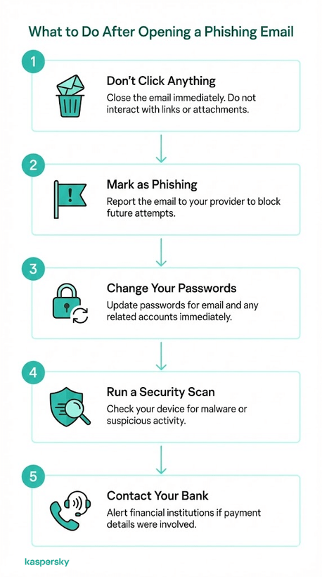
4
How to Spot a Phishing Email
Check the sender address carefully; look for look-alike domains or unexpected addresses.
Be suspicious of urgent requests for passwords, payments, codes, or sensitive information.
Hover over links and verify the real destination before clicking.
Watch for unexpected attachments, spelling/layout problems, generic greetings, or unusual requests.
Verify important requests through a separate, trusted communication channel.
5
6
7

Slide 6
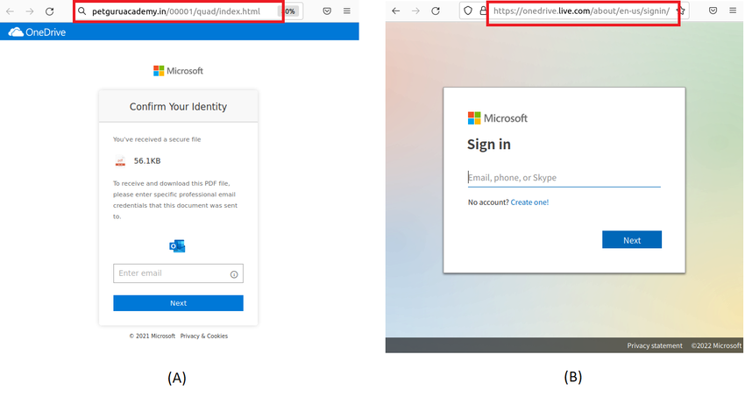
5
Fake Websites & Login Pages
A fake site may copy the logo, colors, wording, and layout of a legitimate service.
HTTPS alone does not prove that a website is legitimate.
Check the domain name carefully and avoid entering credentials through links in unexpected messages.
When possible, open the service through a saved bookmark or type the known address yourself.
6
7

Slide 7
6
Social Engineering Tactics
Pretexting: creating a believable story or identity to obtain information.
Impersonation: pretending to be a manager, coworker, bank, delivery service, or support agent.
Baiting: offering something attractive to encourage an unsafe action.
Quid pro quo: promising a benefit or service in exchange for information or access.
Tailoring: using public information to make the message more convincing.
7
Real-World Example: Twitter, 2020
In July 2020, attackers used social engineering to obtain access to administrative tools used by Twitter.
The compromised access was then used to take control of accounts and support a fraud scheme.
Lesson: even well-known organizations can be affected when attackers successfully manipulate people.
Defense: verify unusual requests, protect privileged access, and use strong authentication and security awareness training.

Slide 8
7
Best Practices: Before You Click
STOP — do not react immediately to pressure or urgency.
CHECK — inspect the sender, domain, link destination, attachment, and context.
VERIFY — contact the person or organization using a trusted channel.
PROTECT — use strong unique passwords and enable MFA.
REPORT — use your organization’s reporting process for suspicious messages.
If You Clicked a Phishing Link
Do not continue entering information or interacting with the page.
If you entered a password, change it immediately from a trusted device and review other sessions.
If MFA or recovery information may be exposed, review account security settings.
Report the incident to the appropriate security/support team.
If financial information was exposed, contact the relevant financial institution promptly.

Slide 9
Phishing Awareness Quiz
Question 1
You receive an urgent email saying your account will be closed in 10 minutes unless you click a link:
A. Click immediately
B. Verify the request through the official service
C. Reply with your password
Answer: B
Question 2
The visible link says company.com, but hovering over it shows a different domain:
A. Click it
B. Ignore it and verify independently
C. Forward it to colleagues
Answer: B
Question 3
Which is a common phishing indicator?
A. Unexpected urgency
B. A trusted bookmark you opened yourself
C. A request you independently confirmed
Answer: A
Question 4
Which action is safest when an email requests sensitive information?
A. Reply to the email
B. Use a trusted communication channel to verify the request
C. Send the information quickly
Answer: B
Question 5
What should you do after entering a password on a suspected phishing page?
A. Ignore it
B. Change the password from a trusted device and report the incident
C. Send the password to IT by email
Answer: B
Question 6 — Smishing
You receive an SMS saying: “Your bank account will be suspended today. Verify your account immediately by clicking this link.” What should you do?
A. Click the link immediately
B. Reply with your banking information
C. Ignore the message and verify through the bank's official website or app
D. Forward the SMS to friends
Answer: C
Question 7 — Malicious Attachment
You receive an unexpected email containing an .exe attachment. What is the safest action?
A. Open it to see what the file contains
B. Download it and scan it later
C. Do not open it and verify the message through a trusted channel
D. Forward the attachment to a colleague
Answer: C

Slide 10
Conclusion :
Phishing is a common cybersecurity threat that targets people through deception and social engineering. By checking senders, links, attachments, and unusual requests, and by verifying suspicious messages through trusted channels, we can reduce the risk of becoming a victim. Staying alert and thinking before clicking are essential to staying safe online.
THANK YOU

