Slide 1
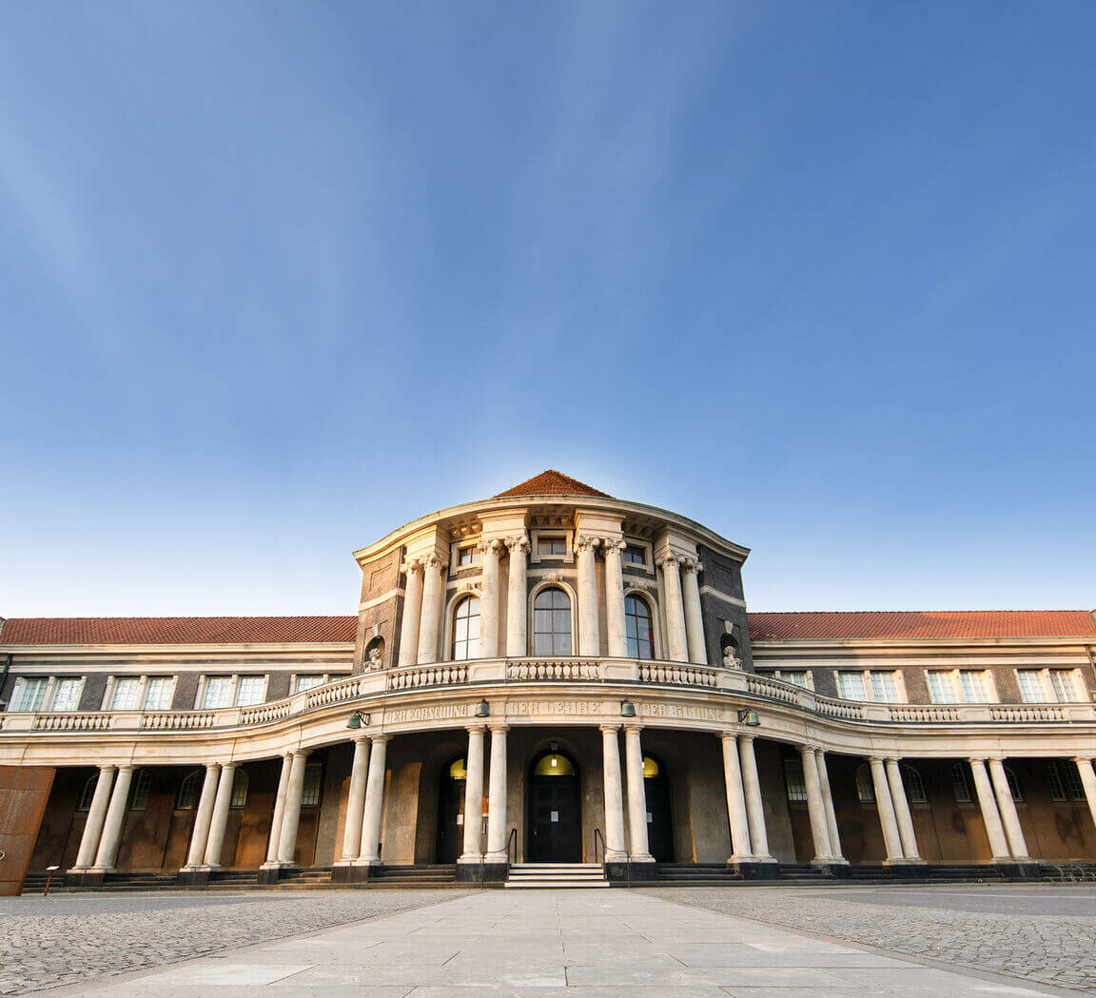
Different Virtual Machines for Different Archival Needs (with a Focus on Database Preservation)
Francesco Gelati (he/him)
2025-03-11
Foto: UHH/Lutsch

Slide 2
Agenda
VMs and Archives
VMs for Digital Storage
VMs and Digital Preservation
VMs and Emulation
Conclusion

Slide 3
Virtual Machines and Archives
In computing, Virtual Machines (VMs) can be used for managing servers, for creating powerful applications, but also for the digital preservation strategy of emulation. A clear overview for which goals which VMs are used in archives seems however to lack.
This presentation refers three types of VMs used by the University of Hamburg Archives (UAHH), the third one tackling specifically database preservation.
UAHH has received in the last few years a couple of SQL databases from the faculty of humanities. About its first project in this field, see Gelati and Rau 2022. For digital preservation of SQL and NoSQL databases in research institutions, see Buelinckx, Gautschy, Gelati et al. 2023.

Slide 4
Virtual Machines for Digital Storage
First of all, the VM may serve as a server thanks to server virtualisation, when a single physical server is partitioned into multiple virtual servers. The Loughborough University Library did so already in 2009, reporting several benefits, from flexibility in allocating server resources to a faster commissioning of new servers and reduced hardware maintenance (Cooper and Brewerton 2010). The UAHH uses a secured Linux server on which basic Linux services (authentication; users’ and permission management; firewall; and a few more) run. It hosts for the moment one single VM where the UAHH’s digital archival holdings (but neither current nor semi-current records) are stored (see, in German: https://www.rrz.uni-hamburg.de/services/weitere/virtuelle-server/rrz-managed-linux-server.html).

Slide 5
Virtual Machines and Digital Preservation
VMs also permit application-level virtualisation which encapsulate computer programs to be run on a different operating system inside one single virtualisation environment (known as container).
Two of such virtualised programs are of interest for archival institutions: OCR4all for optical character recognition (OCR) and handwritten text recognition (HTR), and ViPER, englobing several digital preservation tools like DROID and JHOVE. The UAHH already uses OCR4all.

Slide 6
Virtual Machines and Emulation (1)
VMs can also perform emulation for archival purposes. A VMs was developed in 2024 by the University of Hamburg IT department together with the Archives as an example of an active digital preservation action. The VM is an executable Open Virtualization Package (OVP) which can be run in the open-source virtualisation environment VirtualBox.
The OPV contains two MyCoRe-powered repositories, in fact two web-based XML-running databases.

Slide 7
Virtual Machines and Emulation (2)
MyCoRe (acronym for My Content Repository) is an open source repository software framework for building disciplinary or institutional repositories, digital archives, digital libraries, and scientific journals. It is from an archival perspective a complex application, for it encompasses several building blocks and modules written in different languages (Java, XSLT, Shell, JavaScript, CSS). It is stricto sensu no relational database, for rather XML instead of SQL is the query language. This is why SIARD was not an option, even though it may be appropriate to siard a data dump.

Slide 8
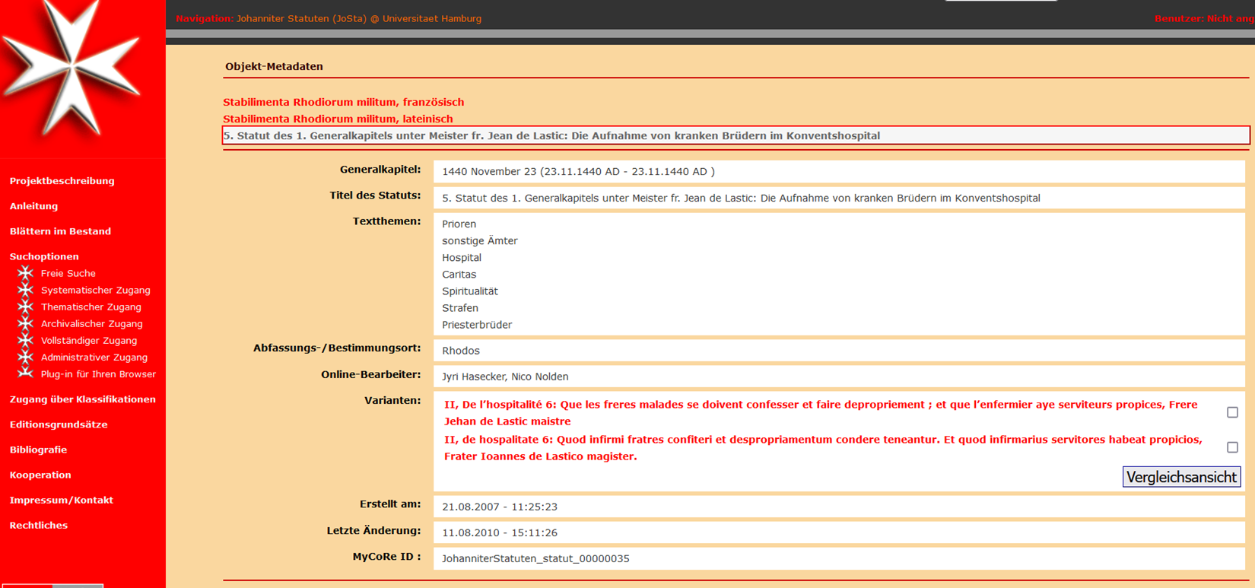
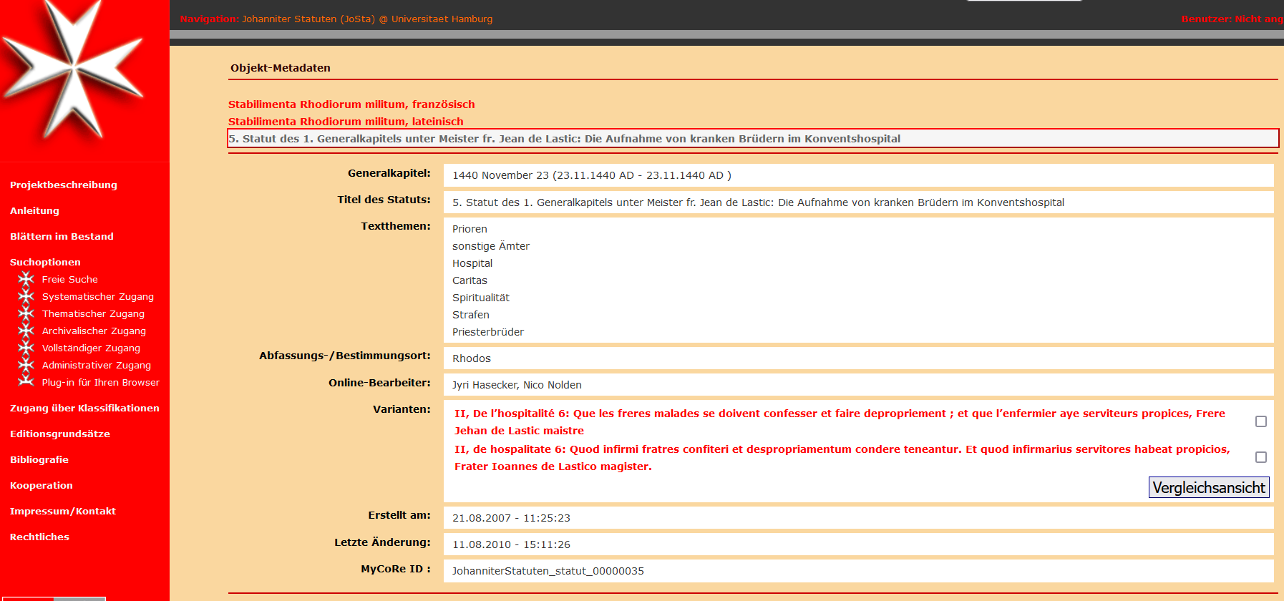
Virtual Machines and Emulation (3)
Our two, to-be-archived databases show late-medieval transcriptions (without images): JoSta and SchuReDo. Both databases are digital-humanities research projects from the faculty of humanities, which were launched in 2007/2008 and are now obsolete. The OVP is designed exclusively for local use and is not suitable for web-based server operations.

Slide 9
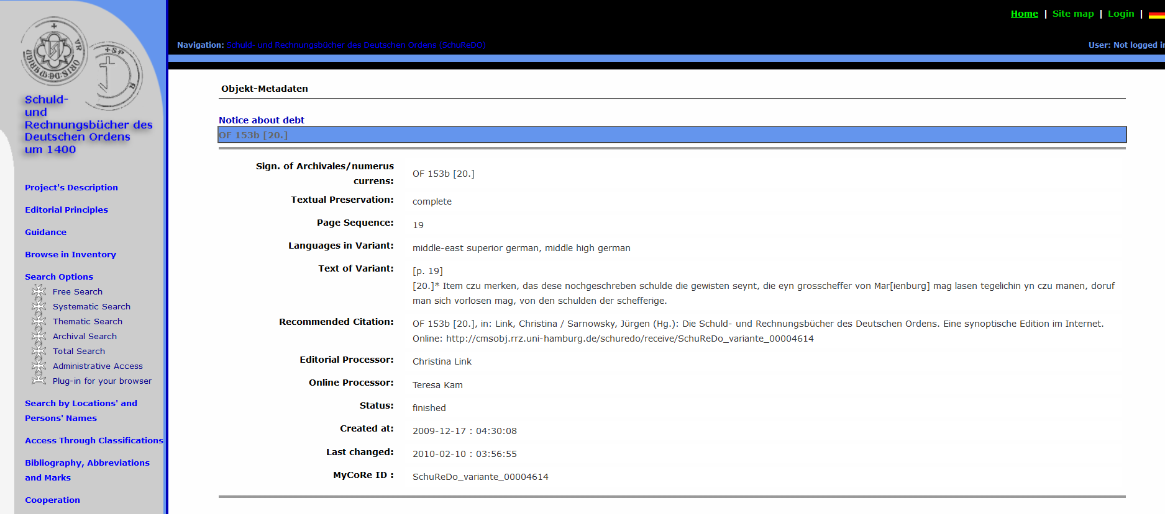
Virtual Machines and Emulation (4)
The OVP includes, as an emulation should do, all the pieces of software that are needed, i.e.: apache2, tomcat, PostgreSQL, Firefox. All these building blocks are open-source, so that no fees will apply.

Slide 10
Conclusion
Some questions remain open.
Database archiving at the UAHH seems to adjoin research data management. In this case too, not only the database was processed, but also project-management information. A data management plan was a posteriori created. To which extent is the work of a data steward different from the work of an archivist?
In other words: to which extent database archiving at big archival institutions (e.g. national archives) and at smaller (e.g. university or municipal archives) differ and should differ?

Slide 11

Contact
Francesco Gelati Head of Section
University of Hamburg Archives Section A13 - Digital Services and Internal Consultancy Mittelweg 177 D-20148 Hamburg
francesco.gelati@uni-hamburg.de
https://orcid.org/0000-0002-6066-1308

