Slide 1


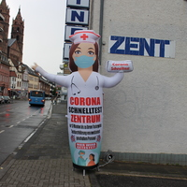
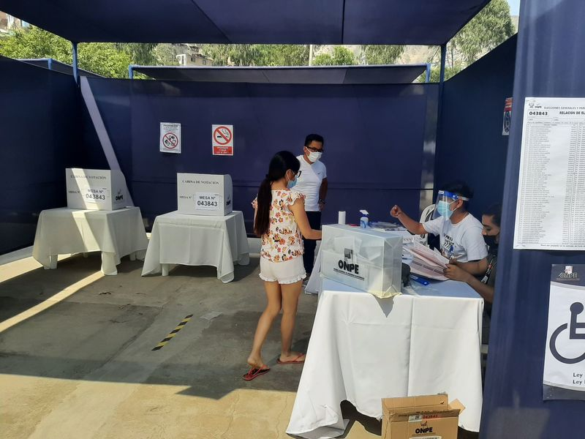
Universitätsarchiv Hamburg
How to Archive a Corona Archive Project? The University of Hamburg’s Coronarchiv and the SIARD file-format
Francesco GELATI, Head of Section Digital Services and Internal Consultancy & Sönke RAU, Deputy Head of Section
University Archives, Universität Hamburg
https://coronarchiv.blogs.uni-hamburg.de ; https://www.archiv.uni-hamburg.de ; archiv@uni-hamburg.de
The story of coronarchiv
What about its long-term digital archiving?
Our open-source, free tools and file-formats
Omeka S: a Content Management System
https://omeka.org/s/
In 2020 the coronarchiv was initiated by three German universities: Universität Hamburg, Ruhr-Universität Bochum and Justus-Liebig-Universität Gießen.
It is a multilingual, participatory, online portal aimed to collect, store, preserve, make accessible and exhibit digital objects documenting the historical time of the pandemic.
People from all over the world
(mainly Germany but also South America, Africa and Asia) uploaded texts, videos and images about how they experienced the Covid-19 pandemic. See e.g. this puppet advertising a Corona test centre.
„Aufblasbare Puppe als Werbemittel für Schnelltestzentrum in Worms/Rhein" by Christian, CC BY-SA 4.0, coronarchiv, online at: https://coronarchiv.blogs.uni-hamburg.de/item?id=16567
The project has been led by Hamburg’s Faculty of Humanities, Department of History, who will soon hand the project over to the University Archives, which will ensure long-term digital archiving.
Since the coronarchiv is a mid-size website, the first option to be explored was web-archiving. The freeware Heritrix developed by The Internet Archive and the ISO-standard file-format WARC (ISO 28500:2009) are today worldwide adopted. Yet the Coronarchiv is not only a website, but also a relational
MySQL-database run by the open-source Content Management System (CMS) Omeka-S. That is why the University Archives decided to convert the database in SIARD files. The non-proprietary SIARD file-format was developed by Switzerland’s Federal Archives and is based on four internationally recognised standards: XML, SQL:2008, UNICODE and ZIP64. It permits archiving mark-leading database types: not only MySQL but also MS Access, Oracle and PostgreSQL.
"Elecciones generales de Perú" by Karen, CC BY-SA 4.0, coronarchiv, online at: https://www.coronarchiv.de/item?id=14104
SIARD: Software Independent Archival of Relational Databases: https://dilcis.eu/content-types/siard
Database Preservation Toolkit (DBPTK): Tool developed by Keep Solutions https://www.keep.pt/
Other digital projects at the University Archives
Hamburger Matrikelportal
Scanned register cards and biographic infos about all 35‘000 students who enrolled in Hamburg between 1919 and 1935.
https://www.matrikelportal.uni-hamburg.de/
Hamburger Professorinnen- und Professorenkatalog
More than 5900 members of the teaching staff from the university‘s foundation in 1919 until today can be searched online.
https://www.hpk.uni-hamburg.de/

