Slide 1

POPULAR VOTE
Private Query Sessions with AI-Powered Clustering
Zachery Francis
CISC 4900 · Fall 2026 · Brooklyn College
DRAFT v13
github.com/Marqed4/CISC-4900-PopularVote
https://marqed.it/PopularVote

Slide 2
Project & Team
Header information and points of contact
Project
Team & Stakeholders
TITLE
TEAM LEAD / DEVELOPER
PopularVote
Zachery Francis
COURSE / TERM
COLLABORATORS/CONTRIBUTORS
CISC 4900, Fall 2026
Solo senior-project extensions
Base app built with Alou Kone, Jonathan Koral, Andrew Li (Intro to SWE)
INSTITUTION
FACULTY SUPERVISOR
Brooklyn College
Prof. Catherine Chung, Brooklyn College
REPOSITORY
EMAIL
github.com/Marqed4/CISC-4900-PopularVote
zacherywfrancis@gmail.com
LIVE DEPLOYMENT
popularvote.marqed.it
PopularVote · CISC 4900 First Draft
2 / 17

Slide 3
Elevator Pitch
Motivation, aims, and scope
PopularVote is an open-source, privacy-focused live Q&A platform built with fellow students. During a session, participants submit questions anonymously; instead of a moderator sifting through a wall of duplicates, an AI clustering layer (Gemini) condenses similar submissions into a handful of representative questions and pushes them live to the whole room. The project pairs that clustering pipeline with privacy-first session mechanics (anonymous submission, optional Google sign-in, and opt-in end-to-end encrypted sessions, currently in progress) so hosts can run open discussion without exposing who asked what.
“Private query session with AI-forked clustering / condensing.”
⇗
GITHUB
⇗
LIVE SITE
github.com/Marqed4/CISC-4900-PopularVote
popularvote.marqed.it
PopularVote · CISC 4900 First Draft
3 / 17

Slide 4
Tools & Tech Stack
Software, services, and hosting used on the project
1
Flask 3.1
2
Flask-SocketIO 5.4
3
Flask-Limiter 3.9
Python web framework serving the REST API
Real-time WebSocket layer for live session updates
Rate limiting to guard submission endpoints from abuse
4
Supabase 2.31
5
google-genai 1.50
6
pypdf 5.1
Managed Postgres for sessions, submissions, and clusters, plus Google OAuth sign-in
Gemini 2.5 Flash for clustering, suggested answers, and chat
Server-side PDF parsing for document-based input
7
Gunicorn + Eventlet
8
Flask-CORS 5.0
9
Render / Railway
Production WSGI serving with async worker support
Origin allow-listing across frontend deployments
Hosting for backend + frontend, custom domain
PopularVote · CISC 4900 First Draft
4 / 17

Slide 5
System Architecture
Technical sketch 1: how the pieces connect
REST + WebSocket
Supabase
Flask Backend (app.py)
Postgres DB + Auth
Client
sessions
submissions
expand
chat
React 19 SPA
(Vite static build)
Google Gemini
SessionManager (in-memory cache, write-through to Supabase) • Flask-SocketIO (live push) • Flask-Limiter (rate limiting) • Flask-CORS (origin allow-list)
Clustering / condensing AI
Hosted on Render / Railway • gunicorn + eventlet workers • custom domain popularvote.marqed.it
All cross-origin traffic is restricted to an explicit allow-list (production frontend, local dev); no open CORS.
PopularVote · CISC 4900 First Draft
5 / 17

Slide 6
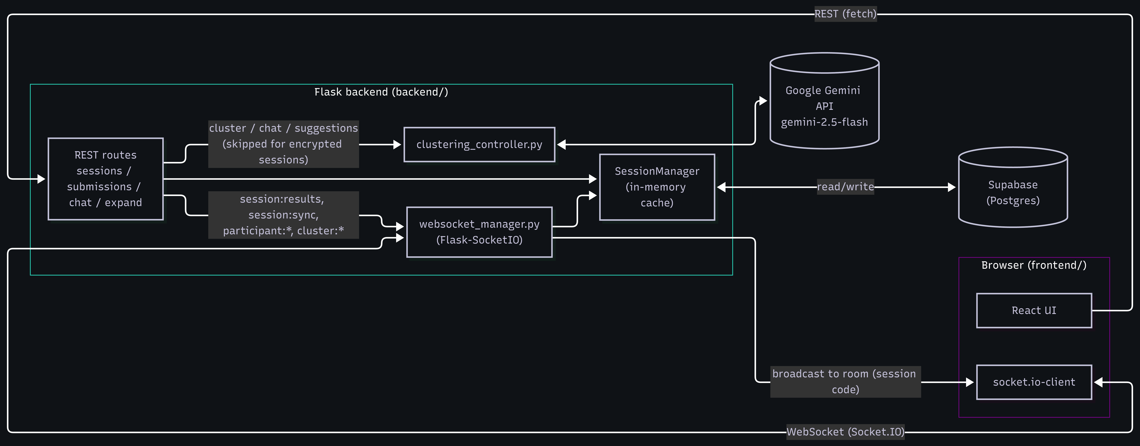
Backend Architecture
Technical sketch 1a: the same system at file and module level
Every REST route reads and writes through SessionManager, never Supabase directly. Clustering, chat and suggestion calls are skipped entirely for encrypted sessions, so ciphertext is never sent to Gemini.
PopularVote · CISC 4900 First Draft
6 / 17

Slide 7
Backend Class Structure
Technical sketch 1b: ownership and call direction between modules
app.py owns the Flask app, the SocketIO server and the single SessionManager instance, then registers every route blueprint against them.
SessionManager is the only class that touches session state. It keeps an in-memory dict of sessions and writes through to SessionStore, so a route never queries Postgres itself.
ClusteringController holds all Gemini prompting: full clustering, incremental clustering, suggested answers and follow-up suggestions. It is stateless, which keeps the AI layer swappable.
WebSocketManager owns room membership and the to_session() broadcast helper, plus the two relay handlers used by encrypted sessions for key exchange.
SessionStore is the thin Supabase boundary. Swapping the database means rewriting this file and nothing above it.
PopularVote · CISC 4900 First Draft
7 / 17

Slide 8
Question Lifecycle
Technical sketch 2: data flow for one submission
1
2
3
4
5
6
Participant submits
Rate limit check
Stored in Supabase
Host triggers clustering
Broadcast live
Dashboard updates
POST /sessions/:code/submit via submissions_bp; content must be non-empty and under 500 characters
Flask-Limiter allows 10 submissions per minute per client, before anything is stored
SessionManager caches the question and writes it through to Postgres; the room gets a live count
sessions_bp sends the questions to Gemini; later passes merge new ones into existing clusters
websocket_manager broadcasts session:results to the room over Socket.IO
Host and participants see the refreshed clusters with no page reload
Submissions are acknowledged immediately (NFR3 target: under 2 s). Clustering is host-triggered and incremental: new questions merge into existing clusters instead of re-clustering from scratch, and results are pushed to the whole room over Socket.IO. If Gemini fails, the session returns to CLOSED so the host can retry with no submissions lost.
PopularVote · CISC 4900 First Draft
8 / 17

Slide 9
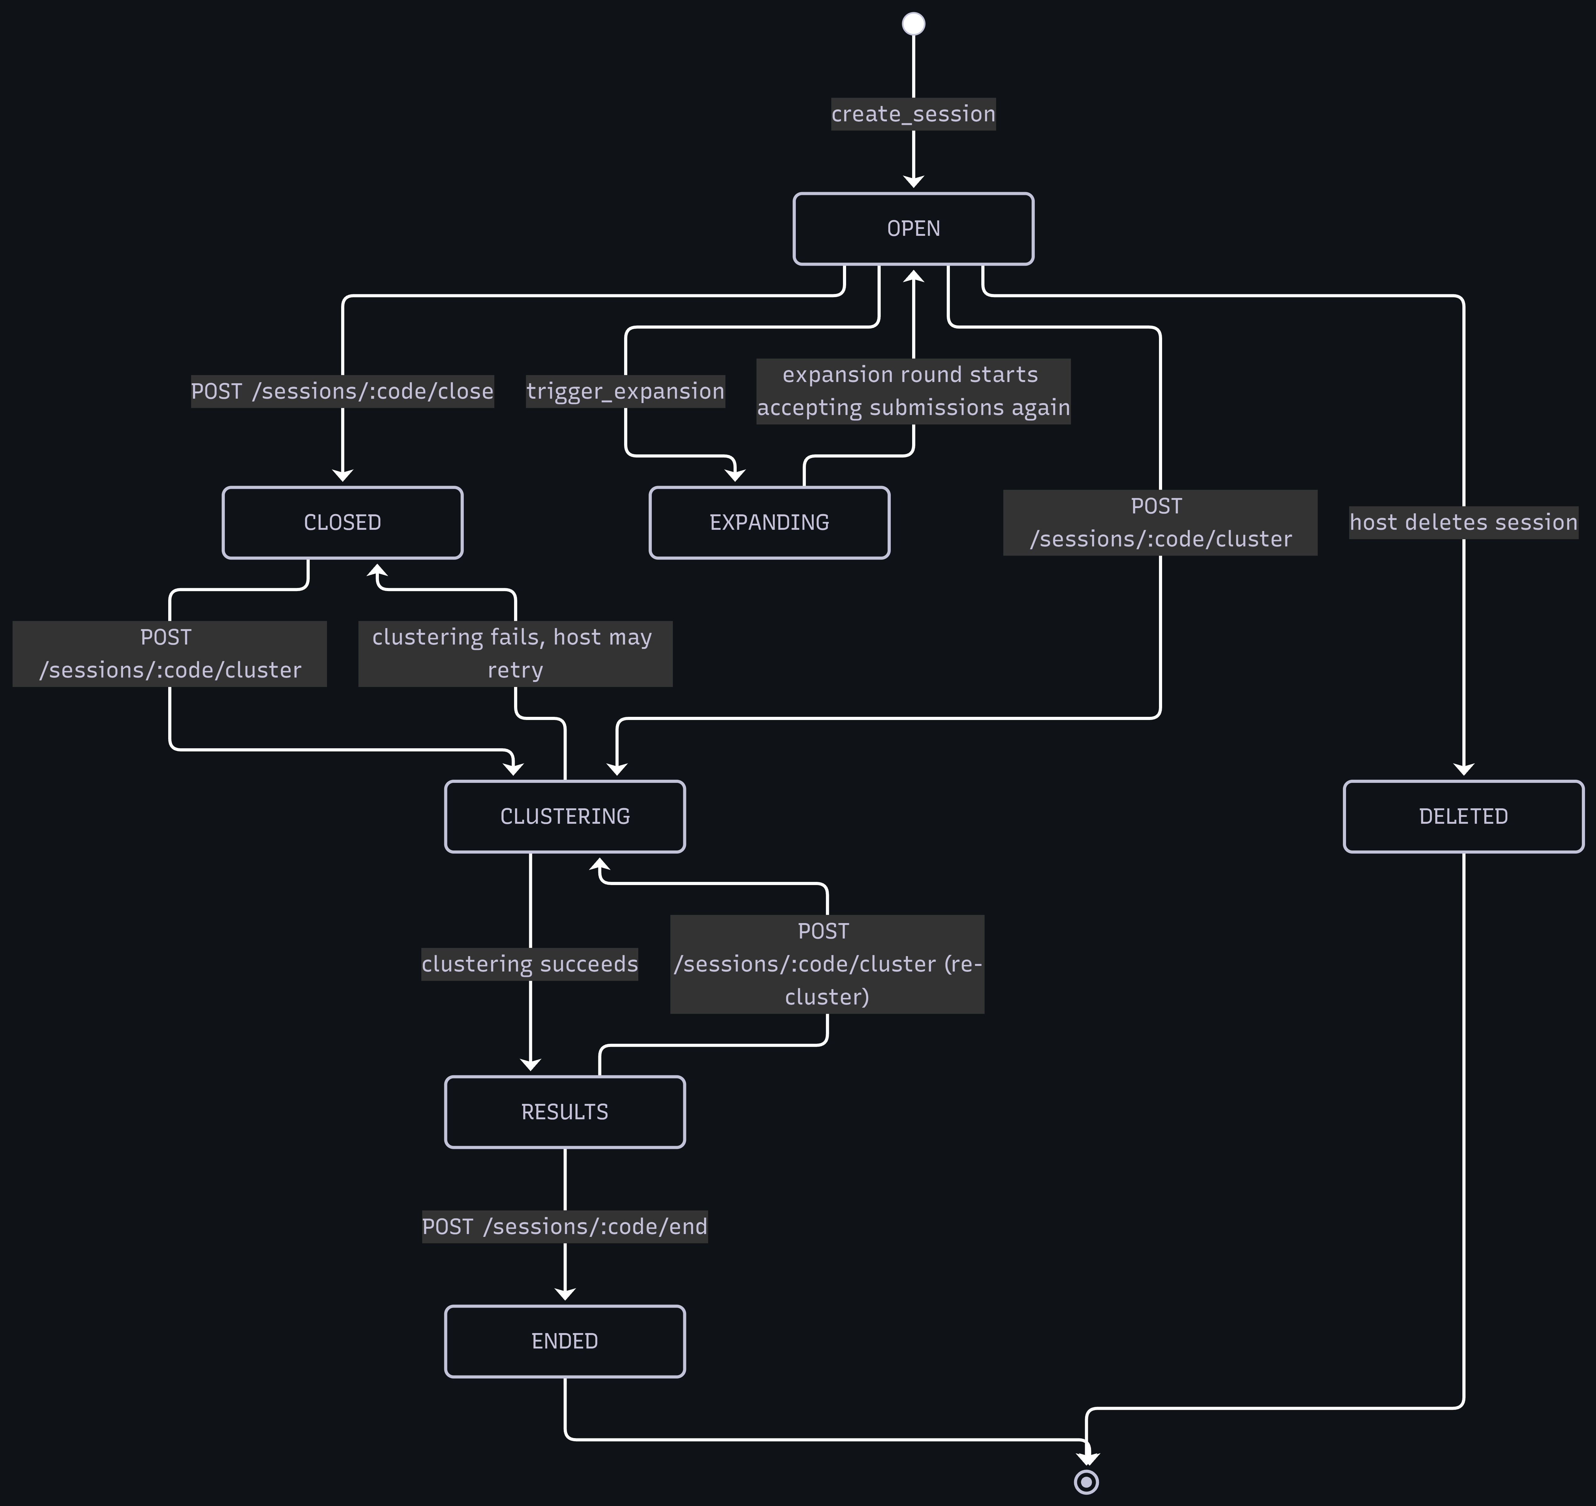
Session Lifecycle
Technical sketch 2a: every phase a session can occupy, and what moves it
A session's phase column is the single source of truth for what the UI shows and which endpoints will accept a call.
OPEN accepts submissions. The host can close the room, cluster straight from OPEN, or trigger an expansion round that returns to OPEN and takes more questions.
CLUSTERING is a working state, broadcast to the room so participants see progress. If Gemini fails the session falls back to CLOSED rather than dropping anything, and the host retries.
RESULTS can loop back into CLUSTERING for a re-cluster, which is what makes incremental passes possible mid-session.
No submission is ever lost to a phase change: failure paths return to a state the host can act from.
PopularVote · CISC 4900 First Draft
9 / 17

Slide 10
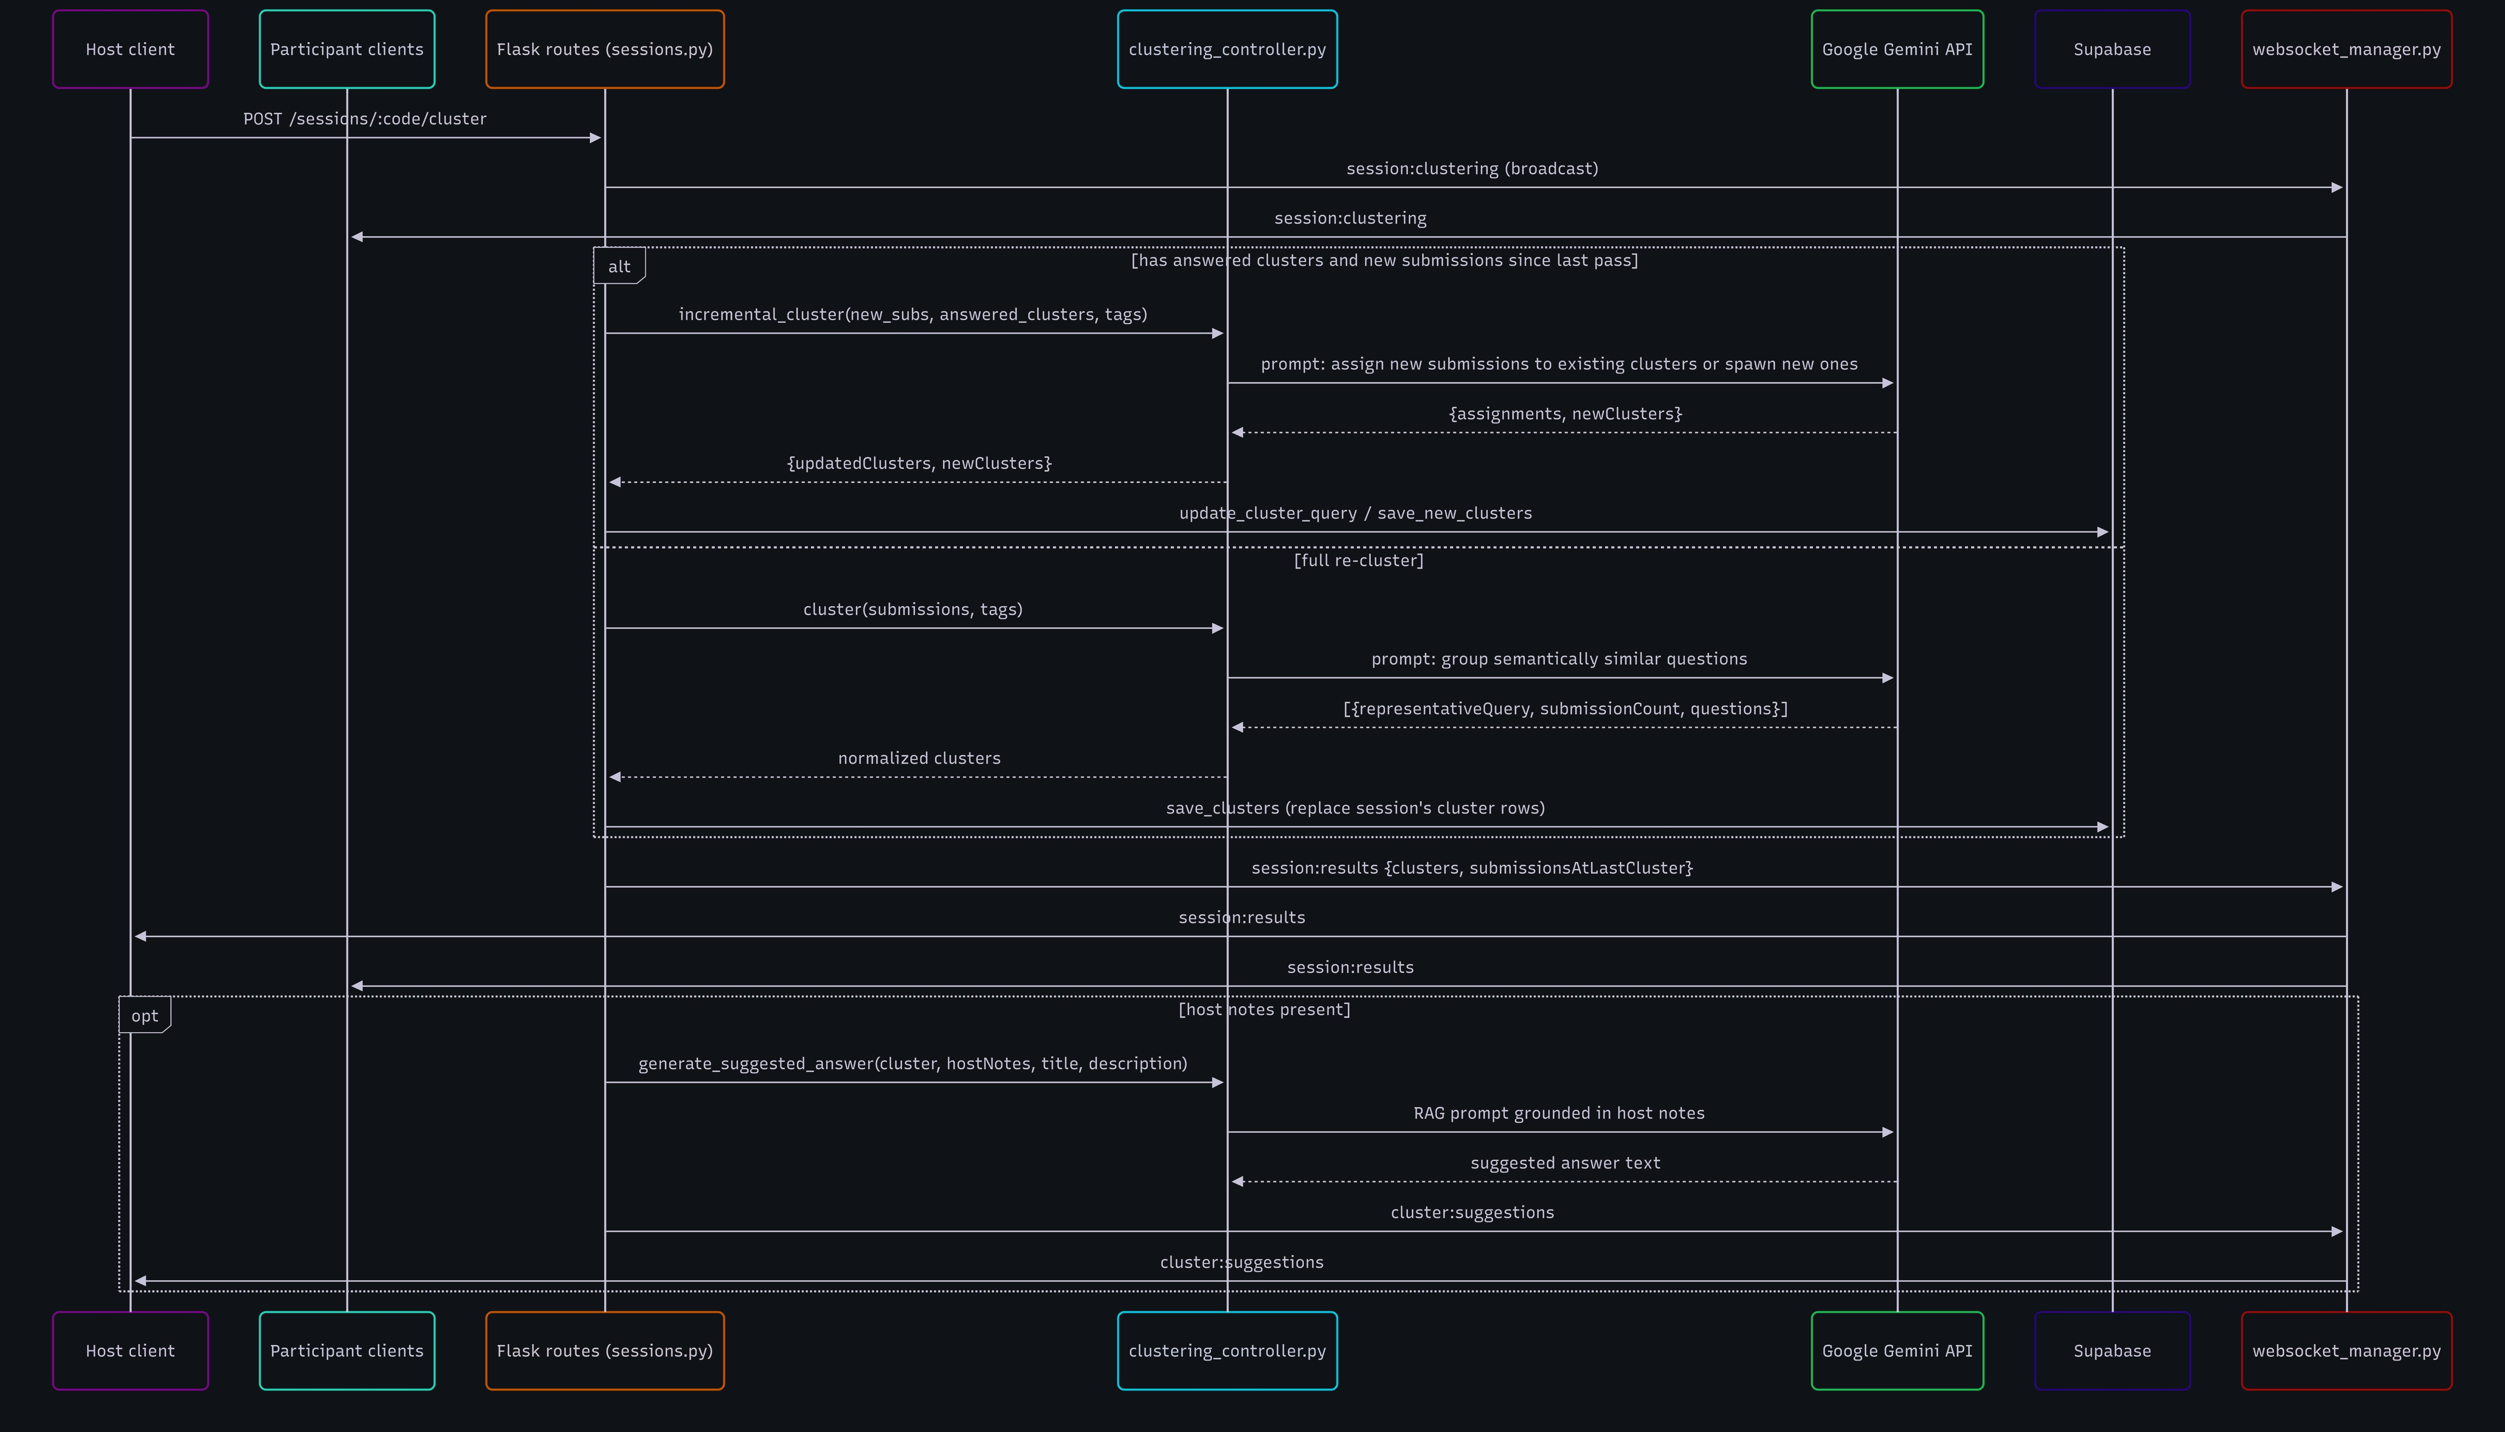
Clustering Pass
Technical sketch 2b: one POST /cluster, from host click to live results
Two paths, one endpoint.
If the session already has answered clusters and new submissions since the last pass, only the new questions go to Gemini, to be assigned to an existing cluster or spawn a new one.
Otherwise the pass is a full re-cluster and the session's cluster rows are replaced.
Either way the room gets session:clustering first and session:results after, so the host and every participant update without a page reload.
When host notes exist, a second grounded call drafts a suggested answer per cluster and arrives separately as cluster:suggestions.
Incremental clustering keeps token cost and latency flat as a session grows, instead of re-sending every question on every pass.
PopularVote · CISC 4900 First Draft
10 / 17

Slide 11
Conceptual Data Model
Technical sketch 3: core entities, aligned with the live Supabase schema
Submission
Session
Cluster
id (PK)
M : 1
code (PK)
1 : M
id (PK)
session_code (FK)
phase
session_code (FK)
content
title
representative_query
participant_answer
host_notes
submission_count
is_curator
curators
questions (jsonb)
created_at
expansion_round
answer
encrypted
upvote_count
Matches the live Supabase schema (key columns shown)
A session owns many submissions and many clusters. Cluster membership is not a foreign key on submissions: each cluster stores its member questions as jsonb ({text, upvoteCount}). Encrypted sessions store ciphertext + nonce as JSON in submissions.content. user_sessions and user_submissions (linked to Supabase Auth) support optional sign-in and are omitted here.
PopularVote · CISC 4900 First Draft
11 / 17

Slide 12
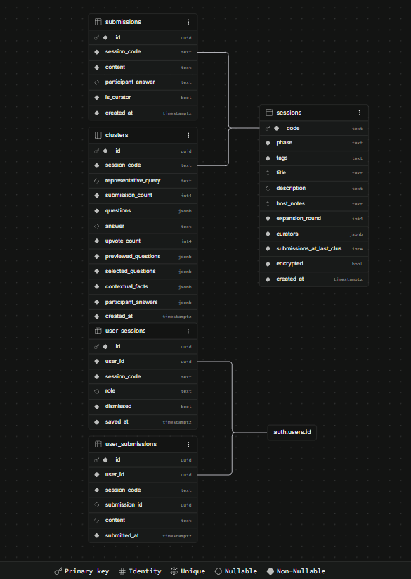
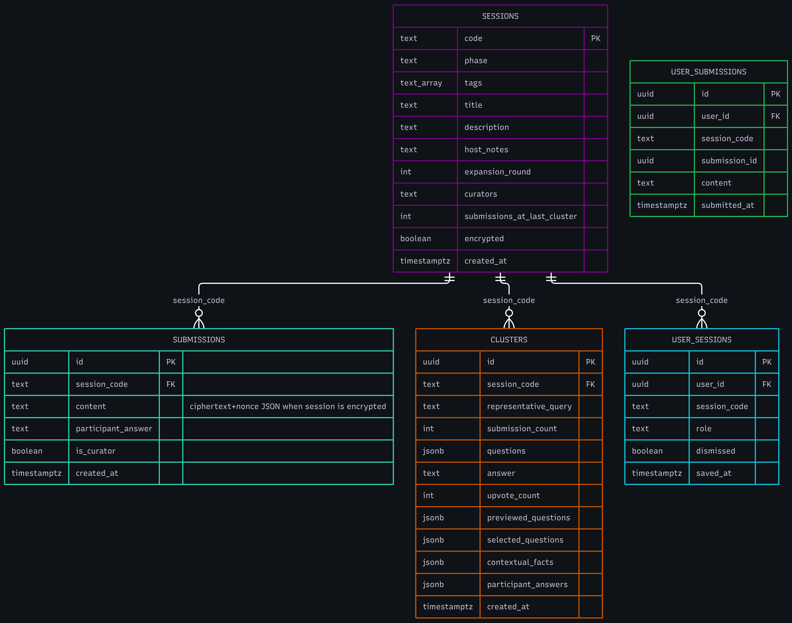
Live Supabase Schema
Technical sketch 3a: the conceptual model as it is actually stored
sessions is the hub. Every other table hangs off its code primary key, which is also the Socket.IO room name, so one identifier covers storage and live delivery.
Cluster membership is not a foreign key. Each clusters row stores its member questions as jsonb, which keeps a re-cluster a single row replacement instead of a cascade of updates.
submissions.content holds plaintext for a normal session and a ciphertext plus nonce JSON blob for an encrypted one. The column type never changes, so the encrypted path needed no migration of the write path.
user_sessions and user_submissions link to Supabase Auth and exist only to support optional sign-in. Anonymous participation touches neither.
Compare with sketch 3: the conceptual entities survived unchanged, and the additions are all about auth and encryption.
PopularVote · CISC 4900 First Draft
12 / 17

Slide 13
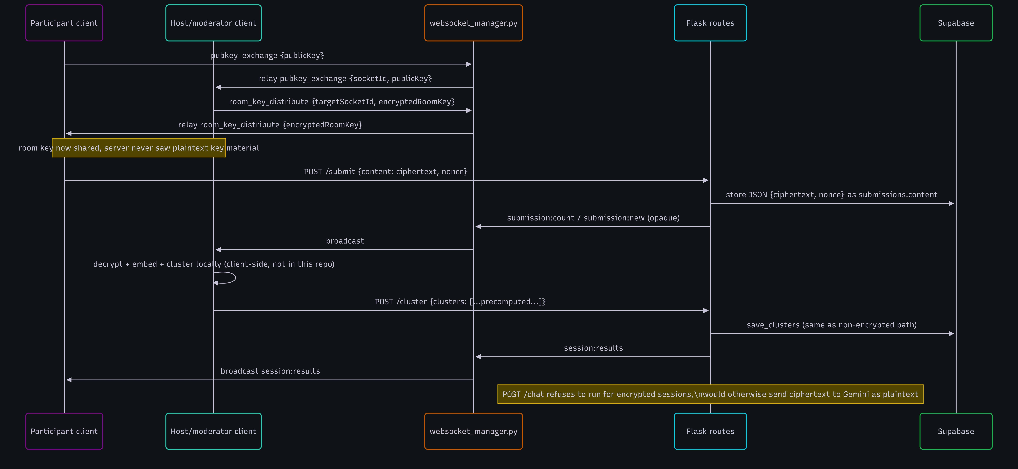
Encrypted Session Flow
Technical sketch 4: key exchange, opaque storage, and client-side clustering
The server relays public keys and the wrapped room key but never holds plaintext key material, so submissions reach Postgres as ciphertext plus nonce. This is why AI chat and suggestions are disabled for encrypted sessions: running them would mean handing Gemini ciphertext and calling it input. Clustering moves into the moderator's browser instead.
PopularVote · CISC 4900 First Draft
13 / 17

Slide 14
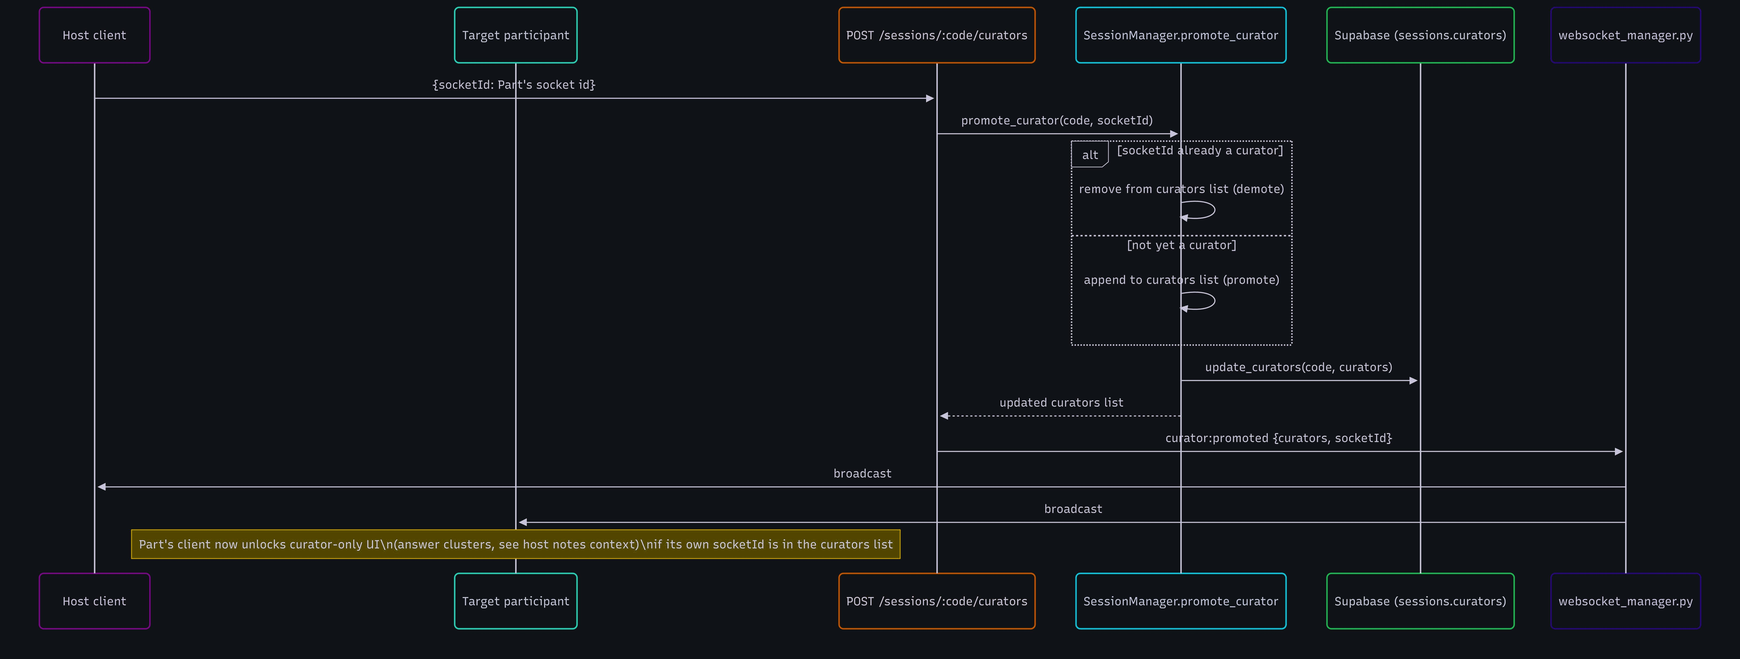
Curator Promotion
Technical sketch 5: how a participant gains moderation rights mid-session
One endpoint toggles: a socket id already in the curators list is demoted, otherwise it is promoted. The updated list is persisted and broadcast to the whole room, and each client unlocks curator-only UI only if it finds its own socket id in that list. Rights are scoped to a live connection, not to an account, which keeps promotion compatible with anonymous participation.
PopularVote · CISC 4900 First Draft
14 / 17

Slide 15
Progress Update
Toughest obstacle so far, and how the board has evolved
Toughest Bug / Obstacle
Project Board Evolution
What broke: the prompt says “respond ONLY with valid JSON, no markdown,” but Gemini can still wrap its answer in ```json fences. json.loads() then raised and the whole clustering request failed.
[ What did the backlog look like at the start? ]
[ What changed: new columns, labels, splitting epics? ]
# managers/clustering_controller.py
def _clean_json(raw):
cleaned = raw.strip()
cleaned = re.sub(r'^```json\n?', '', cleaned)
cleaned = re.sub(r'^```\n?', '', cleaned)
cleaned = re.sub(r'```$', '', cleaned)
return cleaned.strip()
[ How does the board reflect the current architecture (sessions / submissions / clustering)? ]
Fix: strip the fences before parsing and normalize each question to {text, upvoteCount}. A failed run now returns the session to CLOSED, so the host can retry. Takeaway: treat LLM output as untrusted input: clean it, parse it, normalize it, and keep a recovery path.
PopularVote · CISC 4900 First Draft
15 / 17

Slide 16
Tentative Schedule
Remainder of the semester: fill in estimates and actuals as weeks complete
Weeks
Task / Goal
Est. hrs
Actual hrs
Wks 1–3
E2E Phases 1–2: X25519 key exchange and room-key distribution (libsodium), encrypted submissions; run the encrypted-column migration in Supabase
[ ]
[ ]
Wks 4–6
E2E Phases 3–5: client-side clustering in the moderator’s browser (local embedding model), model hosting, and an encrypted-session toggle at session creation
[ ]
[ ]
Wks 7–9
Close E2E gaps: room-key durability across moderator reconnects and identity verification for the key exchange; settle TF-IDF vs. local embeddings
[ ]
[ ]
Wks 10–12
Client-side hashing pipeline research (XOR, bit rotation, FNV, salting vs. SHA-256) and NumPy/pandas analysis features on the Flask backend
[ ]
[ ]
Wks 13–14
Testing against the Requirements v2 non-functional targets, deployment hardening, and docs (the deployment guide is still empty)
[ ]
[ ]
Wks 15–16
Final draft prep and presentation polish
[ ]
[ ]
Tasks follow the E2E build plan (Phases 1–5) and the future directions in Requirements v2; estimates to be filled in as weeks complete.
PopularVote · CISC 4900 First Draft
16 / 17

Slide 17
Learning Outcomes & Future Work
Mapping IS learning outcomes to the project, and what's next
Information Systems Outcomes Covered
Future Work
System requirements + architecture diagram (see sketch 1)
Cut by design: AI chat and suggestions in encrypted sessions, since they would send ciphertext to Gemini (FR6.5)
Data flow of a core use case, end to end (see sketch 2)
In progress: opt-in end-to-end encrypted sessions. Server-side relay is done; client-side crypto and clustering come next
Conceptual schema for evaluating design trade-offs (see sketch 3)
Research: client-side hashing pipeline (XOR, rotation, FNV, salting vs. SHA-256): flexibility vs. cryptographic hardness
Business process: how a live Q&A session actually runs
Python-side analysis (NumPy/pandas) now that the Flask port is complete
Alternatives weighed: Node/Express vs. Flask, in-memory vs. Supabase state, Gemini vs. client-side clustering
Thank you. Questions welcome.
Evaluation: verify Requirements v2 targets (2 s submit ack, 10/min limit, no plaintext for encrypted sessions)
Zachery Francis • github.com/Marqed4/CISC-4900-PopularVote
PopularVote · CISC 4900 First Draft
17 / 17

