Slide 1
Grocery Location Recommendation
Applied Data Science Capstone
IBM Data Science Professional Certificate

Slide 2
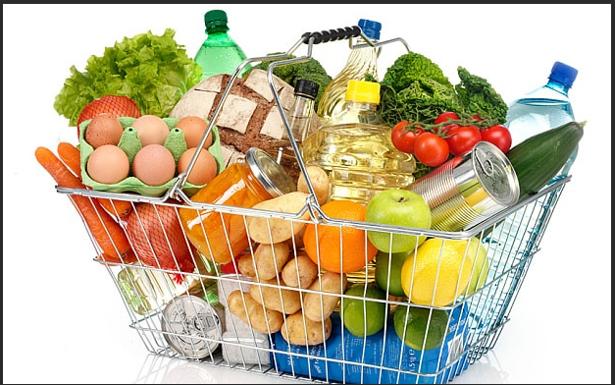
Grocery Locator

Slide 3
Intro
Problem:
A grocery store chain is located in Toronto. The chain wants to expand to East Toronto but does not know where to expand to in terms of neighborhoods. It would like to expand to a location that has similar customers to its current population.

Slide 4
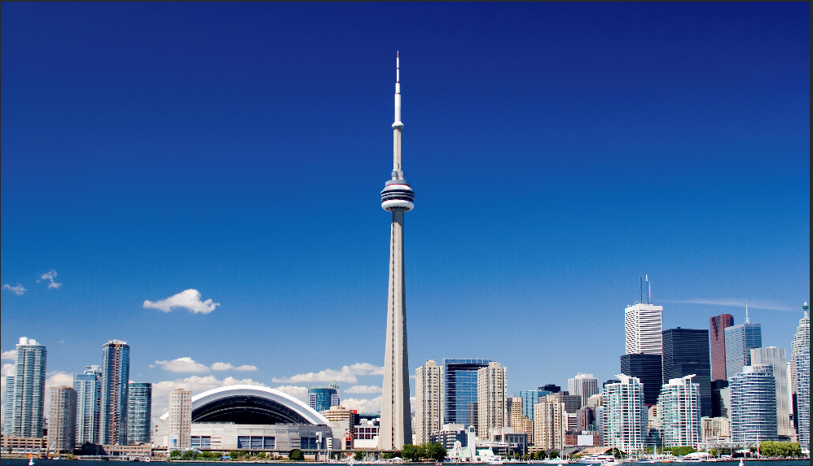
Data
Data Needed
Will need geo-locational information in East Toronto.

Slide 5
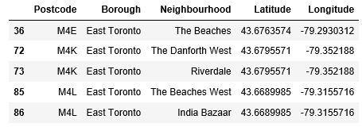
Data
Data Retrieved
We will need data from the following neighborhoods in East Toronto

Slide 6
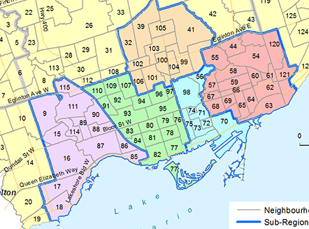
East Toronto

Slide 7
Data
By finding the list of neighborhoods, we are able to list out and group them to show which on is best for the grocery chain. Then they will be able to pick a location based off of the data gathered.

Slide 8
Data
The features of the neighborhoods comes from scrapping data from Wikipedia

Slide 9
Results
Best Riverdale
2nd Danforthwest
3rd Beaches
4th Beaches West
5th India Bazaar

Slide 10


