Slide 1
  Trace Based Streaming Video Traffic Model for 802.16m Evaluation Methodology Document
IEEE 802.16 Presentation Submission Template (Rev. 9)
Document Number:
  IEEE S802.16m-07/145
Date Submitted:
  2007-07-09
Source:
  Ricardo Fricks, Hua Xu
  email: hua.xu@motorola.com
  Motorola Inc.
  1501 West Shure Drive, Arlington Heights, IL 60004, USA
  Jeongeun Julie Lee, Belal Hamzeh
  email: jeong.julie.lee@intel.com
  Intel Corp.
  2111 NE 25th Ave, Hillsboro, Oregon 97124, USA
Venue:
  Response to a call for comments and contributions on draft 802.16m Evaluation Methodology Document
Base Contribution:
  IEEE C802.16m-07/145
Purpose:
  Propose a trace based streaming video traffic model in the IEEE 802.16m draft Evaluation Methodology Document.
Notice:
  This document does not represent the agreed views of the IEEE 802.16 Working Group or any of its subgroups. It represents only the views of the participants listed in the “Source(s)” field above. It is offered as a basis for discussion. It is not binding on the contributor(s), who reserve(s) the right to add, amend or withdraw material contained herein.
Release:
  The contributor grants a free, irrevocable license to the IEEE to incorporate material contained in this contribution, and any modifications thereof, in the creation of an IEEE Standards publication; to copyright in the IEEE’s name any IEEE Standards publication even though it may include portions of this contribution; and at the IEEE’s sole discretion to permit others to reproduce in whole or in part the resulting IEEE Standards publication. The contributor also acknowledges and accepts that this contribution may be made public by IEEE 802.16.
Patent Policy:
  The contributor is familiar with the IEEE-SA Patent Policy and Procedures:
      <http://standards.ieee.org/guides/bylaws/sect6-7.html#6> and <http://standards.ieee.org/guides/opman/sect6.html#6.3>.
  Further information is located at <http://standards.ieee.org/board/pat/pat-material.html> and <http://standards.ieee.org/board/pat >.
Bong Ho Kim
email: bhkim@posdata-usa.com
Posdata Co, Ltd.
2901 Tasman Dr. Suite 219, Santa Clara, CA 95054, USA
Ronny (Yong-Ho) Kim, Kiseon Ryu
email: ronnykim@lge.com
LG Electronics Inc.
LG R&D Complex, 533 Hogye-1dong, Dongan-gu, Anyang, 431-749, Korea

Slide 2
Video Traffic Modeling
Problems and Proposed Solution
Problems:
  Variable-rate, encoded video traffic is self-similar
    There is no silver bullet on synthetic traffic generation
      multiple analytical algorithms were proposed but no single reference algorithm is ideal for the task
  Self-similar generators reproduce only some of the characteristics of video traffic
    Long-range dependence and probability distributions of frame sizes can be reproduced
      Synthetic video traces are dissimilar to the reference traces (e.g., synthetic traces do not capture the effect of scene changes)
Proposed Solution:
  Use traffic traces instead of synthetic traces
    Easy to get and to use
  Define a benchmark set of video traces
    Representative traffic mix of video traces

Slide 3
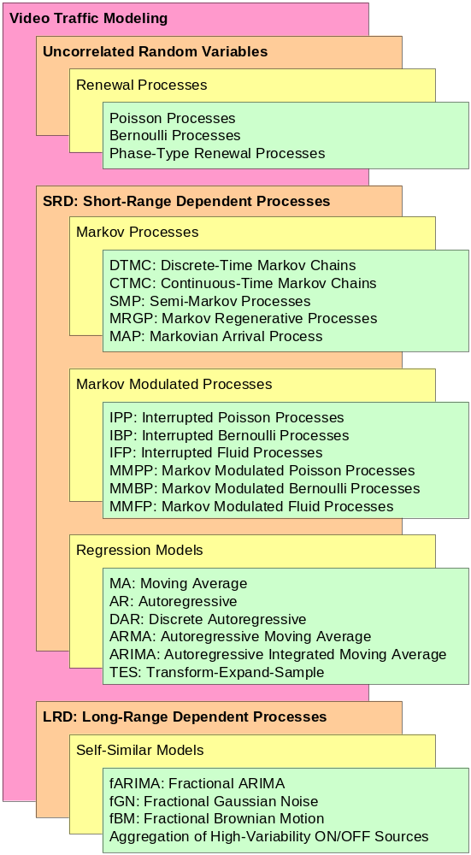
Video Traffic Modeling
Taxonomy
Traffic Modeling:
  V.S. Frost and B. Melamed; Traffic Modeling for Telecommunications Networks; IEEE Communications Magazine, 70-81, March 1994.
  A. Adas; Traffic Models in Broadband Networks; IEEE Communications Magazine; pp. 82-89, July 1997.
  M.R. Izquierdo and D.S. Reeves; A Survey of Statistical Source Models for Variable-Bit-Rate Compressed Video; Multimedia Systems, 7:199-213, 1999.
  X. Yuan and M. Ilyas; Modeling of Traffic Sources in ATM Networks; Proceedings of the IEEE SoutheastCon 2002; pp. 82-87, 2002.
Fractional Gaussian Noise:
  B. Mandelbrot and J.R. Wallis; Computer Experiments with Fractional Gaussian Noises. Part 3: Mathematical Appendix; Water Resources Research, 5:260-267, 1969.
  J. Beran; Statistics for Long-Memory Processes; Chapman and Hall, 1994.
  V. Paxson; Fast, Approximate Synthesis of Fractional Gaussian Noise for Generating Self-Similar Network Traffic; Computer Communication Review, 27(5):5-18, 1997.
  S. Ledesma and D. Liu; Synthesis of Fractional Gaussian Noise Using Linear Approximation for Generating Self-Similar Network Traffic; Computer Communication Review, 30(2):4-17, 2000.
  D.A. Rolls; Improved Fast Approximate Synthesis of fractional Gaussian Noise; pp. 1-4, 2002.
Analytic Modeling
Simulation Modeling

Slide 4
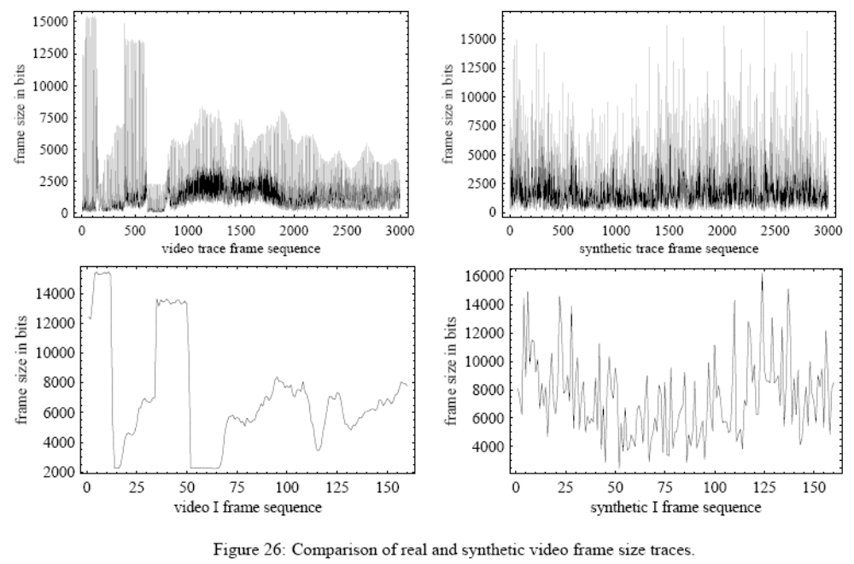
Synthetic Trace vs. Real trace

Slide 5
Video Traces Library
Easy to Get
Growing trend of using real video traces in network performance evaluation:
  Encoded video characteristics are dependent on the content, the encoding standard, and the encoding settings.
  An ideal traffic source provides traces with diverse encoding settings, covering multiple programming genres, and with long traces spanning tens of minutes at least.
Video Traces Research Group at Arizona State University
  Publicly library of 100+ video traces:
    MPEG-4, H.263, H.264, …
    Movies, cartoons, sport events, TV-shows, lecture videos, news programs with multiple encoder settings
  Main reference:
    Seeling, Reisslein, and Kulapala; Network performance evaluation using frame sizes and quality traces of single-layer and two-layer video: A tutorial. IEEE Communications Surveys & Tutorials, 6(3):58-78, 3Q2004.
    URL: http://trace.eas.asu.edu/

Slide 6
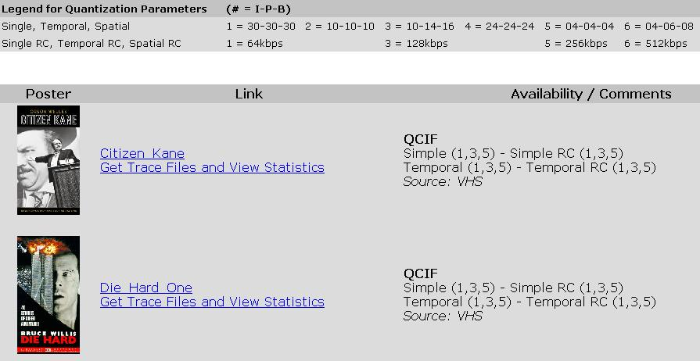
Video Traces Library at Arizona State University
http://trace.eas.asu.edu/cgi-bin/main.cgi

Slide 7
Benchmark of Video Traces
Variability of Trace Characteristics
It is important to consider a selection of video traces that is representative of the typical mix supported by the network.
  Video traffic characteristics depend on the video content itself and the chosen encoder settings (frame types used, quality, and rate control).
  Video streams encoded with constant quality level are highly variable with peak-to-mean ratios in the range from 4 to 25.
  Peak-to-mean ratio of frame sizes is a function of the encoded video quality.

Slide 8
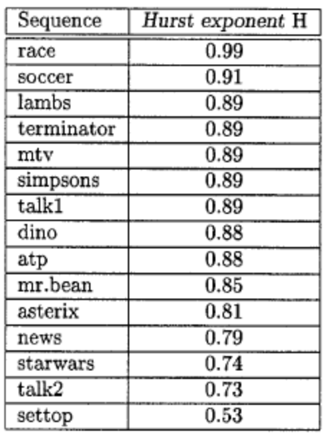
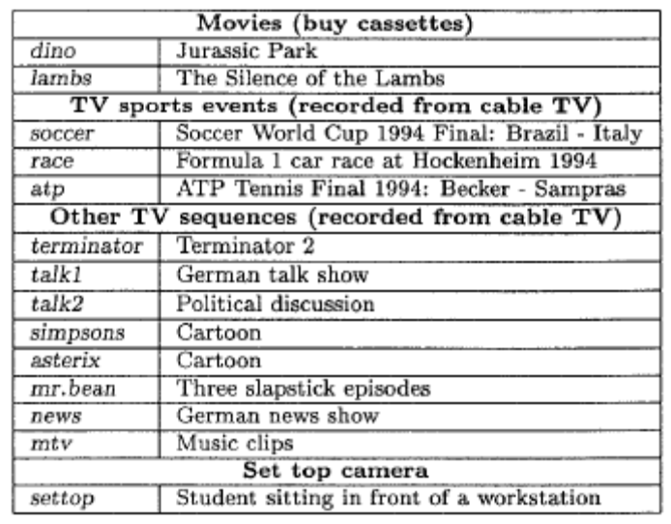
Benchmark of Video Traces
Variability of Hurst Parameter
Proposal: select a set of 12 MPEG4 traces from the ASU library that includes 6 traces representatives of major movie genres (e.g., drama, action, sci-fi), 3 traces of major sport events (e.g., soccer, race, tennis), 3 traces of TV shows (e.g., talk show, newscast, music video).
Tables from Statistical properties of MPEG video traffic and their impact on traffic modeling in ATM systems, O. Rose, 1995

Slide 9
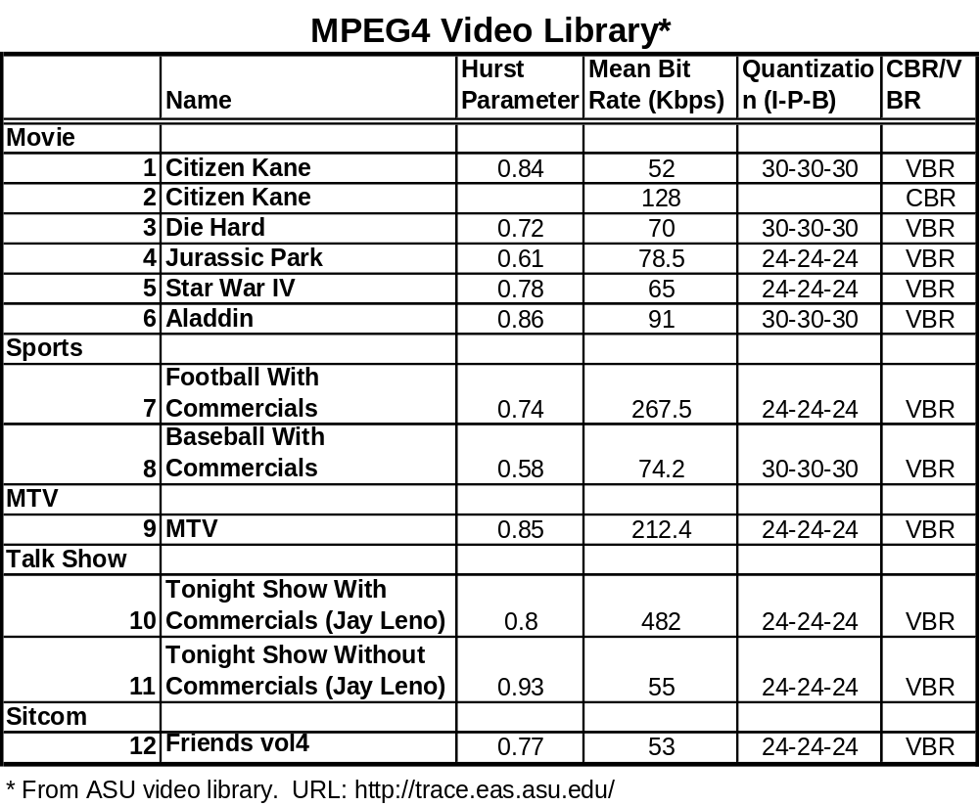

Slide 10
Back Up

Slide 11
Video Traffic Modeling
Problems and Proposed Solution
Problems:
Variable-rate, encoded video traffic is self-similar
  There is no silver bullet on synthetic traffic generation
    multiple analytical algorithms were proposed but no single reference algorithm is ideal for the task
Self-similar generators reproduce only some of the characteristics of video traffic
  Long-range dependence and probability distributions of frame sizes can be reproduced
    Synthetic video traces are dissimilar to the reference traces (e.g., synthetic traces do not capture the effect of scene changes)
Proposed Solution:
Use traffic traces instead of synthetic traces
  Easy to get and to use
Define a benchmark set of video traces
  Representative traffic mix of video traces

Slide 12
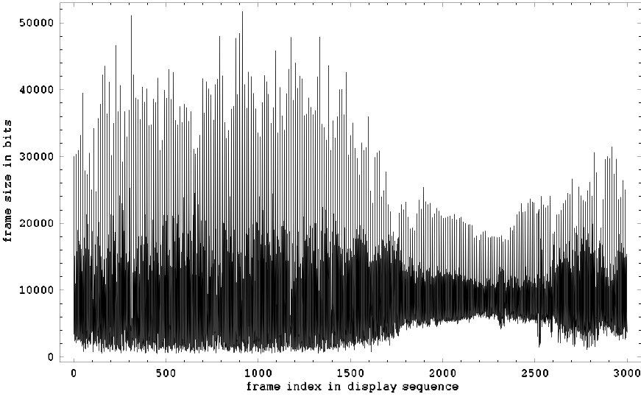
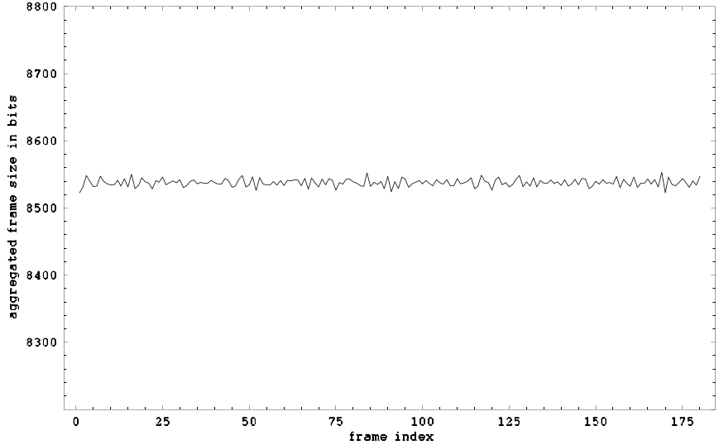
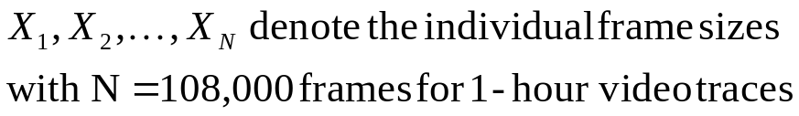
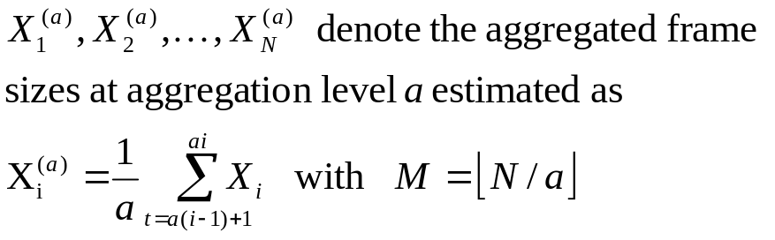
MPEG-4 Video Trace Statistics
Sample Time Plots
CBR-encoded movie segment:
600-frame aggregation level:
CBR: Constant Bit Rate

Slide 13
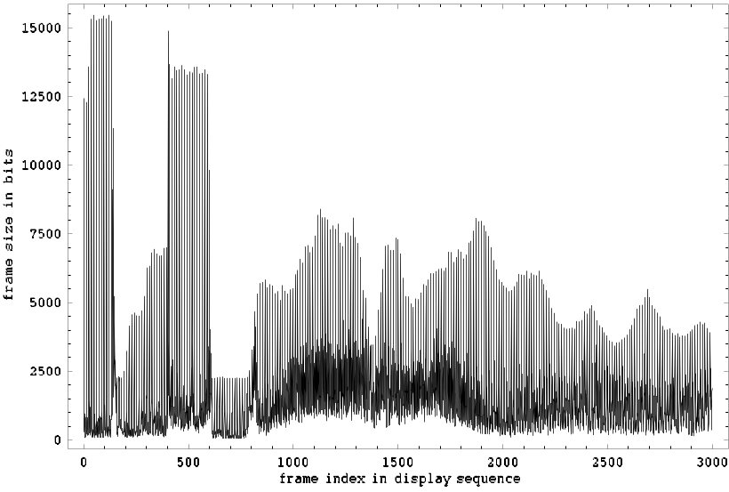
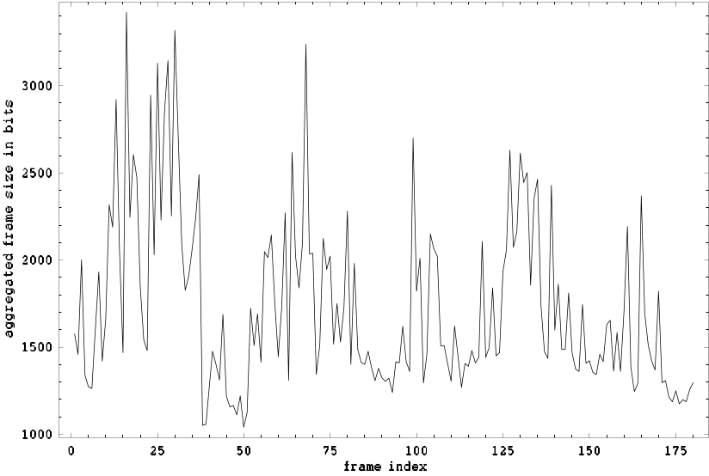
MPEG-4 Video Trace Statistics
Sample Time Plots
VBR-encoded movie segment:
600-frame aggregation level:
VBR: Variable Bit Rate

Slide 14
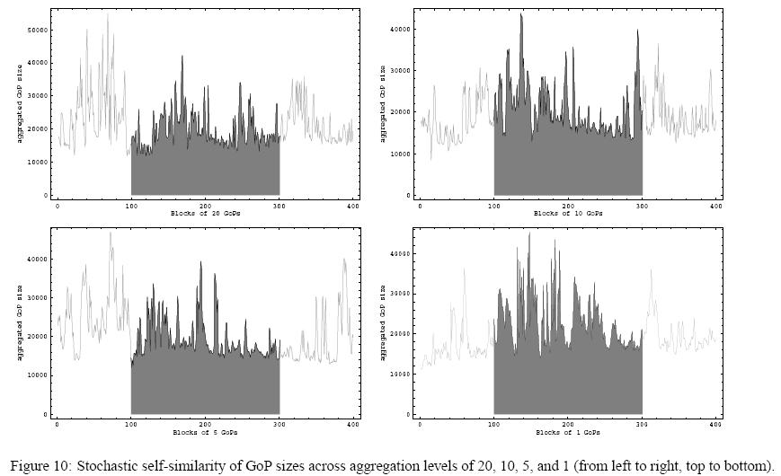
MPEG-4 Video Trace Statistics
Stochastic Self-Similarity of Video Traces

Slide 15
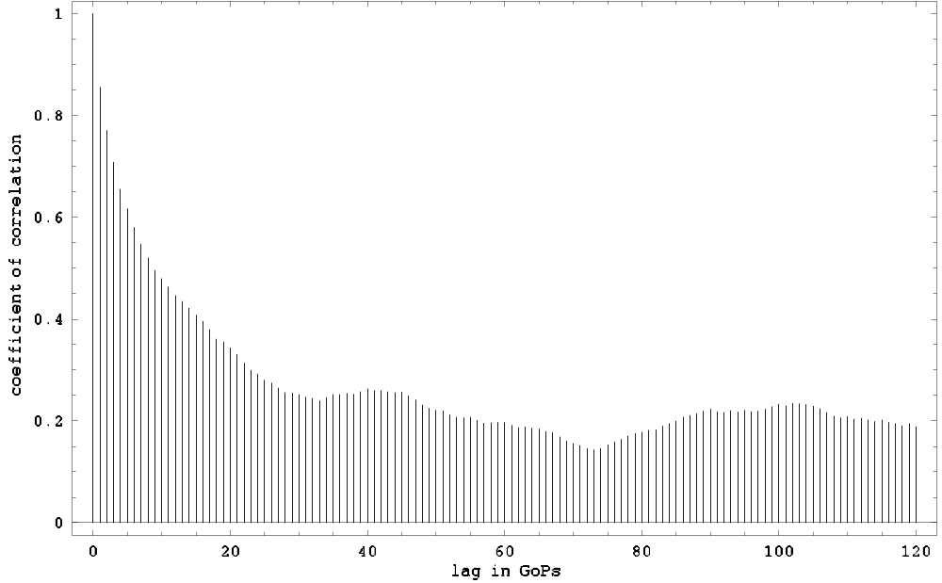
MPEG-4 Video Trace Statistics
Autocorrelation Function for GoP Sizes
…gives a better picture of the underlying decay of the autocorrelation function.
While long-term correlations are individually small, their cumulative effect is non-negligible.
Fairly significant correlations over relatively long time periods, which are mainly due to the correlations in the content of video (e.g., scenes of persistent high motion)
Possible ways of detecting long-range dependences are correlograms, variance-time plots, R/S plots, and periodograms.
100 GoPs ~ 40 sec

Slide 16
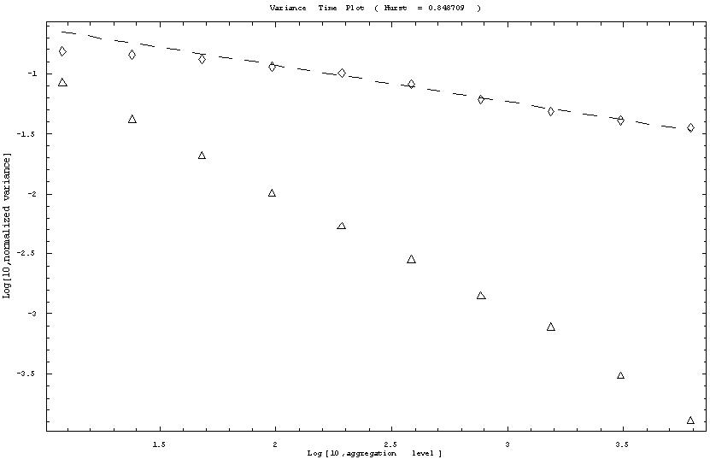
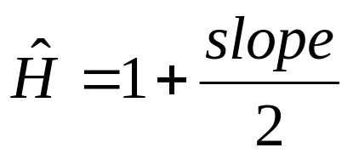
MPEG-4 Video Trace Statistics
Variance-Time Analysis
video trace
Poisson process
traces without long range dependence decrease linearly with a slope of -1 (i.e., Hust parameter = 1/2)

Slide 17
Long-Range Dependence of Video Traces
Performance Consequences
Why should we care?
  Long-range dependence (LRD) of traffic streams have been shown to cause performance problems in network infrastructure.
    The Hurst parameter of video traces encoded without rate control ranges from 0.70 to 1.00, with a large H-value usually reflecting a large amount of video movement in the video sequence.
  If ignored, typically results in overly optimistic performance predictions and inadequate network resource allocations.
    cell delay, cell delay variation (jitter), and cell loss may be significantly higher than predicted by simple traffic models.
    For example, Poisson traffic models may underestimate ATM cell loss by two to three orders of magnitude depending on the network utilization.
Recommended reference:
  Self-Similar Network Traffic and Performance Evaluation
  Edited by K. Park and W. Willinger, John Wiley & Sons, 2000.

Slide 18
Video Traffic Modeling
Problems and Proposed Solution
Problems:
Variable-rate, encoded video traffic is self-similar
  There is no silver bullet on synthetic traffic generation
    multiple analytical algorithms were proposed but no single reference algorithm is ideal for the task
Self-similar generators reproduce only some of the characteristics of video traffic
  Long-range dependence and probability distributions of frame sizes can be reproduced
    Synthetic video traces are dissimilar to the reference traces (e.g., synthetic traces do not capture the effect of scene changes)
Proposed Solution:
Use traffic traces instead of synthetic traces
  Easy to get and to use
Define a benchmark set of video traces
  Representative traffic mix of video traces

Slide 19
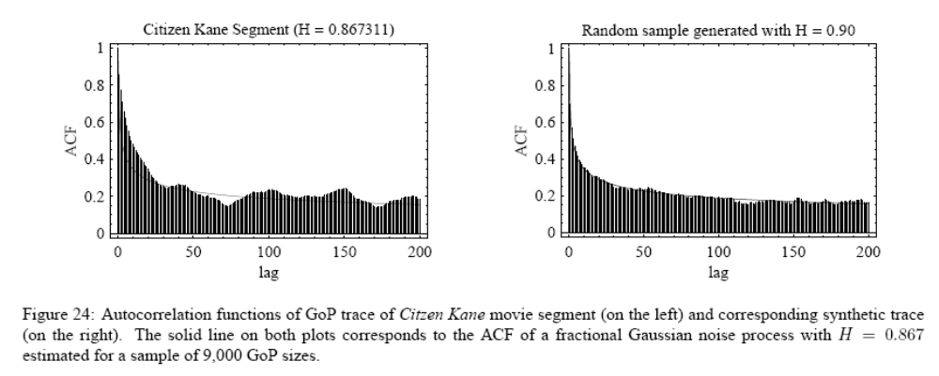
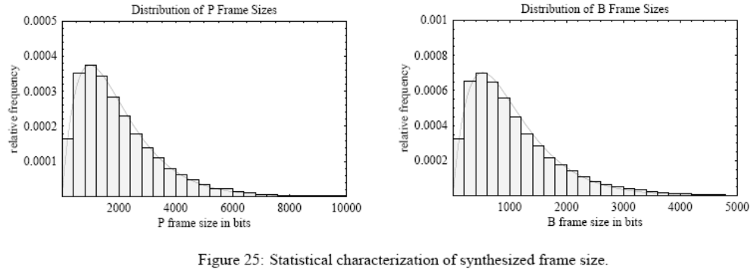
Synthetic Trace vs. Real Trace

Slide 20
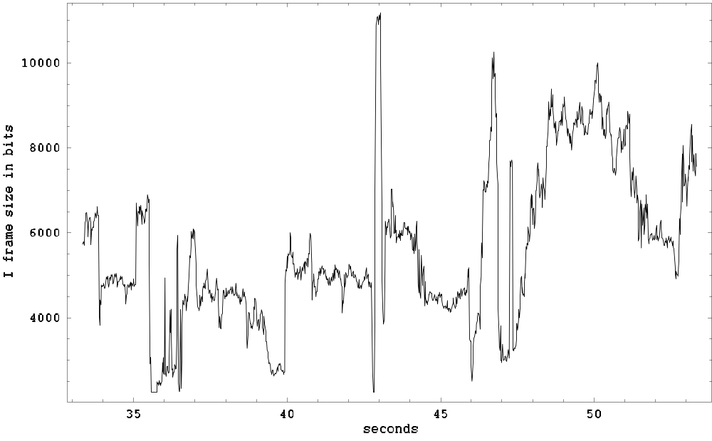
MPEG-4 Video Trace Statistics
Distribution of Scene Changes
1 scene
~ 3 secs
A scene, in the visual sense, is loosely defined as a portion of a movie without sudden changes in view, but with some panning and zooming.
Within small locality of the order of few seconds, I frames exhibit small fluctuation about some average level, which itself varies at larger time scales.

Slide 21
Video Traffic Modeling
Problems and Proposed Solution
Problems:
Variable-rate, encoded video traffic is self-similar
  There is no silver bullet on synthetic traffic generation
    multiple analytical algorithms were proposed but no single reference algorithm is ideal for the task
Self-similar generators reproduce only some of the characteristics of video traffic
  Long-range dependence and probability distributions of frame sizes can be reproduced
    Synthetic video traces are dissimilar to the reference traces (e.g., synthetic traces do not capture the effect of scene changes)
Proposed Solution:
Use traffic traces instead of synthetic traces
  Easy to get and to use
Define a benchmark set of video traces
  Representative traffic mix of video traces

Slide 22
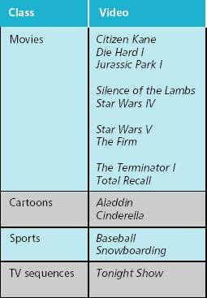
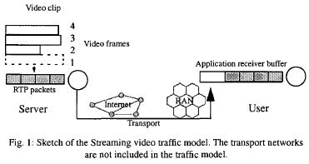
Video Traces Library
Easy to Use
Arizona State
University Library
traffic source
OPNET
from A Streaming Video Traffic Model for the Mobile Access Network, Nyberg, Johansson, and Olin, 2001

Slide 23
Video Traffic Modeling
Problems and Proposed Solution
Problems:
Variable-rate, encoded video traffic is self-similar
  There is no silver bullet on synthetic traffic generation
    multiple analytical algorithms were proposed but no single reference algorithm is ideal for the task
Self-similar generators reproduce only some of the characteristics of video traffic
  Long-range dependence and probability distributions of frame sizes can be reproduced
    Synthetic video traces are dissimilar to the reference traces (e.g., synthetic traces do not capture the effect of scene changes)
Proposed Solution:
Use traffic traces instead of synthetic traces
  Easy to get and to use
Define a benchmark set of video traces
  Representative traffic mix of video traces

