Slide 1
PASSWORD MANAGER
End Sem Project
BATCH A_GROUP 6
21AIE431 APPLIED CRYPTOGRAPHY

Slide 2
Members:
MARREDDY MOHIT SASANK REDDY CB.EN.U4AIE21031
YARRAM SRI SATHWIK REDDY CB.EN.U4AIE21077
B.HARISH BALAJI CB.EN.U4AIE21007
PENTYALA SAI VIJAY KUMAR CB.EN.U4AIE21040

Slide 3
Introduction :
The Password Manager is a security-focused tool designed to securely store and manage user credentials and sensitive information. This presentation outlines the key functionalities and implementation details of the project.
Our project addresses the critical need for robust password management through the development of a secure and efficient Password Manager. As a pivotal tool in fortifying online security practices, our Password Manager goes beyond conventional approaches, integrating advanced encryption techniques and a secure client-server model.
Through meticulous implementation of the Advanced Encryption Standard (AES) and a custom SHA-256 hashing algorithm, we establish a formidable defense against unauthorized access and potential data breaches.
Implementation Overview :
The Password Manager, which uses a Graphical user Interface is implemented with the following key features: Aes Encryption , GUI

Slide 4
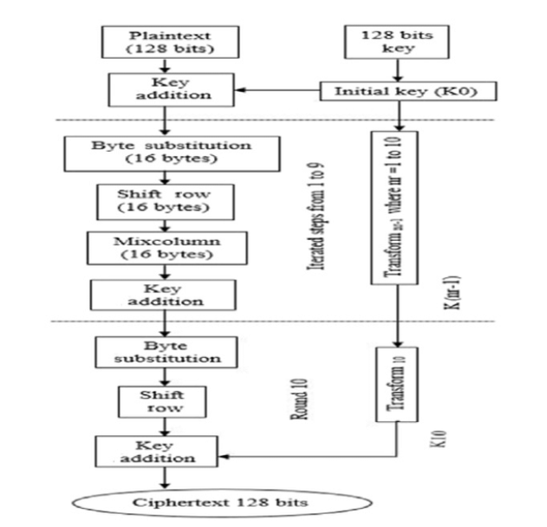
AES :

Slide 5
Introduction :
The first step is to add the plaintext to the initial key (K0). This is followed by nine rounds of transformations, each of which consists of four substeps:
Byte substitution: This step uses a substitution table (S-box) to replace each byte of the data with a different byte. The S-box is designed to be very non-linear, which makes it difficult to reverse the substitution process.
Shift rows: This step shifts the bytes in each row of the data to the left by a different number of positions.
Mix columns: This step mixes the bytes in each column of the data using a matrix multiplication operation.
Key addition: This step adds another subkey (derived from the initial key) to the data.
After the nine rounds of transformations, a final round is performed that consists only of byte substitution and key addition.
The output of the final round is the ciphertext, which is the encrypted form of the plaintext.

Slide 6
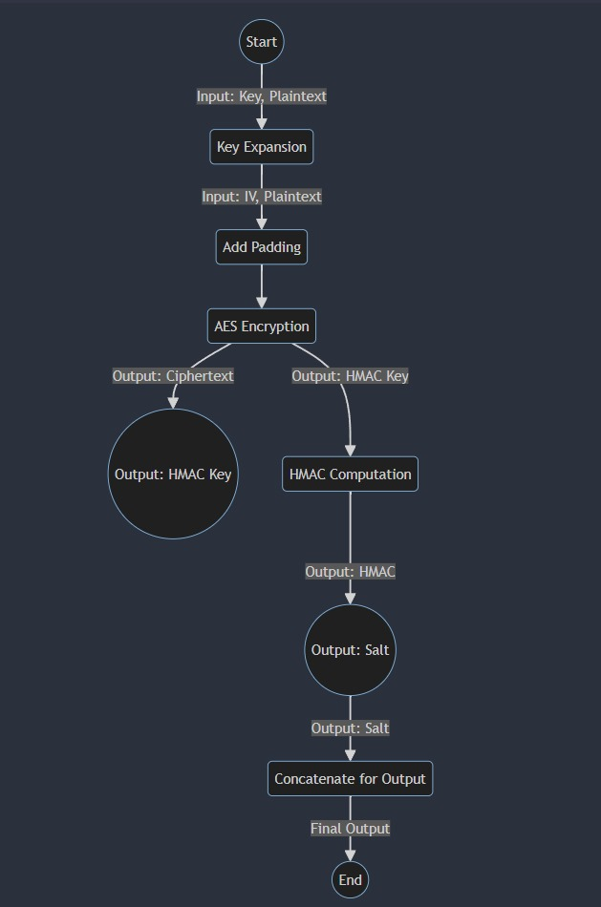
The flowchart also shows that there are different transformations used for different rounds of the AES algorithm. This is done to make the algorithm more resistant to attack.

Slide 7
Explanation:
Key Expansion (B):
Input: The process starts with the user providing a key and plaintext.
Operation: The key expansion process expands the provided key into round keys for AES encryption.
Output: The expanded key is used in the subsequent AES encryption process.
Add Padding (C):
Input: The expanded key and plaintext.
Operation: Padding is added to the plaintext to ensure it's a multiple of the block size (16 bytes) for AES encryption.
Output: Padded plaintext ready for encryption.
AES Encryption (D):
Input: Padded plaintext and IV (Initialization Vector).
Operation: AES encryption is performed on the padded plaintext using the expanded key and IV. The encryption is performed in blocks.
Output: Ciphertext after AES encryption.
HMAC Computation (F):
Input: HMAC Key, Salt, and Ciphertext.
Operation: HMAC (Hash-based Message Authentication Code) is computed using the HMAC key, salt, and the ciphertext obtained from AES encryption.
Output: Computed HMAC.
Concatenate for Output (H):
Input: Computed HMAC, Salt, and Ciphertext.
Operation: The HMAC, salt, and ciphertext are concatenated to form the final output.
Output: Final output ready to be presented or transmitted.
End (I):
The process concludes, and the final output is the result of the encryption process.

Slide 8
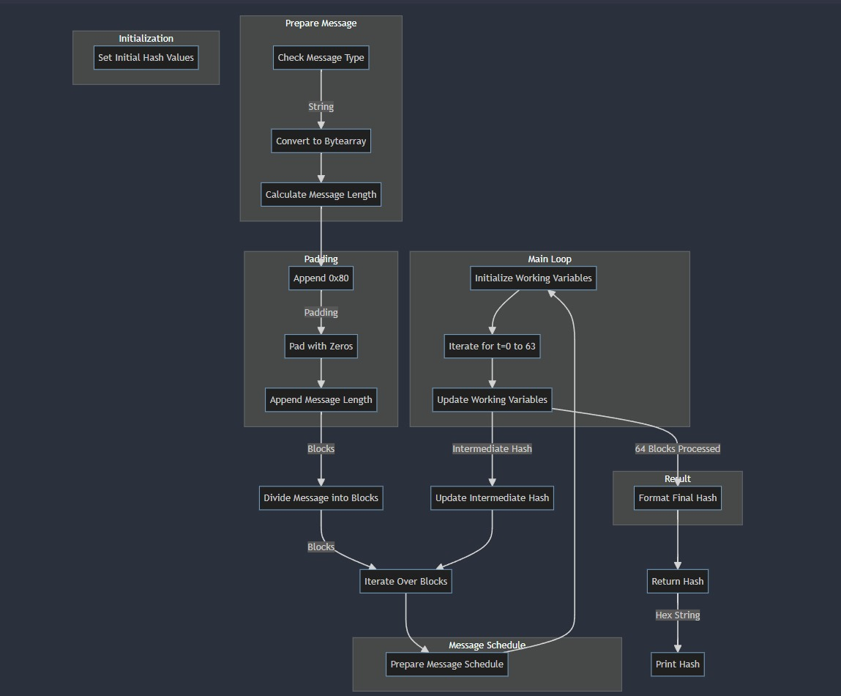
SHA 256:

Slide 9
Explanation:
Prepare Message:
Check the type of the message (e.g., if it's a string).
Convert the message to a bytearray.
Calculate the length of the message.
Padding:
Append the byte 0x80 to the message.
Pad the message with zeros until it reaches the appropriate length.
Append the original message length to the padded message.
Initialization:
Set the initial hash values. In the case of SHA-256, these are specific constant values.
Divide Message into Blocks:
Divide the padded message into blocks, typically 512-bit blocks.
Message Schedule:
Prepare the message schedule, which involves breaking each block into 32-bit words and creating a schedule of 64 words.

Slide 10
Main Loop:
Initialize working variables, such as hash values.
Iterate over 64 rounds (t=0 to 63) within the main loop.
Update working variables based on the message schedule and constants.
Intermediate Hash:
Update the intermediate hash values after processing each block.
Result:
Format the final hash value.
Return the hash value.
Print Hash:
Print the hash value as a hex string.

Slide 11
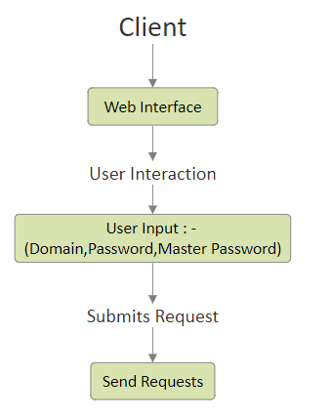
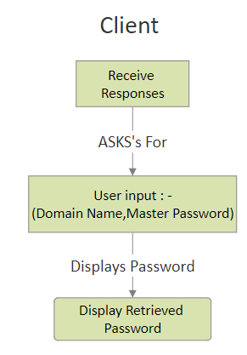
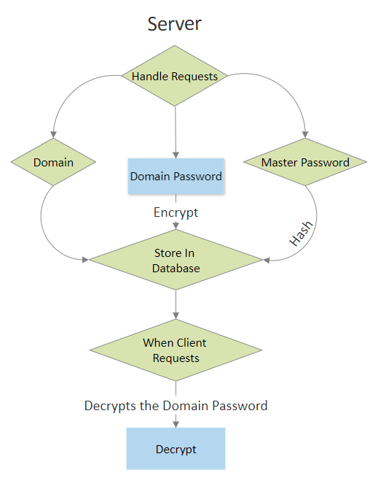
BLOCK DIAGRAM
HTTPS
HTTPS

Slide 12
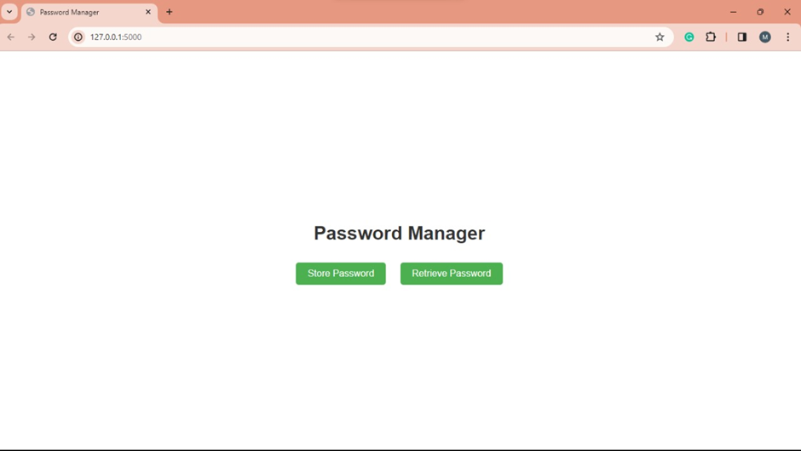
Implementation of a Graphical User Interface :

Slide 13
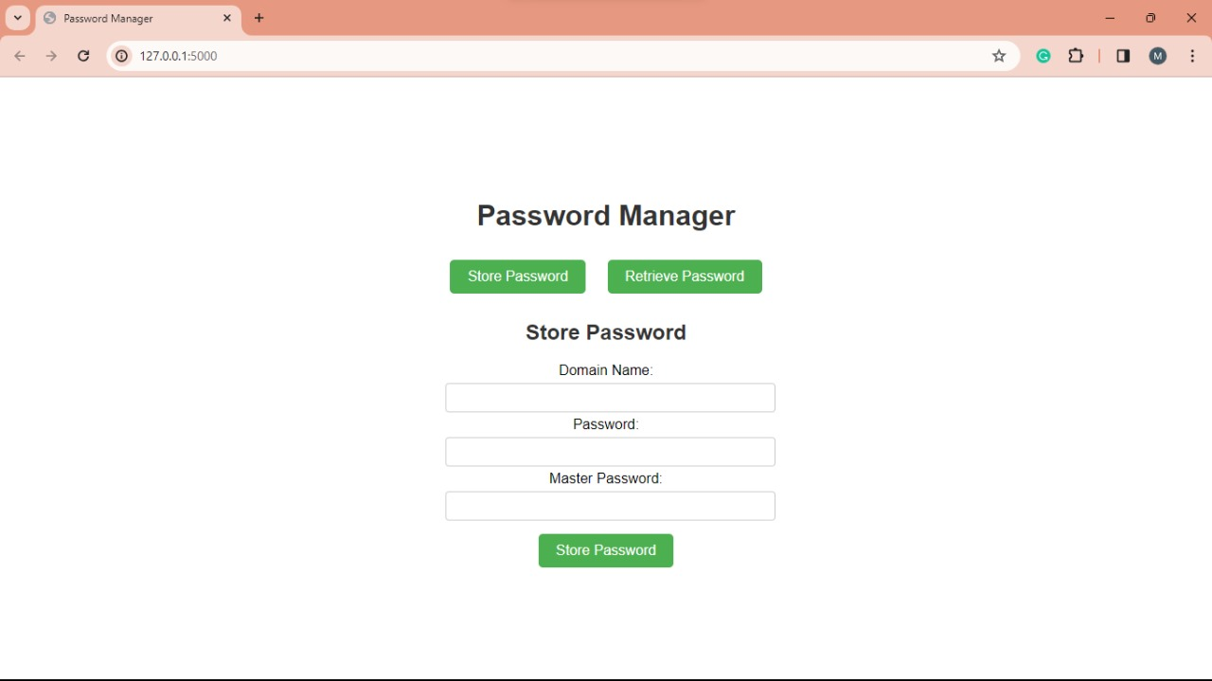
Website Overview :

Slide 14
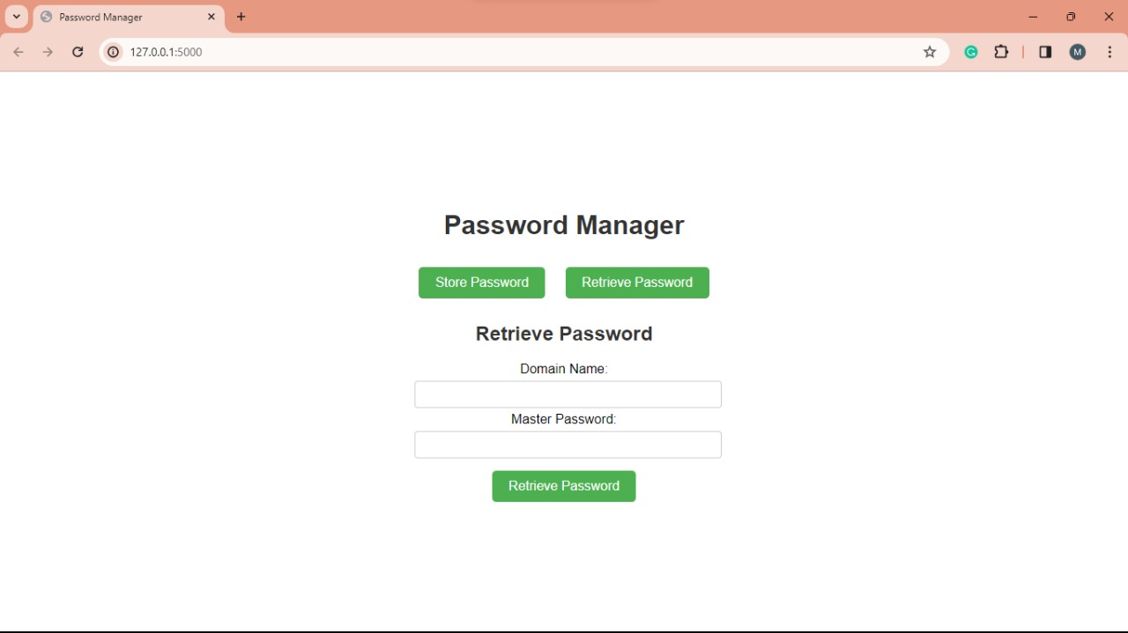
Website :

Slide 15
Conclusion:
The implemented password management system using Flask, SHA-256 hashing, PBKDF2 key derivation, and AES encryption provides a robust and secure solution for storing and retrieving passwords. The web application offers a user-friendly interface while prioritizing data confidentiality and master password protection. The choice of cryptographic algorithms and secure coding practices enhances the overall security posture.

Slide 16
Future Work:
In advancing this password management system, several key areas warrant exploration. First, the integration of biometric authentication can enhance user convenience and security. Additionally, the implementation of a robust intrusion detection system and anomaly detection algorithms will fortify the application against evolving cyber threats. Enhancing scalability through cloud-based storage solutions and exploring blockchain for decentralized security measures are avenues for consideration. To improve user experience, incorporating a comprehensive password strength evaluation mechanism and refining the user interface for mobile responsiveness will be beneficial. Lastly, continuous security audits and adherence to emerging cryptographic standards will ensure the system remains resilient in the face of emerging threats, contributing to a sustainable and secure password management solution.

Slide 17
References:
https://link.springer.com/book/10.1007/978-3-662-04722-4
https://csrc.nist.gov/csrc/media/projects/cryptographic-standards-and-guidelines/documents/aes-development/rijndael-ammended.pdf

Slide 18
CONTRIBUTION:
MARREDDY MOHIT SASANK REDDY | Aes Implementation
YARRAM SRI SATHWIK REDDY | hashing algorithm and client to server
B.HARISH BALAJI | hashing algorithm and client to server
PENTYALA SAI VIJAY KUMAR | Aes Implementation

Slide 19
Thank you

