Slide 1
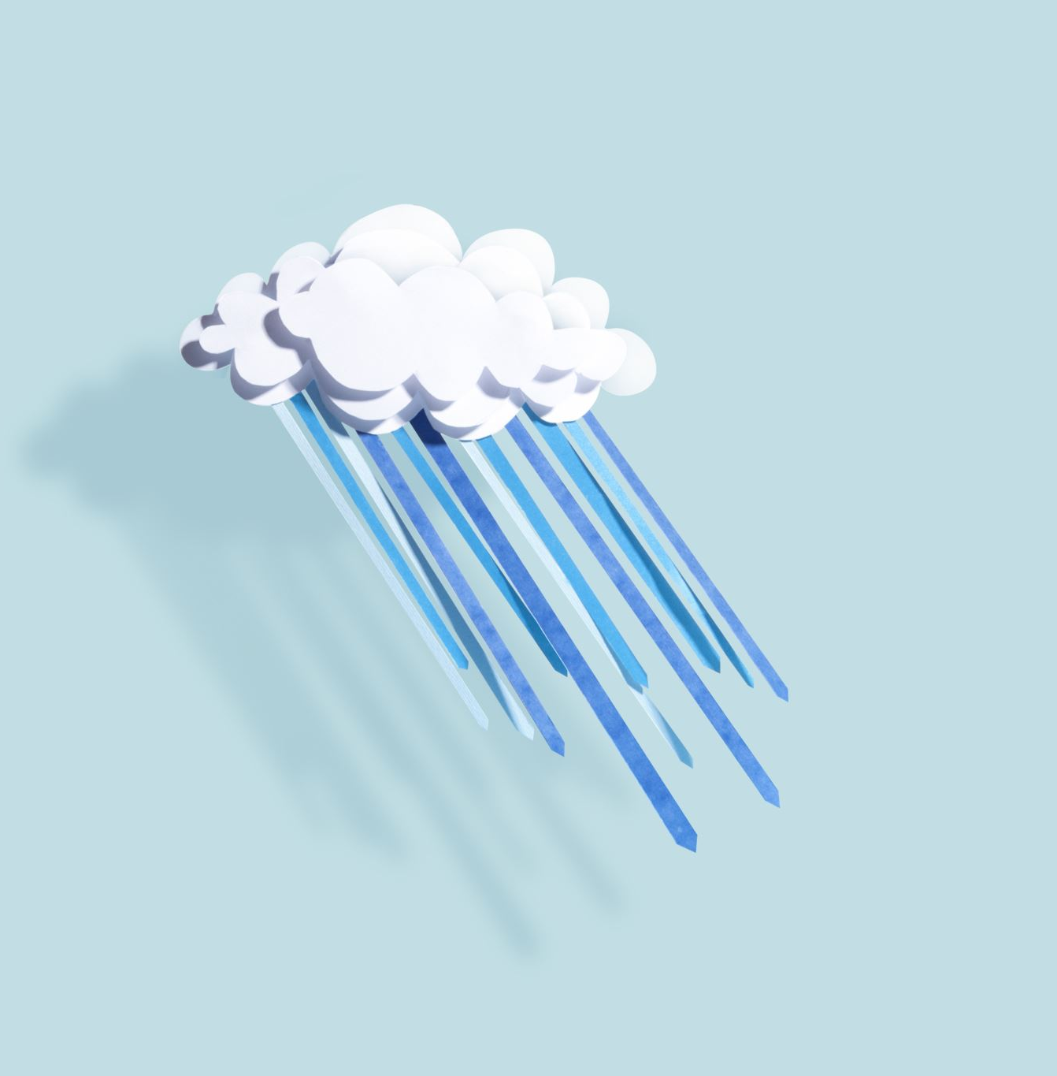
Weather Forecast WebApp

Slide 2
Problem Statement
Developing
Developing a user-friendly Weather Prediction System to forecast weather conditions based on user-input parameters.
Addressing
Addressing the challenge of providing accurate and timely weather predictions to aid decision-making in various sectors.
Creating
Creating a tool that transforms intricate weather data into accessible insights for individuals and businesses.

Slide 3
Tools
Vs Code
Libraries
Numpy
Google Colab
Anaconda
Pandas
Scikit-Learn
Pickle
Matplotlib
Streamlit

Slide 4
Data Collection and Preprocessing
Data Collection
The data I have used to train the model is of New York and it is taken from NOAA.
Data Cleaning
Then using numpy, I removed the null rows and columns And cleaned the data.
Data Visualization
Using Matplotlib and Seaborn to make graphs in order to visualize the patterns in the data

Slide 5
Model Selection
Linear Regression: Initially, I utilized linear regression to predict weather patterns. However, due to the presence of multicollinearity in the data, this approach resulted in substantial errors in prediction.
Random Forest Regressor: To address these issues, I shifted to the more sophisticated Random Forest Regressor. Despite its complexity, this model also encountered challenges and yielded significant prediction errors.
Ridge Regression: Recognizing the need to handle multicollinearity effectively, I turned to Ridge Regression. This technique allowed me to manage the intercorrelation among variables, leading to improved prediction accuracy.

Slide 6
Model Training and Evaluation
Model Selection: To address multicollinearity and enhance prediction accuracy, the Ridge Regression model was chosen as a suitable option.
Data Splitting: The dataset was divided using the train_test_split module from scikit-learn. This division was set to a 4:1 ratio, allocating 80% for training and 20% for testing.
Training the Model: The Ridge Regression model was trained using the training dataset. The model.fit() method facilitated the optimization of model parameters for improved performance.
Prediction: With a trained model, predictions were made using the model.predict() method. This allowed for generating forecasts based on the provided input data.
Using Pickle to save the model and dump it into sav file.
User Interface: Using streamlit for user interface of the webapp. Loading the dumped model and asking user to give the related parameters to predict the weather

Slide 7
Achievements
Precision in Forecasting
Intuitive User Experience
Model Adaptability

