Slide 1
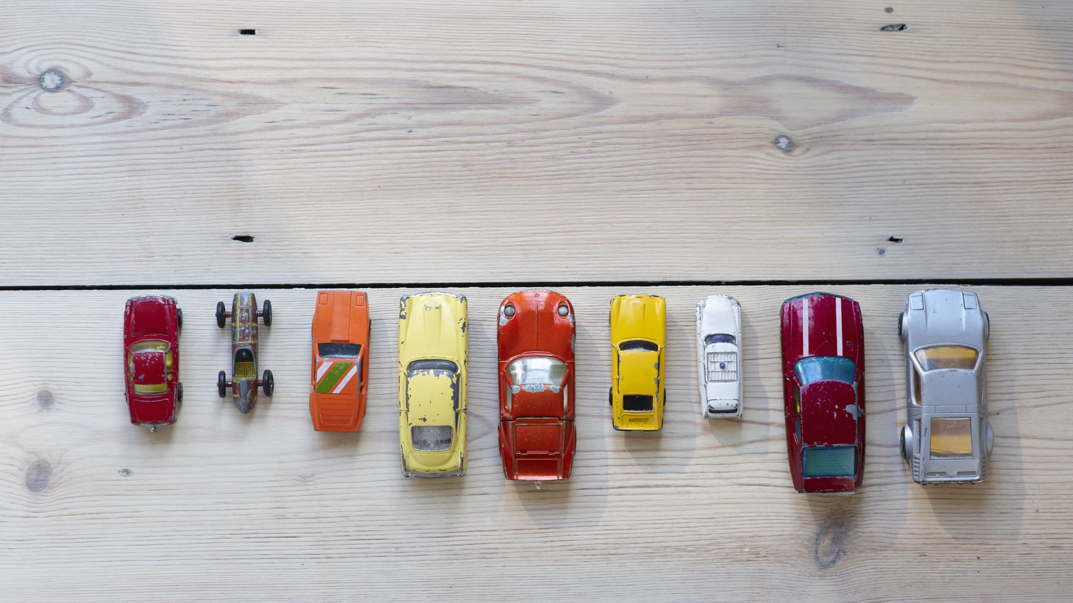
Classification

Slide 2
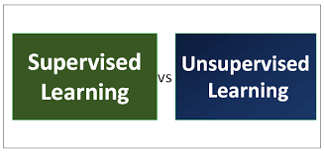
In Supervised learning, you train the machine using data which is well "labeled." It means some data is already tagged with the correct answer.
Unsupervised learning is a machine learning technique, where you do not need to supervise the model. Instead, you need to allow the model to work on its own to discover information. It mainly deals with the unlabelled data.

Slide 3
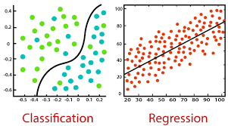

Slide 4
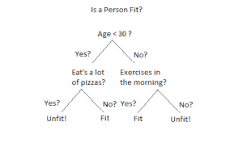

Slide 5
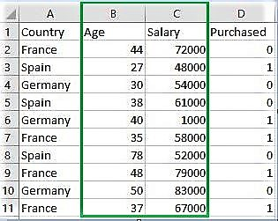
Feature Scaling
Feature Scaling is a technique to standardize the independent features present in the data in a fixed range. It is performed during the data pre-processing to handle highly varying magnitudes or values or units. If feature scaling is not done, then a machine learning algorithm tends to weigh greater values, higher and consider smaller values as the lower values, regardless of the unit of the values.

Slide 6
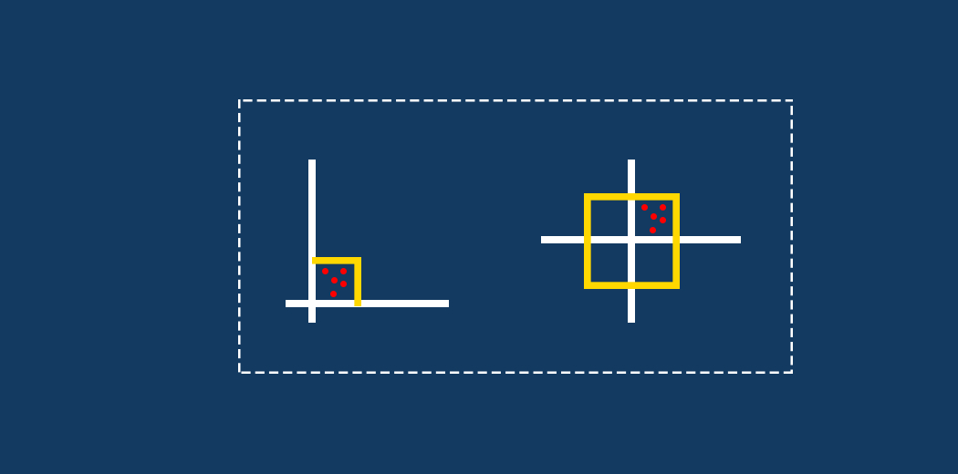
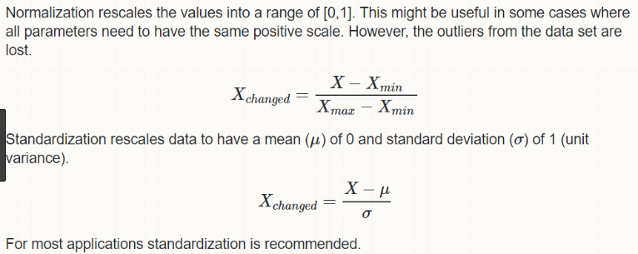

Slide 7
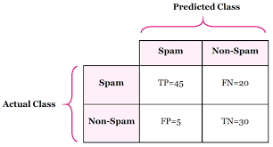
Confusion Matrix

