Slide 1
Clustering

Slide 2
INDEX
What is clustering?
Why do we need clustering?
How do we measure similarity?
K-Means Algorithm and Properties
Hierarchical Clustering and properties
Demo

Slide 3
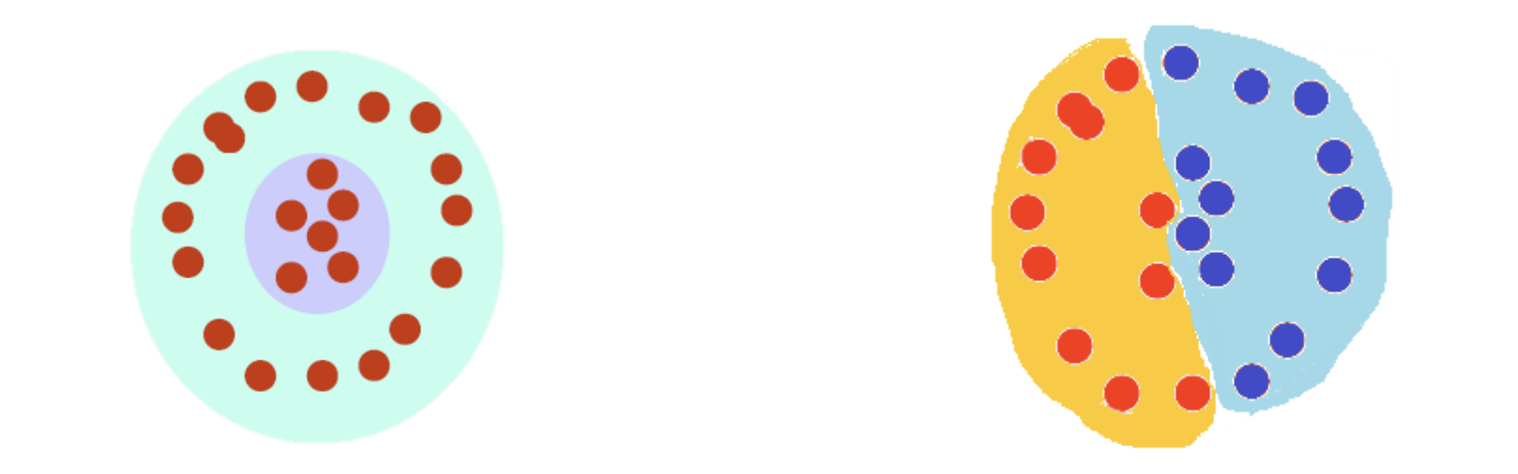
What is Clustering?
The organization of unlabeled data into similarity groups called clusters.
A cluster is a collection of data items which are “similar” between them, and “dissimilar” to data items in other clusters.

Slide 4
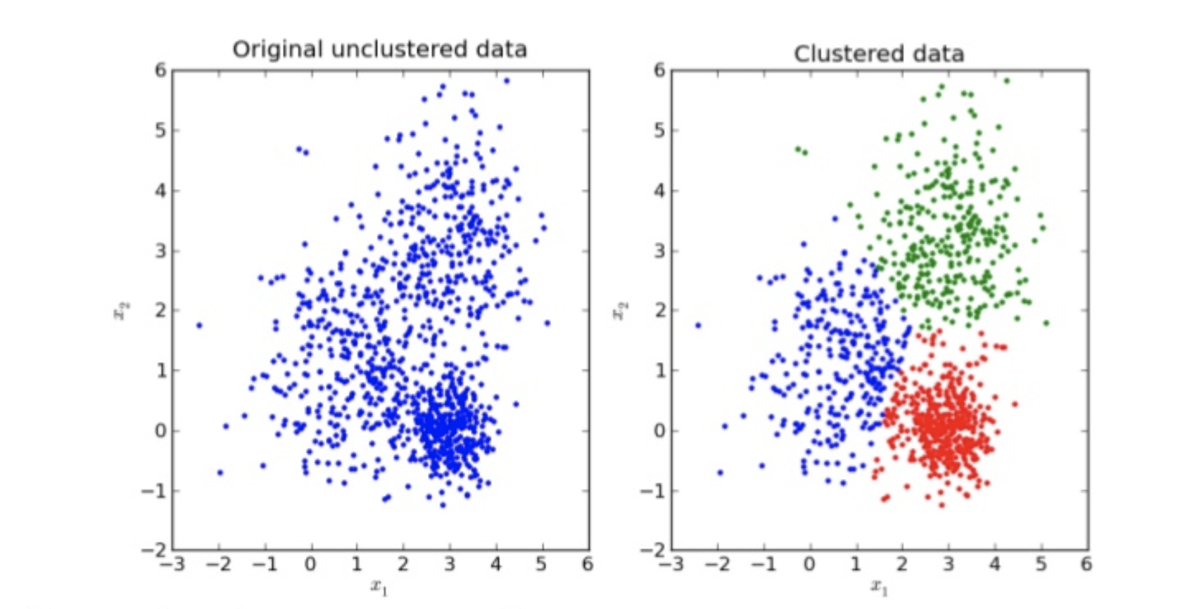
Showing The results of Clustering

Slide 5
Why do we need clustering?
Marketing :- Finding group of customers with similar behavior given a large data-base of customers. Data containing their properties and past buying records (conceptual Clustering).
Biology :- Classification of Plants and Animals Based on the properties under observation (conceptual Clustering).
Insurance :- Identifying groups of motor insurance policy holders with a high average claim cost (conceptual Clustering).
City-Planning :- Groups of houses according to their house type, value and geographical location it can be both (conceptual Clustering and Distance Based Clustering

Slide 6
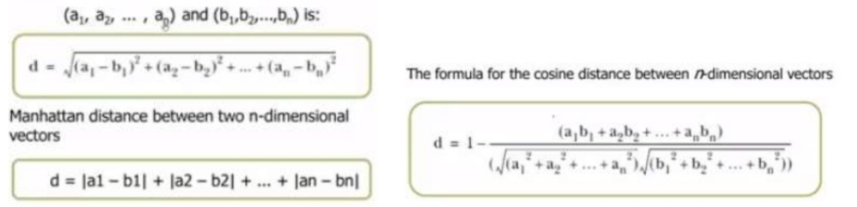
How do we measure the similarity?
We usually use Euclidian, Manhattan or Cosine Distance

Slide 7
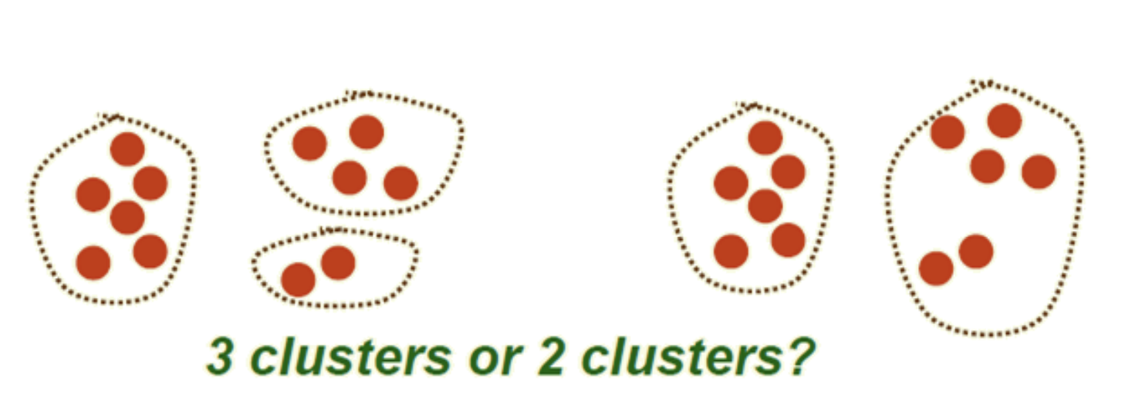
How do we decide the number of clusters?
There are two solutions based on the algorithm we select:
K-Means( Elbow Method )
Hierarchal Clustering( Dendogram Method )

Slide 8
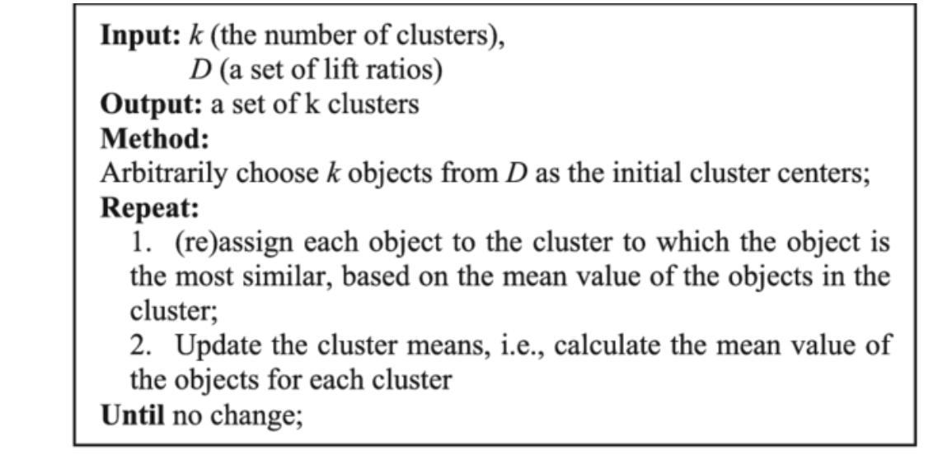
K-Means Algorithm

Slide 9
Animation Of K-Means Algorithm Working

Slide 10
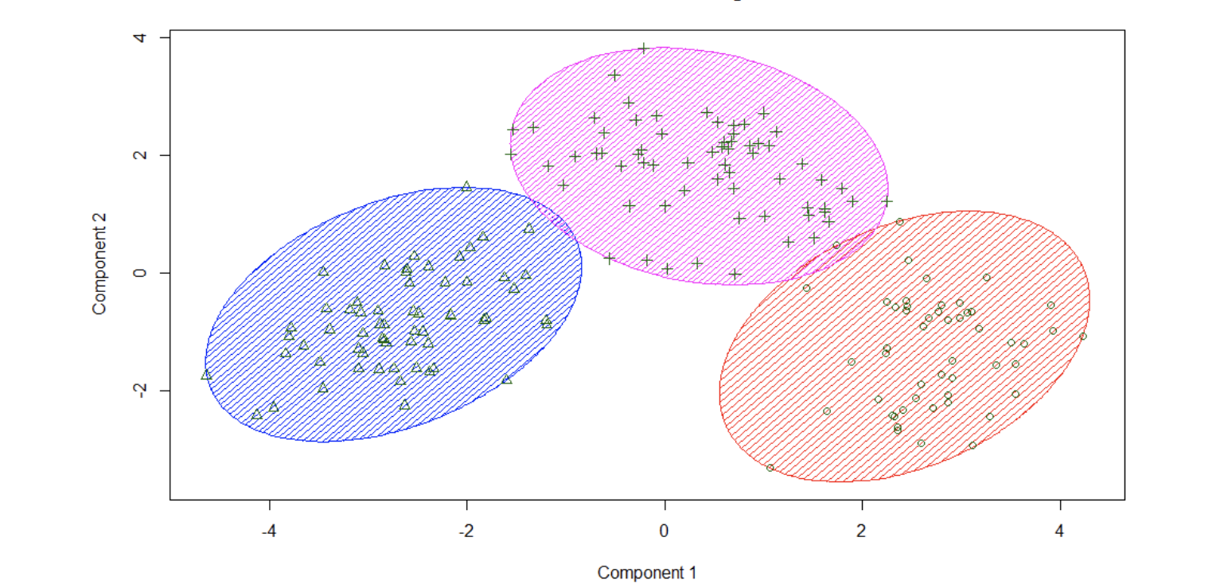
K-Means
The main objective is to minimise the euclidian distance
We find centroid using distance formula to find points closest to the centroid.
We find optimal no. of cluster using elbow method.
We use kmeans++ for initialisation to avoid traps.

Slide 11
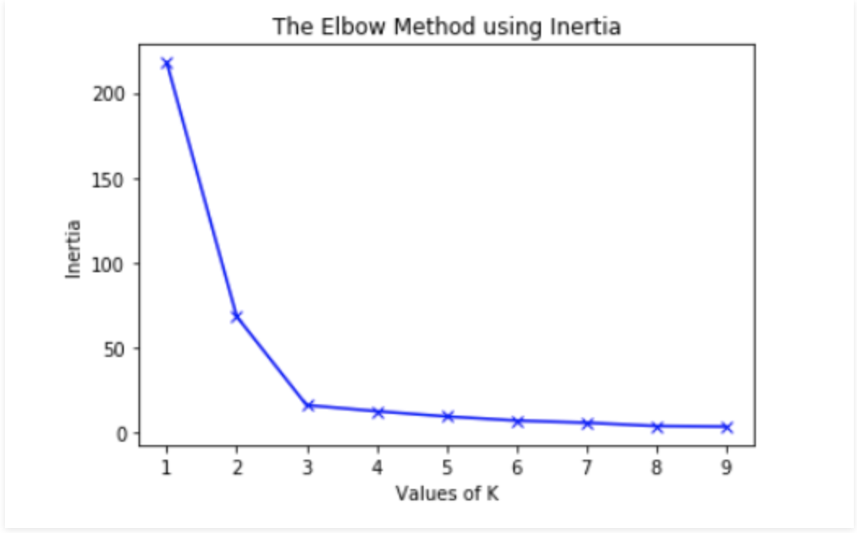
Elbow Method
To determine the optimal number of clusters, we have to select the value of k at the “elbow” ie the point after which the distortion/inertia start decreasing in a linear fashion.

Slide 12
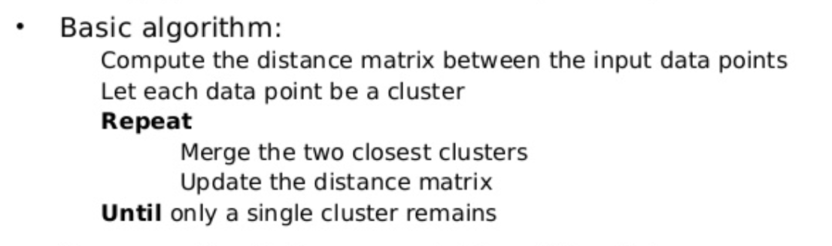
Hierarchical Clustering Algorithm

Slide 13
Animation Of Hierarchical Clustering Algorithm Working

Slide 14
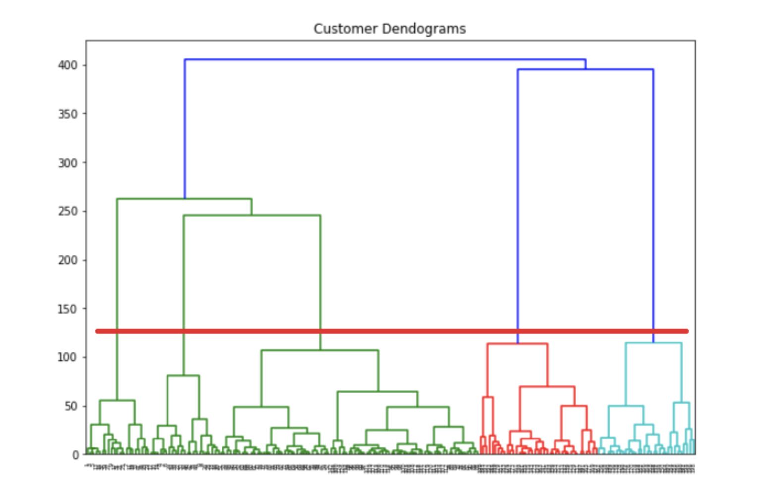
Hierarchical Clustering
We use dendrograms we identify the number of clusters.
Hierarchical clustering starts by treating each observation as a separate cluster.
Then, it repeatedly executes the following two steps:
(1) identify the two clusters that are closest together
(2) merge the two most similar clusters. This iterative process continues until all the clusters are merged together.

Slide 15
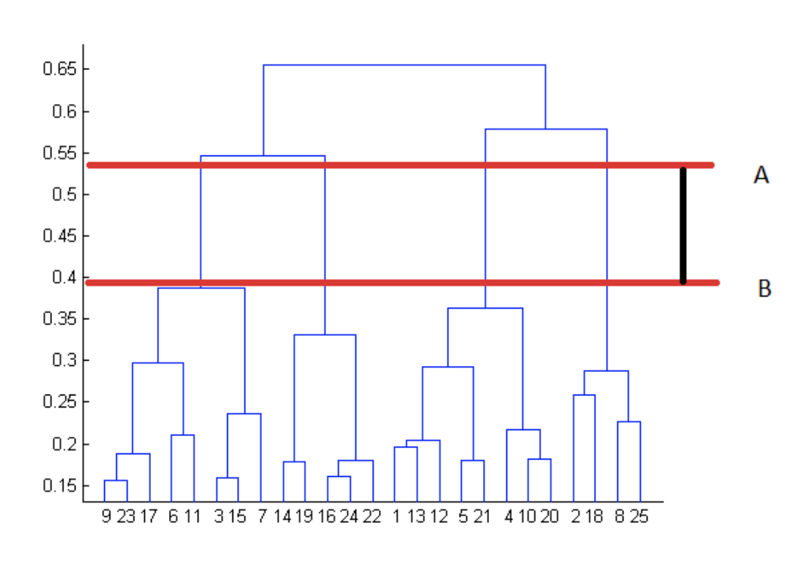
Deciding Number Of Clusters
Determine the largest vertical distance that doesn’t intersect any of the other clusters
Draw a horizontal line at both extremities
The optimal number of clusters is equal to the number of vertical lines going through the horizontal line

Slide 16
DEMO

Slide 17
THANK YOU

