Slide 1
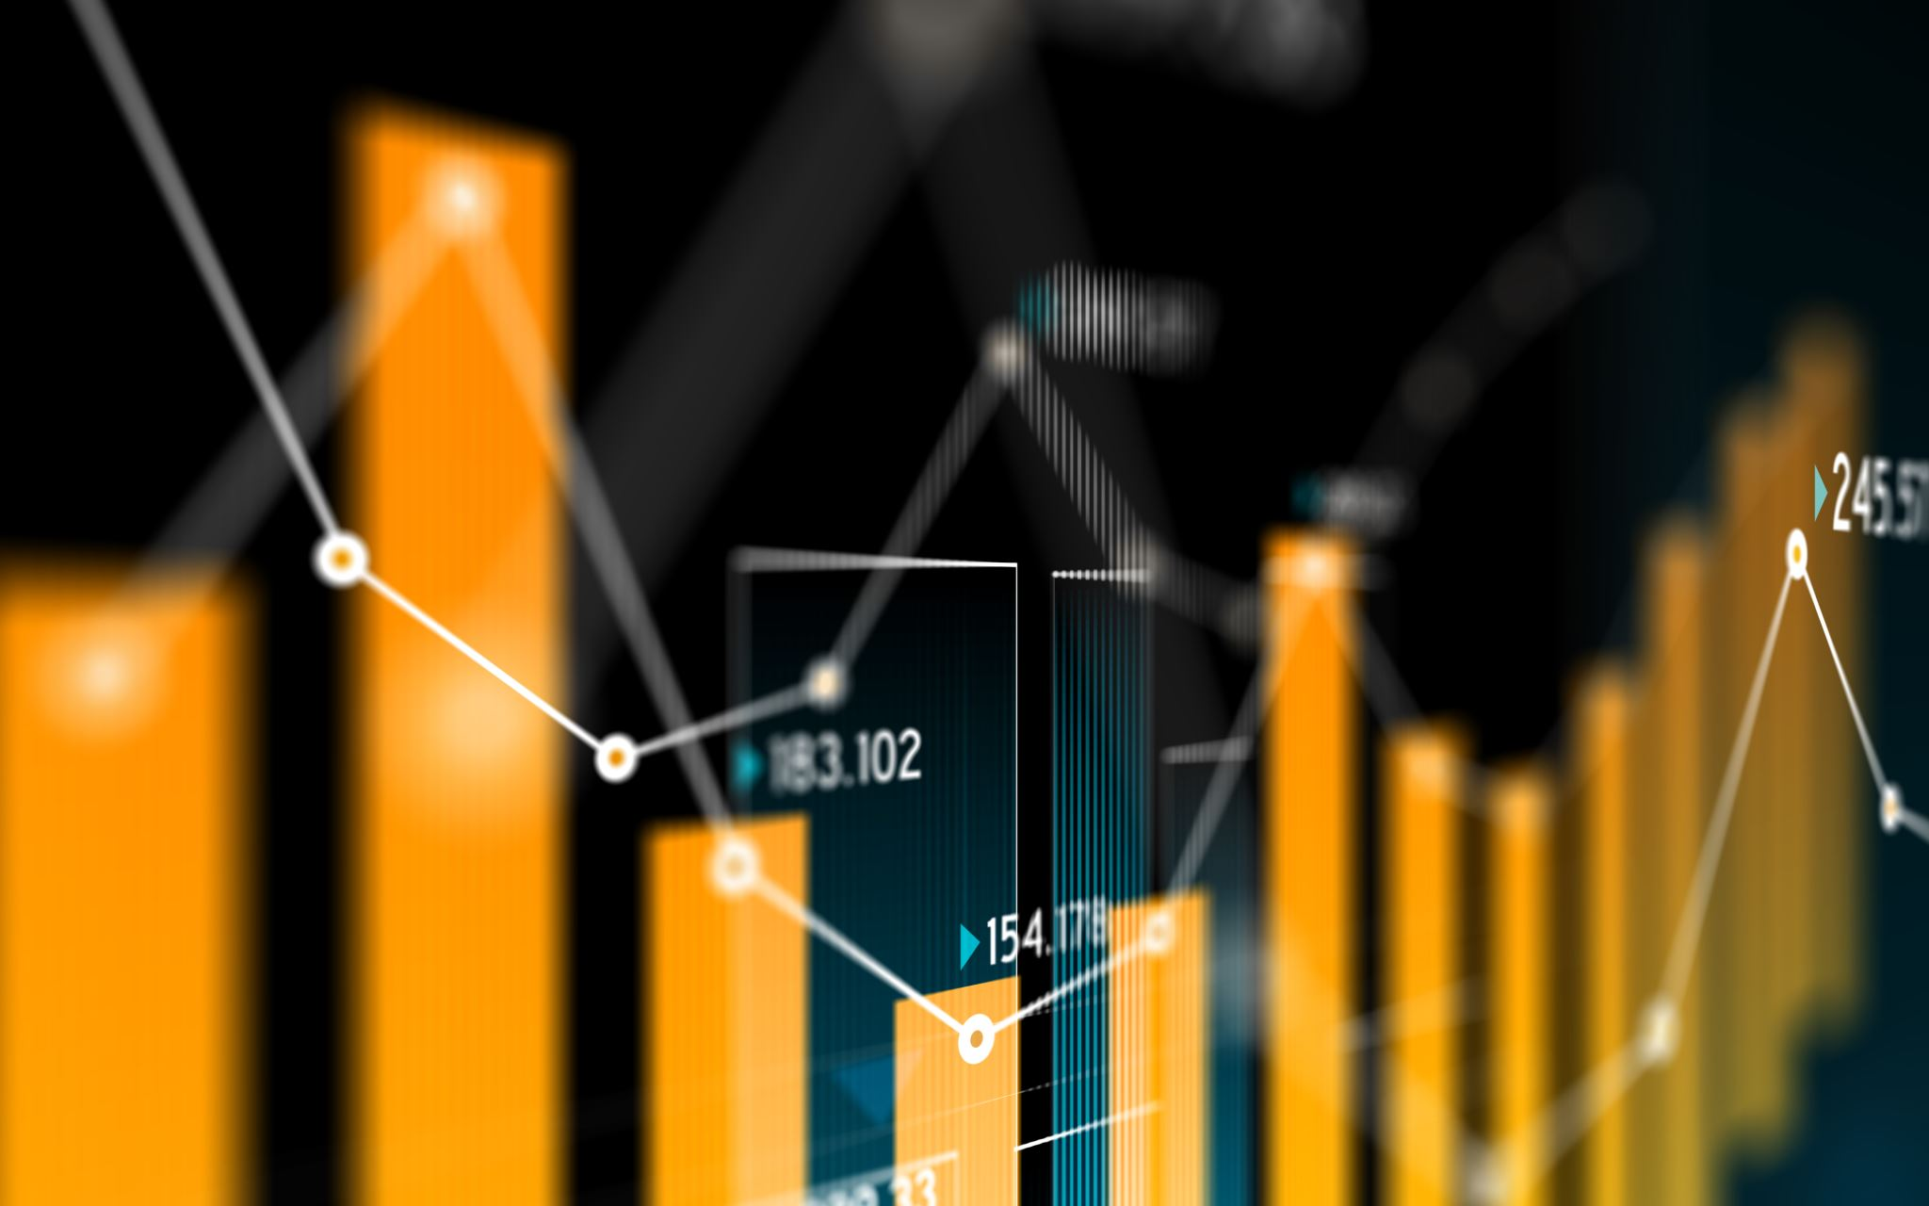
REGRESSION?

Slide 2
Regression is a statistical method that attempts to determine the strength and character of the relationship between one dependent variable (usually denoted by Y) and a series of other variables (known as independent variables X).It is used in finance, investing, and other disciplines
Linear regression is a linear approach to modeling the relationship between Y and X
For more independent variables we call it as multiple linear regression

Slide 3
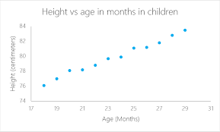

Slide 4
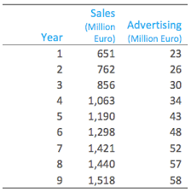

Slide 5
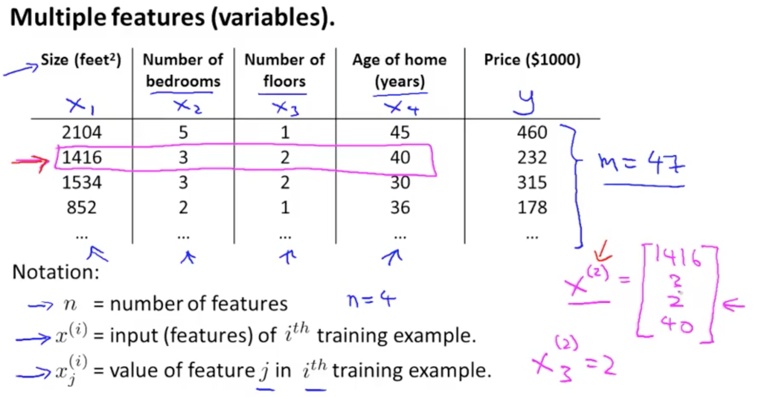

Slide 6
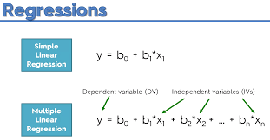

Slide 7
Correlation
Correlation is a statistical technique that can show whether and how strongly pairs of variables are related. For example, height and weight are related; taller people tend to be heavier than shorter people
It ranges from -1.0 to +1.0. The closer r is to +1 or -1, the more closely the two variables are related.

Slide 8
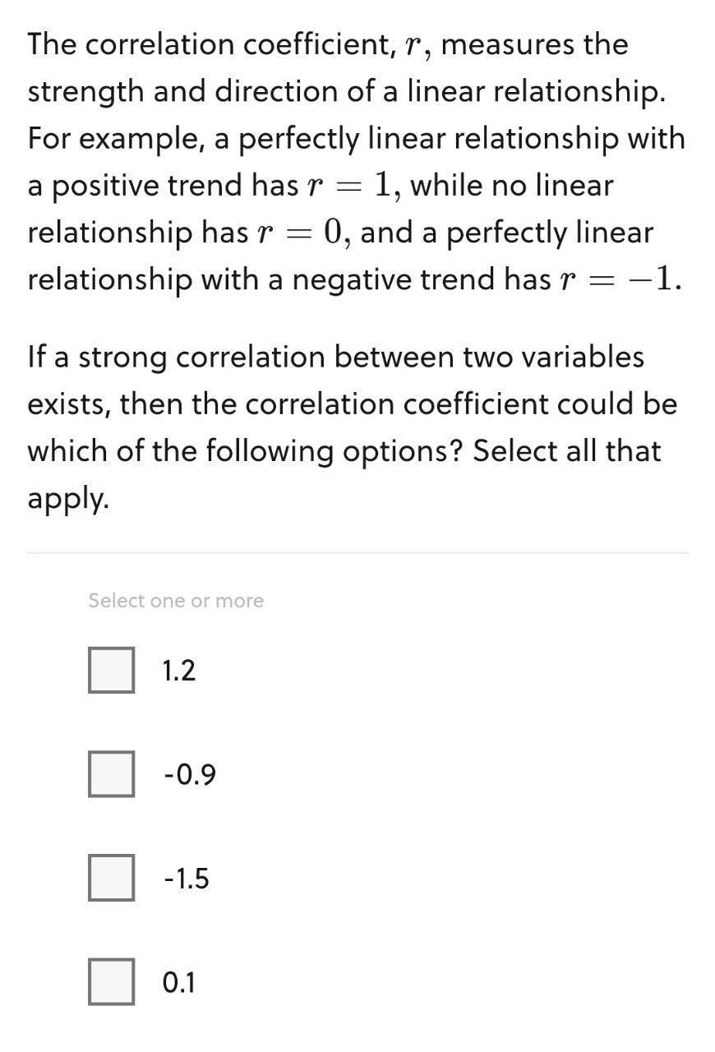

Slide 9
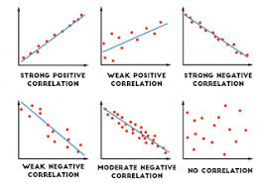

Slide 10
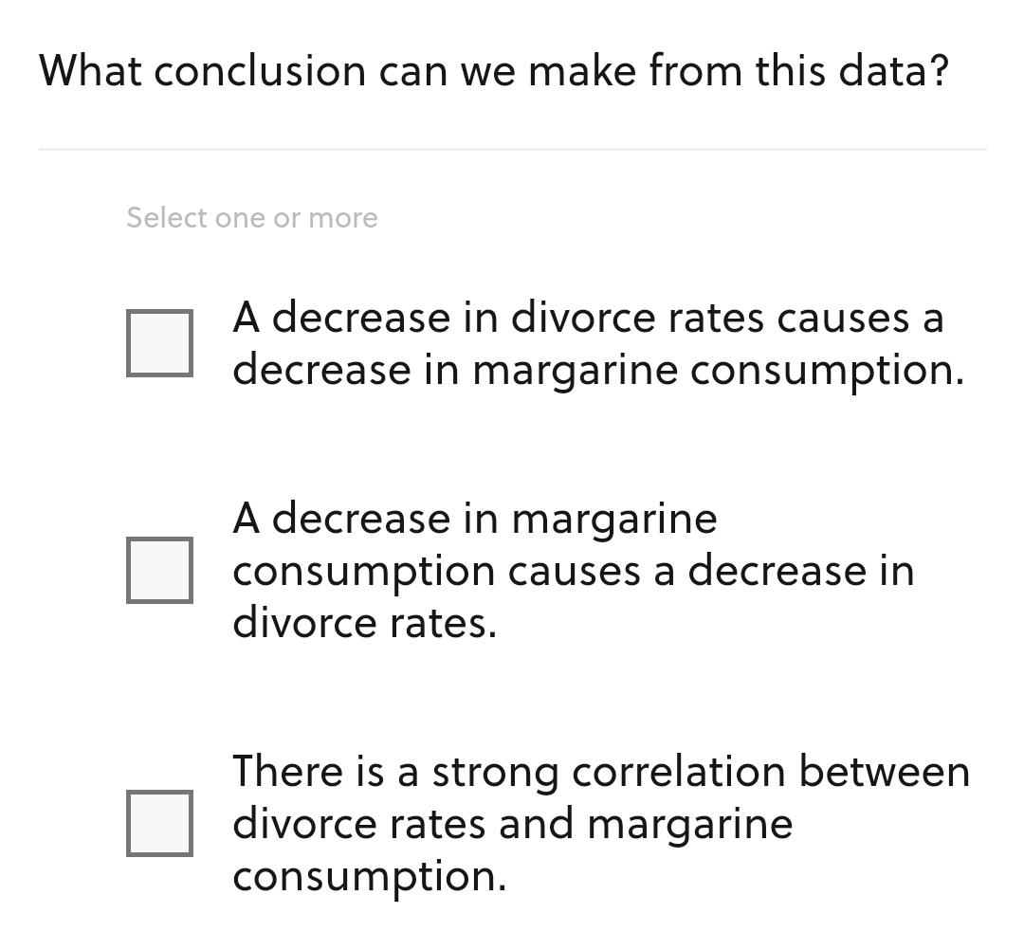
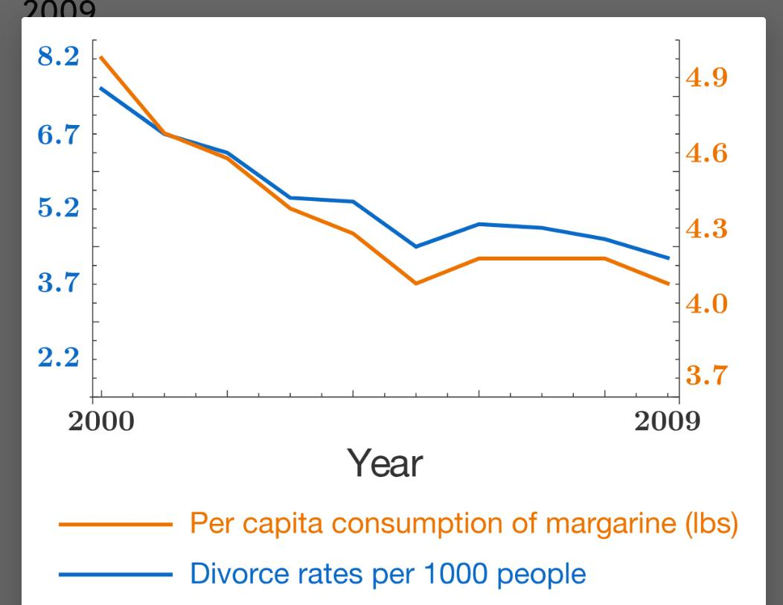

Slide 11
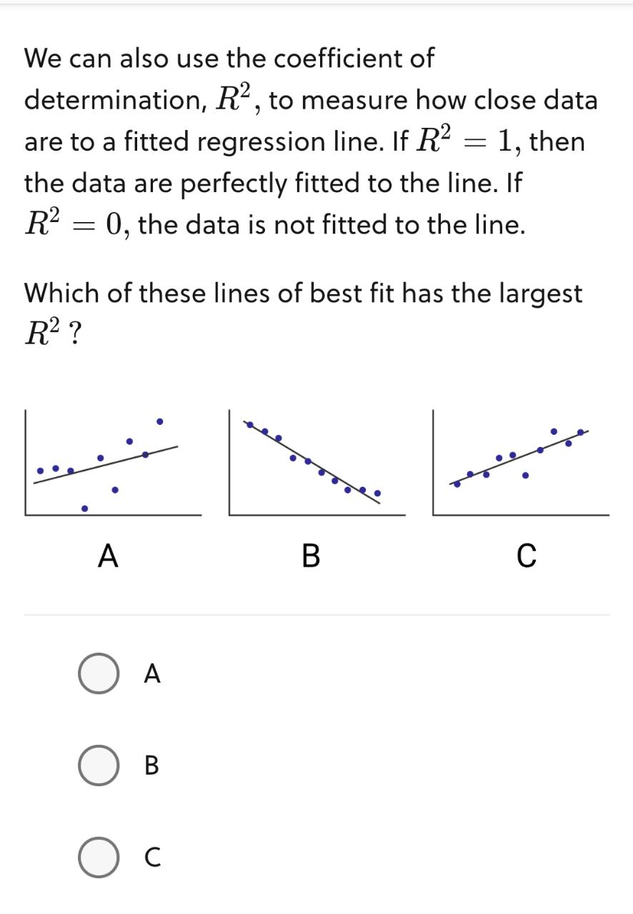

Slide 12
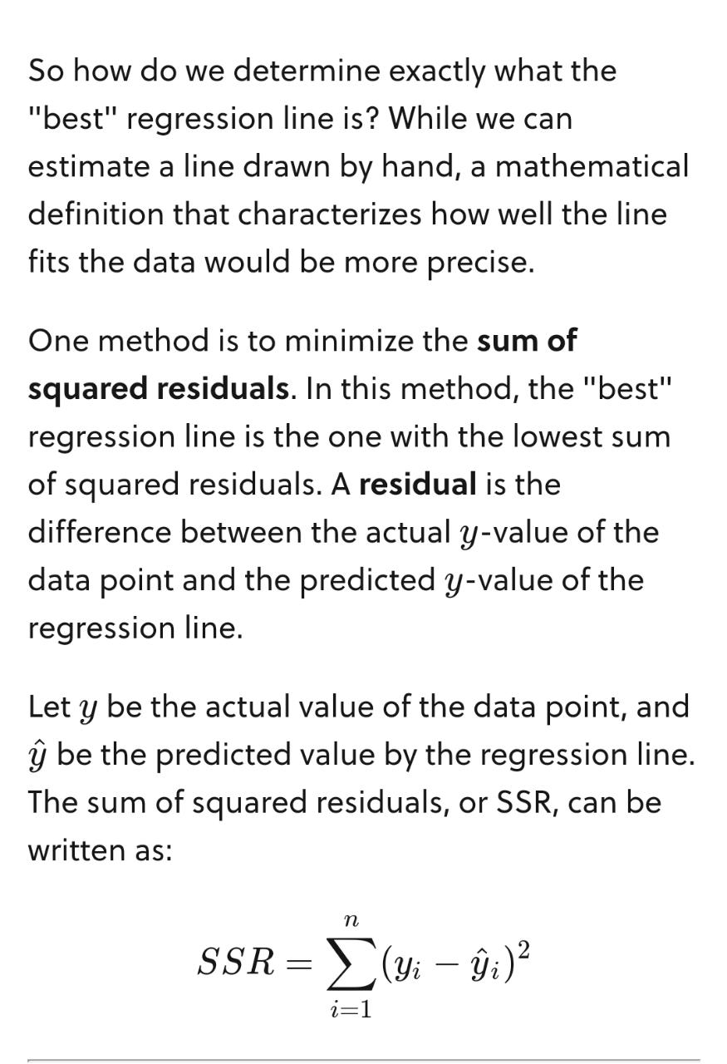

Slide 13
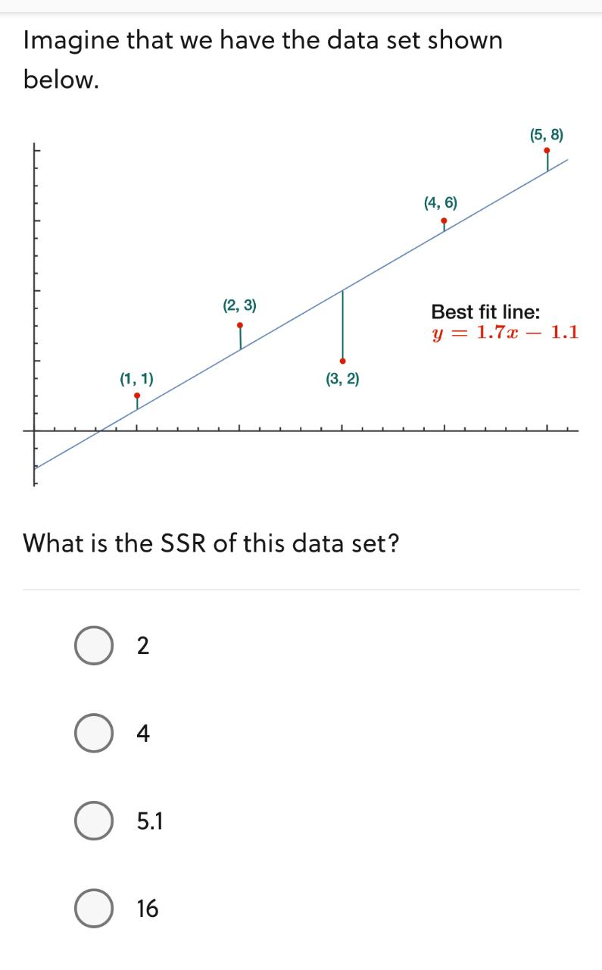

Slide 14
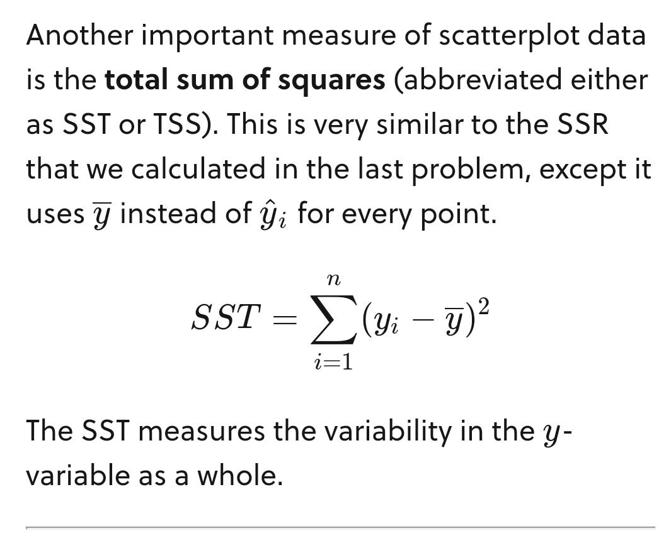

Slide 15
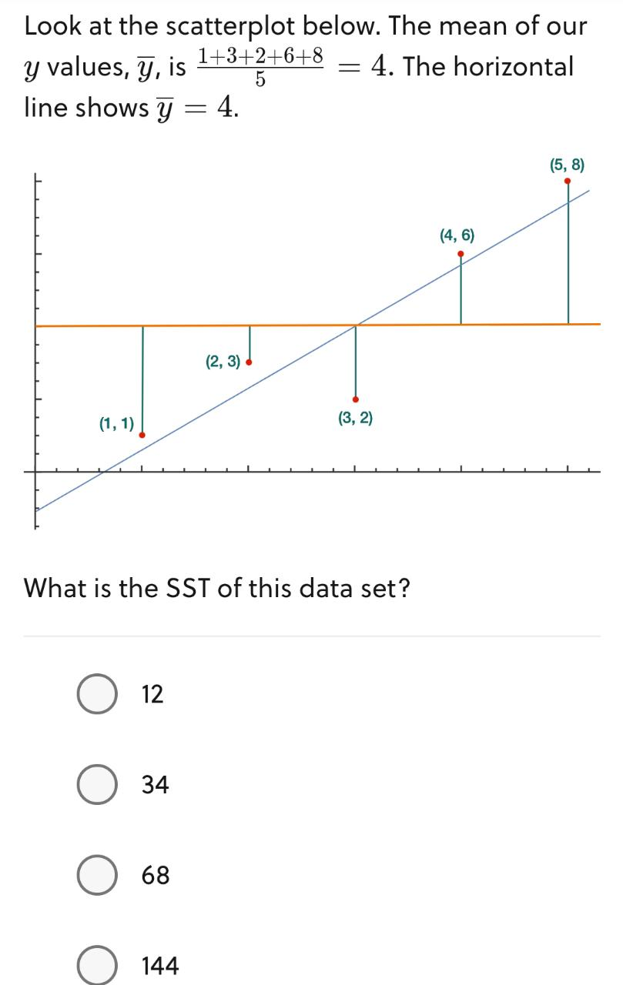

Slide 16
