Slide 1
STATISTICS FUNDAMENTALS

Slide 2

STATISTICS?
Statistics is a tool for quantifying information. It can help us better understand randomness and uncertainty in the world
It starts from data and then asks what was used to generate it.
By learning building blocks of statistics –mean, median, mode, variance, standard deviation will help us analyze graphs, determine statistical significance, making decisions

Slide 3
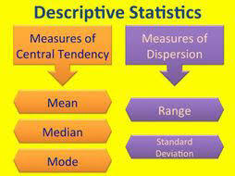

Slide 4
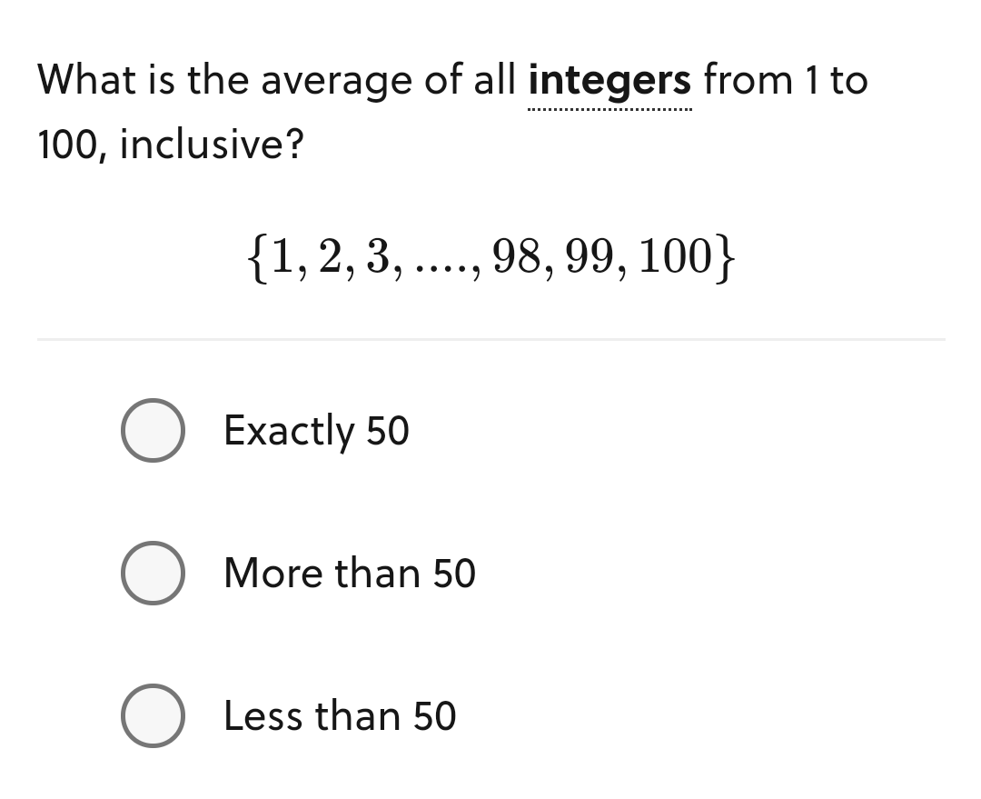
MEAN = sum of values in the set number of items in set

Slide 5
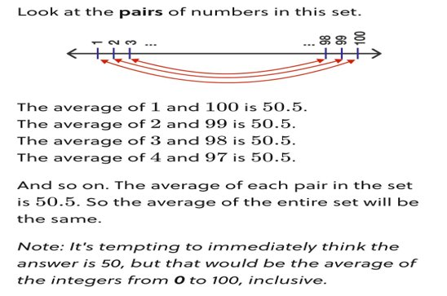

Slide 6
Find the mean in this Dataset?
{4, 4, 5, 5, 5, 5, 5, 6, 6 ,6, 7, 7,300}

Slide 7
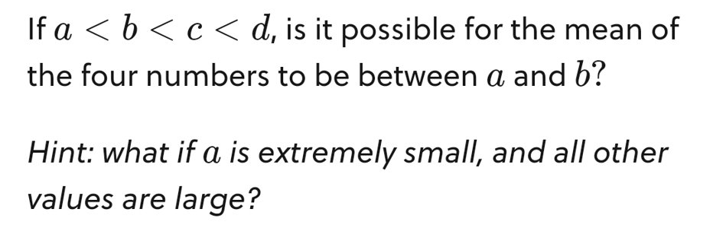

Slide 8
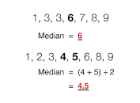
The Median is the value that splits a set in half when it is ordered from least to greatest; that is, the "middle number" in set of values

Slide 9
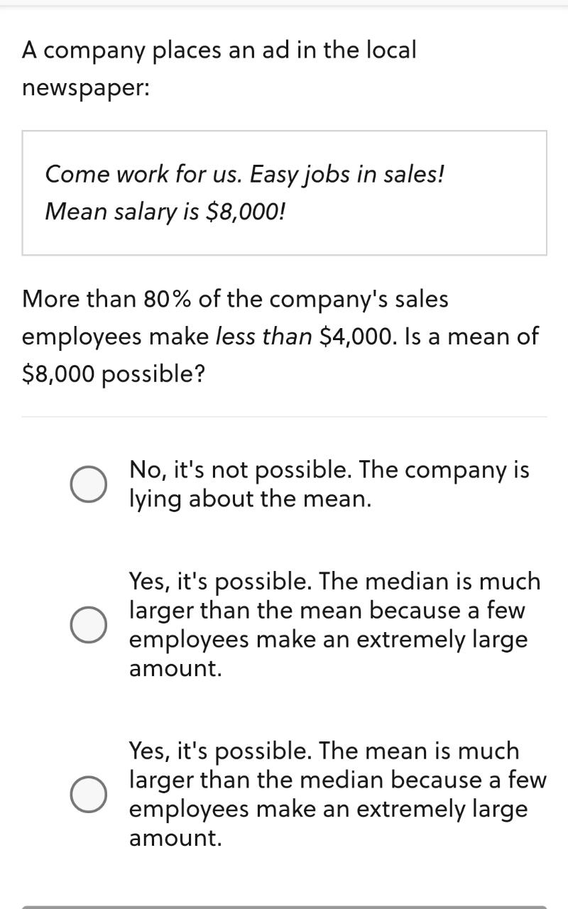
Hint : Mean depends more on outliers

Slide 10
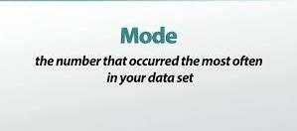
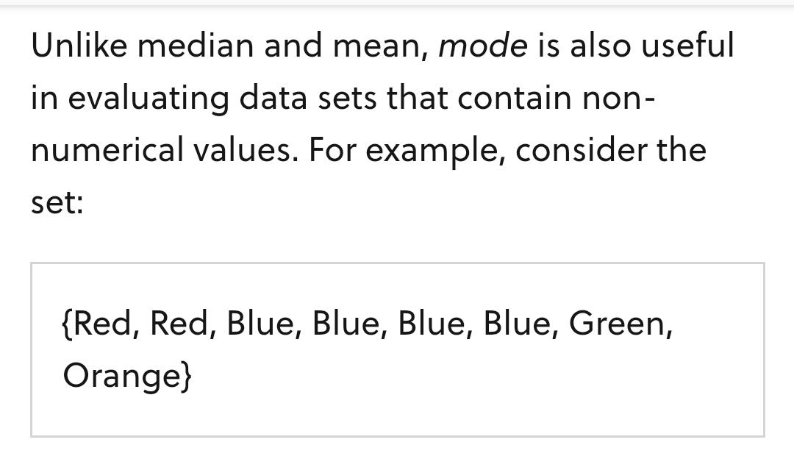

Slide 11
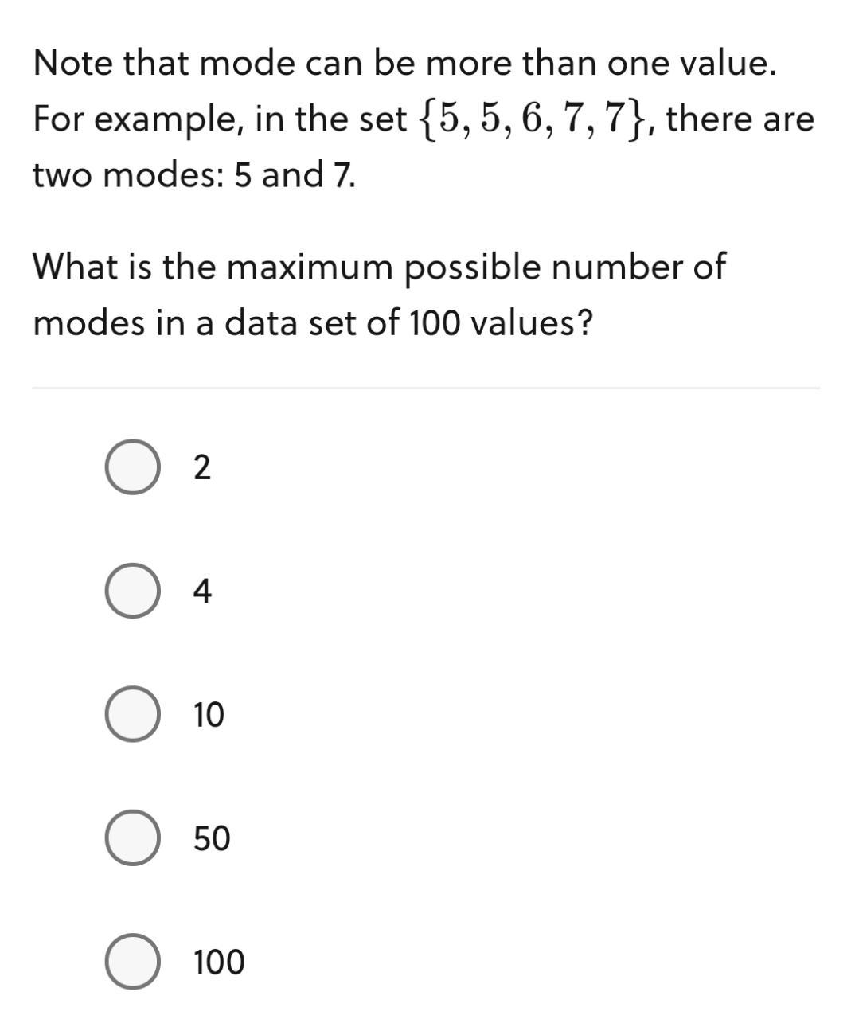

Slide 12
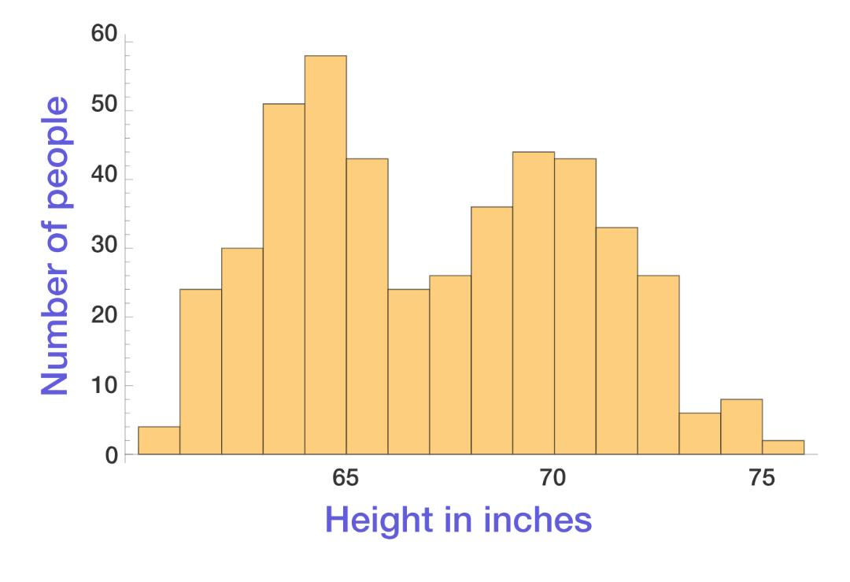
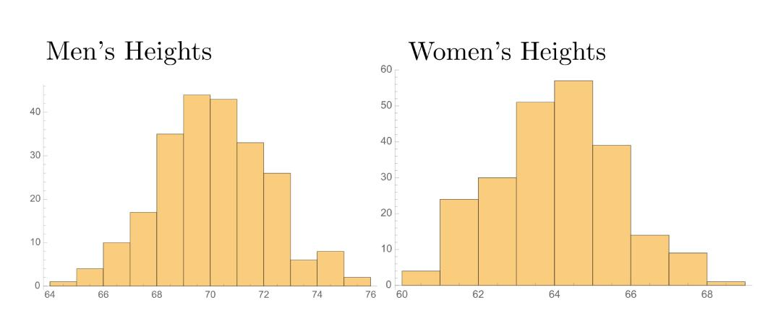

Slide 13
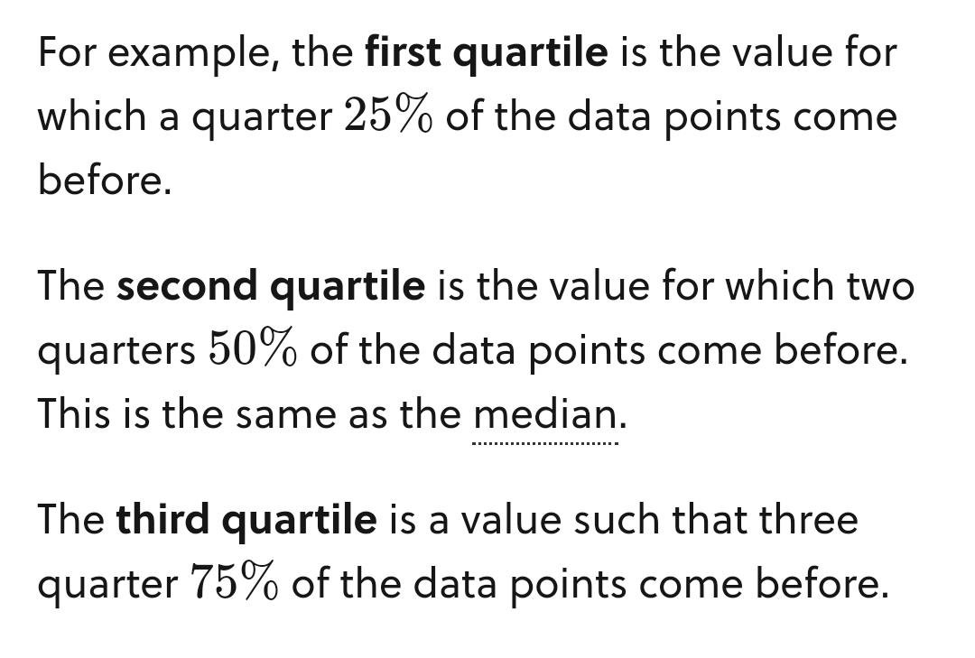
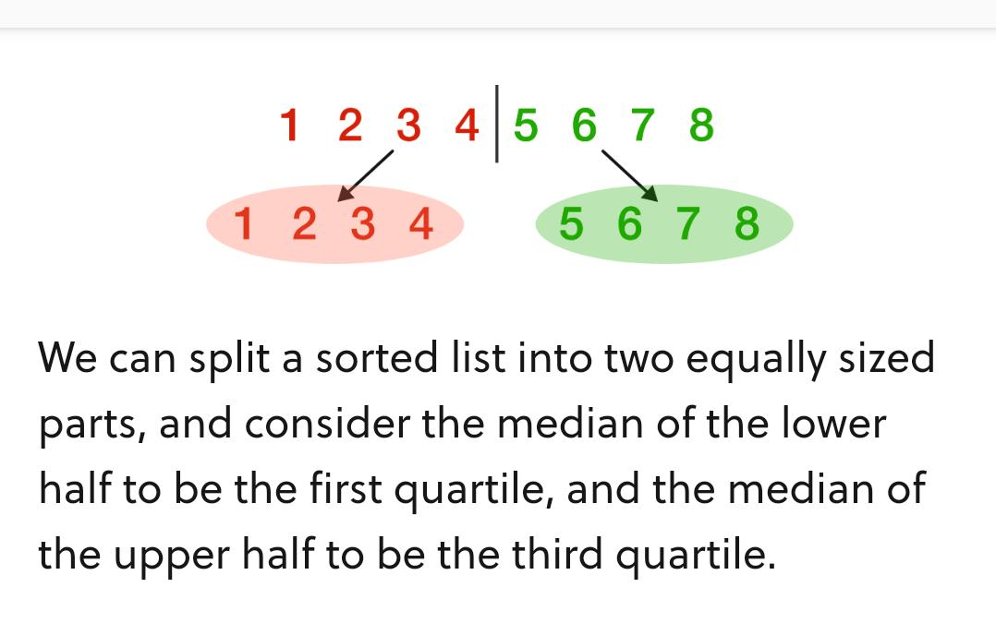
Quantiles?

Slide 14
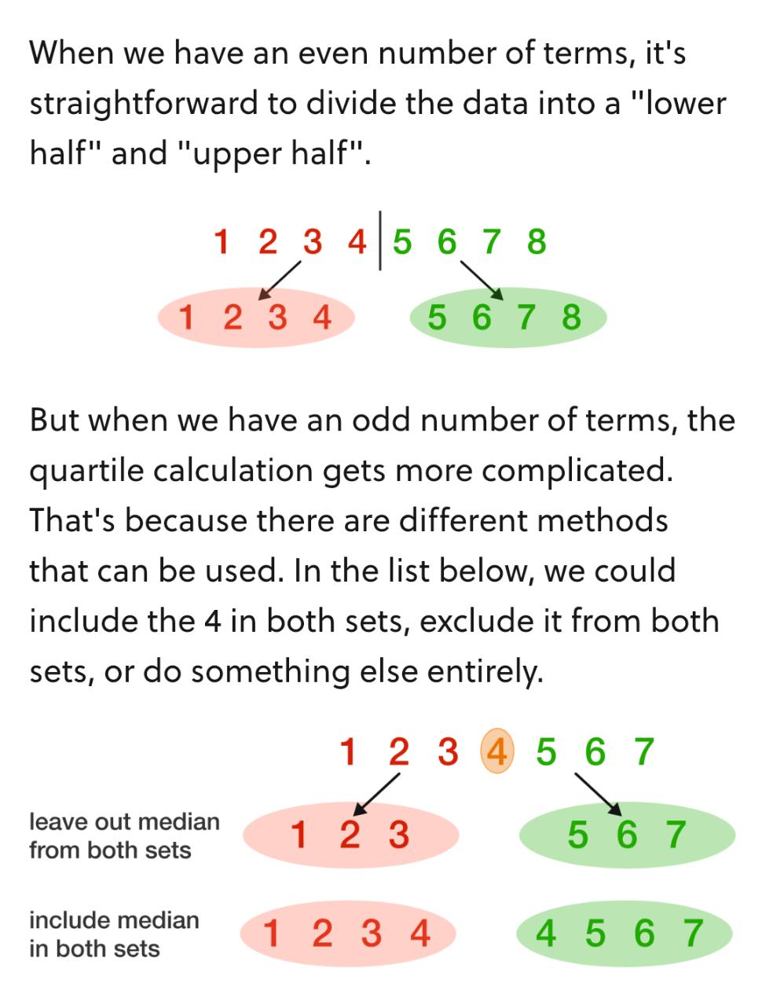
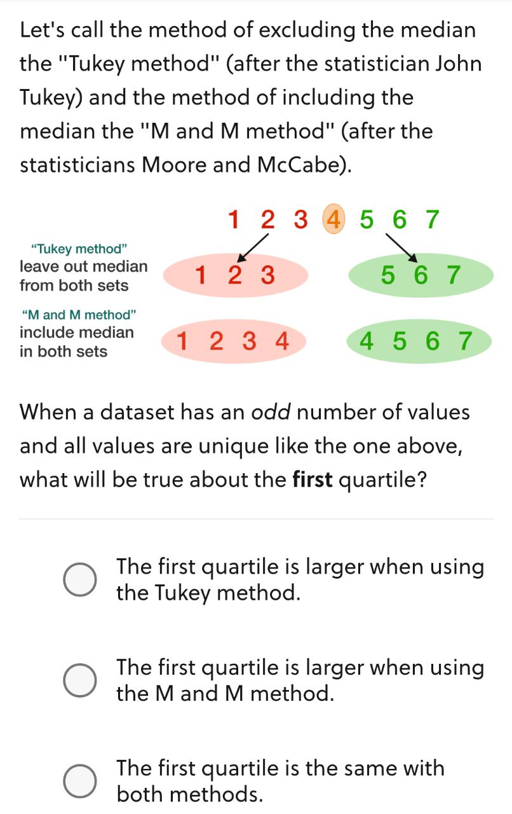

Slide 15
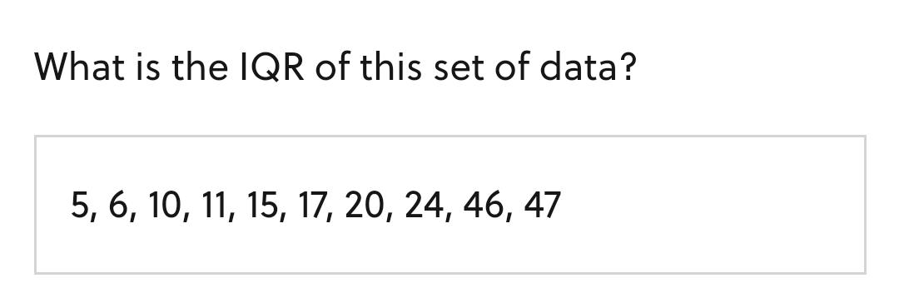
One number often used in statistics is the interquartile range, or IQR. It's the difference between the first quartile(25%) and third quartile(75%)

Slide 16
Find the outlier in this Dataset?
{4, 4, 5, 5, 5, 5, 5, 6, 6 ,6, 7, 7,300}

Slide 17
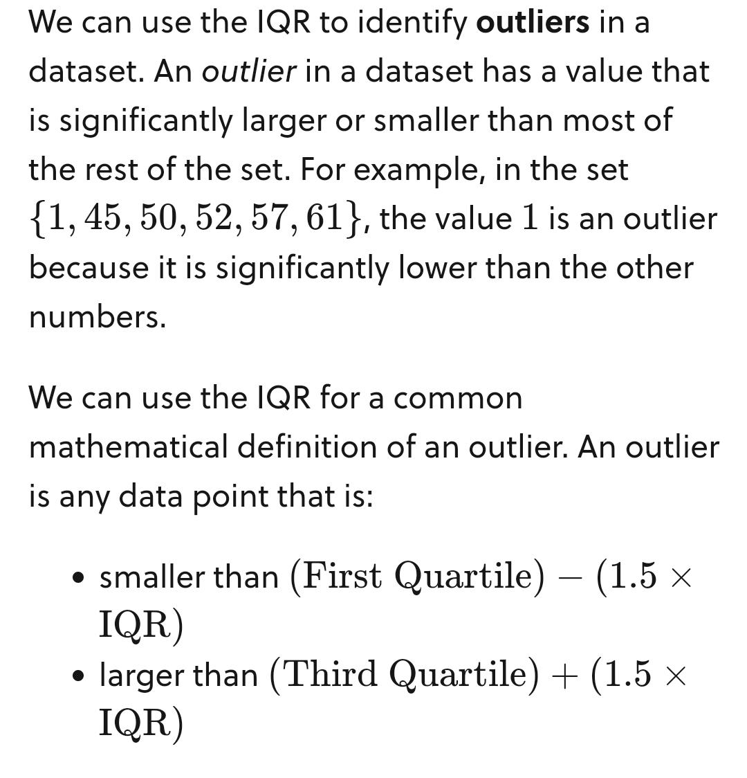
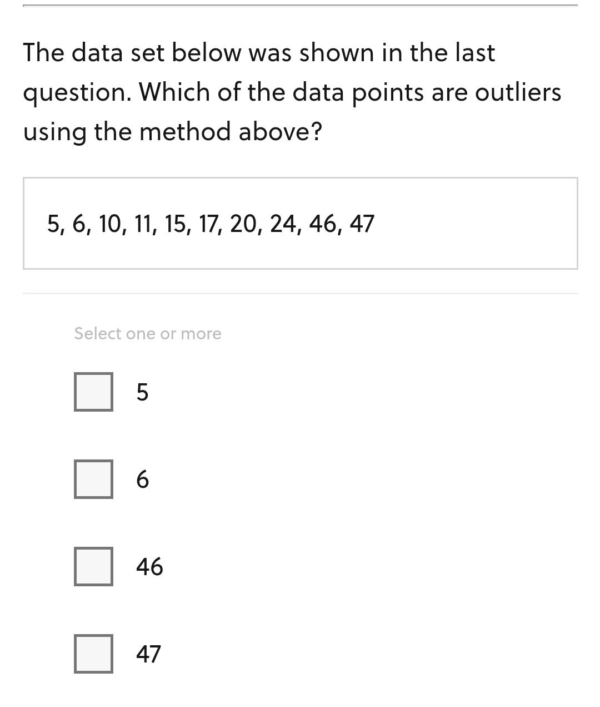

Slide 18
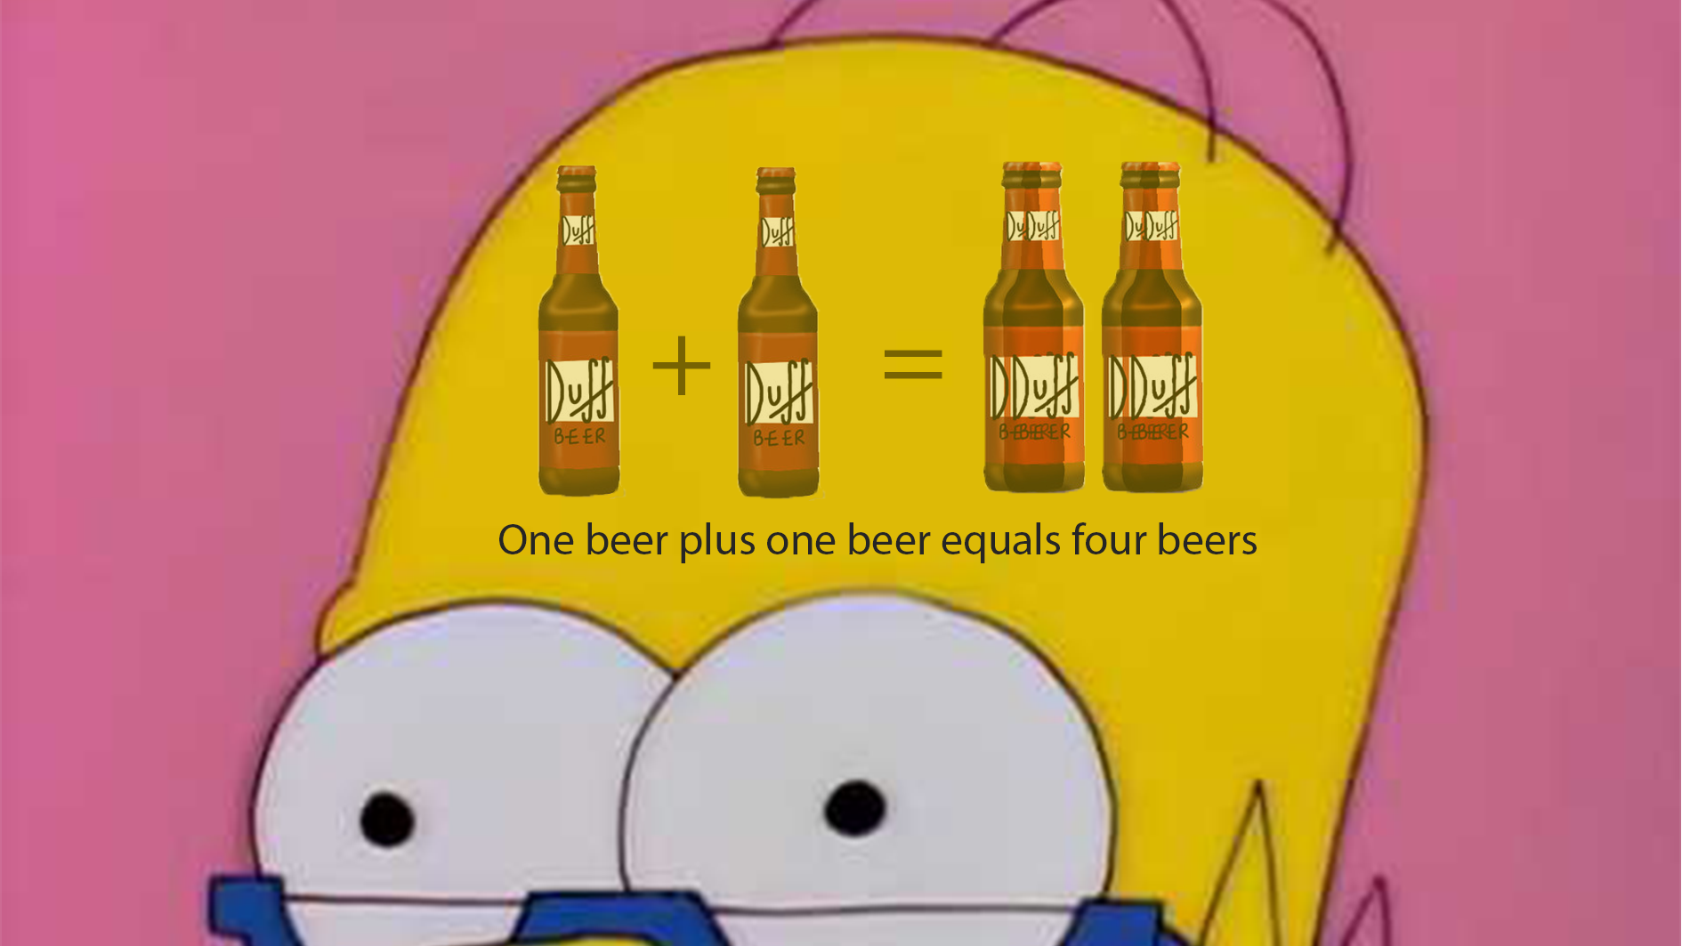

Slide 19
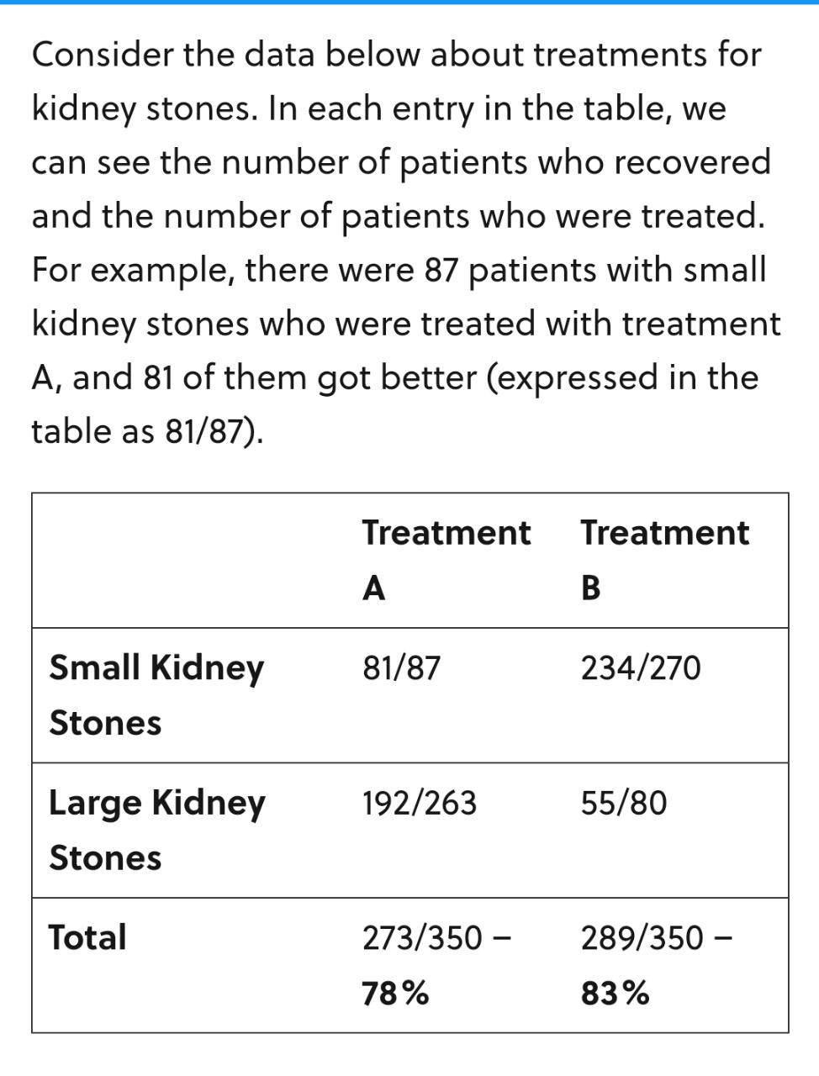
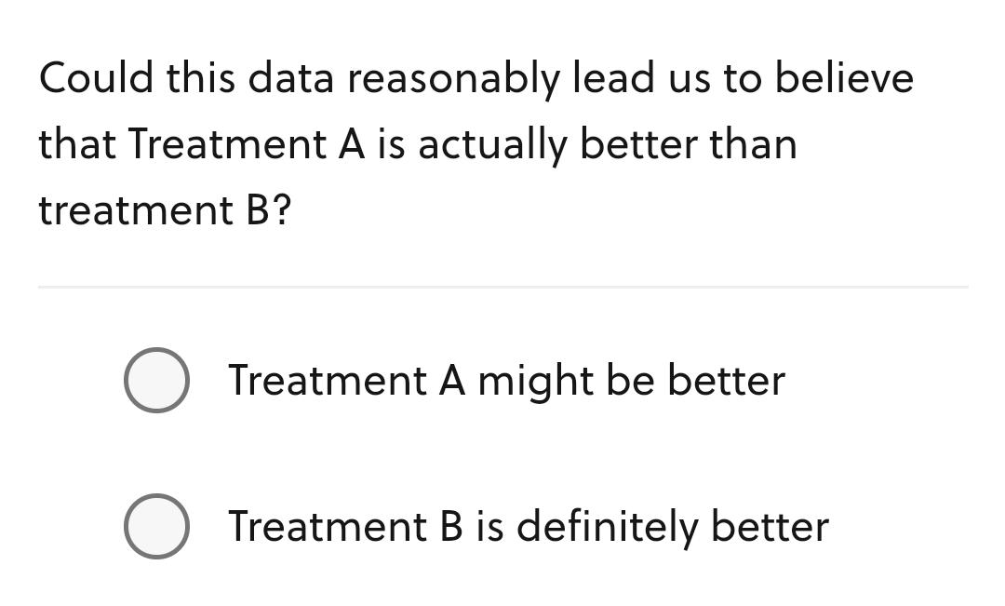

Slide 20
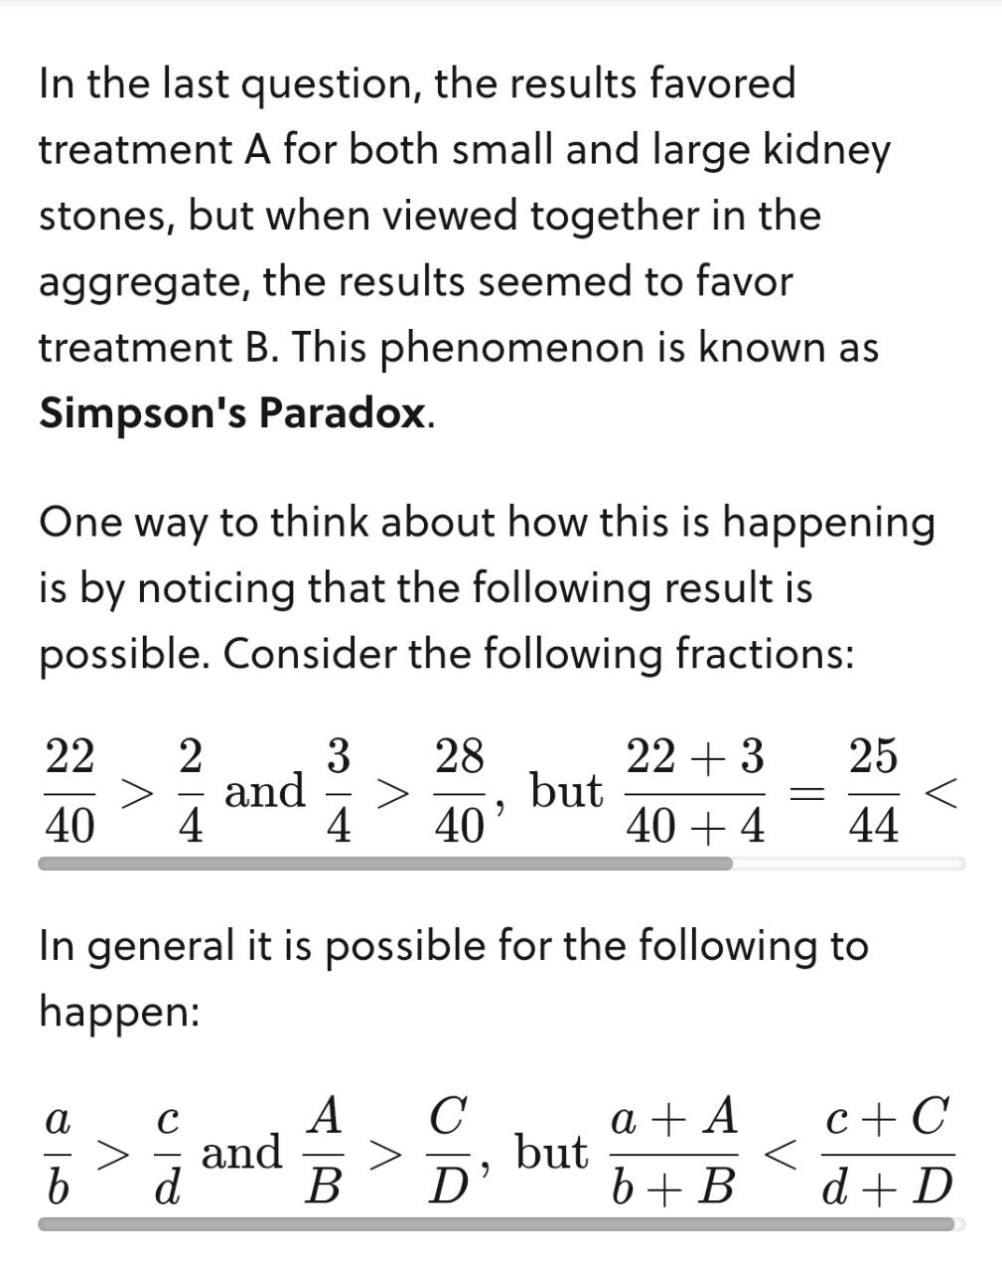
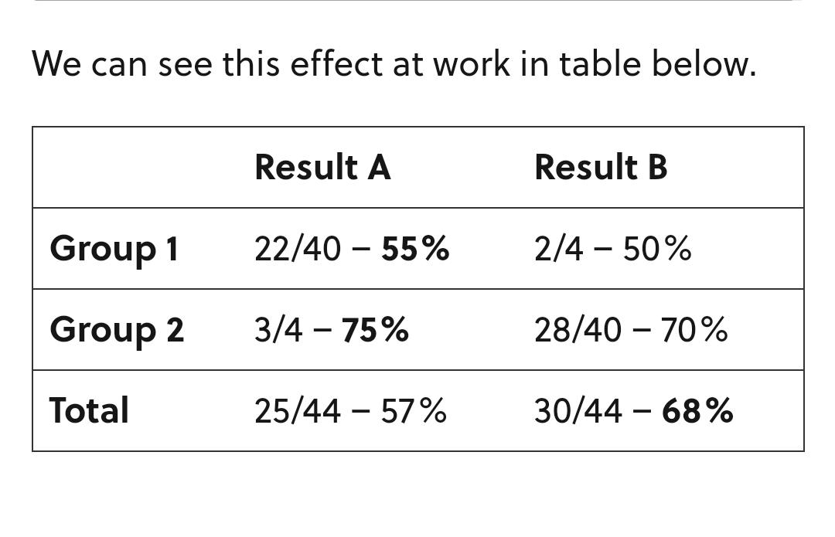

Slide 21
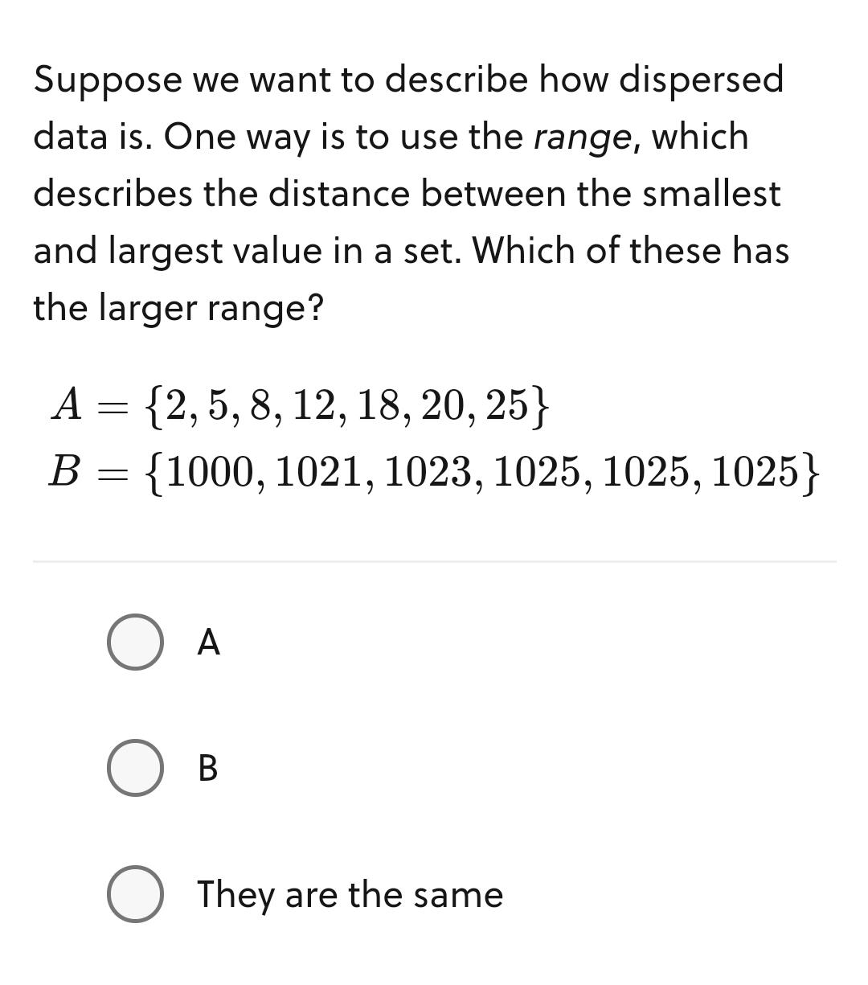
Up untill now, we have seen measures of central tendency like mean,median and mode.
These statistics attempt to find the "center" of the distribution .This is important information,but we often want to know how much the data varies from this center

Slide 22
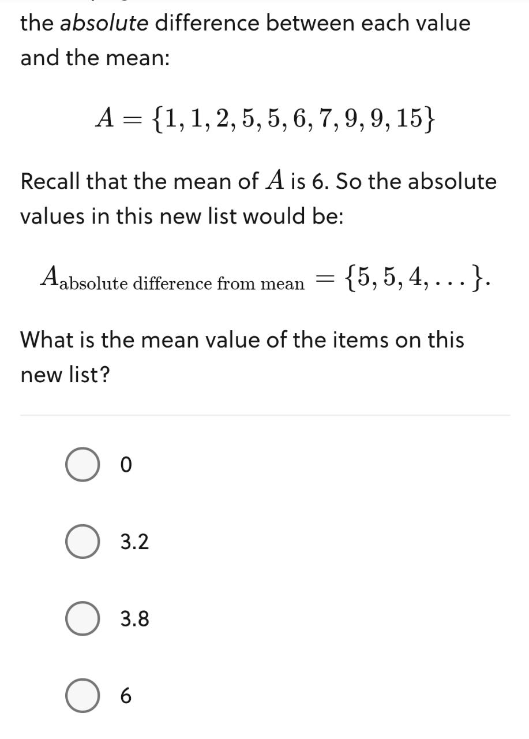
Mean Absolute Deviation(MAD)

Slide 23
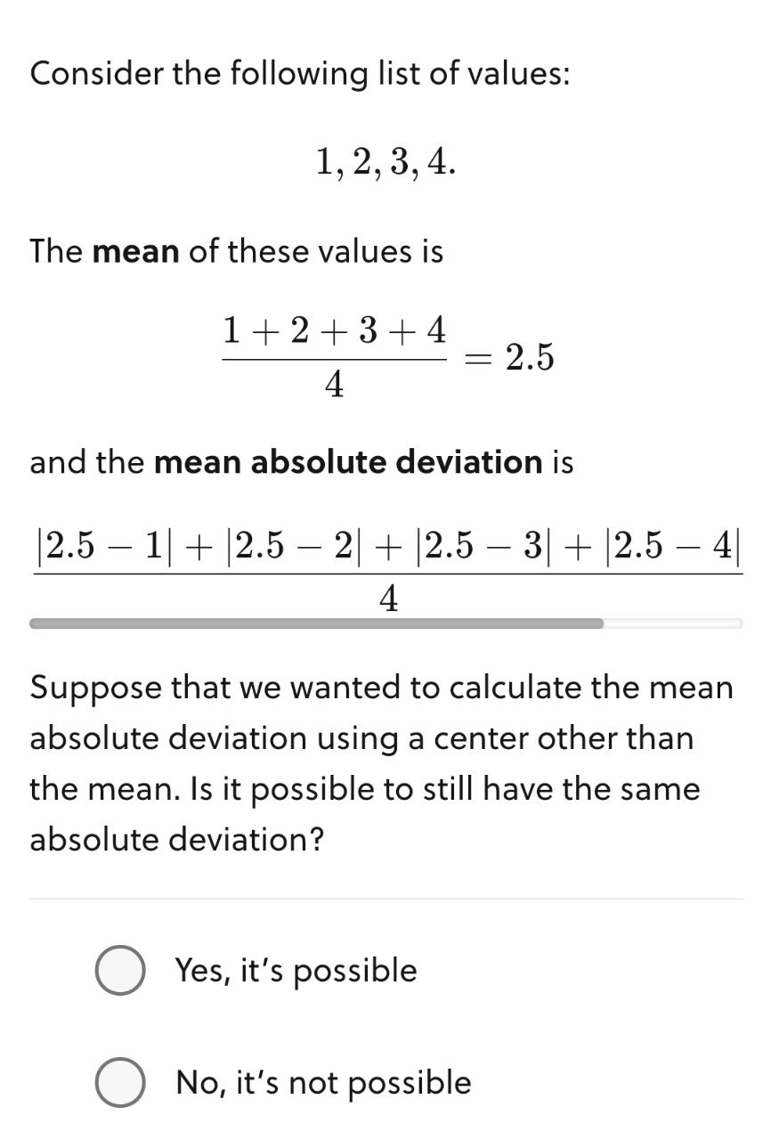
Problems with MAD

Slide 24
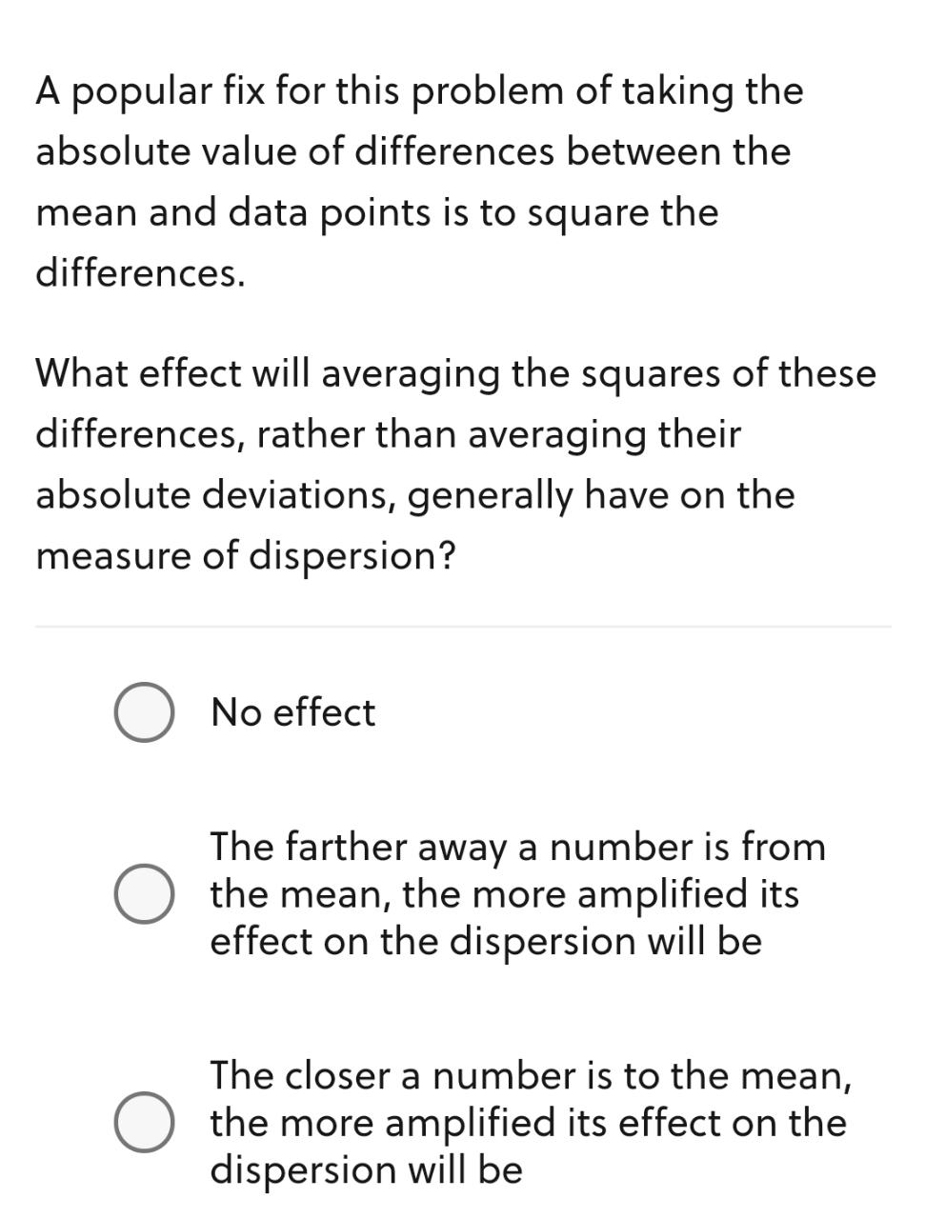

Slide 25
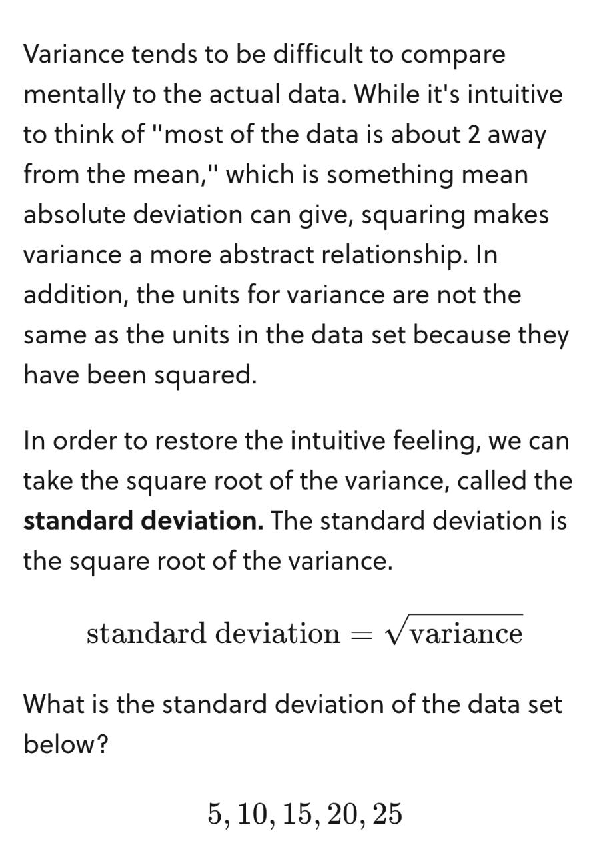
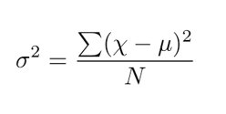
Variance

Slide 26
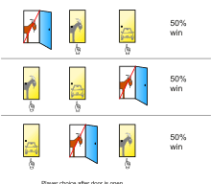
Monty Hall Problem Will you switch?

Slide 27

Thank You

