Slide 1
HUMIDITY AND TEMPERATURE MEASURMENT USING ARDUINO

Slide 2
INTRODUCTION
Here we now discuss about our measuring parameters humidity and temperature
using Arduino.
Humidity: it is amount of water vapour present in atmosphere.
Moist air rises above dry air because water molecules are lighter than air molecules.
For controlling humidity we can use humidifier or dehumidifier.
Temperature: it is a degree of hotness or coldness present in atmosphere.
We measure temperature because to know the atmosphere type and to control it for our convenience.

Slide 3
Humidity and temperature measuring using Arduino
Components required:
DHT11 sensor.
Arduino board.
Arduino software.
resistor.
bread board.

Slide 4
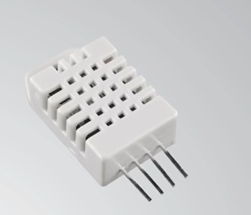
DHT11 sensor
It is very cheap sensor and it gives accurate results.
Temperature range is 0-50 degrees and accuracy is +-2degree centigrade.
Humidity range is 20- 80% and accuracy 5%.
It can take one reading in every second.
Operating voltage is 3-5v.
Max current during measurement 2.5mA.

Slide 5
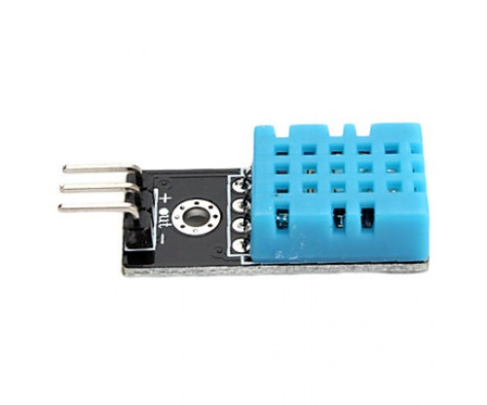
Working principle
DHT sensor can measure both temperature and humidity.
Humidity sensing component exist inside it which senses humidity.
Here NTC temperature sensor thermistor to sense temperature.

Slide 6
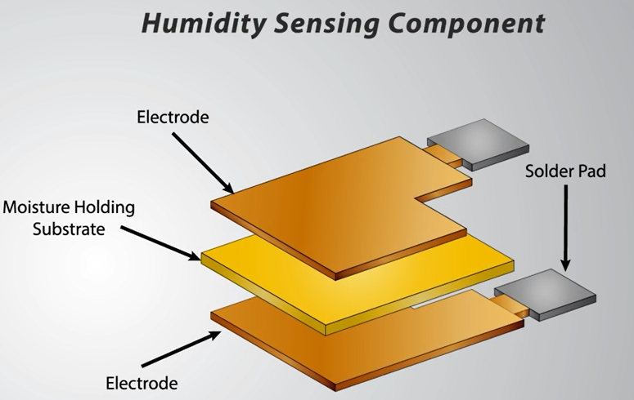
Humidity sensing component
It has two electrodes up and down between we have a moisture holding substance.
As the humidity changes the moisture holding substance heat changes and resistance between two electrodes changes.
This change in resistance measured and processed by IC which makes it to be ready to read by a micro controller.

Slide 7
CONNECTIONS
Arduino board is used to connect sensors and use as a circuit to measure things by writing programme.
Now connect sensor DHT11 to bread board it has four pins in which VCC,Ground,Data pin, NC not connected which has no use.
A resistor from 5k to 10k ohms is required in order to keep data life high to enable the communication between sensor and the Arduino board.

Slide 8
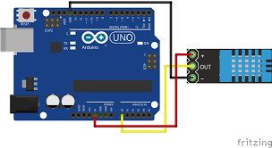
Connections diagram

Slide 9
APPLICATIONS:
By measuring humidity at musical instruments shop we can control it. thus it has more life.
Humidity measures at some industries to keep its products for long time for proper humidity measures.
Here we will give our input to varies humidity by using ice in cloth and humidifier to varies humidity so that we can increase or decrease it.

Slide 10
Working progress
We have purchased components and installed Arduino software in laptop.
And we have understood the process and analysing it for further extent.
We have to connect and see its accuracy by changing humidity and temperature.
By thinking innovative we want to give our project a design that as a model.

