Slide 1



Aurangabad Municipal Corporation
Smart Nagrik App
Date :- 18/07/2022

Slide 2
APP Main / Home Page
Increase Font size of all tabs

Slide 3

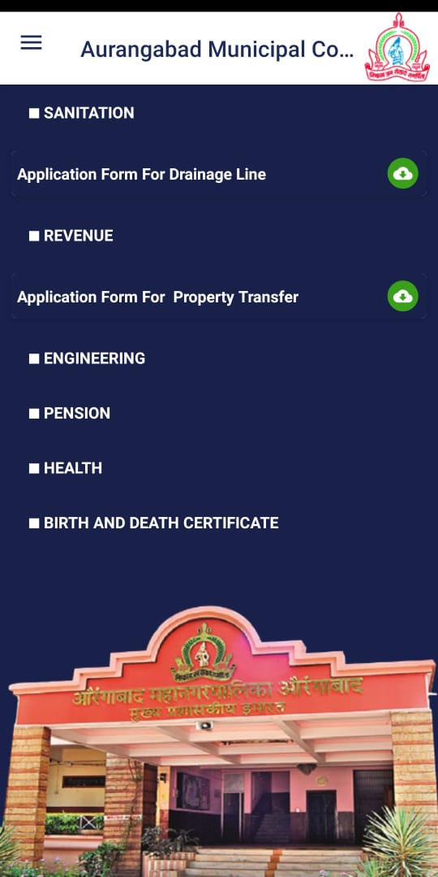
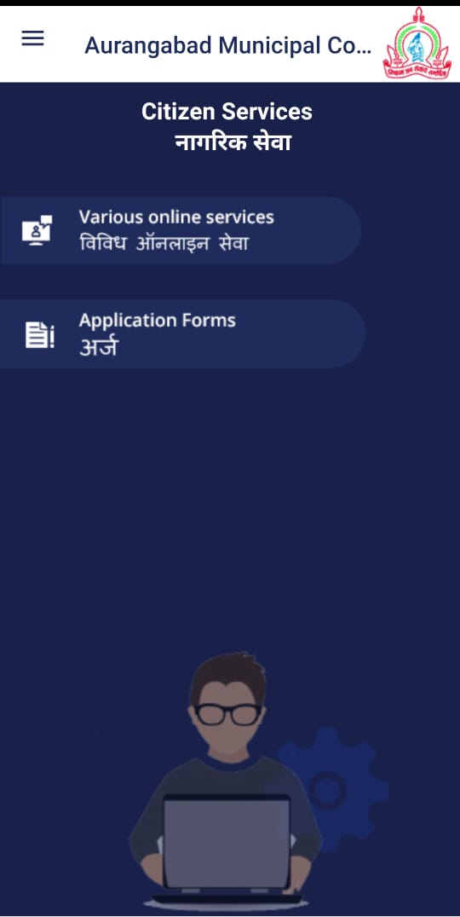
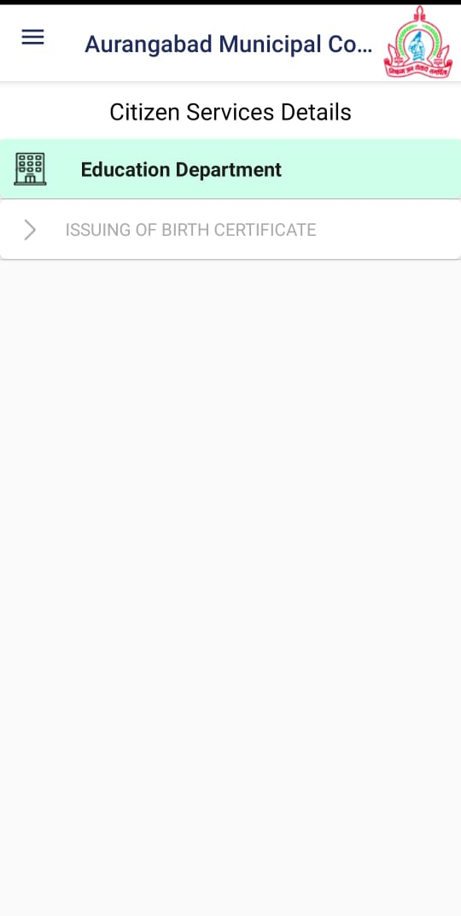
Know / Pay Your Taxes
आपले कर देय पहा आिण भरा
Response/Resolution
Need to add service form
In CSMS we added Five form for category 1. Sanitation 2.Revenue.3. Birth Certificate 4. Death Certificate .5.Health but in App it show revenue and sanitation

Slide 4
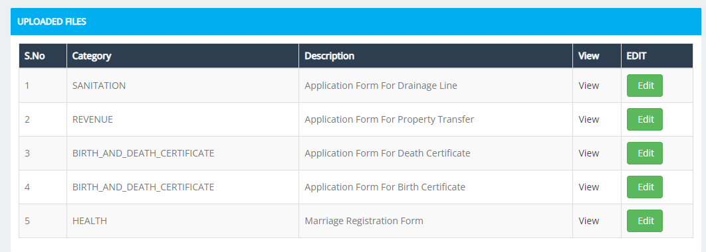
Know / Pay Your Taxes
आपले कर देय पहा आिण भरा

Slide 5
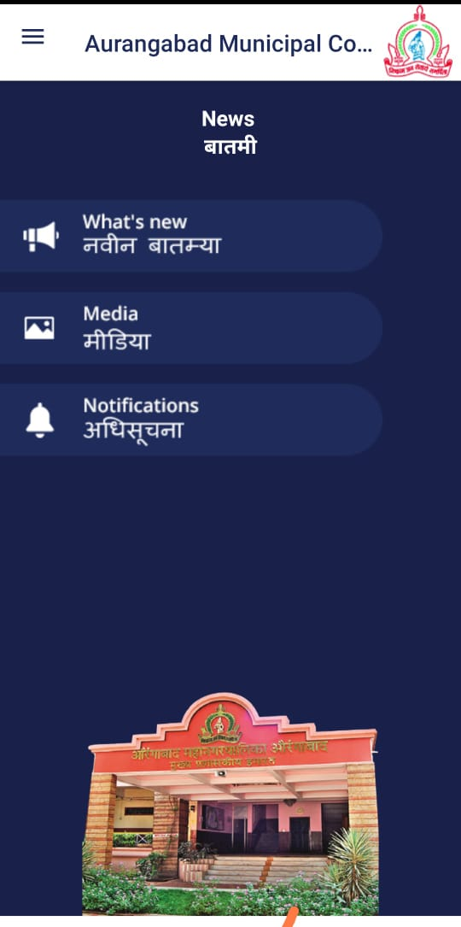
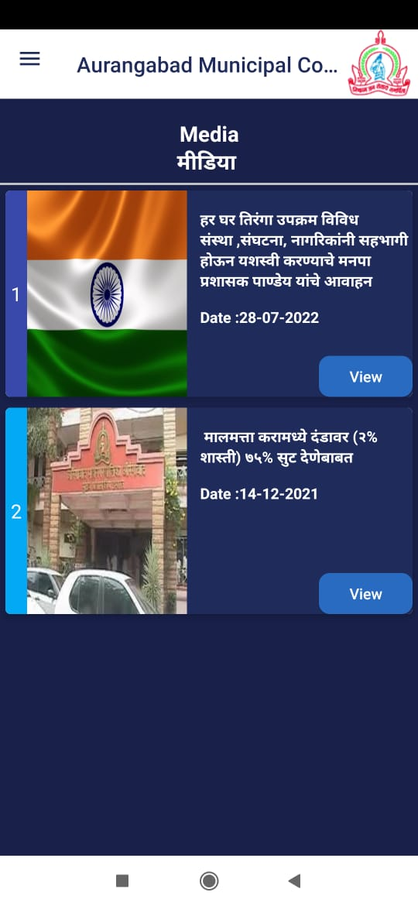
Know / Pay Your Taxes
आपले कर देय पहा आिण भरा
In Media afer clickon view image is not shown.pls check.

Slide 6
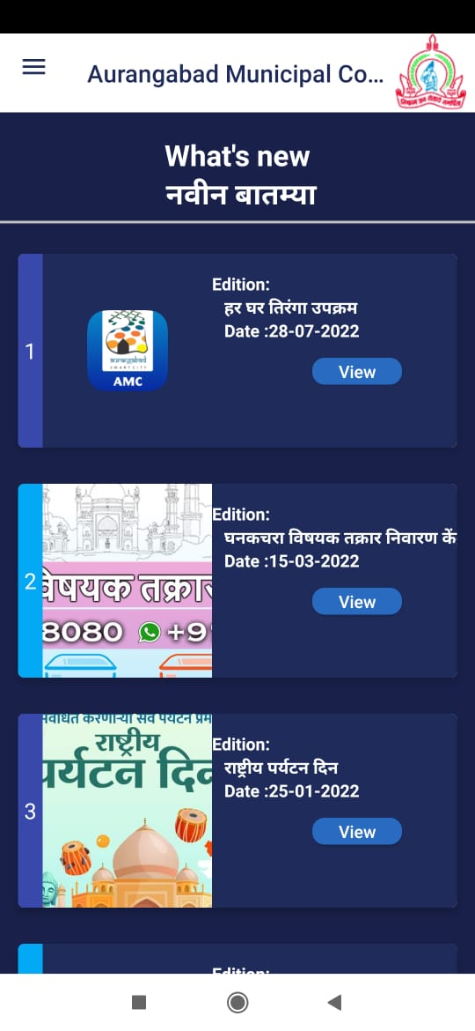
Know / Pay Your Taxes
आपले कर देय पहा आिण भरा
In whats New photo is no attached text is not displayed in welformat.

Slide 7
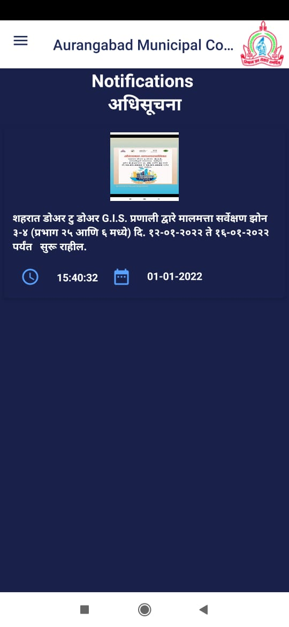
Know / Pay Your Taxes
आपले कर देय पहा आिण भरा
There should be mass popup notification.

Slide 8
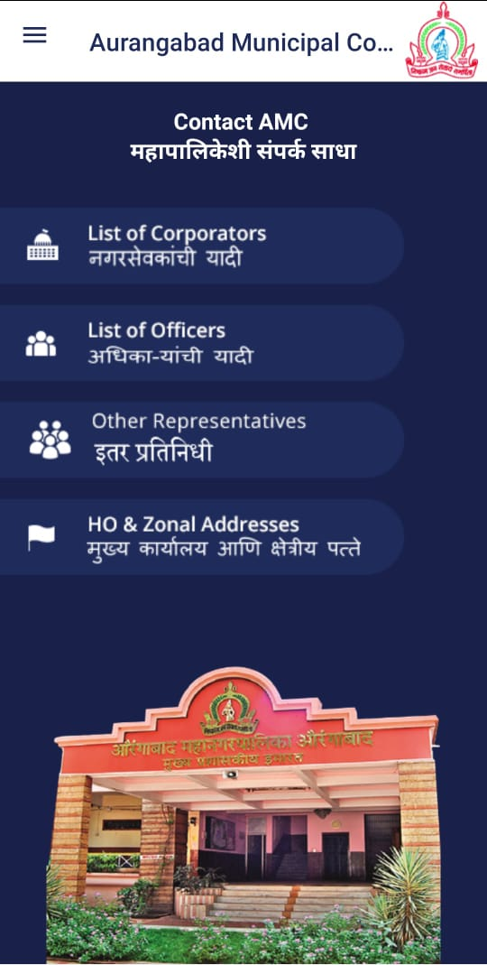
Know / Pay Your Taxes
आपले कर देय पहा आिण भरा
In List of officer there should be drop down to select designation according to designation employee will populate.
Remove other representation

Slide 9
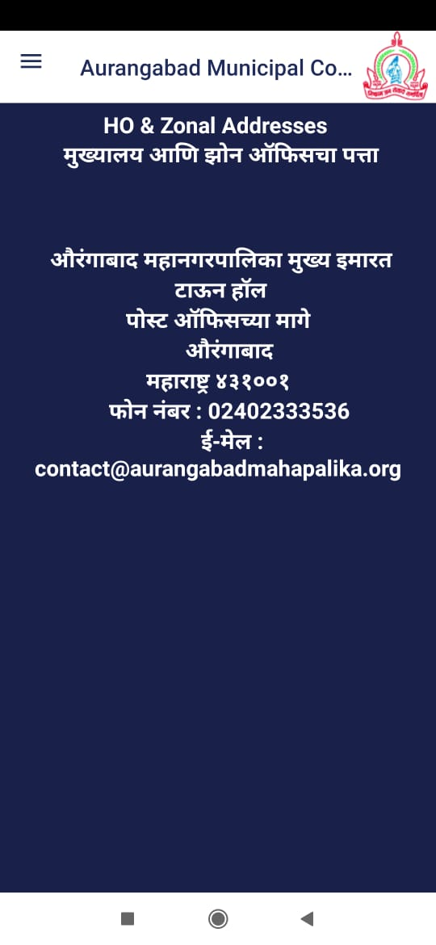
Know / Pay Your Taxes
आपले कर देय पहा आिण भरा
Address in table format

Slide 10
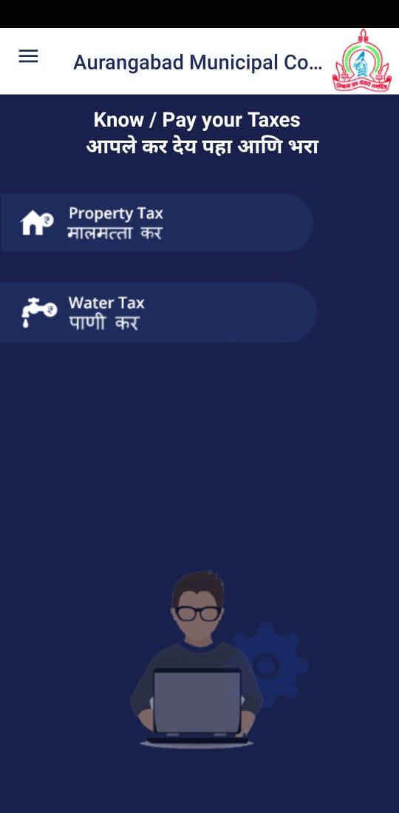
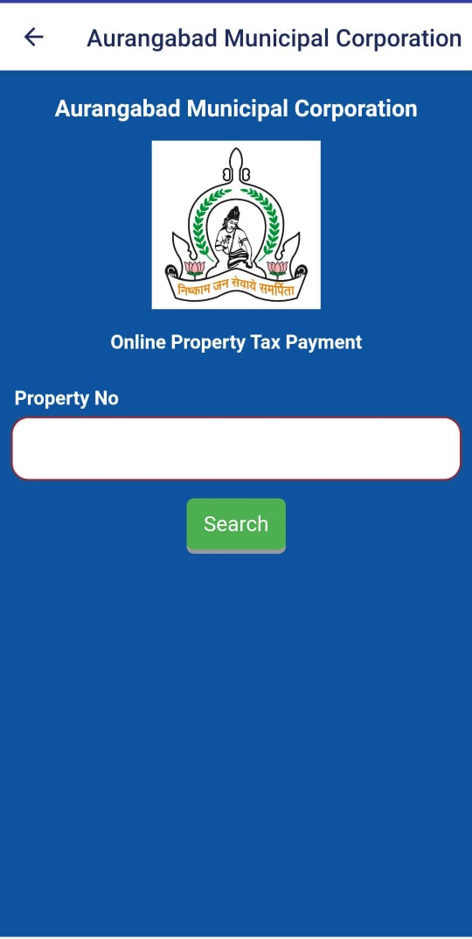
Know / Pay Your Taxes
आपले कर देय पहा आिण भरा
Response/Resolution
View and down load receipt option irequired

Slide 11
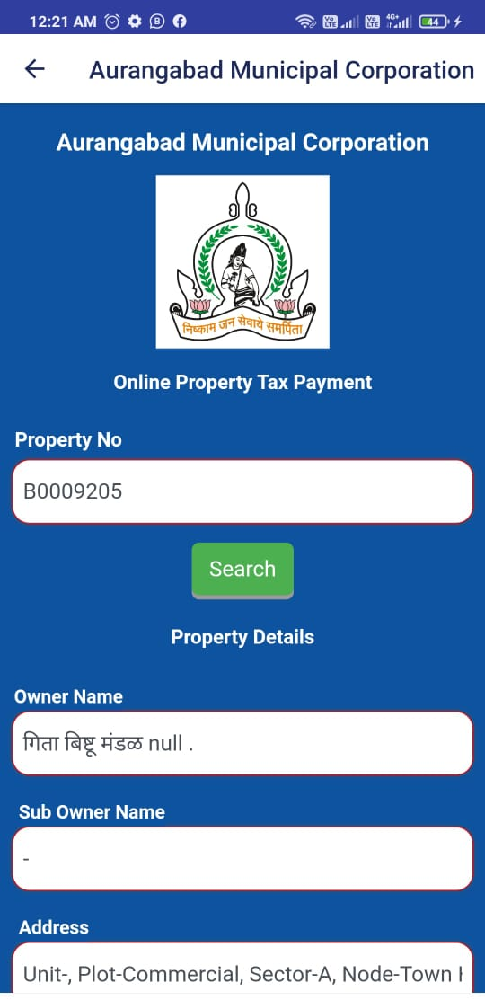
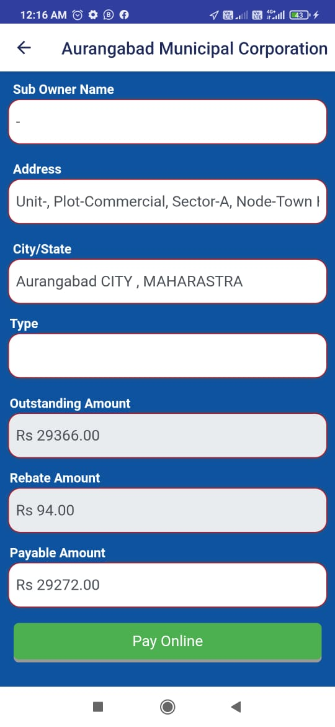
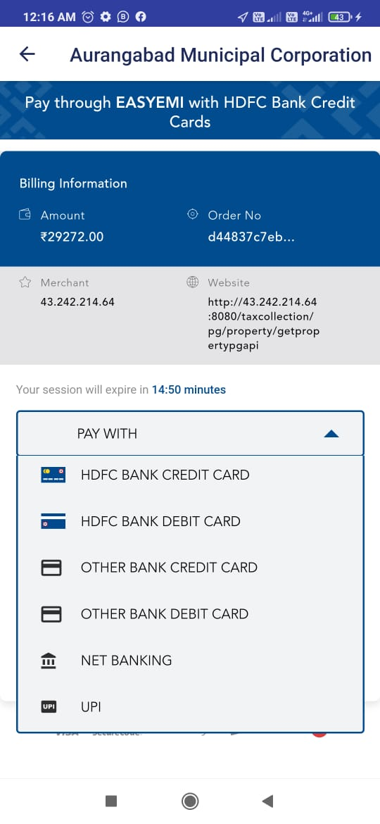
Know / Pay Your Taxes
आपले कर देय पहा आिण भरा
Response/Resolution
After payment receipt is generated same as CFC or web view receipt.

Slide 12
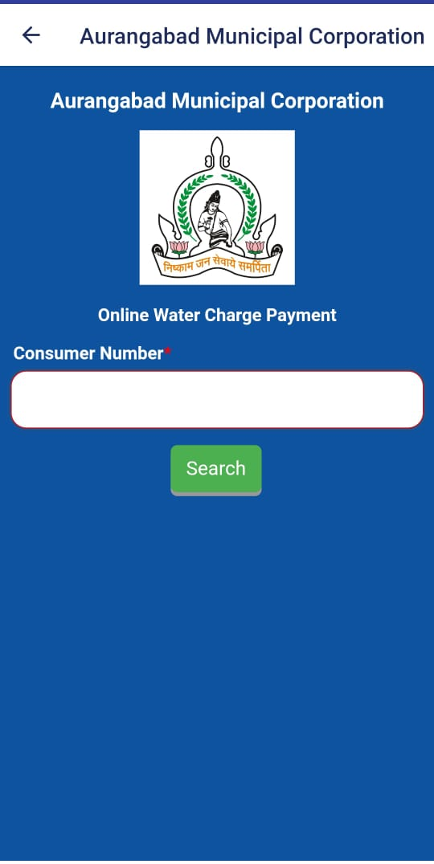
Know / Pay Your Taxes
आपले कर देय पहा आिण भरा
Response/Resolution
View and down load receipt option is required

Slide 13
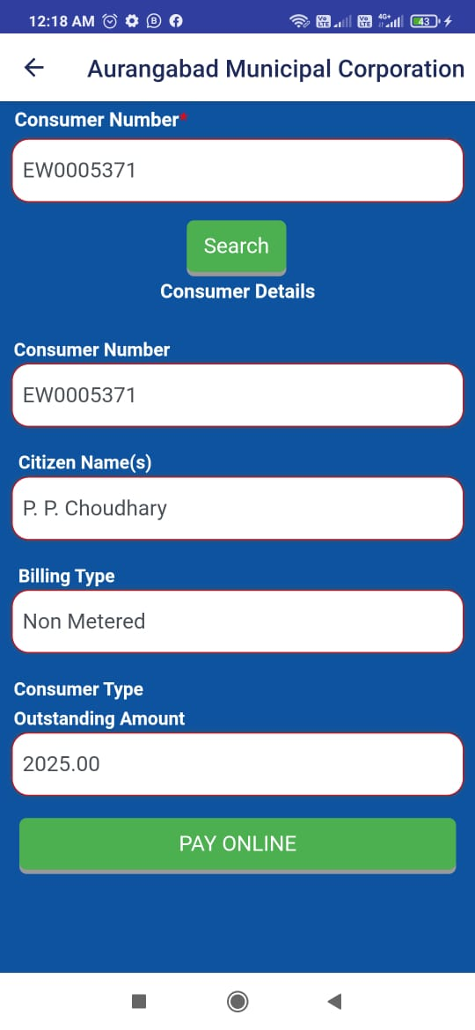
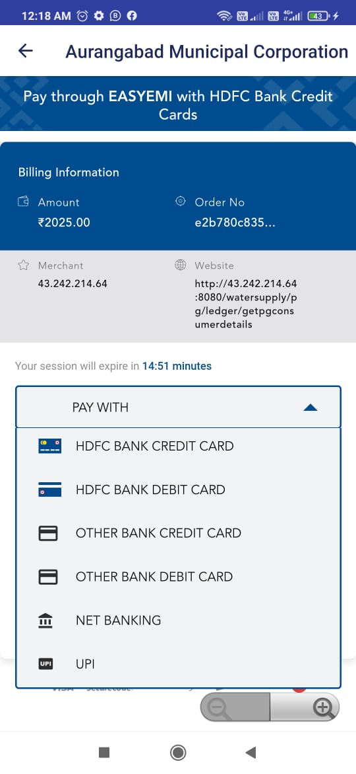
Know / Pay Your Taxes
आपले कर देय पहा आिण भरा
Response/Resolution
After payment receipt is generated same as CFC ,web view receipt.

Slide 14
Other Notes
1. All links need to be updated / active
2. All information needs to be properly structured
3. App response time should be better
4. There should be a session timeout facility
5. There should be facility to send mass pop up notifications
6. For property and water payments I have already informed that View Bill / Pay Bill / View Receipt should be available alongwith the ledger.
7.Failed to Newly Install in Android / iOS (for iPhone Users)*

