Slide 1
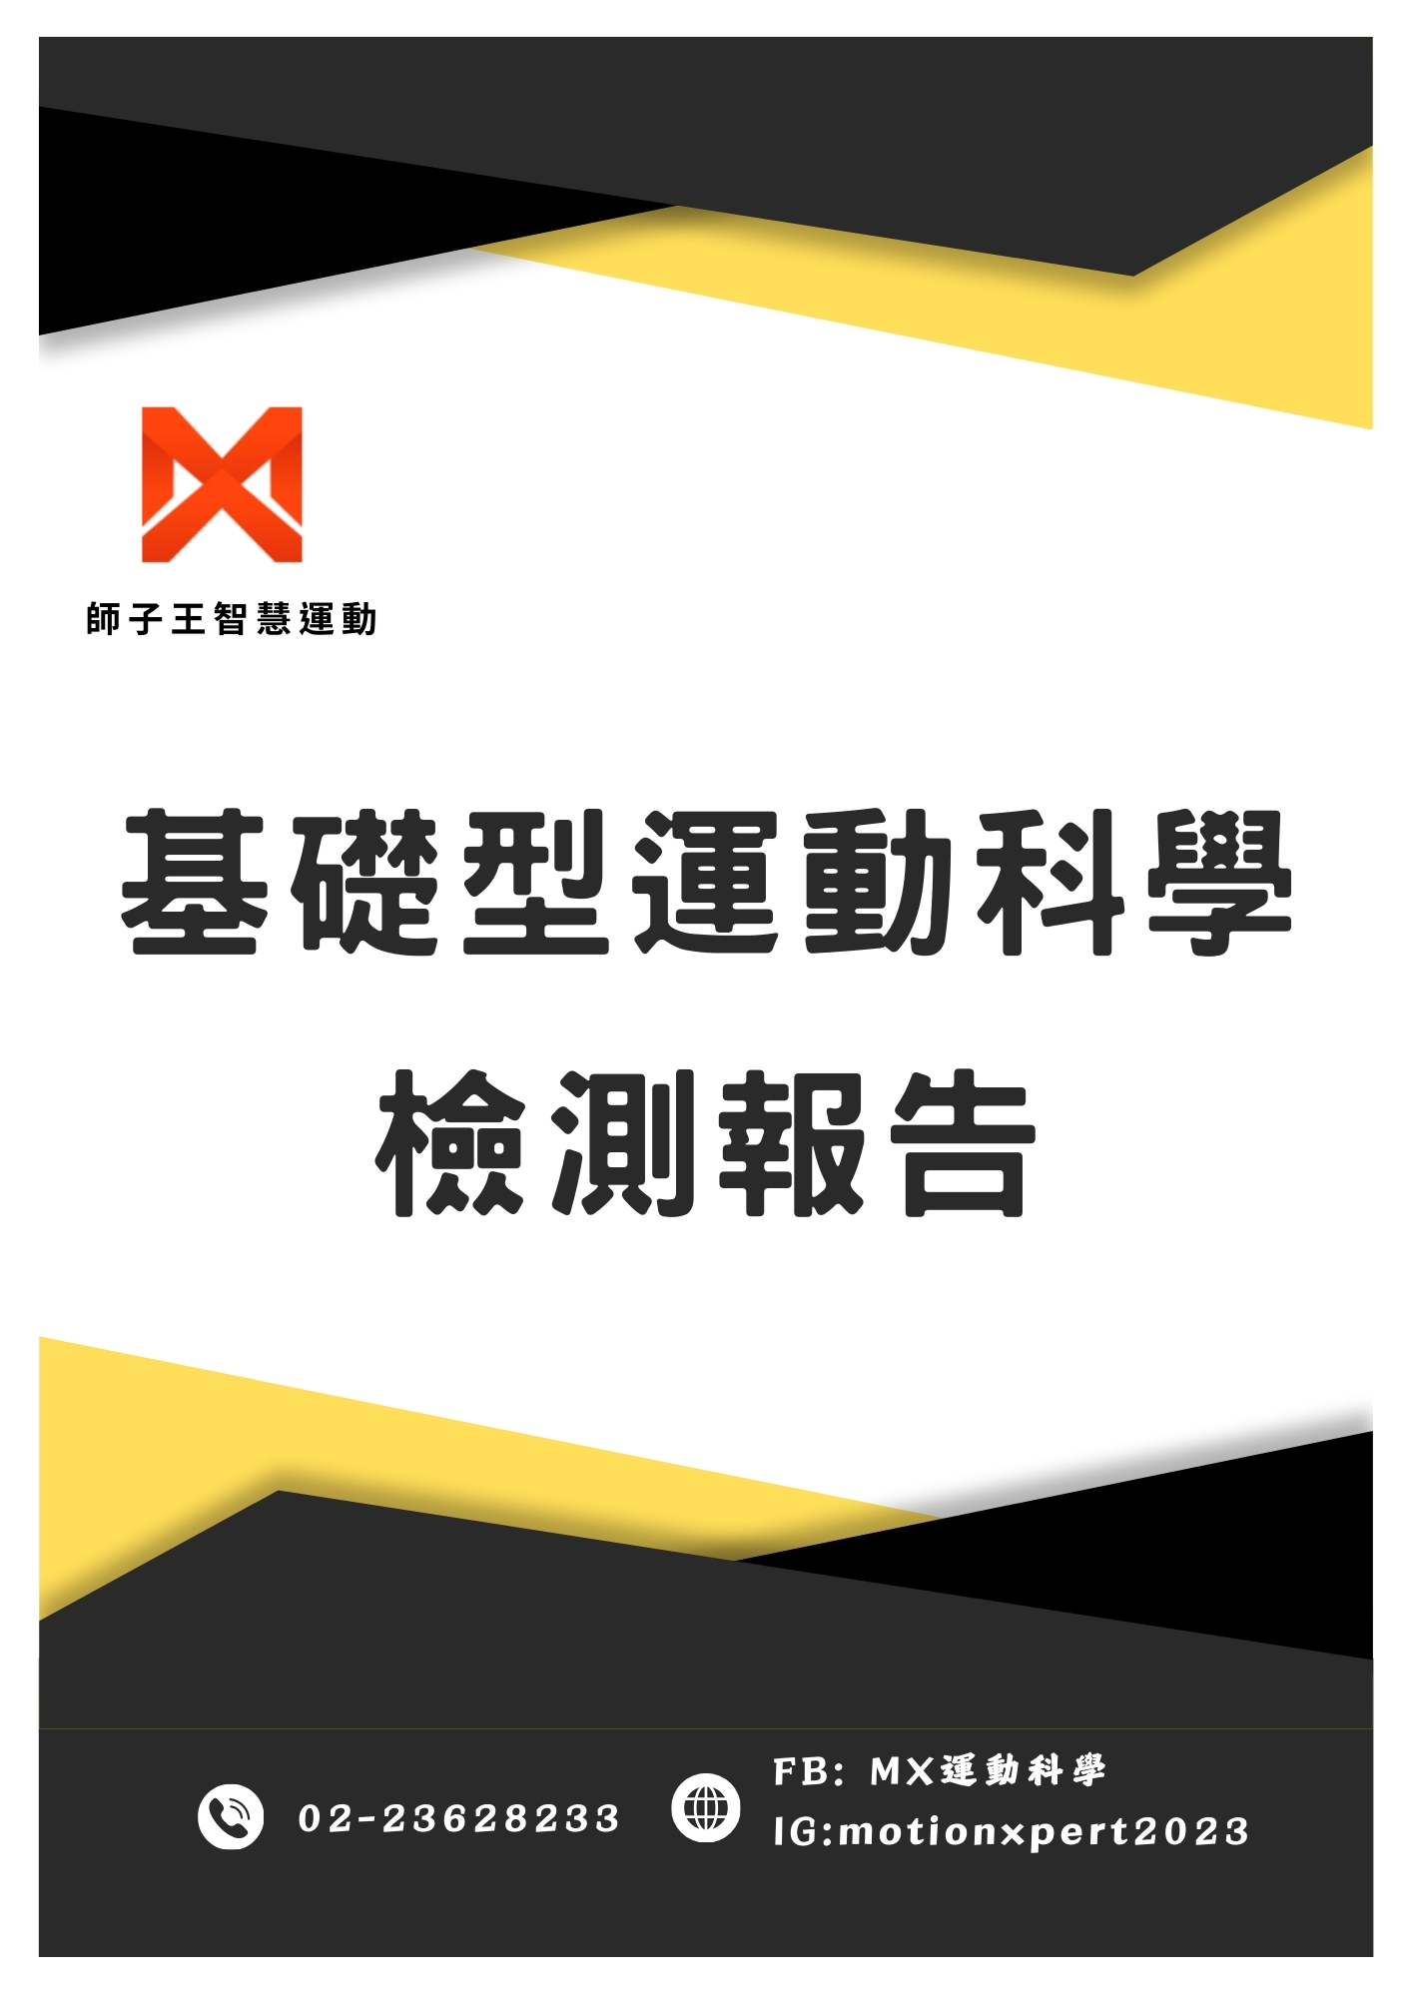

Slide 2

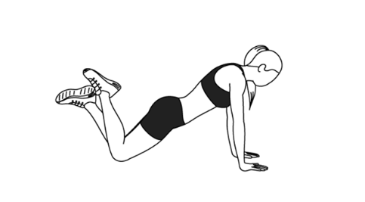
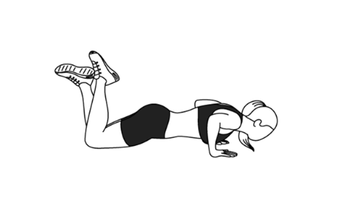
上肢
vd_upper_1.jpg
vd_upper_2.jpg
vd_upper_3.jpg
kf_upper_1.jpg
kf_upper_2.jpg
kf_upper_3.jpg
note
胸大肌
前三角肌
前鋸肌
-----------------------------------------------------
-----------------------------------------------------
-----------------------------------------------------
[1] Marcolin, G., Petrone, N., Moro, T., Battaglia, G., Bianco, A., & Paoli, A. (2015). Selective activation of shoulder, trunk, and arm muscles: a comparative analysis of different push-up variants. Journal of Athletic Training, 50(11), 1126-1132. https://doi.org/10.4085/1062-6050-50.9.09.

Slide 3
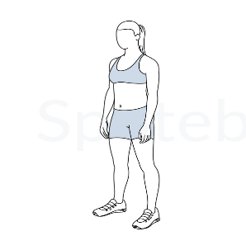
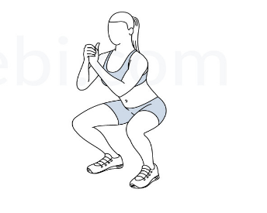
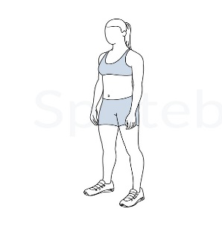
下肢
vd_lower_1.jpg
vd_lower_2.jpg
vd_lower_3.jpg
kf_lower_1.jpg
stiffness
kf_lower_2.jpg
kf_lower_3.jpg
note
股四頭肌
腿後肌
腓腸肌
----------------------------------------
----------------------------------------
----------------------------------------
[1] Slater, L. V., & Hart, J. M. (2017). Muscle activation patterns during different squat techniques. Journal of Strength and Conditioning Research, 31(3), 667-676.
.

Slide 4
平衡
張眼
vd_balance_open_1.jpg
kf_balance_open_1.jpg
vd_balance_open_2.jpg
kf_balance_open_2.jpg
閉眼
vd_balance_close_1.jpg
kf_balance_close_1.jpg
vd_balance_close_2.jpg
kf_balance_close_2.jpg
note

