Slide 1
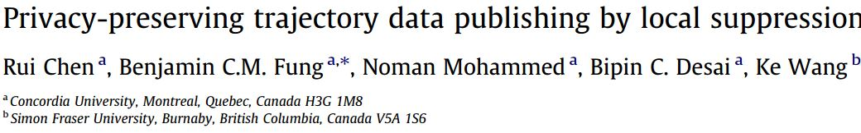
制作人：刘新倩 1689890718@qq.com 轨迹数据发布
Notes:
本文主要讲述的是保护社交网络中的敏感关系，

Slide 2
Table of Content
Challenge And Solution
Background knowledge
Proposal
Evaluation and Experiment
Conclusion

Slide 3
Challenge + Solution
Challenge : high dimensionality
sparseness
sequentiality
Solution : local suppression+ (K,C)L-privacy
Low
Data
utility
L——at most L location—time doublets
K——at least K records
C——confidence of inferring any sensitive value at most C

Slide 4
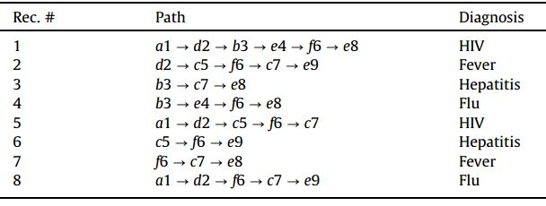
(2,50%)2-privacy
L=2,K=2,C=50%,S={HIV , Hepatitis}
Background knowledge P:
d2 e4
K=1 C=1

Slide 5
Identity linkage attack
Attribute linkage attack
Ed : a1 f6
2/3=67% confidence
Infer the victim having HIV.
Bob : d2 e4

Slide 6
Table of Content
Challenge And Solution
Background knowledge
Proposal
Evaluation and Experiment
Conclusion

Slide 7

Background knowledge
Trajectory database
Identity linkage attack: |T(Kv)| small
Attribute linkage attack
high
Satisfy (K,C)L-privacy any subsequence q in T [0 < |q| ≤ L]
|T(q)| ≥ K
Conf(s | T(q)) ≤ C for any s ∈ S, 0 ≤ C ≤ 1

Slide 8
Table of Content
Challenge And Solution
Background knowledge
Proposal
Evaluation and Experiment
Conclusion

Slide 9
Proposal
identify all violating sequences that breach a given (K,C)L-privacy requirement
perform a sequence of local and global suppressions

Slide 10
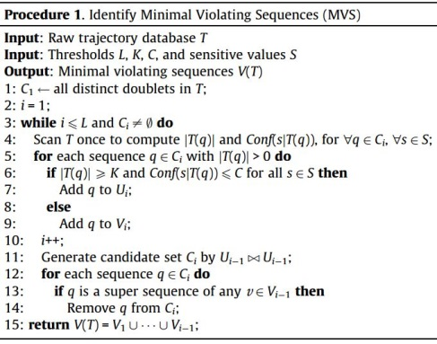
The First Step——Identifying violating sequences
Input: T, L, K, C ,S
Identify all distinct doublets C1
i=1
q∈C1,|T(q)|,Conf(s|T(q))
|T(q)|≥K
Conf(s|T(q)) ≤C
Add q to U_{i}
Add q to V_{i}
i++
Ci=U_{i-1}joinU_{i-1}
Output: V(T)
_{i≤L}
C_{i} ≠0
q ∈Ci is super seq of v ∈V_{i-1}
Ci remove q

Slide 11

The Second Step——Removing violating
sequences
Check if a local suppression is valid though local suppress doublet p from MVS m
the new MVS q must contain p.
q ∈ T(m) and q ∈ (T(p) - T(m))
2. Computer Score(p)
3. Local suppression or global suppression

Slide 12
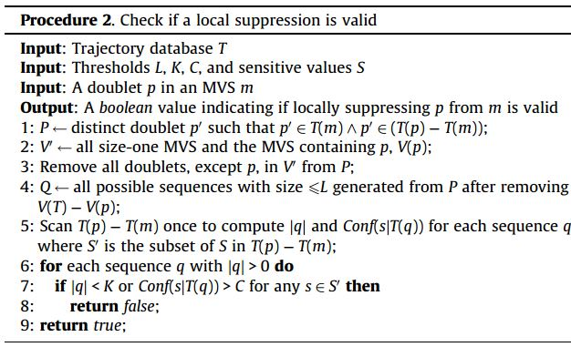
L = 2, K = 2, C = 50%, S = {HIV , Hepatitis}.
m={d2 , e4} p={d2}
T(m)={R1},T(p)={R1,R2,R5,R8}
T(P)-T(m)={R2,R5,R8} P={d2,f6}
V’={a1,d2b3,d2e4,d2e8}
Q={d2,f6,d2f6} are not violating sequences, this local suppression is valid.

Slide 13
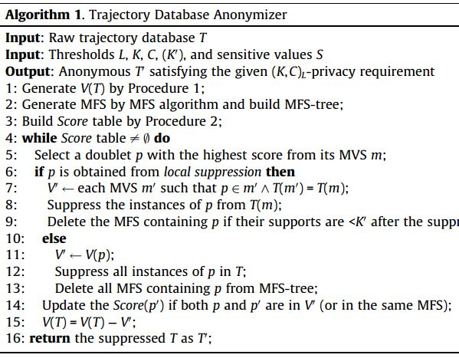
Input: T, L, K, C ,S
Generate V(T)
Build Score table
a doublet p with the highest score
p is obtained from local suppression
local suppression
Global suppression
Score table ≠0
Output: T’

Slide 14
Table of Content
Challenge And Solution
Background knowledge
Proposal
Evaluation and Experiment
Conclusion

Slide 15


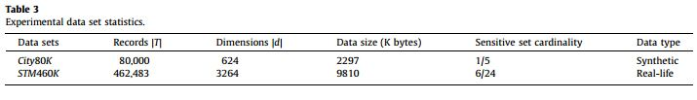
Evaluation and Experiment
data utility metrics :
①instances of location-time doublets
②frequent sequences
Data sets

Slide 16
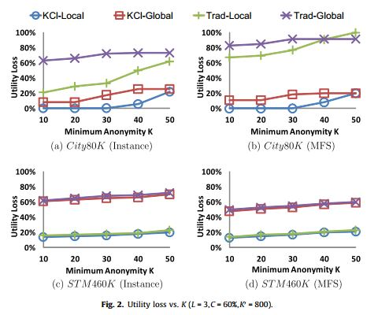
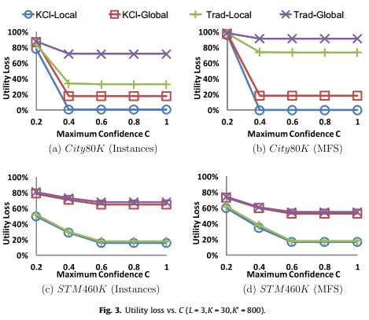
(K,C)L-privacy and local suppression are sufficient to guarantee good data utility.
This is due to the fact that most MVS of STM460K are of size-3 or less.

Slide 17
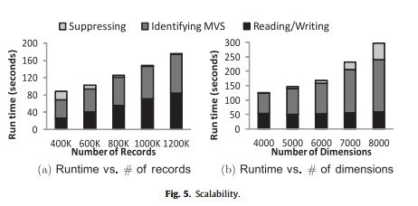
Our anonymization framework is able to efficiently process large trajectory data sets.

Slide 18
Table of Content
Challenge And Solution
Background knowledge
Proposal
Evaluation and Experiment
Conclusion

Slide 19
Conclusion
Personalized privacy setting , giving various sensitive values different weigh
Extend this method to deal with similarity attack and Skewness attack
Evaluation criteria: data utility and the risk of privacy discloses

Slide 20
Maximal frequent sequence
generalization

Slide 21
Thanks for your listening!

