Slide 1


诗文溯源系统
Poetry
Tracing
System
空山新雨后天气晚来秋
明月松间照清泉石上流

Slide 2
DICTORY
Project execution
Risk plan
Test plan
Lessons learnt
Conclusion
Future plan for next cycle

Slide 3
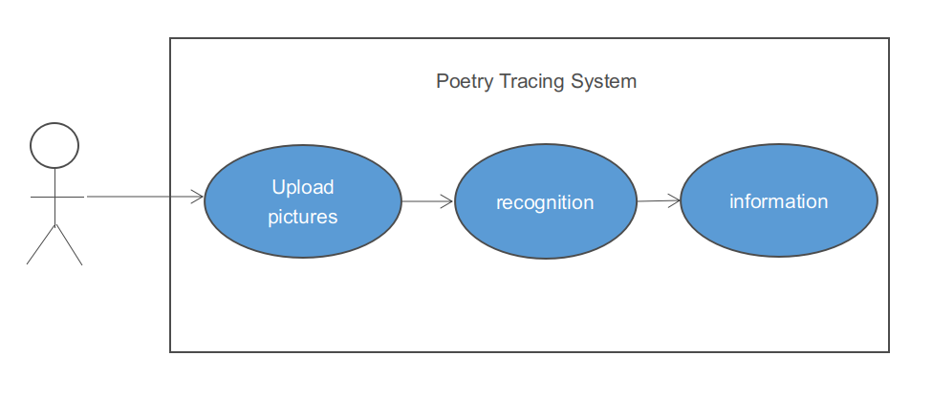
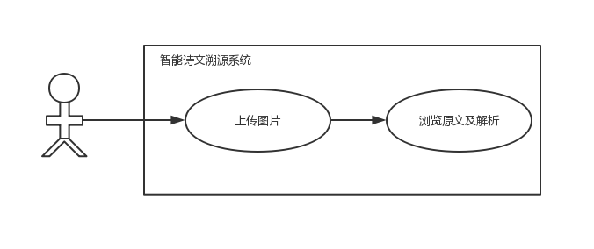
Project execution
The first iteration of the system

Slide 4
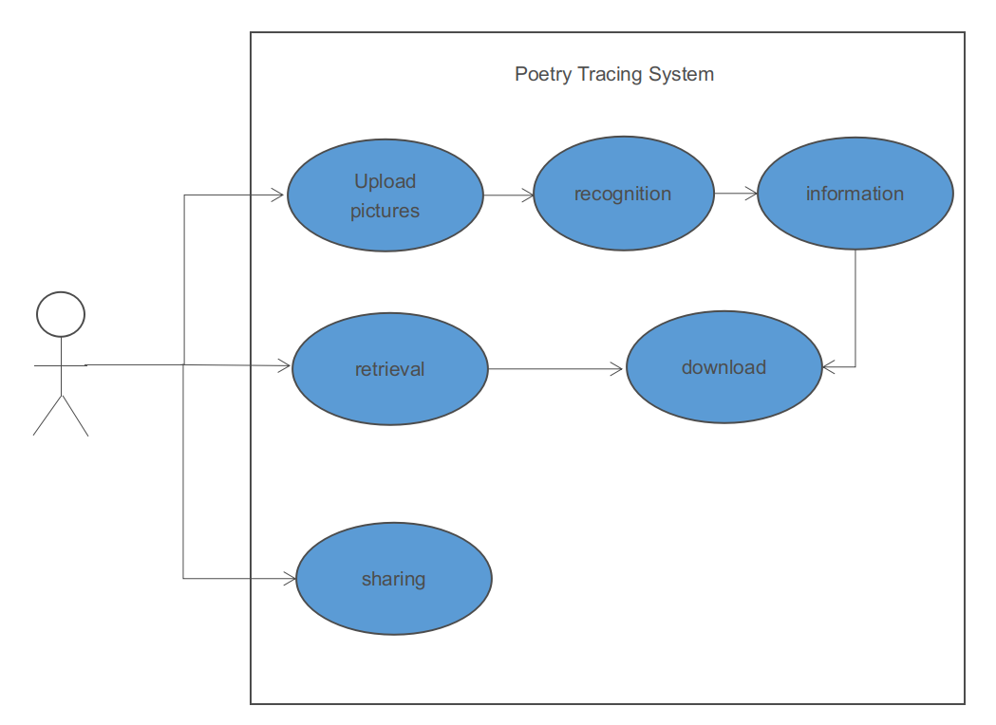
Project execution
The second iteration of the system

Slide 5
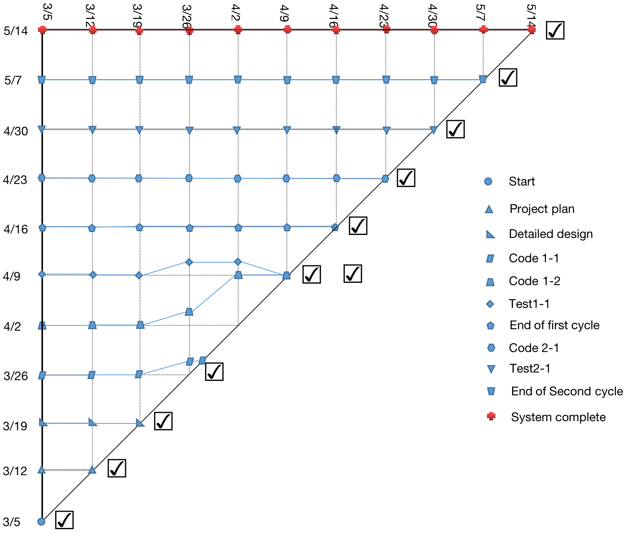
Project execution
second iteration
first iteration
Milestone trend chart

Slide 6
Risk plan
Risk description | Strategy | Technological | Cost | Schedule
The front-end framework has difficulty invoking page data. | Change the page component type and rearrange the layout. | Medium | High | High
The front-end frame cannot properly call the picture channeling interface. | Because it takes more time to change the image acceptance mode and the improvement is small, skip this image processing step to avoid project delays. | Low | Low | Low
The person in charge of the front-end page module failed to submit the code of the development stage on time. | The two-day delay in submission did not affect the progress of the project. | Low | Low | Medium
The document did not meet the requirements and was rewritten, almost missing task. | Spend the night revising the document and submitting it before the deadline. | Low | Medium | Low

Slide 7
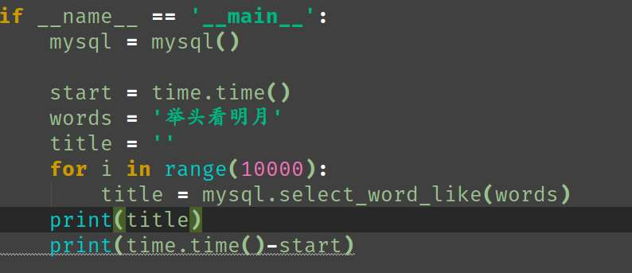

Test plan
fuzzy query interface test

Slide 8
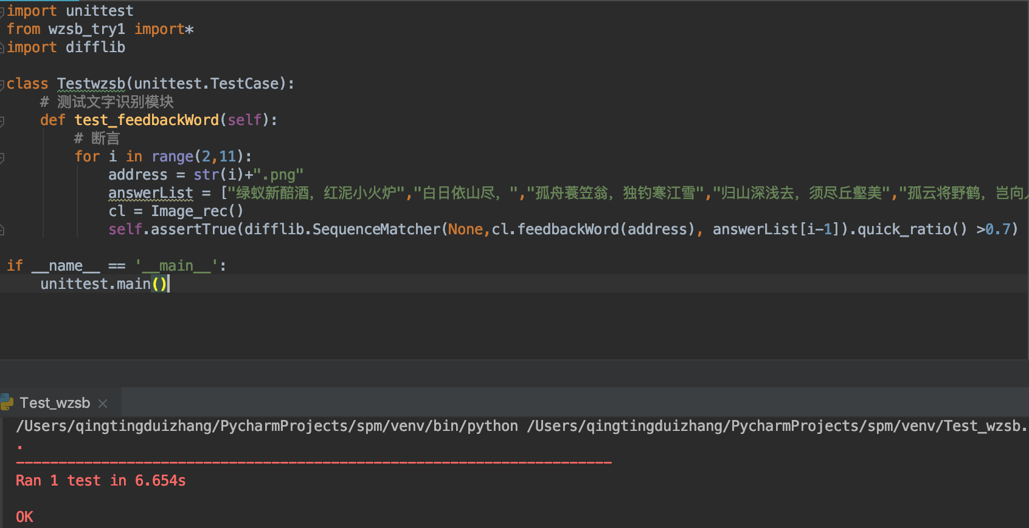
Test plan
image recongnition interface test

Slide 9
Lessons learnt
The technical coupling between modules should not be too high, otherwise it will easily lead to the integration of modules due to technical differences.
There should not be too long time interval between the two iterations of the project.
The amount of tasks should be consistent with the development time, that is, the working pressure of developers in two iterations should be similar.

Slide 10
Conclusion
The "poetry traceability system" project lasted 70 days and two development cycles. There are 4 members in the project team, who are respectively responsible for 4 modules and other test tasks. The task parallel mechanism is adopted, and the work results are submitted every 7 days.
The project has realized two main functions of image retrieval and keyword retrieval. The retrieval time and website stability are in line with the project requirements, and the project goal has been basically completed.
There are some small defects in the project.The text recognition module cannot recognize certain fonts, which makes it impossible to retrieve
poems, and it also has certain requirements on the
shooting Angle and environment of pictures.

Slide 11
Future plan
Product optimization：
Optimizing the Scope of Character Recognition
Optimizing the page logic
Optimizing System Function

Slide 12
Future plan
Commercial optimization：
Increase the function of advertising booth leasing.
Promotion to secondary schools or educational institutions.
Make the sub functions of WeChat or Alipay software.

Slide 13

Thanks
江山父老能容我，不使人间造孽钱。

