Slide 1
ECE231 Op Amps II
Maj Kevin Walchko

Slide 2
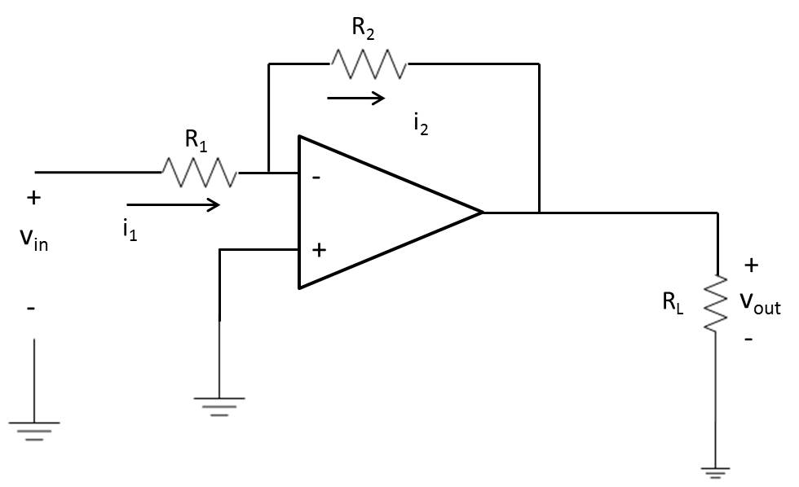
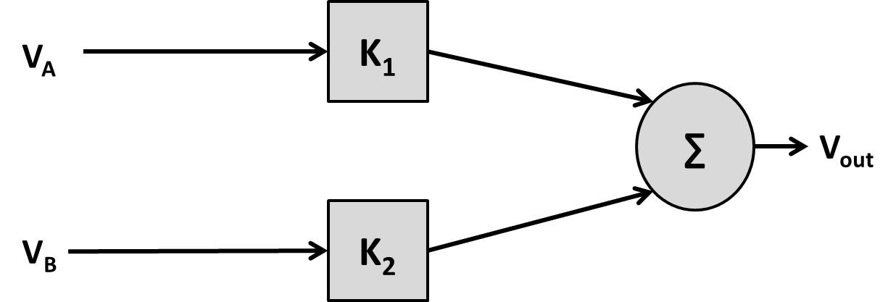
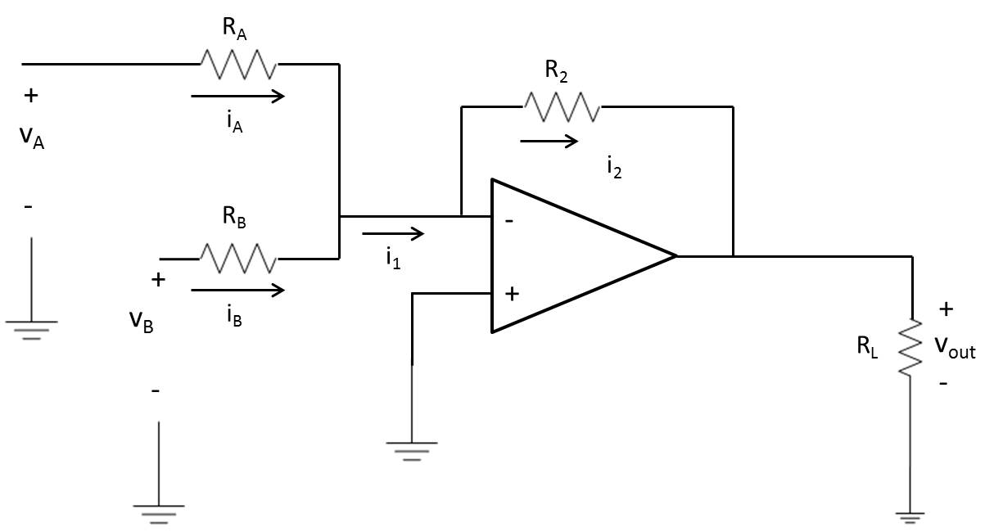
Summer
inverter

Slide 3
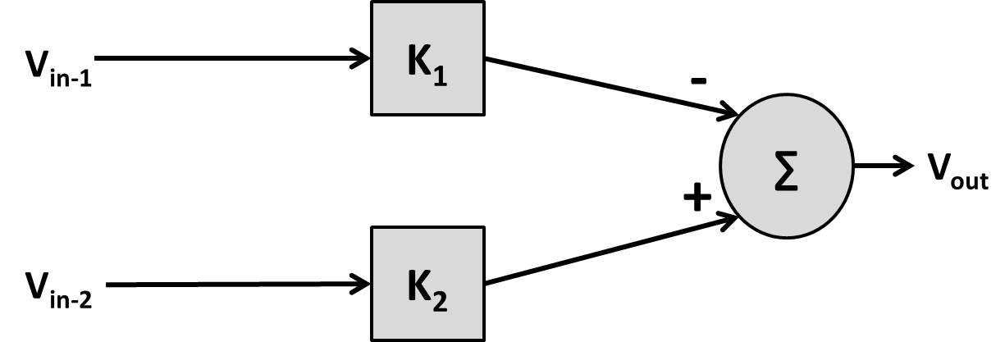
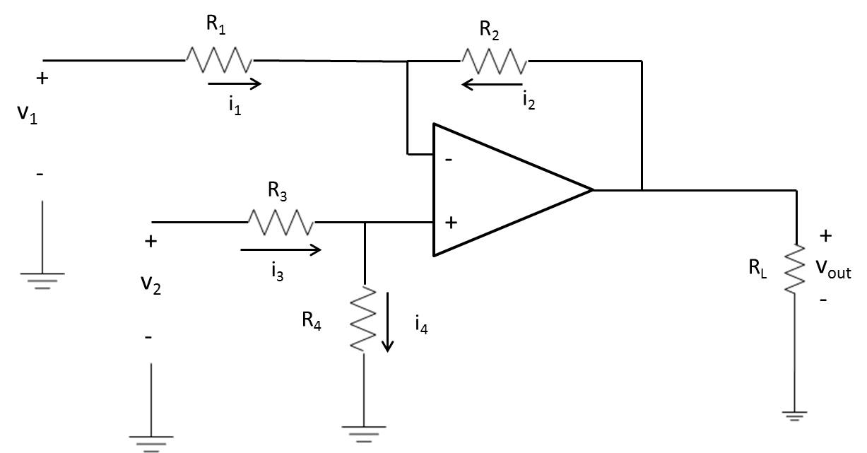
Differential Amp (Subtractor)
A
B

Slide 4
Examples
Design an inverting summer that implements:
V_{out} = -(5V_{A} + 13V_{B})
Using the above gains, find V_{out} if V_{A} = 2V and V_{B} = -.5V
Using the above and V_{A} = 500 mV, V_{cc} = 15V, what is the maximum value of V_{B} and still have it be linear?
Design a circuit that implements:
V_{out} = 8V₂ – 4 V₁ (use a differential amp)

Slide 5
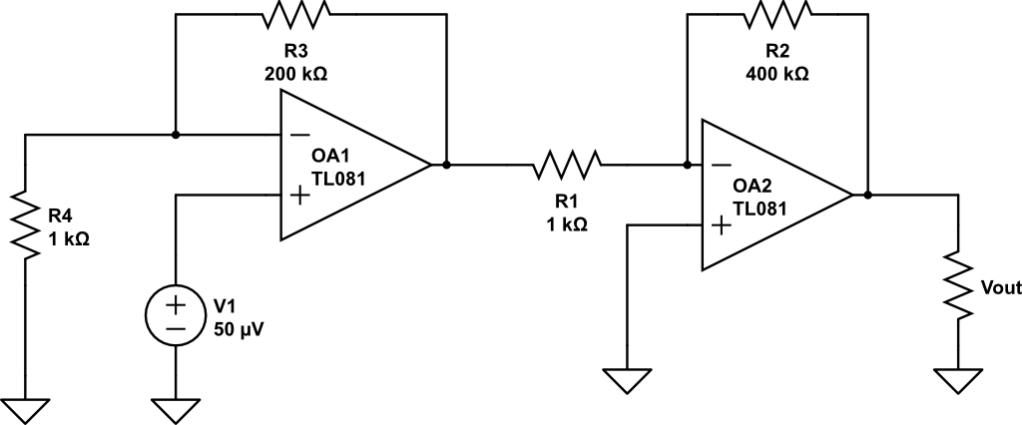
Find V_{out}
+
V_{B}
-
Non-inverting
Inverting

Slide 6
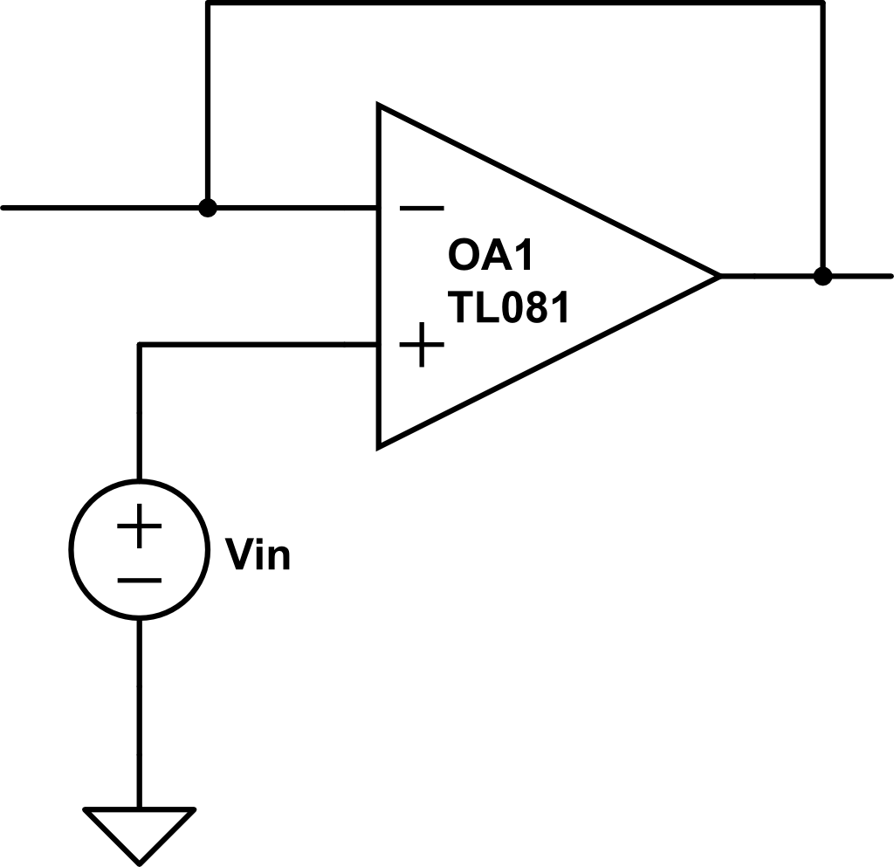

Buffer
Short
Open
circuit
+
V_{out}
+
-
V_{out}
-
Looking at the non-inverting op amp
Buffers help circuits with different impedances work correctly without overloading one another or effecting operation

Slide 7
Backups

Slide 8
Example
(a) Find the transfer characteristics of a differential amplifier if:
R1 = 10k Ω
R2 = 40k Ω
R3 = 10k Ω
R4 = 15k Ω
(b) If Vcc is ± 15 V and V1 = 3V, what is the allowable range of V2 for linear ops?
Vo = -4V1 + 3V2
-1 V ≤ V2 ≤ 9 V

