Slide 1
ECE231 Time Varying Signals
Maj Kevin Walchko

Slide 2
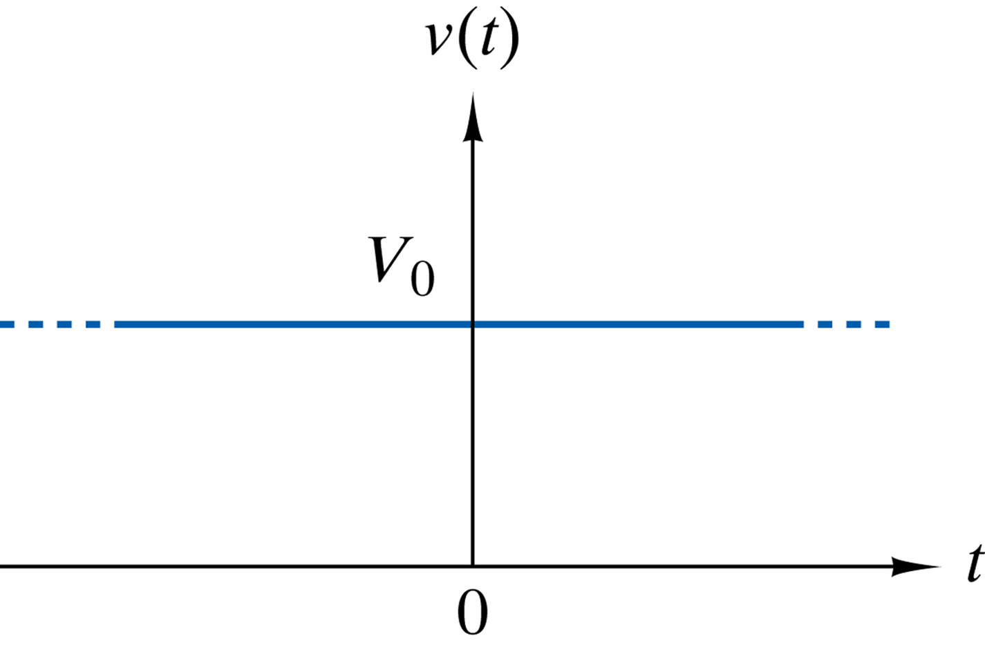
Up to now, we have done DC

Slide 3
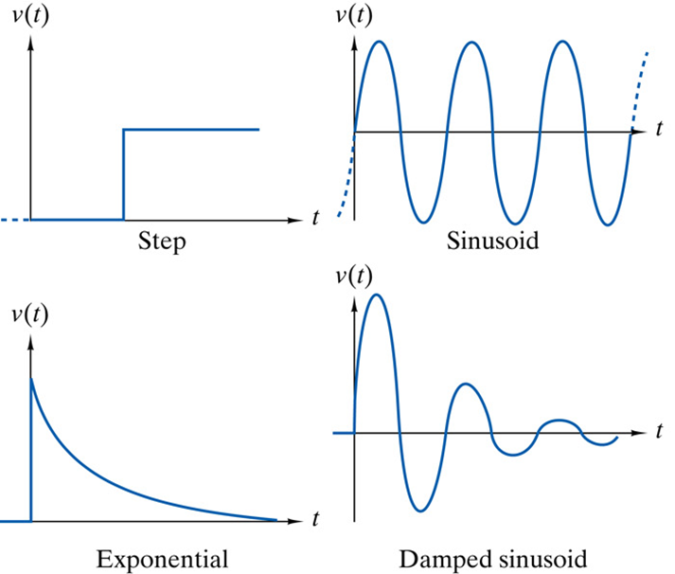
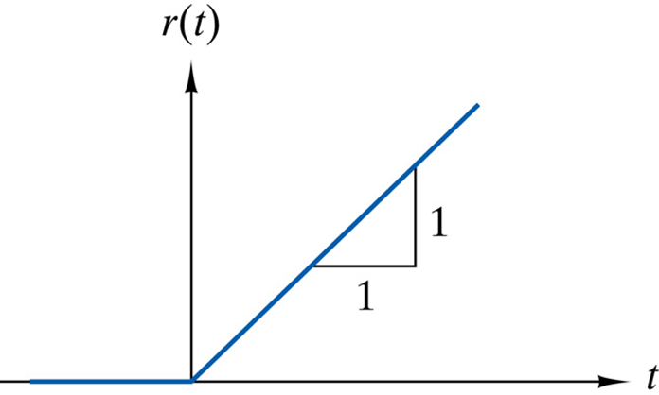
Signals
Ramp

Slide 4
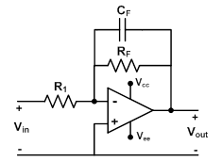
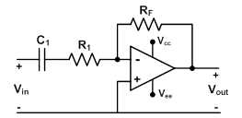
Why are we learning this?
Low pass filter
High pass filter
And other dynamic circuits

Slide 5
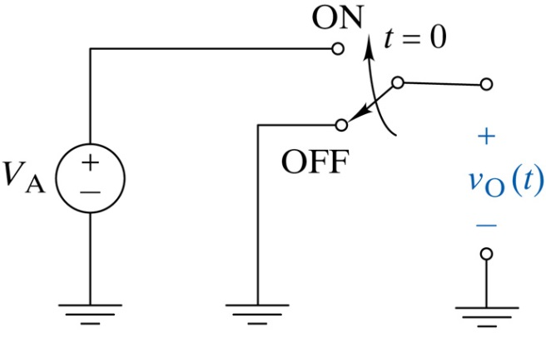
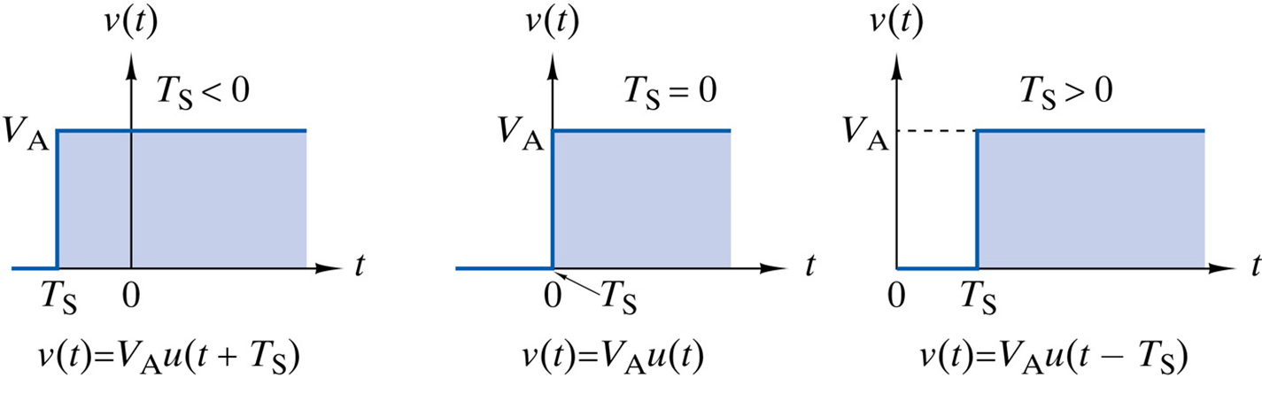
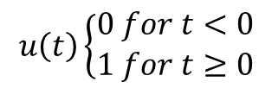
Step
$$u\left(t\right)\left\{\begin{aligned}0 for t<0 \\ 1 for t≥0\end{aligned}\right.$$
Representative of flipping a switch
You can move the step function left or right by adjusting the argument

Slide 6
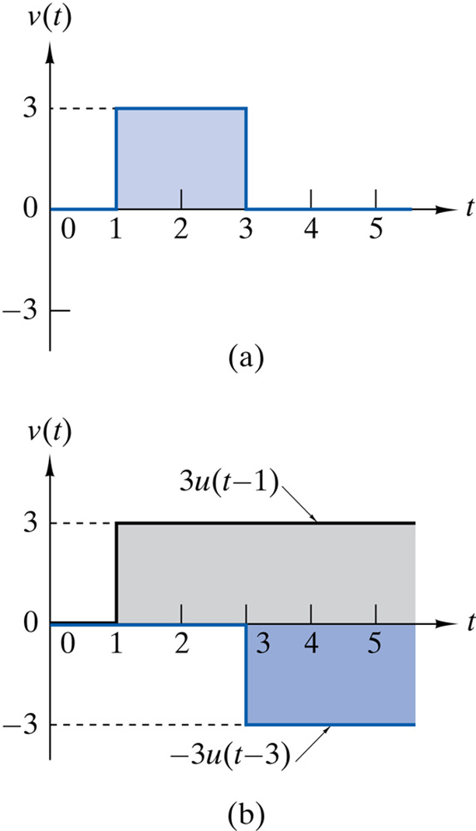
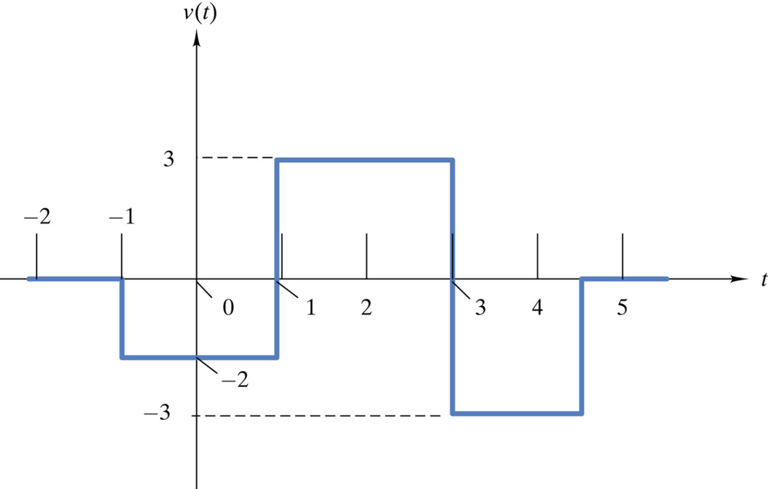
Making Complex Waveforms
Combining 2 wave forms
How would you create this one?
v(t)=-2u(t+1)+5u(t-1)-6u(t-3)+3u(t-4.5)
v(t) = 3u(t-1)-3u(t-3)

Slide 7
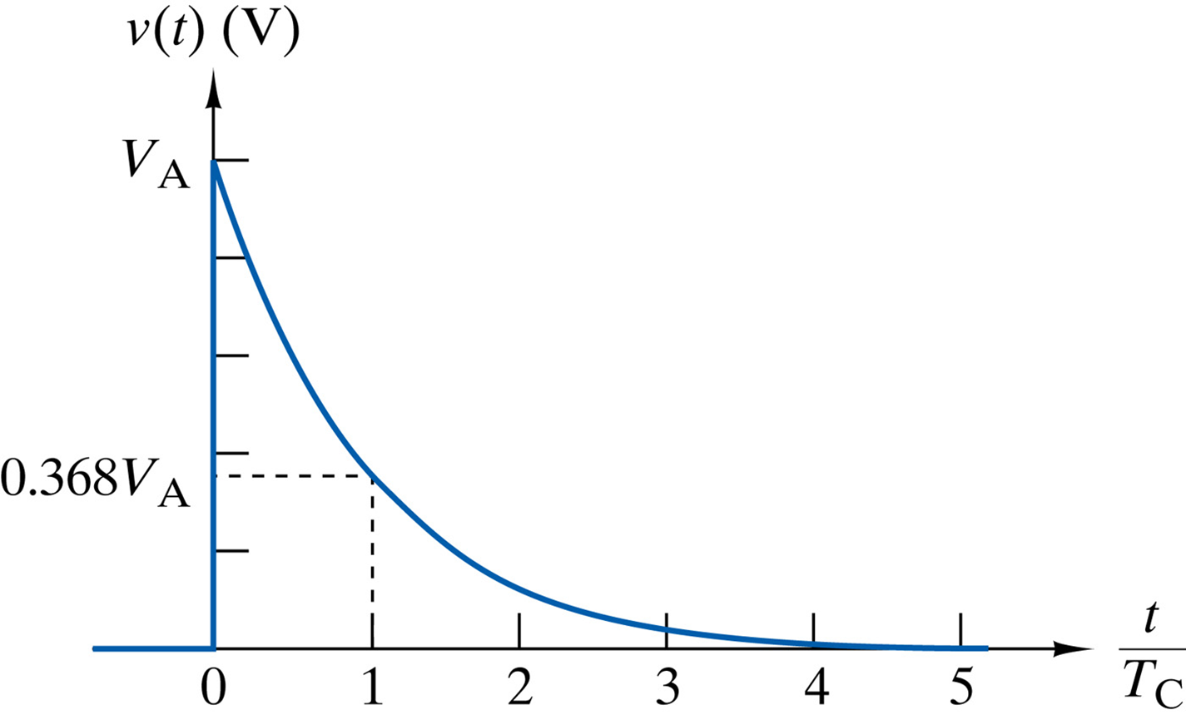

Exponential Function
$$f\left(t\right)=V_{A}e^{−\frac{t}{T_{c}}}∗u(t)$$
This function decreases to essentially 0 at 5 time constants (T_{c})
Tc | f(t)
0 | 1.00
1 | 0.367
2 | 0.135
3 | 0.049
4 | 0.0183
5 | 0.0067

Slide 8
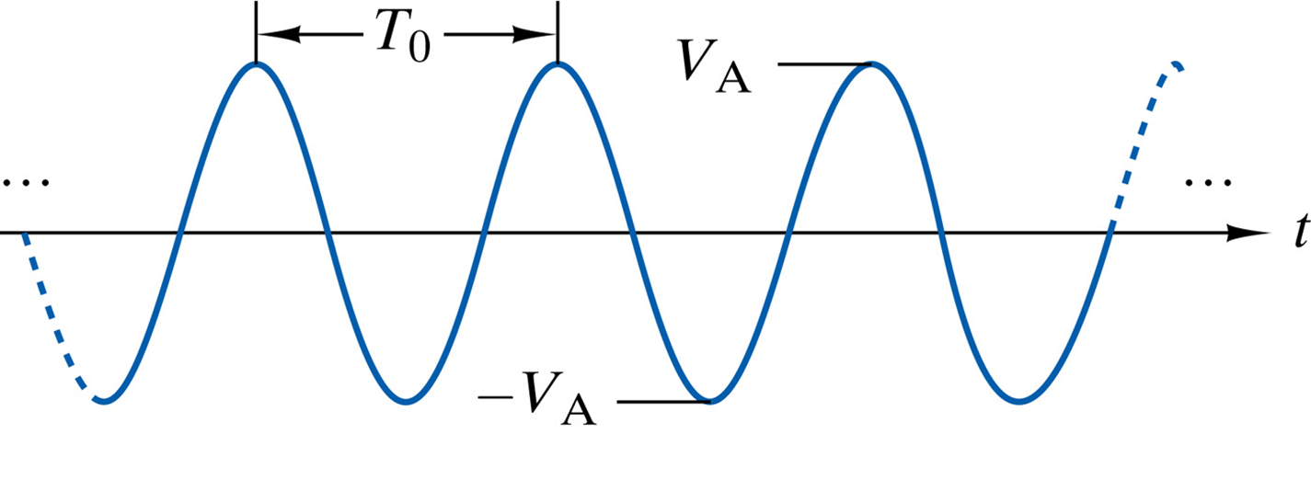
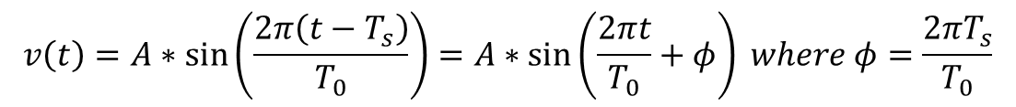
Sinusoid
angular freq
$v\left(t\right)=Bias+A∗\cos\left(2πft+φ\right)=Bias+Acos(ωt+φ)$ where $f=\frac{ω}{2π}$
$$v\left(t\right)=A∗\sin\left(\frac{2π\left(t−T_{s}\right)}{T_{0}}\right)=A∗\sin\left(\frac{2πt}{T_{0}}+φ\right) where φ=\frac{2πT_{s}}{T_{0}}$$
Time shift
period
+
Shift signal (phase)
-

Slide 9
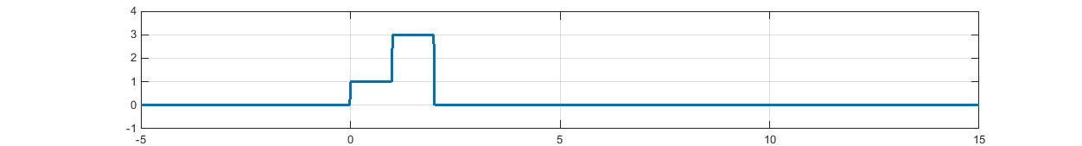

Problems
Write an equation for the plot shown below:
1 sec
2 sec
$$f\left(t\right)=u\left(t\right)+2u\left(t−1\right)−3u(t−2)$$
Determine when $f\left(t\right)=4e^{−1000t}u(t)$ is effectively zero
$T_{c}=\frac{1}{1000}=1 msec→5 msec$ remember, 5 time const

Slide 10

Problems
What is the equation for this exponential?
4V
v(0)=A=4
v(10ms) = 4e^{-10ms/τ} = 2V → τ = 14.4 ms
2V
v(t) = 4e^{-t/14.4ms} u(t)V
0
10 ms
0 sec
7V
What is the equation of this line?
2V
$$v\left(t\right)=2V+5\cos\left(2π∗0.1t−\frac{π}{2}\right)V$$
-3V
10 sec

Slide 11
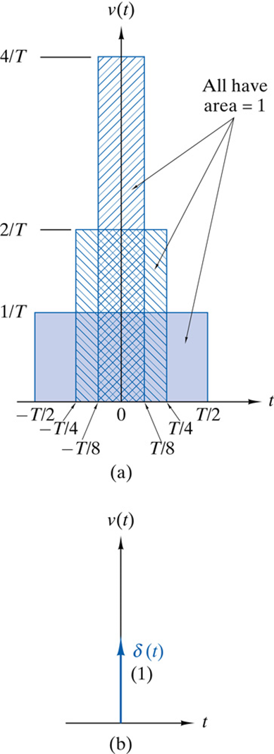


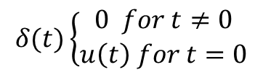
Ramp and Impulse
$$r\left(t\right)=t∗u(t)$$
$$δ(t)\left\{\begin{aligned}0 for t≠0 \\ u\left(t\right) for t=0\end{aligned}\right.$$

Slide 12
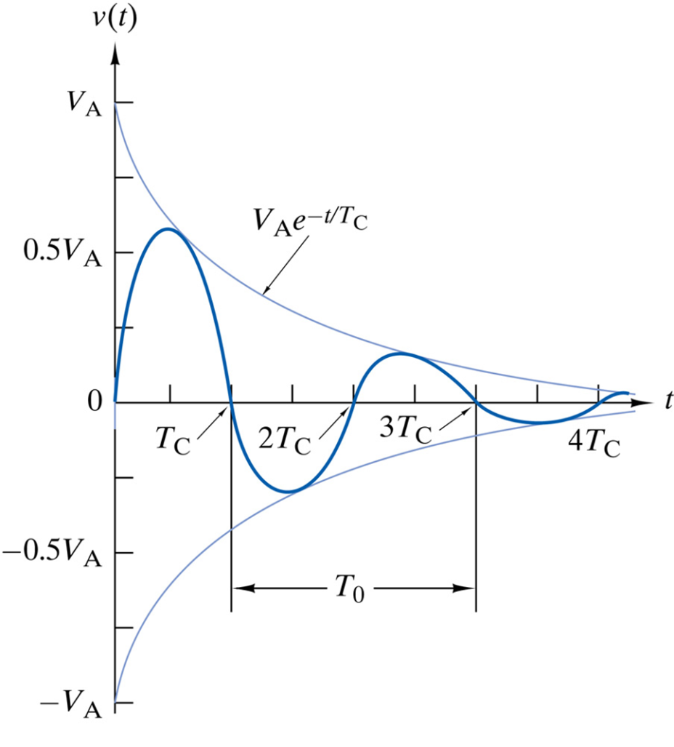
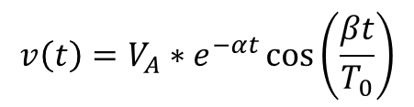
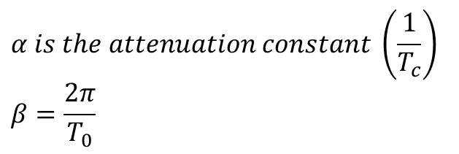
Damped Sinusoid
$$v\left(t\right)=V_{A}∗e^{−αt}\cos\left(\frac{βt}{T_{0}}\right)$$
$$α is the attenuation constant \left(\frac{1}{T_{c}}\right)$$
$$β=\frac{2π}{T_{0}}$$

Slide 13
Backups

Slide 14
Summary
V_{in}
K
V_{out}=KV_{in}
Non-inverting Op Amp
V_{in}
-K
V_{out}=-KV_{in}
Inverting Op Amp
V_{in1}
-K1
V_{in2}
-K2
+
V_{out}=-K1*V_{in1}-K2*V_{in2}-…-K_{n}*V_{inn}
Summing Op Amp
…
V_{inn}
-Kn
V_{in}
1
V_{out}=V_{in}
Buffer
V_{in1}
K1
+
V_{out}=K1*V_{in1}-K2*V_{in2}
Differential Op Amp
V_{in2}
-K2
More than one way to draw these, Fig 4-48, pg 188 is different

