Slide 1
ECE231 Integrating Factors
Maj Kevin Walchko

Slide 2
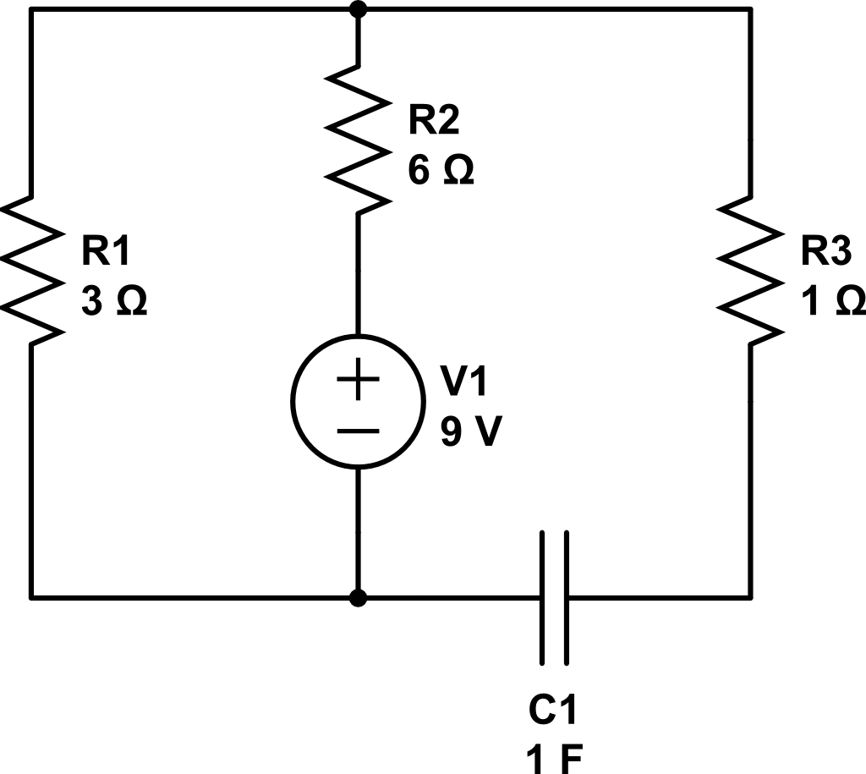
Use MUC to find Vc
Vc(0) = 5V

Slide 3
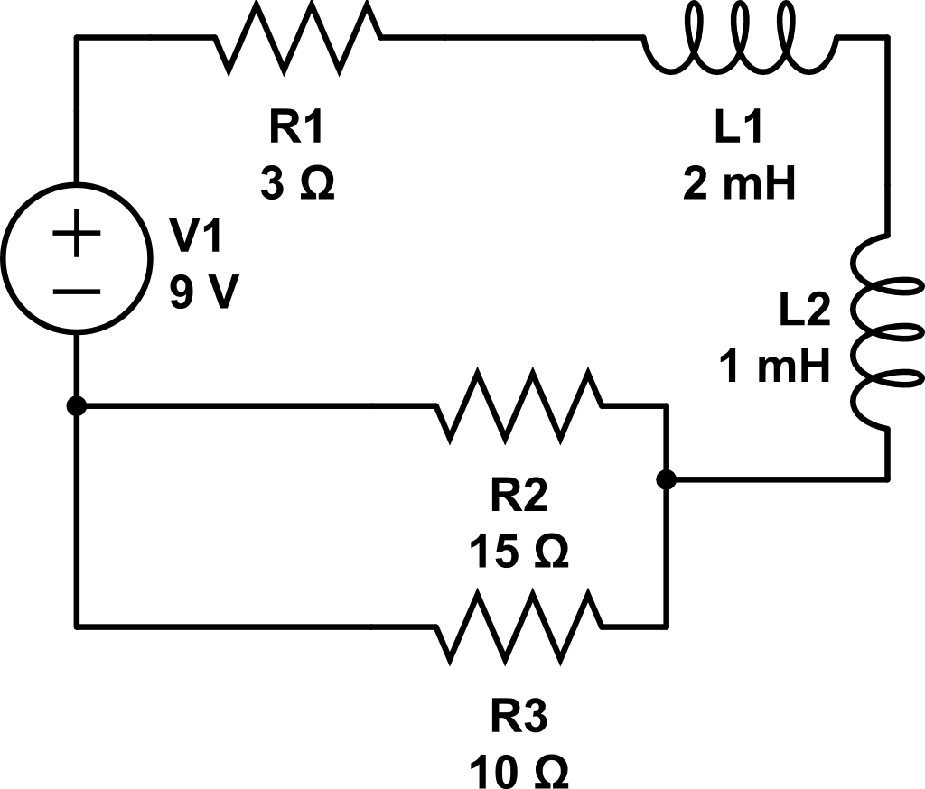
Use integrating factors to find i_{L}
i_{L}(0) = 2A

Slide 4
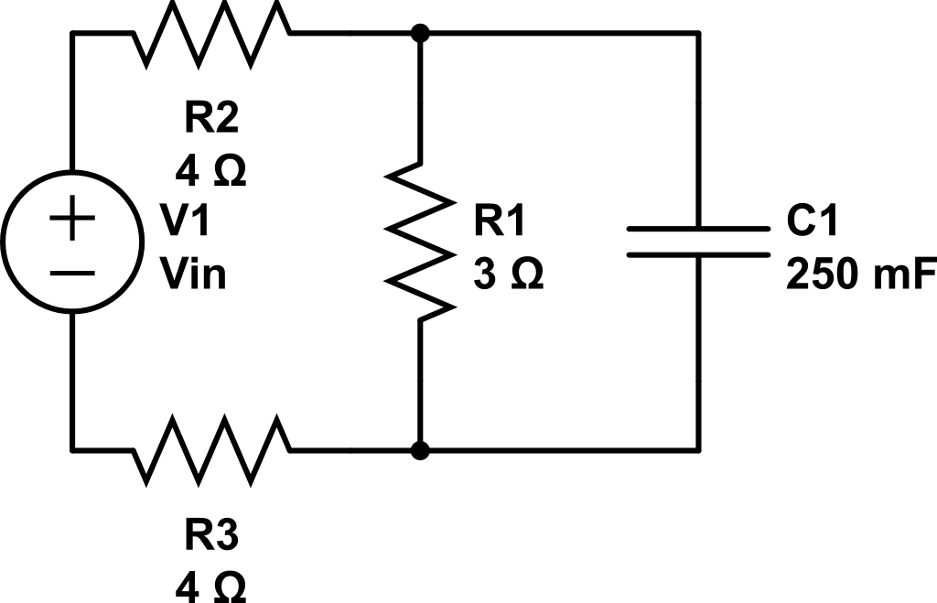
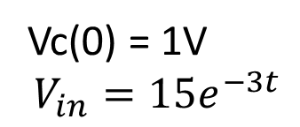
Find Vc
Vc(0) = 1V
$$V_{in}=15e^{−3t}$$

Slide 5
Backups

Slide 6
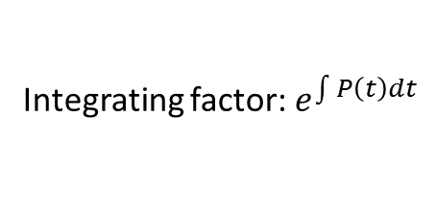



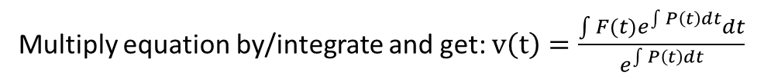
Integrating Factors
Need equations like: $\frac{∂v}{∂t}+P\left(t\right)v\left(t\right)=F(t)$
Integrating factor: $e^{\int{P\left(t\right)dt}}$
Multiply equation by/integrate and get: $v\left(t\right)=\frac{\int{{F(t)e}^{\int{P\left(t\right)dt}}dt}}{e^{\int{P\left(t\right)dt}}}$
Example: $\frac{∂v}{∂t}+10v=4e^{40t}$
Compare to: $\frac{∂v}{∂t}+P\left(t\right)v\left(t\right)=F(t)$
Make sure you read the handout on integrating factors!

Slide 7
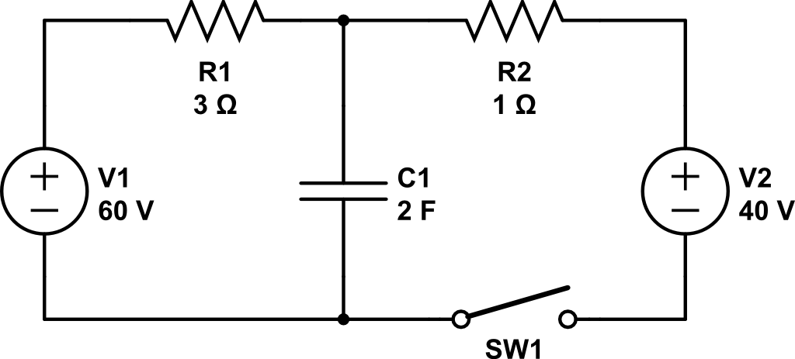

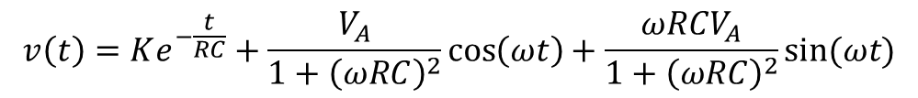
(one more sin ex) Find V_{c}
Finish up from last time
+
Vc
$$40cos\left(20t\right)V$$
-
$$v\left(t\right)=Ke^{−\frac{t}{RC}}+\frac{V_{A}}{1+{\left(ωRC\right)}^{2}}\cos\left(ωt\right)+\frac{{ωRCV}_{A}}{1+{\left(ωRC\right)}^{2}}sin⁡(ωt)$$
Full derivation, (7-26), p339

