Slide 1
ECE231 More Stuff
Maj Kevin Walchko

Slide 2
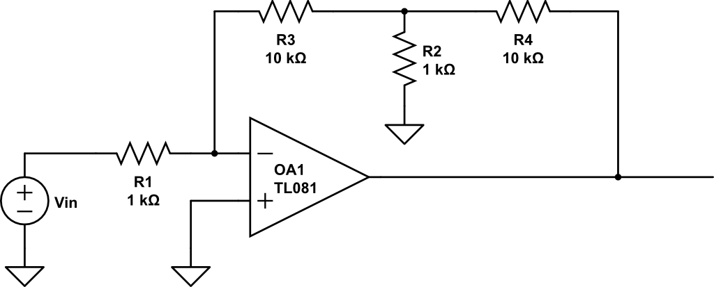
Find the gain
Vout
Hint: you are going to have to derive the equation … nodal?

Slide 3
Design the Sensor Conditioning
Pressure
Senor
Computer
50psi
50psi = 5V
0psi = -5V
0psi
0V
2V
Sensor response from datasheet
What is the equation?

Slide 4
Design the Op Amp Circuit
Use the equation from the previous problem

Slide 5
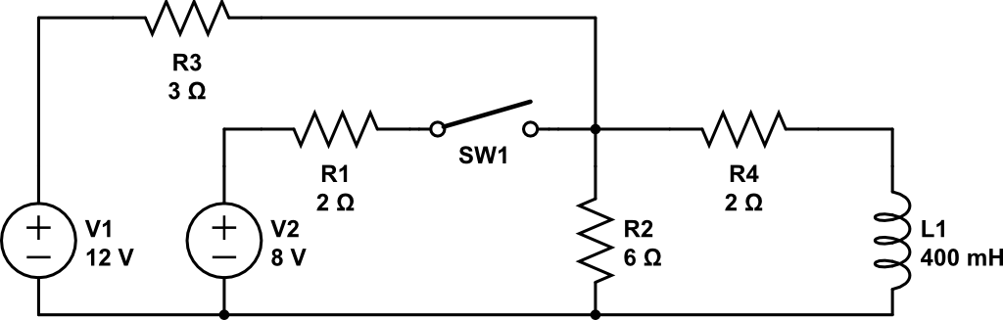
Find i_{L}(t)
i_{L}(t)

Slide 6
Backups

Slide 7
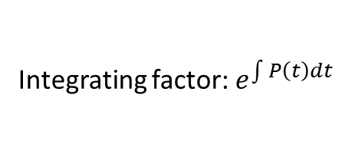



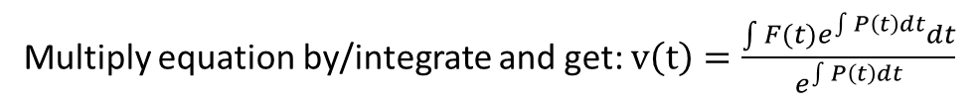
Integrating Factors
Need equations like: $\frac{∂v}{∂t}+P\left(t\right)v\left(t\right)=F(t)$
Integrating factor: $e^{\int{P\left(t\right)dt}}$
Multiply equation by/integrate and get: $v\left(t\right)=\frac{\int{{F(t)e}^{\int{P\left(t\right)dt}}dt}}{e^{\int{P\left(t\right)dt}}}$
Example: $\frac{∂v}{∂t}+10v=4e^{40t}$
Compare to: $\frac{∂v}{∂t}+P\left(t\right)v\left(t\right)=F(t)$
Make sure you read the handout on integrating factors!

