Slide 1
ECE231 Phasors and Impedance
Maj Kevin Walchko

Slide 2
Potential Topics for GR
Given a plot of a signal, determine the equation
Also the reverse: eqn -> plot it
Given an op amp circuit, derive the equation
Also the reverse: eqn -> op amp circuit
Signal conditioning/transducer interfaces
Given an ODE, solve
Phasors (today’s stuff)
Others?

Slide 3
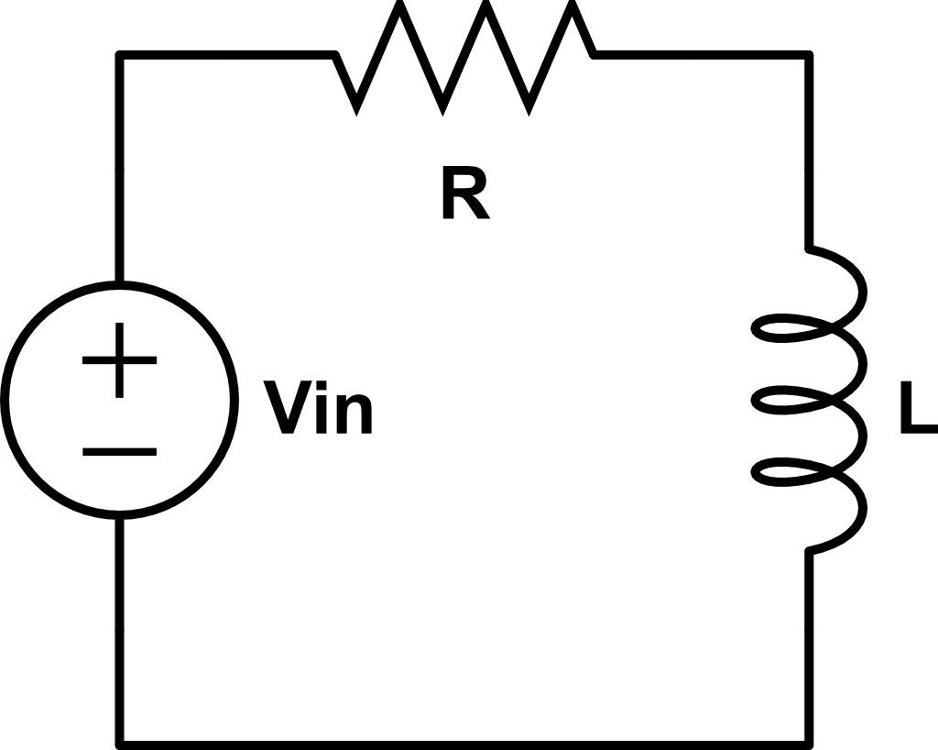

Steady State Analysis
t >> 0
$$V_{in}=V_{m}cos⁡(ωt+α)$$
Find i_{L}(∞)
This gets more complicated as we get more signals … need a better way

Slide 4

Complex Number Review
Im
$$a+jb$$
b
c
θ
a
Re

Slide 5
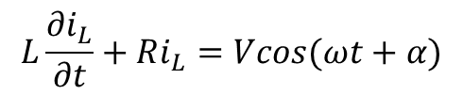



Phasors
$$L\frac{∂i_{L}}{∂t}+Ri_{L}=Vcos(ωt+α)$$
$$i_{Lss}=Icos(ωt+θ)$$
$$Vcos\left(ωt+α\right)=Re\left\{Ve^{j\left(ωt+α\right)}\right\}=Re\{Ve^{jα}e^{jωt}\}$$
$$\tilde{V_{s}}=Ve^{jα}=V<α$$
$$Vcos\left(ωt+α\right)=Re\{\tilde{V_{s}}e^{jωt}\}$$
projection
Complex number
Rotation, CCW

Slide 6
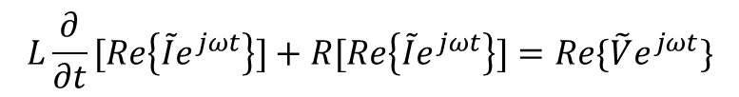
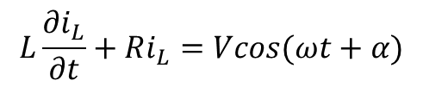
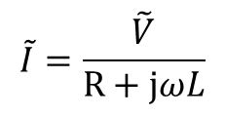

Use Phasors
$$L\frac{∂i_{L}}{∂t}+Ri_{L}=Vcos(ωt+α)$$
$$L\frac{∂}{∂t}[Re\left\{\tilde{I}e^{jωt}\right\}]+R[Re\left\{\tilde{I}e^{jωt}\right\}]=Re\{\tilde{V}e^{jωt}\}$$
$$jωL\tilde{I}+R\tilde{I}−\tilde{V}=0$$
$$\tilde{I}=\frac{\tilde{V}}{R+jωL}$$
We have eliminated time and only have frequencies left

Slide 7
Backups

