Slide 1
ECE231 Phasors Circuit Analysis and Design I
Maj Kevin Walchko
Don’t wait until the last minute to get a calculator that can do phasors

Slide 2


Phasors
$$Vcos\left(ωt+α\right)=Re\left\{Ve^{j\left(ωt+α\right)}\right\}=Re\{Ve^{jα}e^{jωt}\}$$
$$\tilde{V_{s}}=Ve^{jα}=V<α$$
$$Vcos\left(ωt+α\right)=Re\{\tilde{V_{s}}e^{jωt}\}$$
projection
Complex number
Rotation, CCW

Slide 3
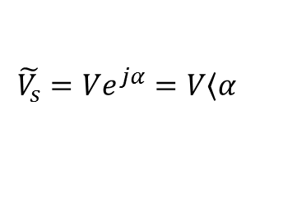
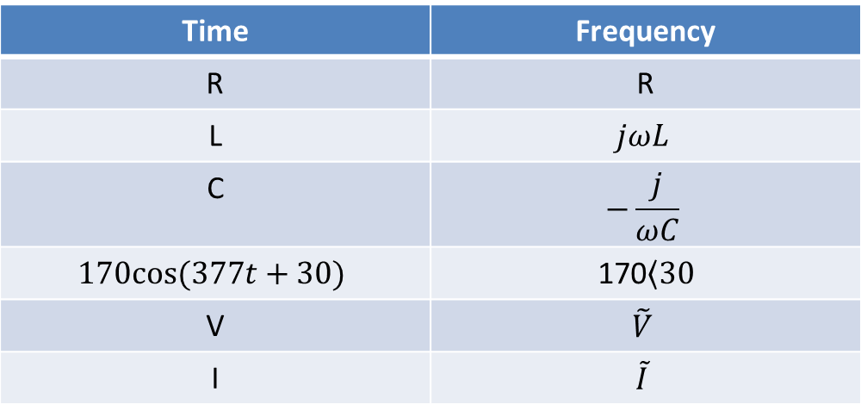
Time to Freq Domain
Time | Frequency
R | R
L | $$jωL$$
C | $$−\frac{j}{ωC}$$
$$170cos⁡(377t+30)$$ | 170$\left\langle 30\right.$
V | $$\tilde{V}$$
I | $$\tilde{I}$$
Where:
$$\tilde{V_{s}}=Ve^{jα}=V\left\langle α\right.$$

Slide 4
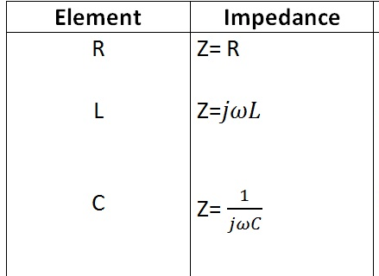
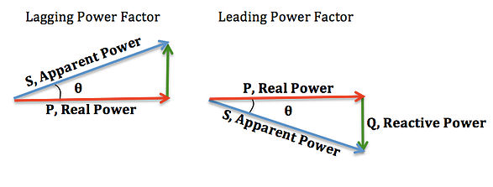

Phasors
Phasors only apply to the Steady State domain where the input is a sinusoid
Behave like resistors in serial and parallel
$$Z=R+jX$$
Always positive
(no negative resistors)
Can be + or -, where:
+ inductive (lag)
- capacitive (lead)

Slide 5
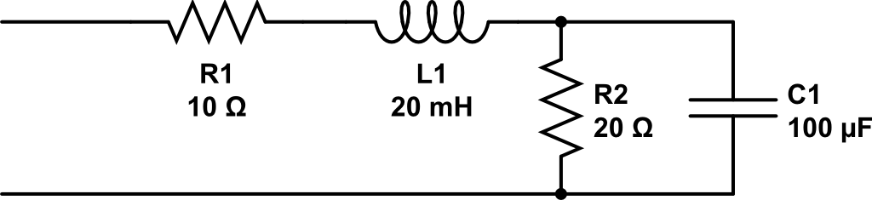
Find Z_{eq}

Slide 6
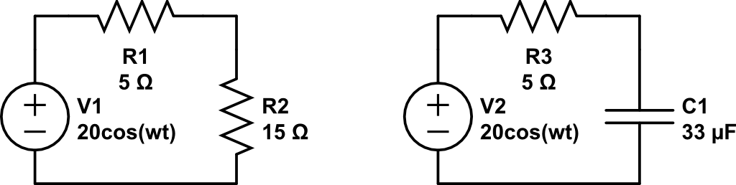
Find V_{out}
V_{out}
V_{out}

Slide 7
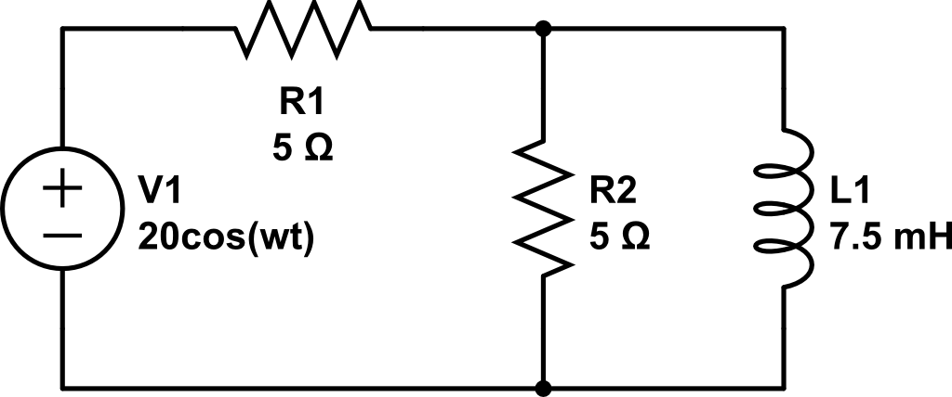
Find current through R1 and L1

Slide 8
Use Nodal to find i_{L}
A
B
Ground

Slide 9
Backups

Slide 10
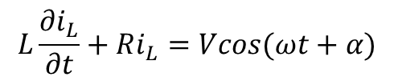



Phasors
$$L\frac{∂i_{L}}{∂t}+Ri_{L}=Vcos(ωt+α)$$
$$i_{Lss}=Icos(ωt+θ)$$
$$Vcos\left(ωt+α\right)=Re\left\{Ve^{j\left(ωt+α\right)}\right\}=Re\{Ve^{jα}e^{jωt}\}$$
$$\tilde{V_{s}}=Ve^{jα}=V<α$$
$$Vcos\left(ωt+α\right)=Re\{\tilde{V_{s}}e^{jωt}\}$$
projection
Complex number
Rotation, CCW

