Slide 1
ECE231 Basics
Maj Kevin Walchko

Slide 2
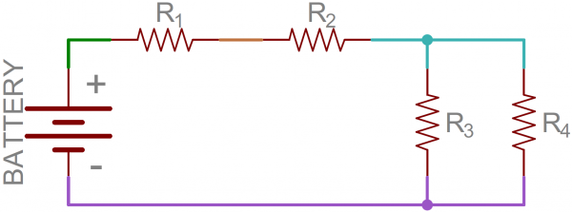
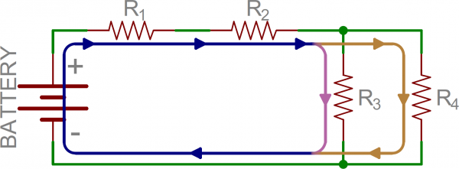
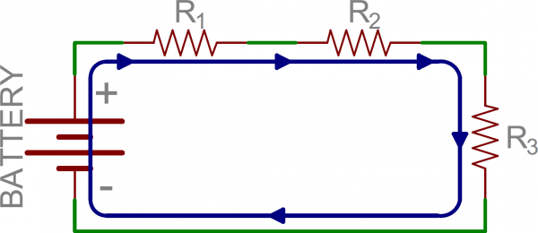
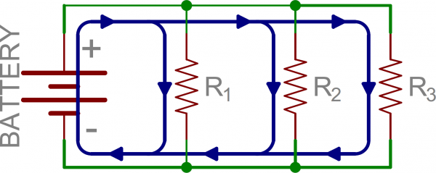


Equivalent Circuits
Given the following circuit, there are multiple nodes and loops which need to be calculated to determine the current flow through the circuit. However, we can simplify this with the idea of equivalent resistors.
Series (all see the same current)
Parallel (all see the same voltage drop)
(this only applies to 2 resistors)

Slide 3
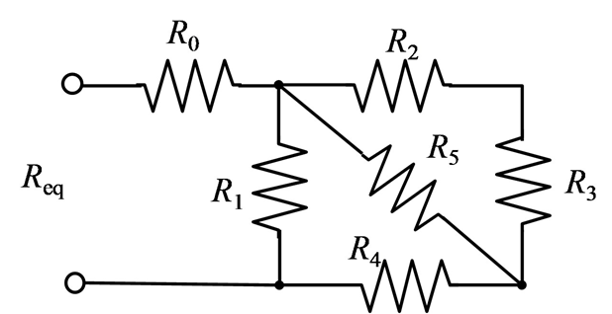
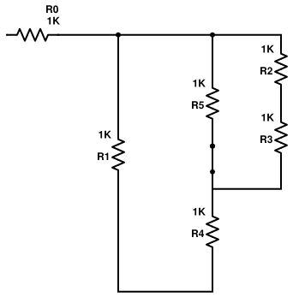
Example
Redraw
Series: Eq1 = R2 & R3
Parallel: Eq2 = R5 & Eq1
Series: Eq3 = R4 & Eq2
Parallel: Eq4 = R1 & Eq3
Series: R0 & Eq4

Slide 4
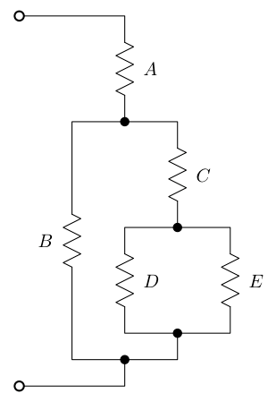
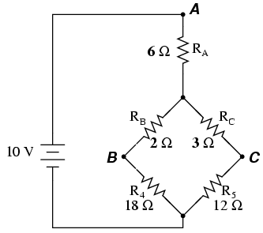
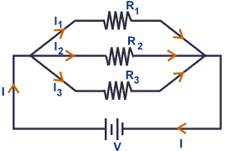
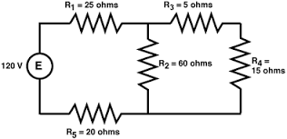
Parallel or Series?

Slide 5
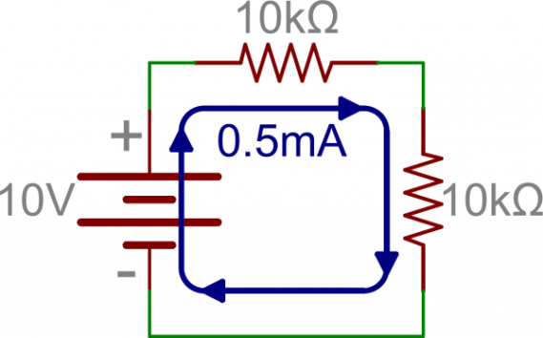
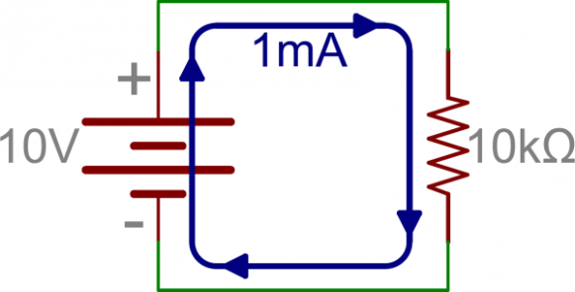
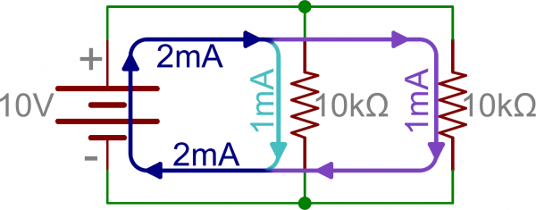
Equivalent Resistance
1. Original
2. Series
3. Parallel
I = V/R
I = 10 V / 10 kΩ
I = 1 mA
P = IV
P = 1 mA * 10 V
P = 10 mW
I = V / R
I = 10 V / ( 10 kΩ + 10 kΩ)
I = 0.5 mA
P = 0.5 mA * 10 V = 5 mW
I = V / R_{eq}
I = 10 V / (100/(10 + 10) kΩ)
I = 10 V / 5 kΩ
I = 2 mA
P = 2 mA * 10 V = 20 mW
For #2 , the added resistor increased the difficulty for current to flow through the circuit loop, thus increasing the resistance proportionally. Higher resistance means less current and lower power consumption.
For #3, notice the R_{eq} is less than the smallest R value. Thus, less resistance means more current flow and power consumption.

Slide 6
Current/Voltage Division
Voltage Division (series)
Current Division (parallel)
R₁
R₁
R₂
R₂
What is the current across R₂?
I₂ = 10 kΩ / 20 kΩ * 2 mA
I₂ = 1 mA
What is the voltage drop across R₂?
V₂ = 10 kΩ / 20 kΩ * 10 V
V₂ = 5 V
This equation is possible because all resistors in parallel see the same voltage drop, thus,
I₂*R₂ = I_{s}*R_{eq} -> I₂= R_{eq}/R₂*I_{s} = R₁/R_{sum}*I_{s}
Note: The R₂ cancel
This equation is possible because all resistors in series see the same current, thus, V₂/R₂ = V_{s}/R_{eq} = V_{s}/R_{sum}

Slide 7
Backups

