Slide 1
ECE231 Phasors Circuit Analysis and Design I
Maj Kevin Walchko
Don’t wait until the last minute to get a calculator that can do phasors

Slide 2
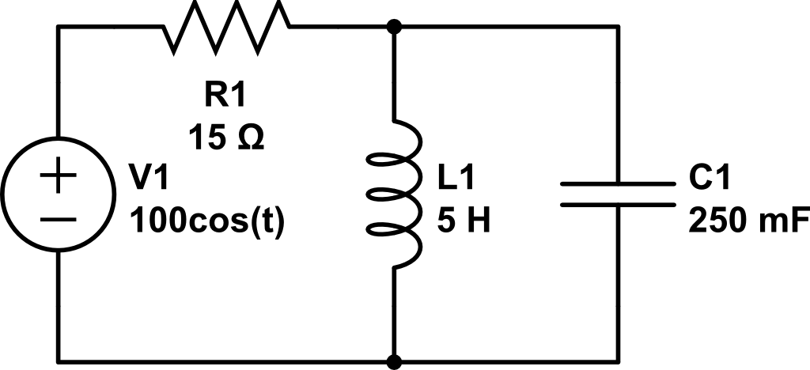
Use Current Div to find i_{L}(t)
Anything strange about this current divider solution???

Slide 3
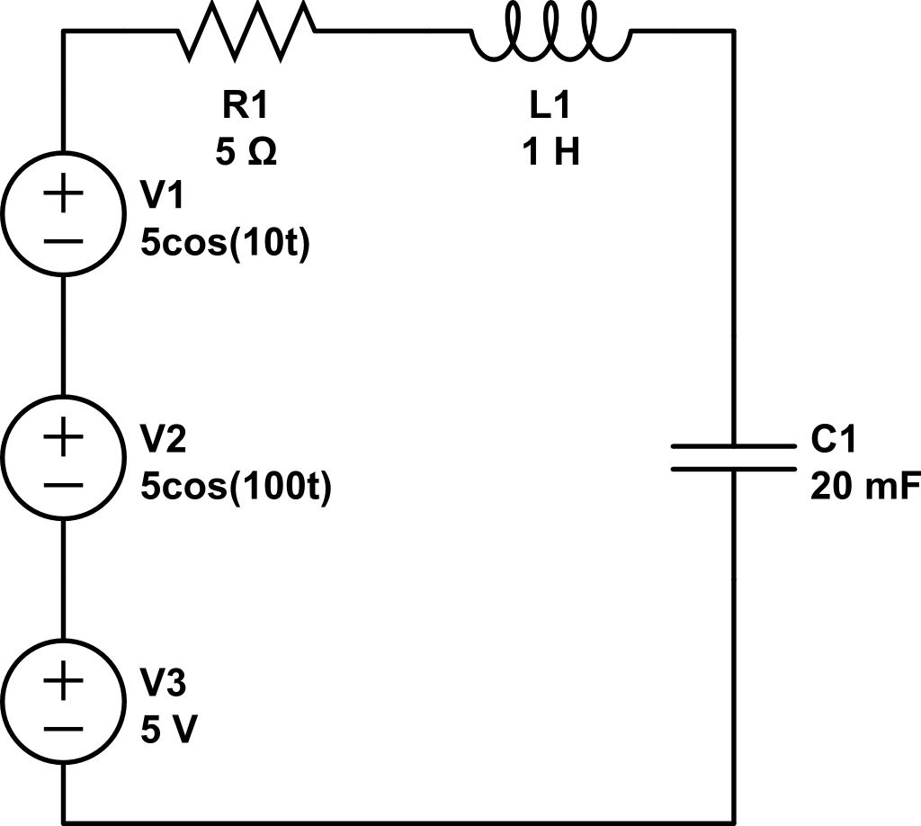
Find V_{out}(t)
+
V_{out}
-

Slide 4
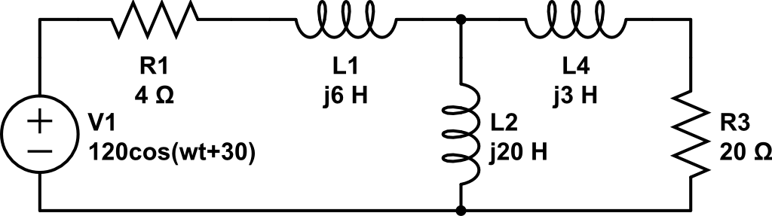
Find V_{out} using Nodal
A
Combine
B
C
+
V_{out}
-
Ground

Slide 5
Backups

Slide 6


Phasors
$$Vcos\left(ωt+α\right)=Re\left\{Ve^{j\left(ωt+α\right)}\right\}=Re\{Ve^{jα}e^{jωt}\}$$
$$\tilde{V_{s}}=Ve^{jα}=V<α$$
$$Vcos\left(ωt+α\right)=Re\{\tilde{V_{s}}e^{jωt}\}$$
projection
Complex number
Rotation, CCW

Slide 7
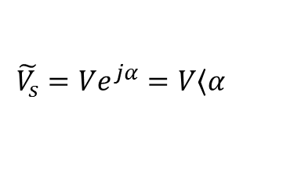
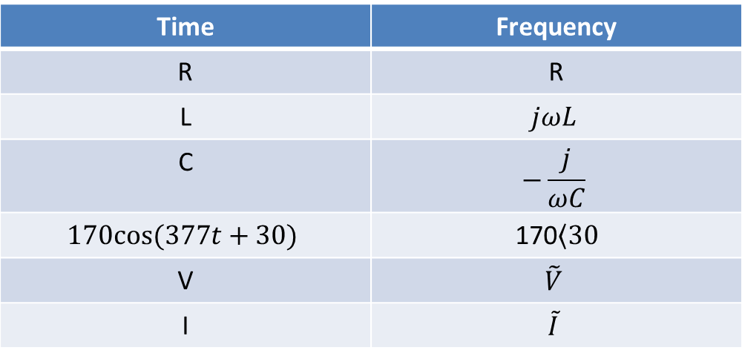
Time to Freq Domain
Time | Frequency
R | R
L | $$jωL$$
C | $$−\frac{j}{ωC}$$
$$170cos⁡(377t+30)$$ | 170$\left\langle 30\right.$
V | $$\tilde{V}$$
I | $$\tilde{I}$$
Where:
$$\tilde{V_{s}}=Ve^{jα}=V\left\langle α\right.$$

