Slide 1
ECE231 Instantaneous Power and Max Power
Maj Kevin Walchko
Don’t wait until the last minute to get a calculator that can do phasors

Slide 2
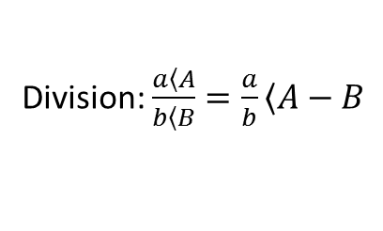
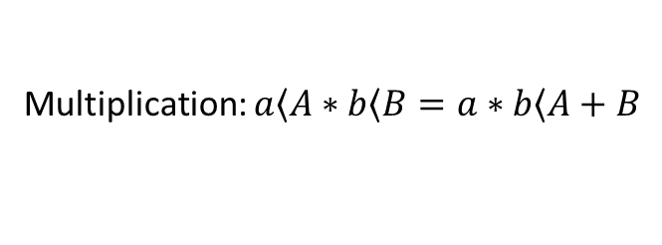
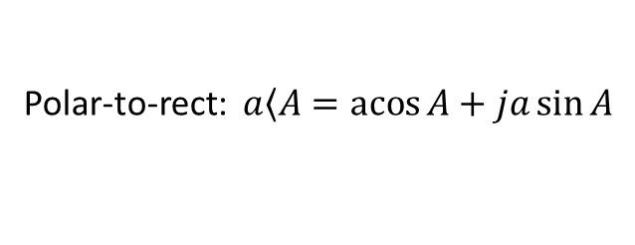
Review
Math:
Multiplication: $a\left\langle A\right.∗b\left\langle B\right.=a∗b\left\langle A+B\right.$
Division: $\frac{a\left\langle A\right.}{b\left\langle B\right.}=\frac{a}{b}\left\langle A−B\right.$
Add/subtract: polar -> rectangular -> polar
Conversions:
Polar-to-rect: $a\left\langle A\right.=\operatorname{acos}{A}+ja\sin{A}$
Rect-to-polar: $a+jb →mag=\sqrt{a^{2}+b^{2}} angle=\operatorname{atan}{\frac{b}{a}}$
Get a good calculator or know how to use Matlab

Slide 3
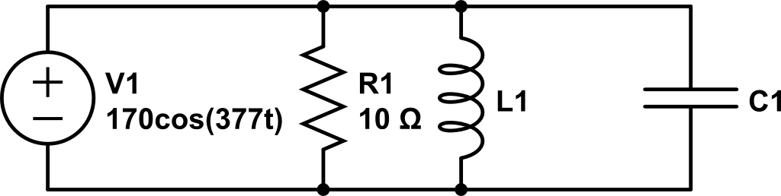
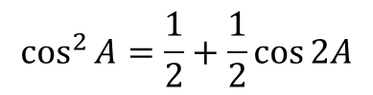
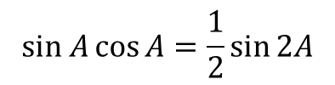
What is the instantaneous and average power?
(we will derive some things as we go along)
20/377 H
1/3770F
$$\cos^{2}{A=\frac{1}{2}+\frac{1}{2}\cos{2A}}$$
$$sin A\cos{A=\frac{1}{2}\sin{2A}}$$
Trig identities:

Slide 4
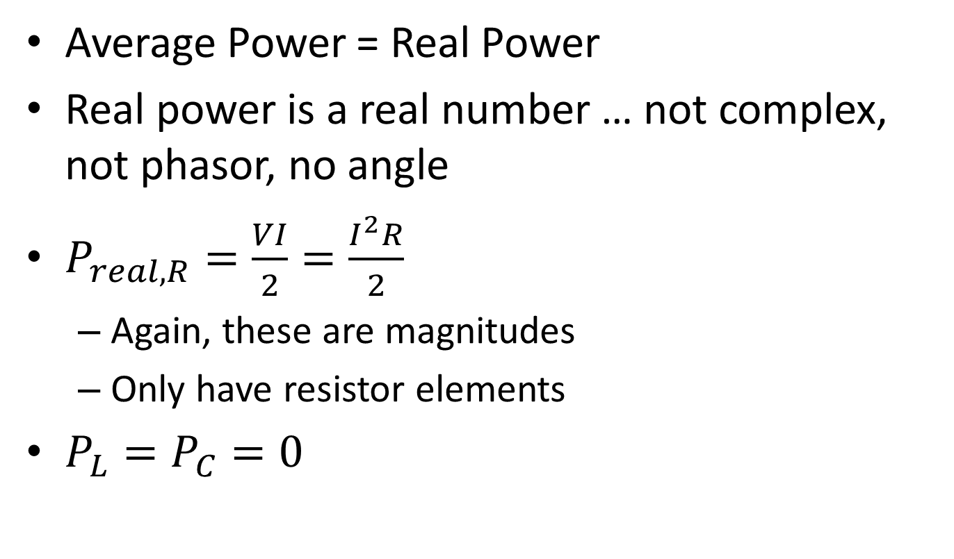
Summary
Average Power = Real Power
Real power is a real number … not complex, not phasor, no angle
$P_{real, R}=\frac{VI}{2}=\frac{I^{2}R}{2}$
Again, these are magnitudes
Only have resistor elements
$P_{L}=P_{C}=0$

Slide 5
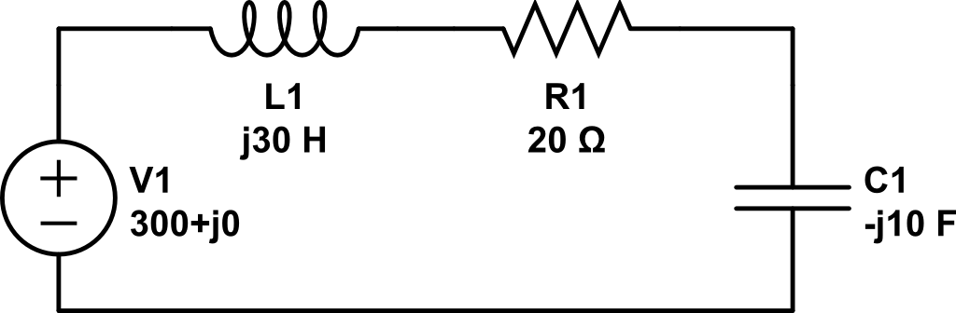

Find the real power
$$\tilde{I}$$

Slide 6
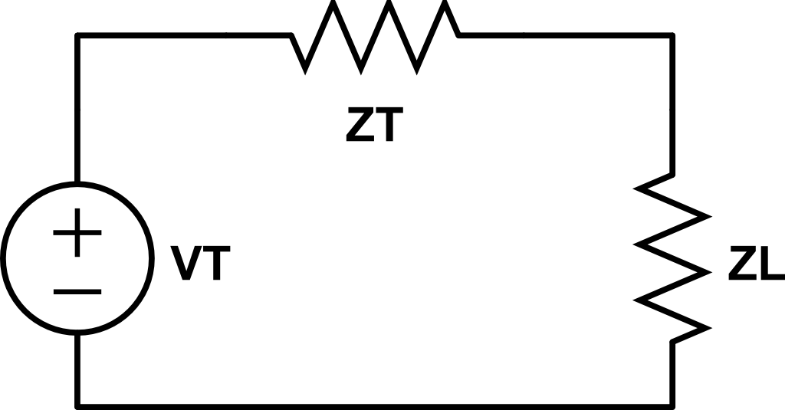
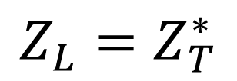
Max Power Transfer
Amp
source
load
What is a good process to find max power transfer?
How did we find max power transfer before?
$$Z_{L}=Z_{T}^{∗}$$

Slide 7
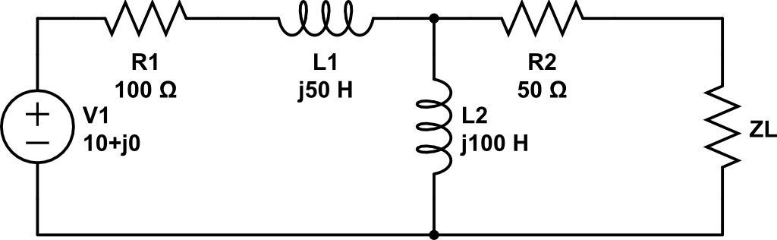
Find Z_{L} for max power transfer and real power of the load

Slide 8
Find Z_{L} for max power transfer and real power of the load
DMM
Z_{T}

Slide 9
Find Z_{L} for max power transfer and real power of the load
DMM
V_{T}

Slide 10
Find Z_{L} for max power transfer and real power of the load

Slide 11
Backups

Slide 12


Phasors
$$Vcos\left(ωt+α\right)=Re\left\{Ve^{j\left(ωt+α\right)}\right\}=Re\{Ve^{jα}e^{jωt}\}$$
$$\tilde{V_{s}}=Ve^{jα}=V<α$$
$$Vcos\left(ωt+α\right)=Re\{\tilde{V_{s}}e^{jωt}\}$$
projection
Complex number
Rotation, CCW

Slide 13
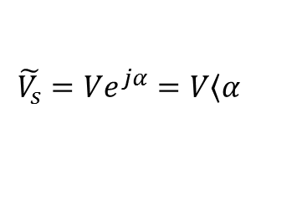
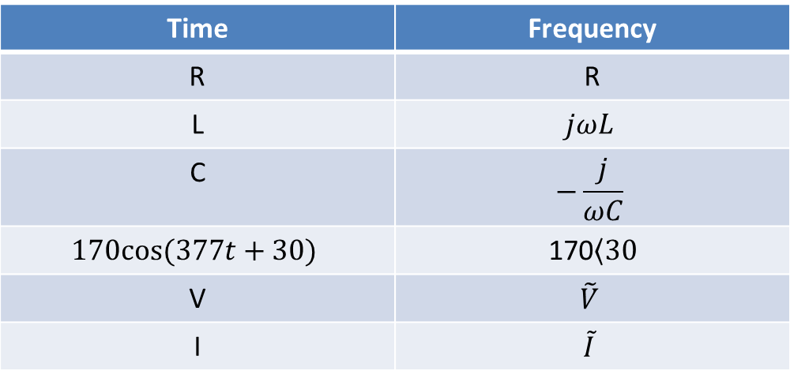
Time to Freq Domain
Time | Frequency
R | R
L | $$jωL$$
C | $$−\frac{j}{ωC}$$
$$170cos⁡(377t+30)$$ | 170$\left\langle 30\right.$
V | $$\tilde{V}$$
I | $$\tilde{I}$$
Where:
$$\tilde{V_{s}}=Ve^{jα}=V\left\langle α\right.$$

