Slide 1
ECE231 Filters I: Transfer Functions
Maj Kevin Walchko
Don’t wait until the last minute to get a calculator that can do phasors

Slide 2
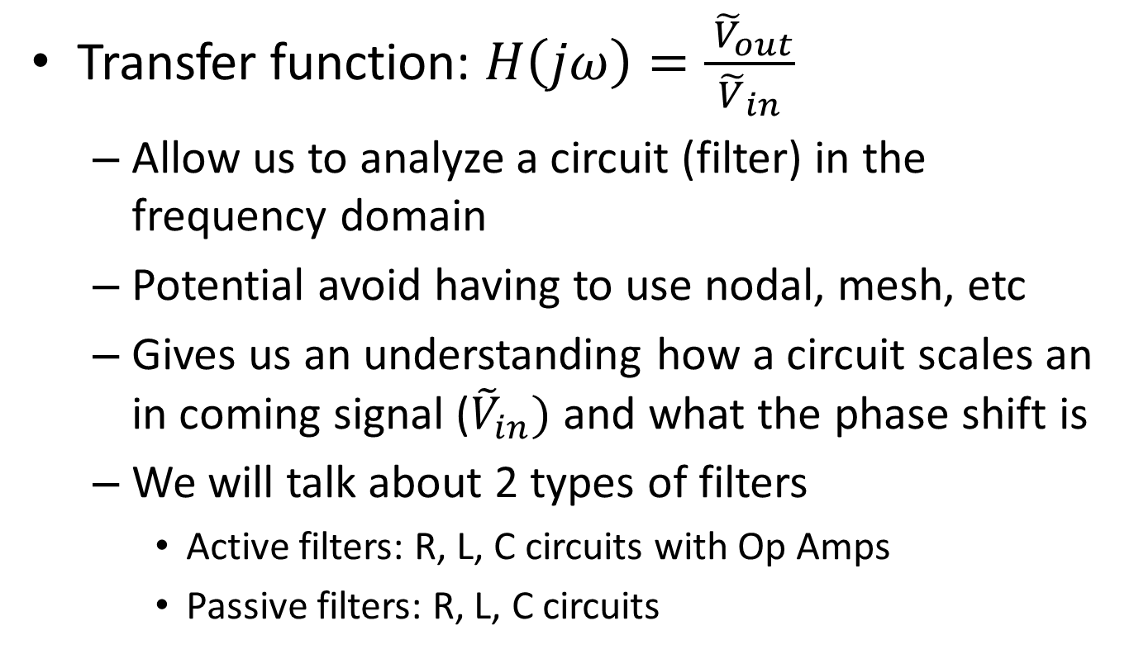
Intro
Transfer function: $H\left(jω\right)=\frac{ {\tilde{V}}_{out}}{{\tilde{V}}_{in}}$
Allow us to analyze a circuit (filter) in the frequency domain
Potential avoid having to use nodal, mesh, etc
Gives us an understanding how a circuit scales an in coming signal (${\tilde{V}}_{in})$ and what the phase shift is
We will talk about 2 types of filters
Active filters: R, L, C circuits with Op Amps
Passive filters: R, L, C circuits

Slide 3
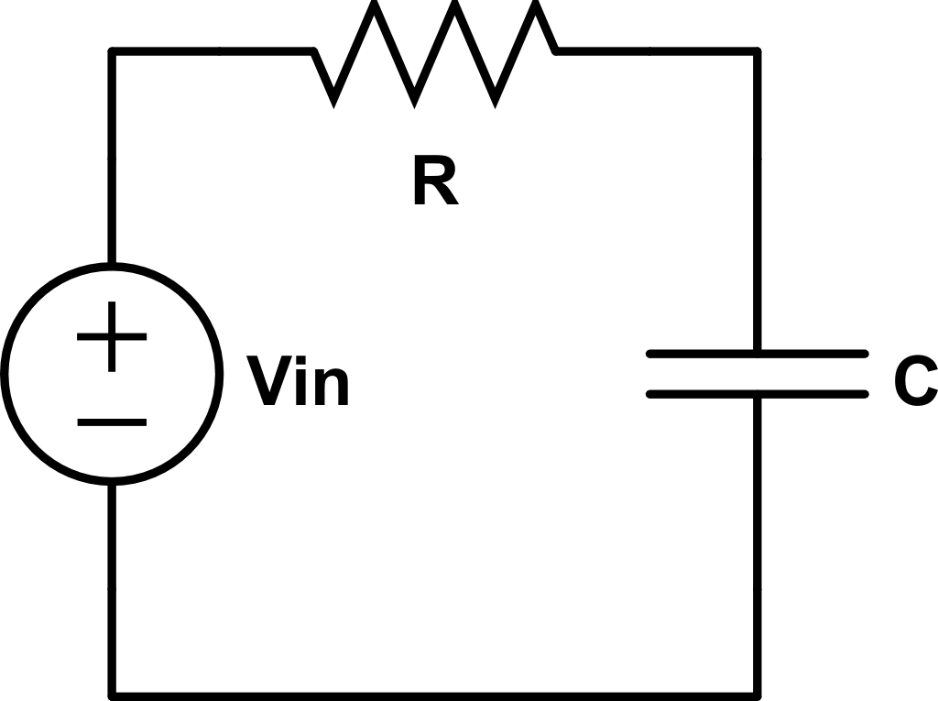


Find the transfer function
$$V_{out}$$
$$\frac{1}{jωC}$$

Slide 4
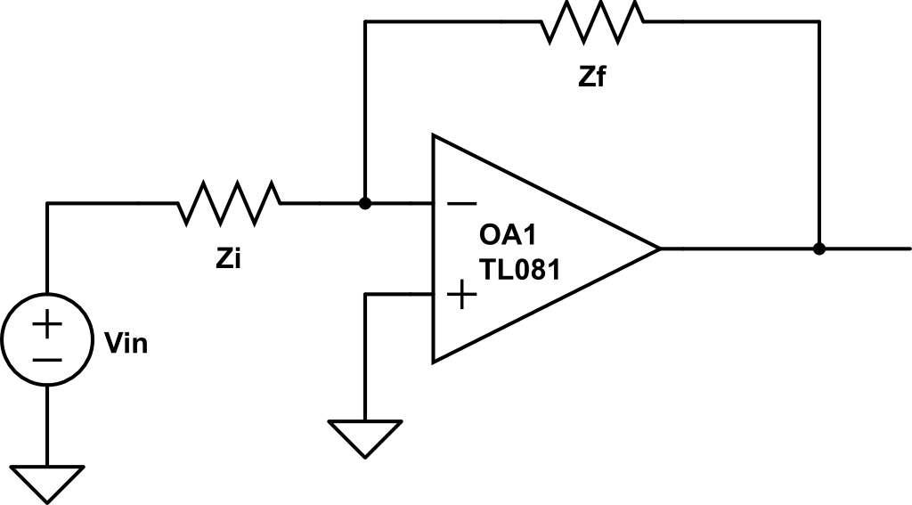

Find the Transfer Function
$$V_{out}$$

Slide 5
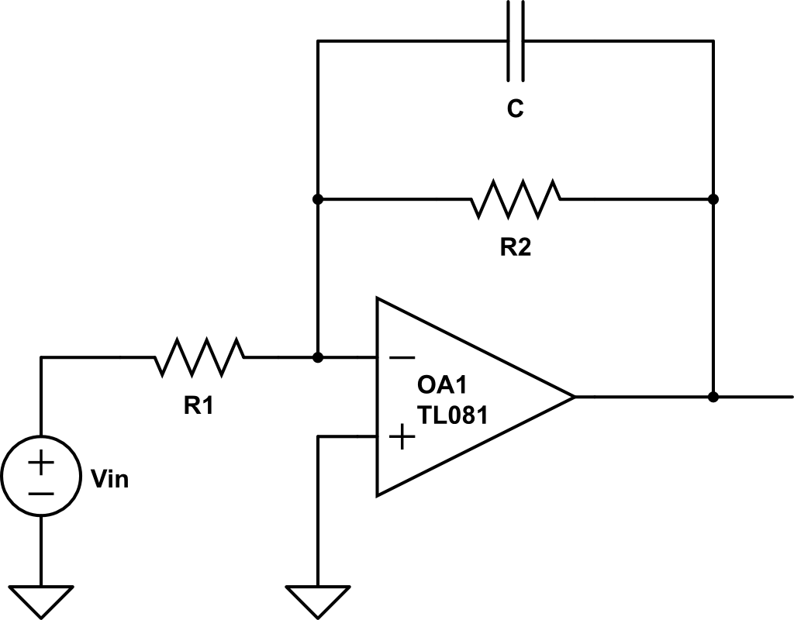


Find the Transfer Function
$$\frac{1}{jωC}$$
$$V_{out}$$

Slide 6
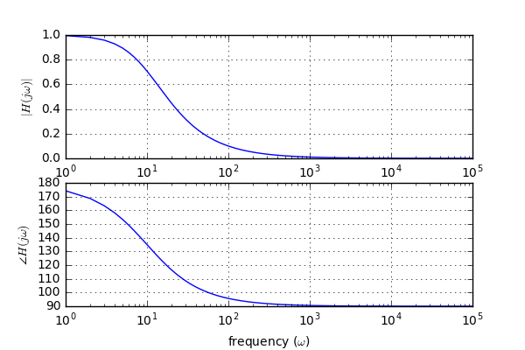
Bode Plot
You can plot the resulting transfer function across frequencies
This is called a low pass filter

Slide 7
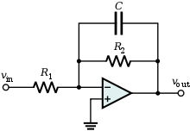
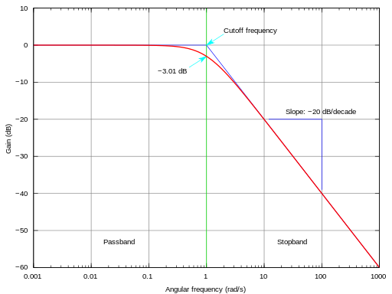
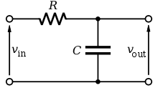
Can be done different ways
Active
Passive

Slide 8
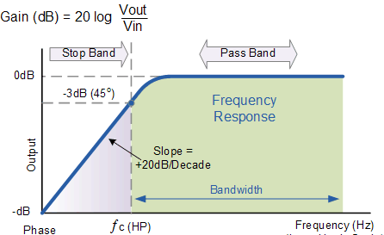
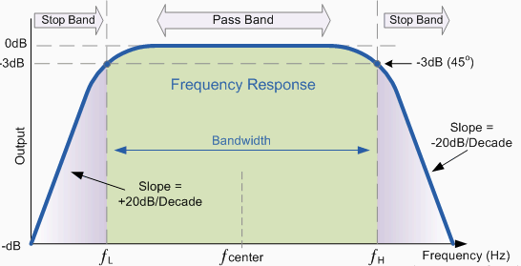
Other types
High Pass
Band Pass

Slide 9
Backups

Slide 10


Phasors
$$Vcos\left(ωt+α\right)=Re\left\{Ve^{j\left(ωt+α\right)}\right\}=Re\{Ve^{jα}e^{jωt}\}$$
$$\tilde{V_{s}}=Ve^{jα}=V<α$$
$$Vcos\left(ωt+α\right)=Re\{\tilde{V_{s}}e^{jωt}\}$$
projection
Complex number
Rotation, CCW

Slide 11
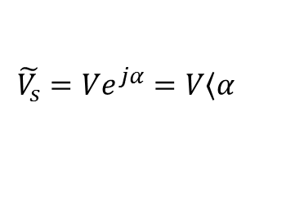
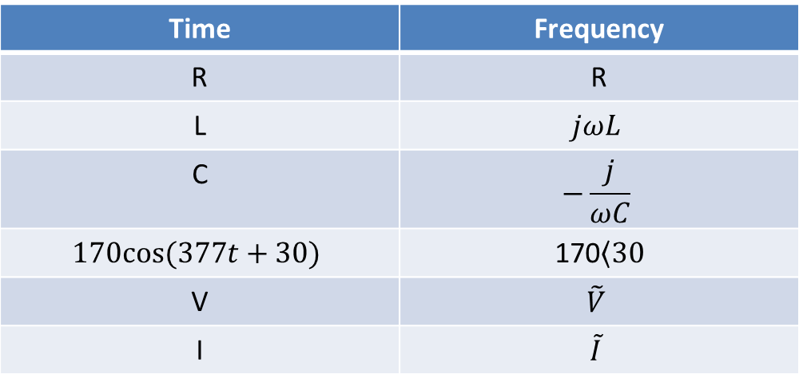
Time to Freq Domain
Time | Frequency
R | R
L | $$jωL$$
C | $$−\frac{j}{ωC}$$
$$170cos⁡(377t+30)$$ | 170$\left\langle 30\right.$
V | $$\tilde{V}$$
I | $$\tilde{I}$$
Where:
$$\tilde{V_{s}}=Ve^{jα}=V\left\langle α\right.$$

Slide 12
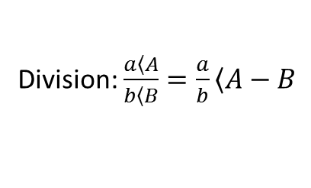
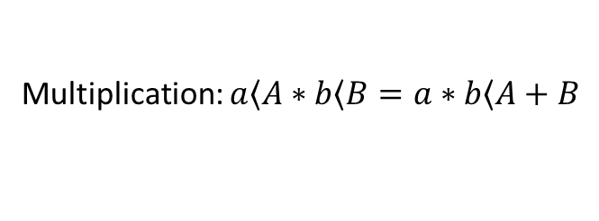
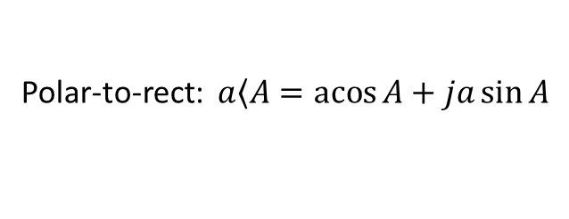
Review
Math:
Multiplication: $a\left\langle A\right.∗b\left\langle B\right.=a∗b\left\langle A+B\right.$
Division: $\frac{a\left\langle A\right.}{b\left\langle B\right.}=\frac{a}{b}\left\langle A−B\right.$
Add/subtract: polar -> rectangular -> polar
Conversions:
Polar-to-rect: $a\left\langle A\right.=\operatorname{acos}{A}+ja\sin{A}$
Rect-to-polar: $a+jb →mag=\sqrt{a^{2}+b^{2}} angle=\operatorname{atan}{\frac{b}{a}}$
Get a good calculator or know how to use Matlab

