Slide 1
ECE231 Mesh Analysis
Maj Kevin Walchko

Slide 2
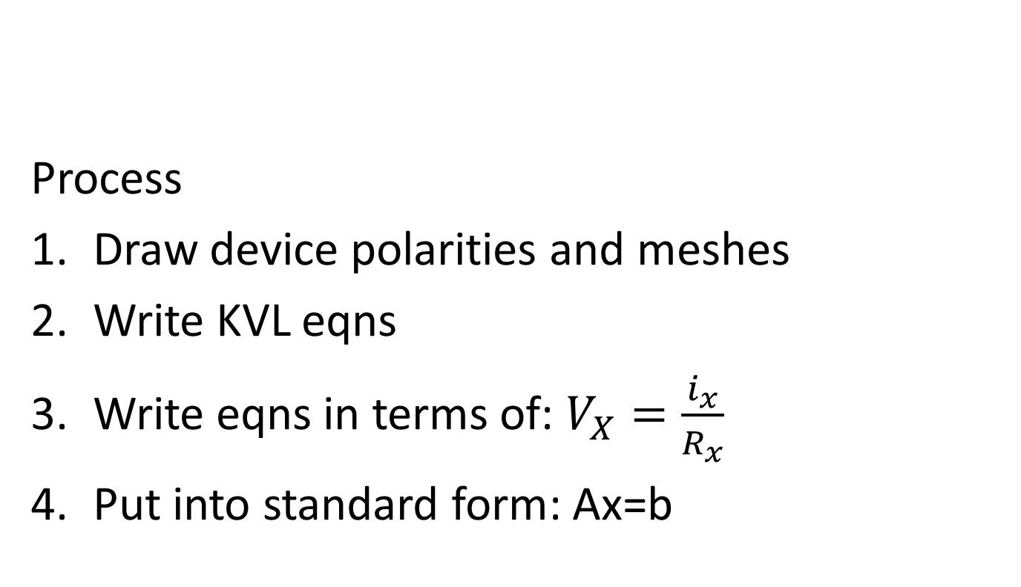
Mesh Analysis
Process
Draw device polarities and meshes
Write KVL eqns
Write eqns in terms of: $V_{X}=\frac{i_{x}}{R_{x}}$
Put into standard form: Ax=b
Make sure you have Matlab installed by now!

Slide 3
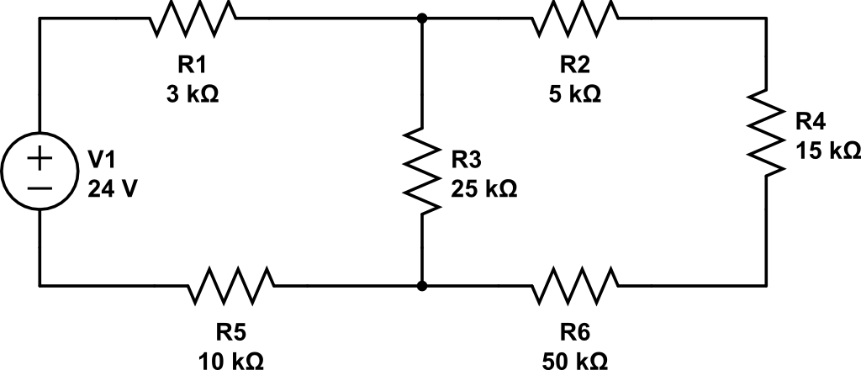
Simple Mesh

Slide 4
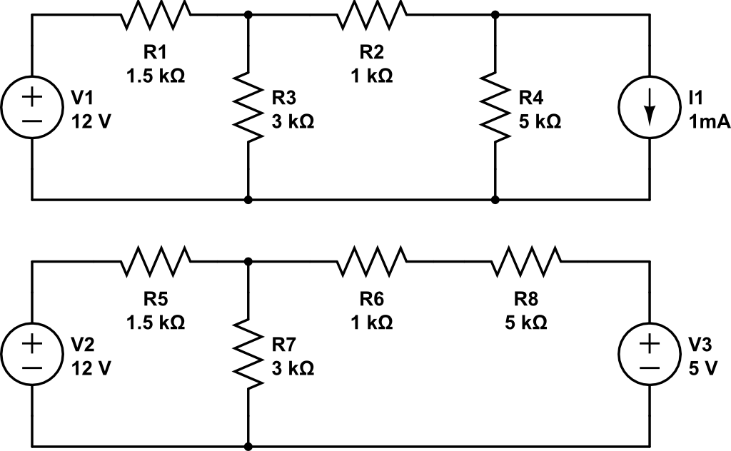
Current Src and Src Transform

Slide 5
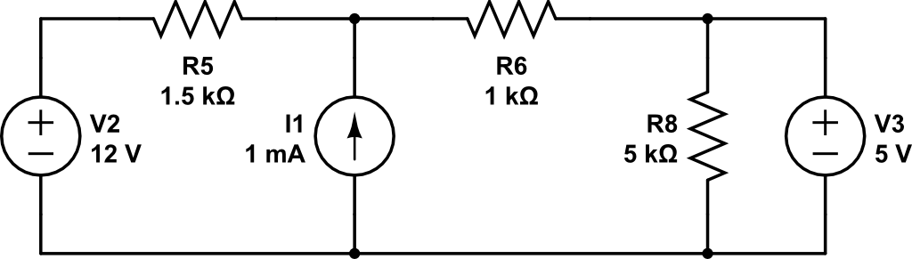
Super Mesh

Slide 6
Backups

