Slide 1
ECE231 Max Power Transfer
Maj Kevin Walchko

Slide 2
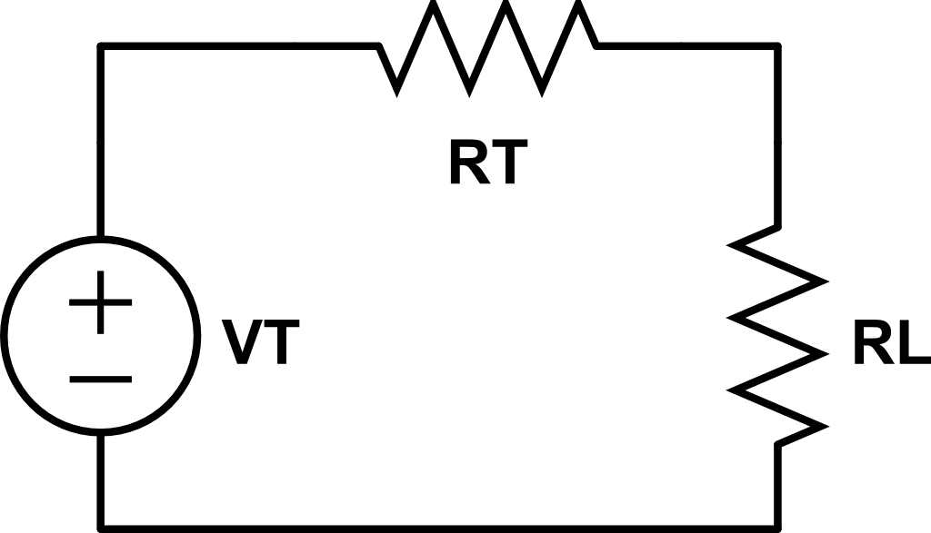
Max Power

Slide 3
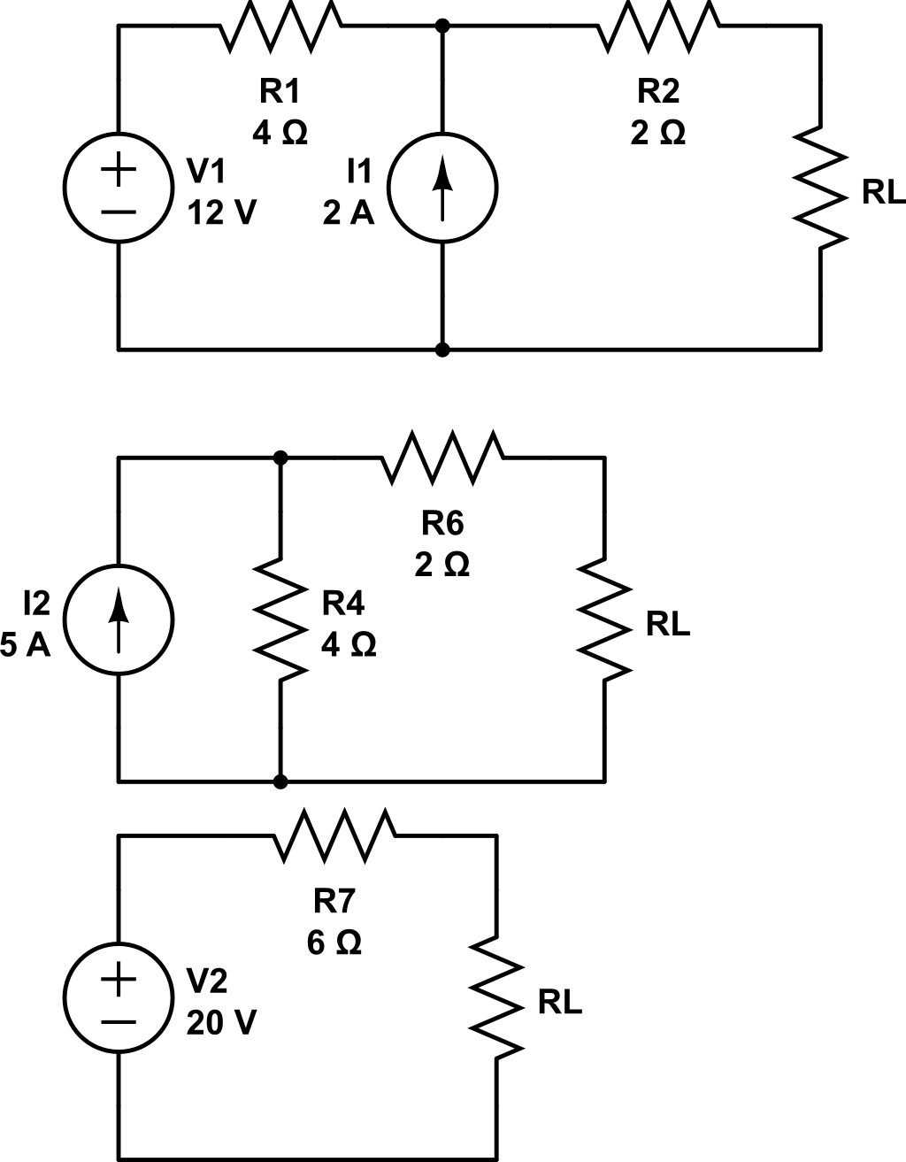
Find P_{max} and R_{L}

Slide 4
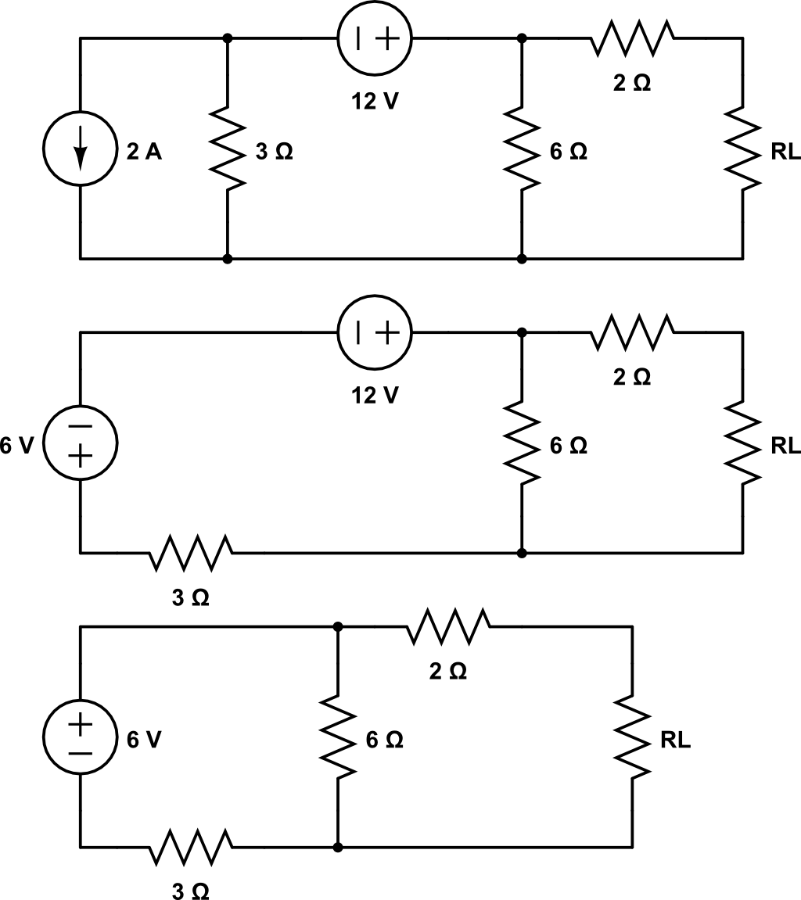
Find P_{max} and R_{L}
V_{oc}

Slide 5
Backups

Slide 6
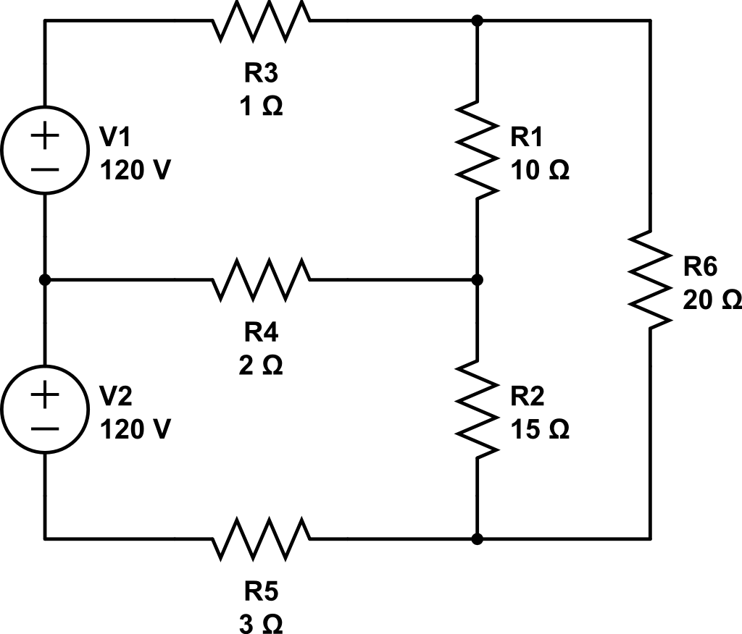
Node Analysis
1
2
Gnd
3
5
4

