Slide 1
ECE231 Max Power Transfer
Maj Kevin Walchko

Slide 2
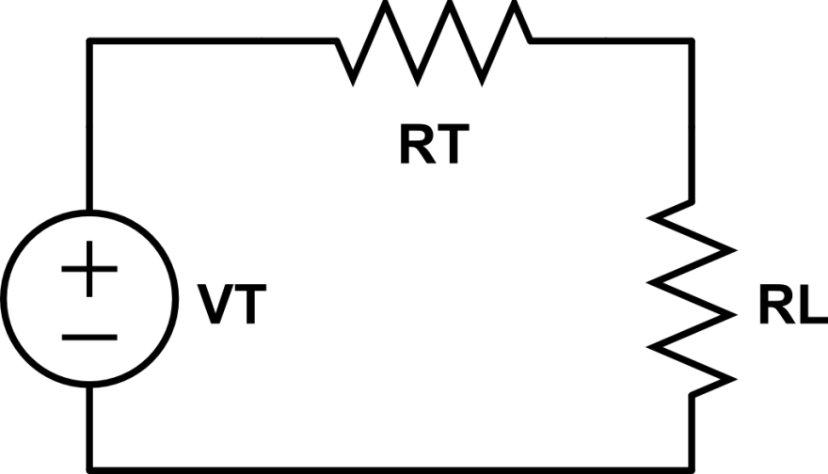
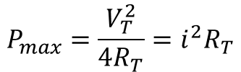





Max Power
$$i_{L}=\frac{V_{T}}{R_{L}+R_{T}}$$
$$R_{L}=∞→i_{L}=0→P_{L}=0$$
$$V_{L}=\frac{R_{L}}{R_{L}+R_{T}}V_{T}$$
$$R_{L}=0→V_{L}=0→P_{L}=0$$
i_{L}
$$P_{L}=i_{L}V_{L}→\frac{∂P_{L}}{∂R_{L}}→R_{L}=R_{T}$$
$$P_{max}=\frac{V_{T}^{2}}{4R_{T}}=i^{2}R_{T}$$

Slide 3
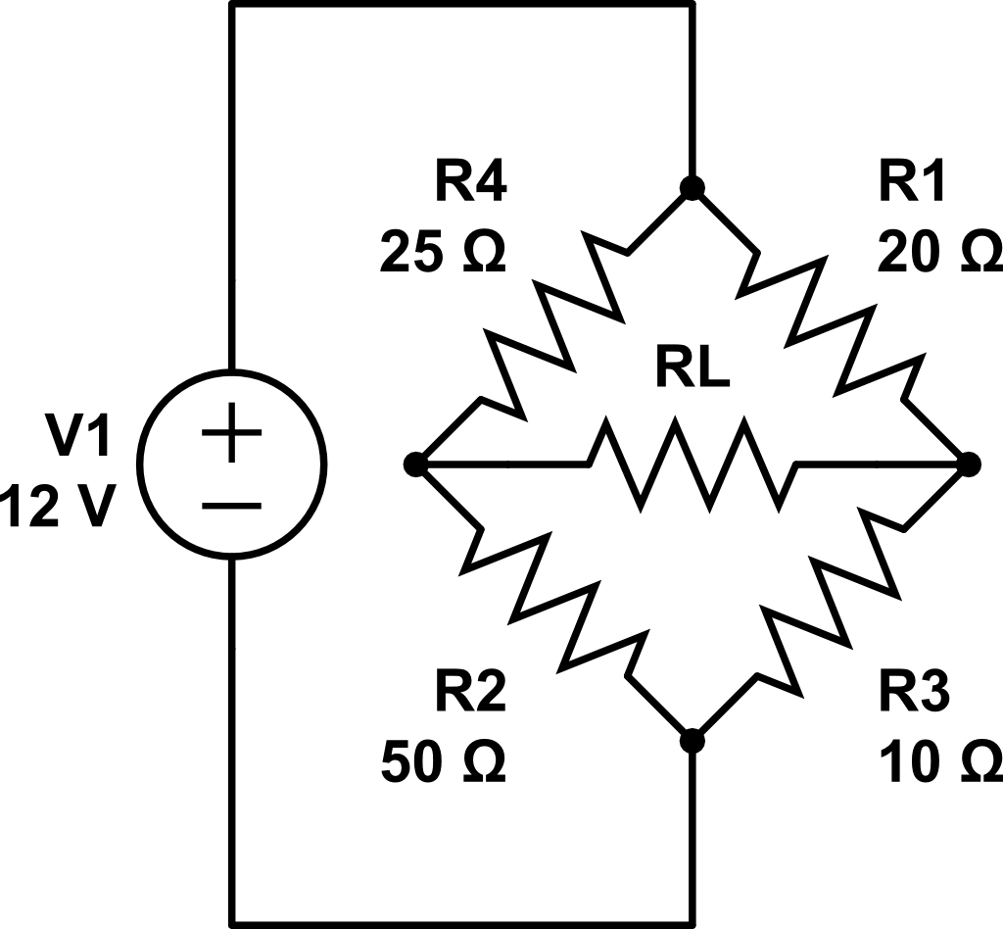
Find the Thevenin Equiv
1
V4 = Gnd = 0V
2
+
-
3
Voc
4

Slide 4
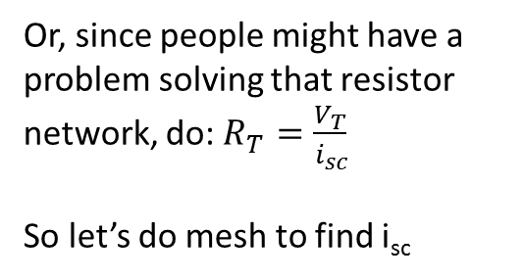
Find the Thevenin Equiv
Or, since people might have a problem solving that resistor network, do: $R_{T}=\frac{V_{T}}{i_{sc}}$
So let’s do mesh to find i_{sc}
1
2
+
-
3

Slide 5
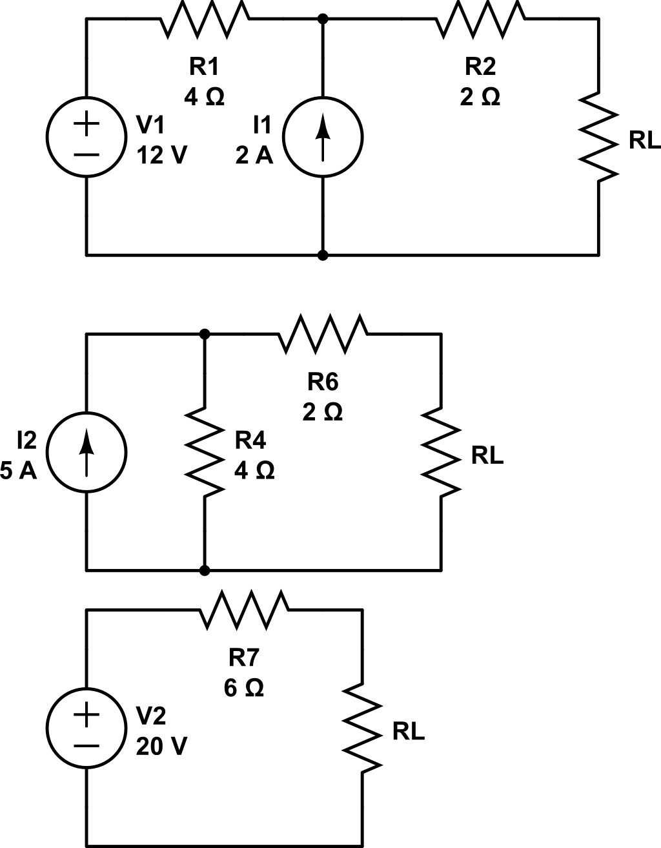
Find P_{max} and R_{L}

Slide 6
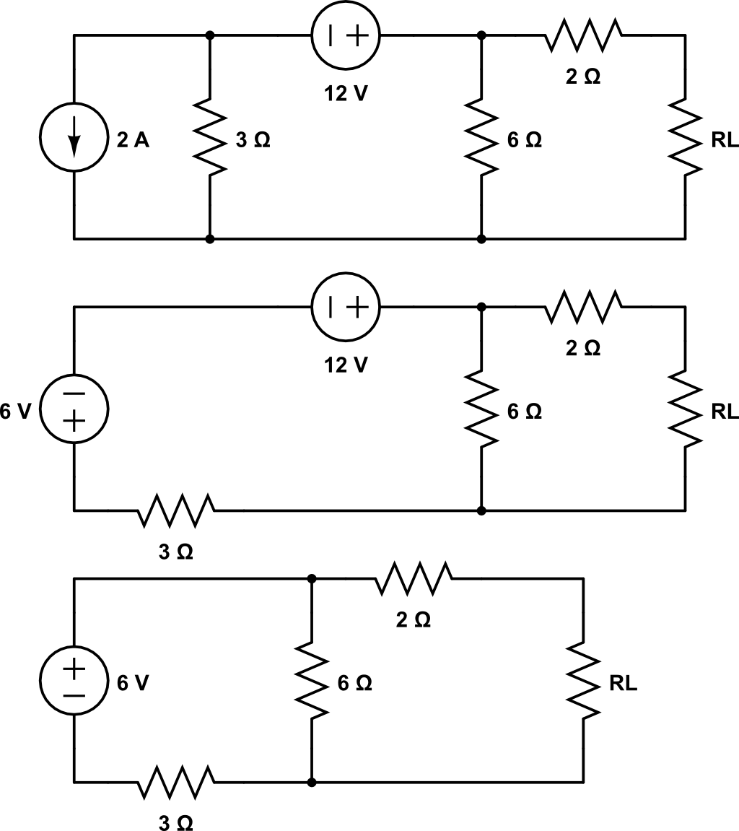
Find P_{max} and R_{L}
V_{oc}

Slide 7
Backups

Slide 8
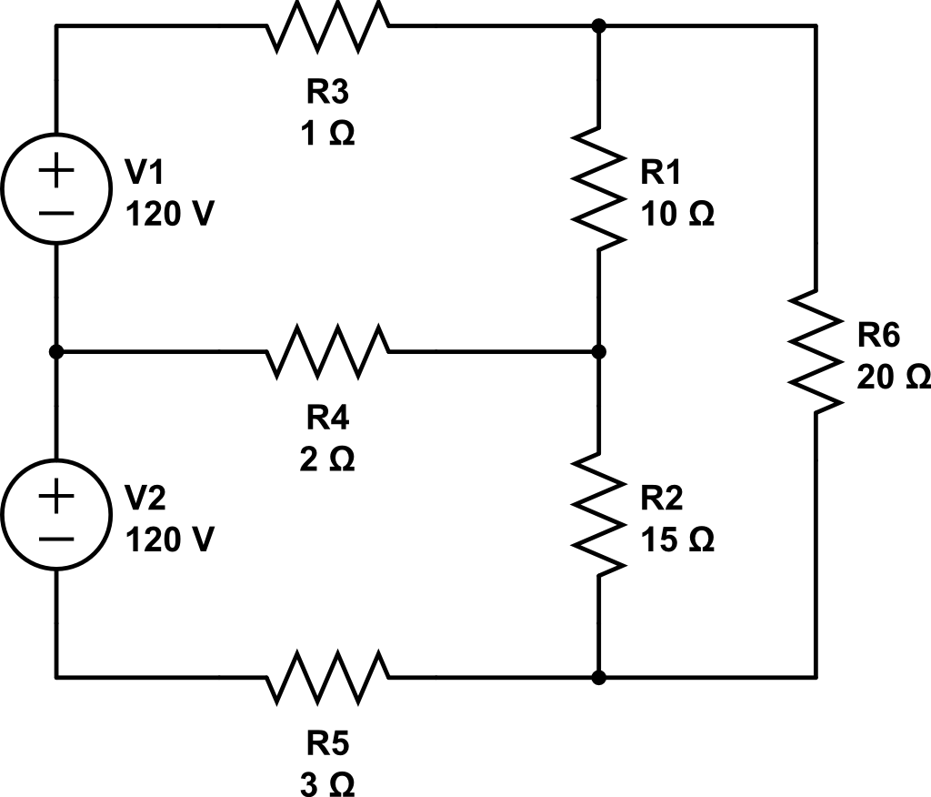
Node Analysis
1
2
Gnd
3
5
4

