Slide 1
ECE231 Review
Maj Kevin Walchko
Make sure you have read/understand the ethics reading on the website

Slide 2
Hints/Suggestions
Write neatly and clearly
I will not guess at equations/numbers
Work through the problem in a manor I can follow
I will not guess where numbers come from
Use proper units and engineering notation
Answers that are obviously wrong (e.g., creation of energy) will loose more points than math errors
If you correctly identify your answer if flawed and how, I will give you points back
Don’t spend too long on any one problem, move on!
There will be no Matlab on the GR, no computers will be allowed during the test

Slide 3
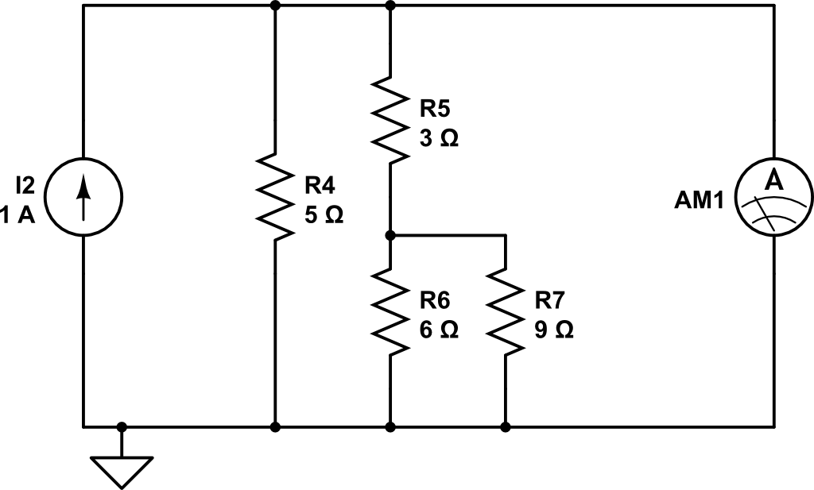
Lab 1
What is the ammeter reading?
< 1 min

Slide 4
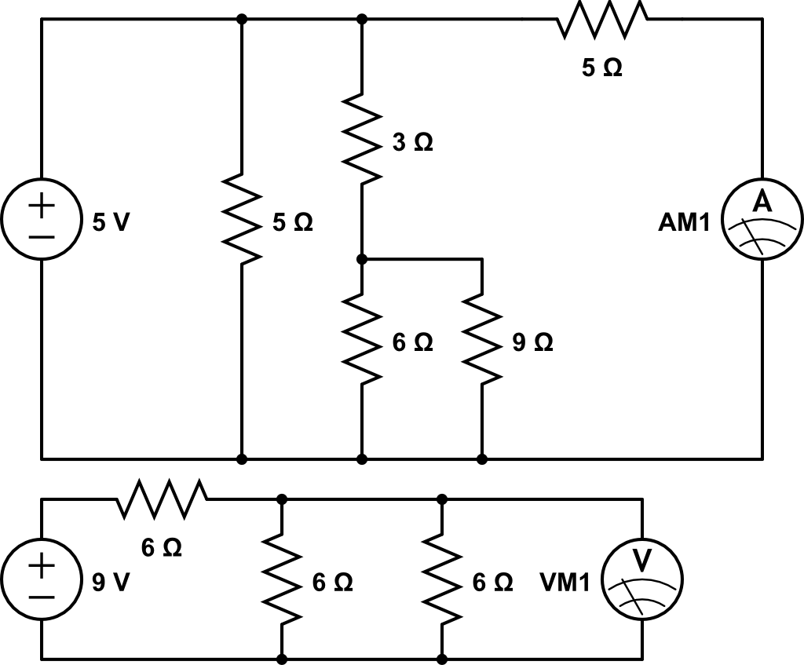
Lab 1
What is the ammeter
reading?
What is the voltmeter reading?

Slide 5
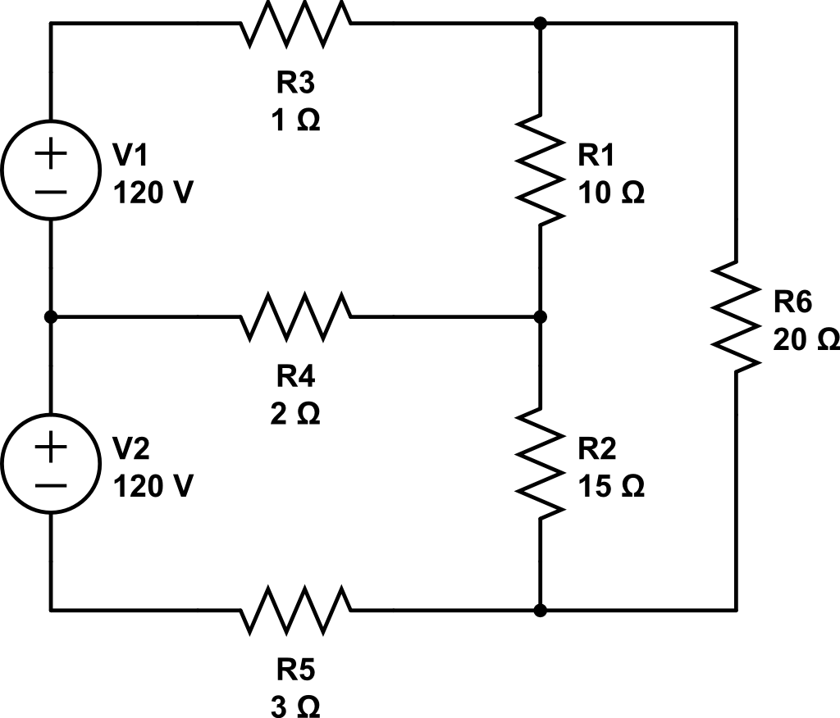
Node Analysis, find voltages
1
2
V1 = 120 V
V2 = 101.7 V
V3 = 7.6 V
V4 = -76.5 V
V5 = -120 V
Gnd
3
5
4
10 mins

Slide 6
Mesh Analysis, find currents
2
I1 = 18.32 A
I2 = 8.91 A
I3 = 14.51 A
1
3
10 mins

Slide 7
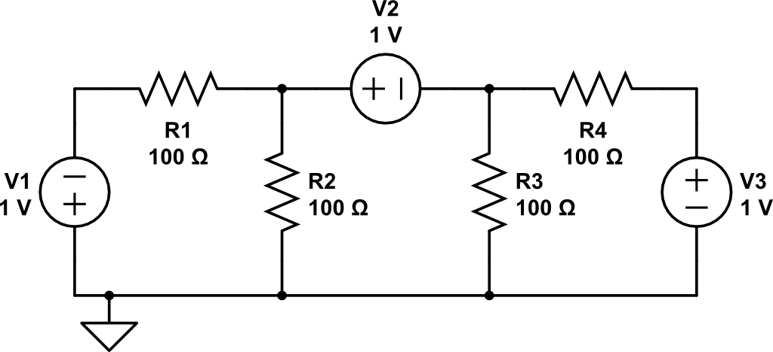
Use Nodal Analysis, find Vx
V_{x}
Vx = - 500 mV
10 mins

Slide 8
Backups

