Slide 1
ECE231 Review
Maj Kevin Walchko
Make sure you have read/understand the ethics reading on the website

Slide 2
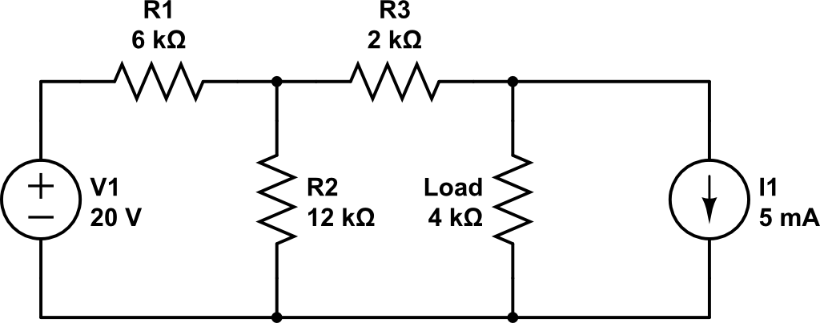
Review
+
Vo
-
Find:
V_{o} using superposition
V_{o} using mesh
V_{o} using node
Thevenin equivalent
Norton equivalent
Replace the 4kΩ load with another resistor that maximizes power transfer and find that power
V_{o} = -6.667 V
V_{T} = -16.67 V
R_{T} = 6kΩ
I_{N} = -2.777 mA
R_{N} = 6kΩ
R_{L} = 6kΩ
P_{max} = 5.79 mW

Slide 3
Backups

