Slide 1
ECE231 Dependent Sources
Maj Kevin Walchko

Slide 2
Definitions
GR1 DONE!!!
T2 Avg: 72%
T3 Ave: 82%
Again, source transforms were done wrong
Active Devices – need external power
Gain – ratio of output/input
Dependent Source
Voltage/current source controlled by another voltage/current source
Cannot turn off dependent src unless you turn off the controlling src
This is to prepare you for op amps
Active circuits behave differently than passive circuits, but with a little modification, we can use the tools we already have!

Slide 3

Dependent Sources
+
+
KV_{x}
Ri_{x}
GV_{x}
Ki_{x}
-
-
VCVS
CCVS
VCCS
CCCS
K = scalar
R = resistance
$G=\frac{1}{R}$ = conductance
K = scalar

Slide 4
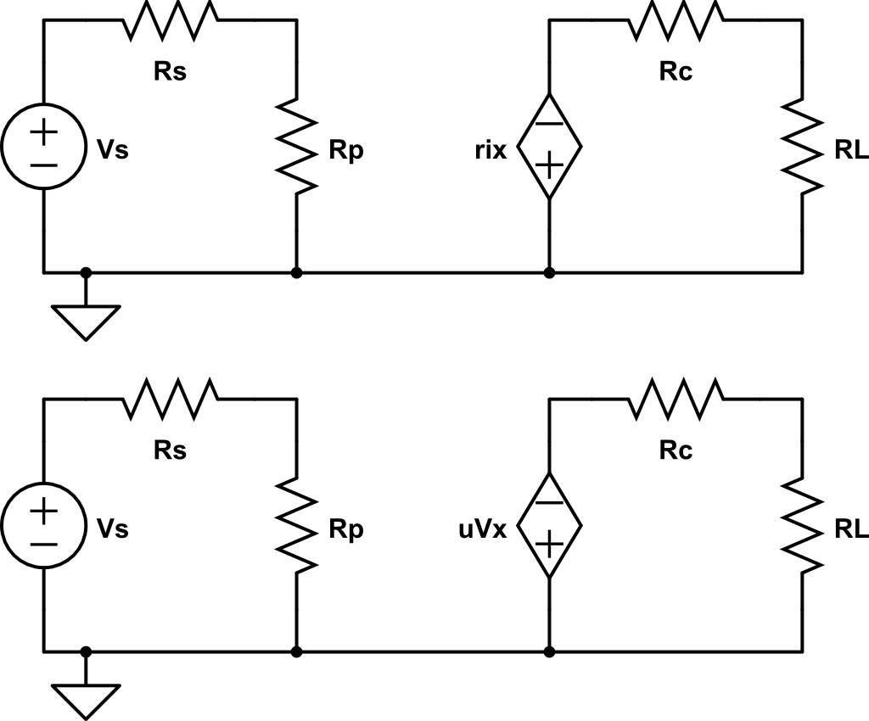
Find Vo in terms of Vs
+
-

Slide 5
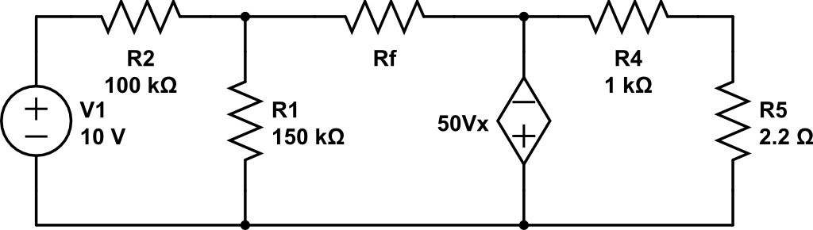
Find Vo in terms of Rf
Use nodal analysis
A
B
C
D
+
+
Vx
Vo
-
-
Gnd

Slide 6
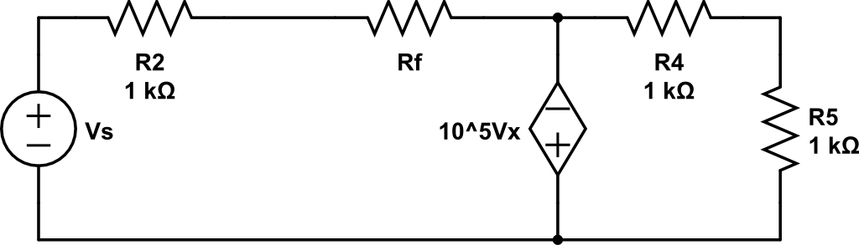
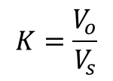
Find an expression for the gain K
$$K=\frac{V_{o}}{V_{s}}$$
Use nodal analysis
A
B
C
D
+
+
Vx
Vo
-
-
Gnd

Slide 7
Backups

