Slide 1
ECE231 Op Amps
Maj Kevin Walchko

Slide 2
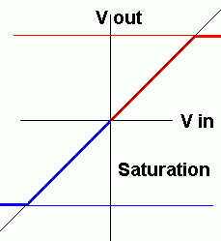

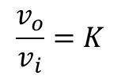






Op Amp
Inverting input (v_{p})
+
A
output
Non-inverting input (v_{n})
-
Vcc = power source
$$v_{o}=A(v_{p}−v_{n})$$
$$\frac{v_{o}}{v_{i}}=K$$
A = open loop gain
K = closed loop gain
and
Op Amp is an active device
Theoretically the gain (A) is ∞, but typically 20k – 200k
Current in is 0
Input impedance (Z_{in}) is ∞
Output impedance (Z_{out}) is 0
No voltage difference between v_{p} and v_{n}
Linear mode:
$$A\left|v_{p}−v_{n}\right|<V_{cc}$$
$$v_{o}=A(v_{p}−v_{p})$$
Saturation mode:
$$A\left|v_{p}−v_{n}\right|>{+V}_{cc}$$
$$v_{o}=+V_{cc}$$
or
$$A\left|v_{p}−v_{n}\right|<{−V}_{cc}$$
$$v_{o}=−V_{cc}$$

Slide 3
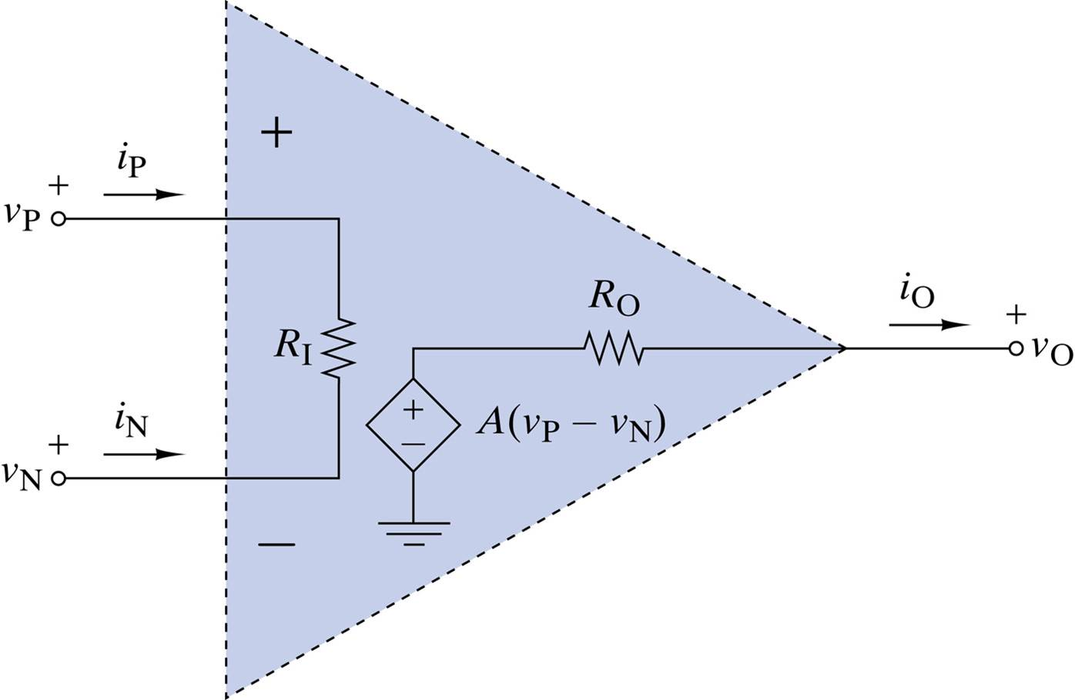
Ideal Op Amp
VCVS, in open loop, there is a small difference between vp and vn
We will always assume an ideal op amp

Slide 4
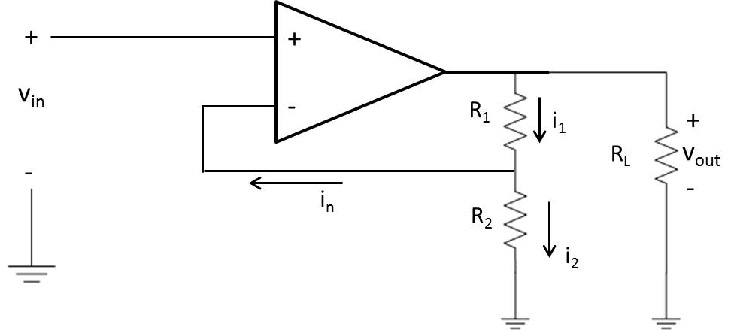
Non-inverting Op Amp
Find Vout and gain (K)

Slide 5
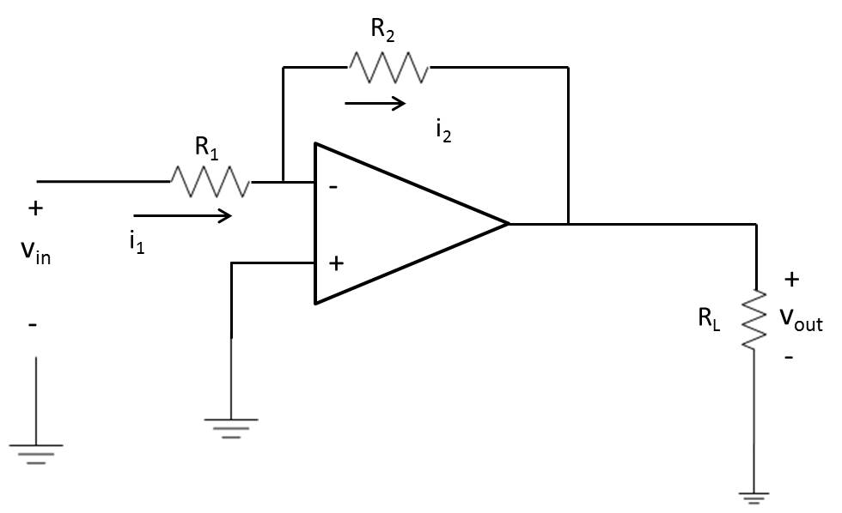
Inverting
Find Vout and gain (K)

Slide 6
Simple Examples
If a non-inverting op amp circuit is operating with R₁ = 2R₂ and V_{cc} = ± 12V, what is the gain?
Design an inverting op amp with a gain of 30 ± 10% (use standard resistor values)
A 2mV signal needs to be amplified by a gain of k = -450 ± 10%. Design an amp to do this.
Find V_{out} of an inverting amp with R1 = 10kΩ, R2 = 33kΩ, V_{cc} = ± 15V when Vin is 2V, 4V, and 6V.

Slide 7
Backups

