Slide 1
ECE231 Op Amps II
Maj Kevin Walchko

Slide 2
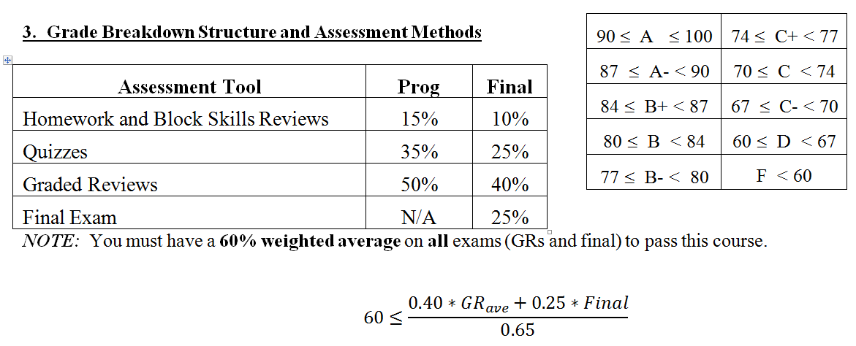
What Is My Grade?
How can we calculate your current average in this class?
Still a lot of points left!!
To be honest, I wish we did straight points rather than %, but ECE likes %

Slide 3
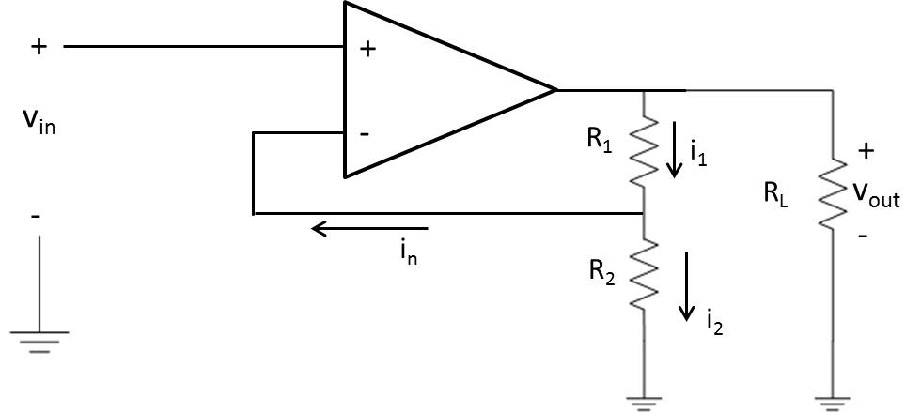
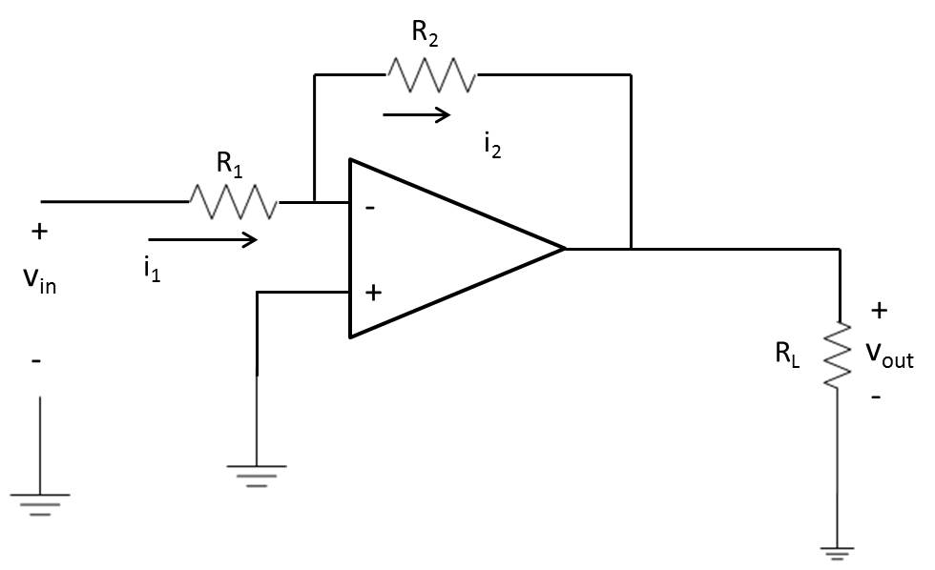
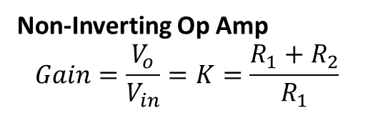

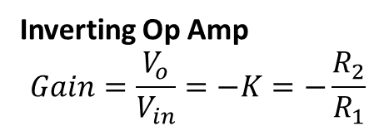
Op Amps So Far
Non-Inverting Op Amp
$$Gain=\frac{V_{o}}{V_{in}}=K=\frac{R_{1}+R_{2}}{R_{1}}$$
Inverting Op Amp
$$Gain=\frac{V_{o}}{V_{in}}=−K=−\frac{R_{2}}{R_{1}}$$
$$R_{f}$$
Op amps allow us to boost a weak signal or attenuate a strong signal (signal conditioning)
Now let’s talk about:
Summer
Differential
Buffer

Slide 4
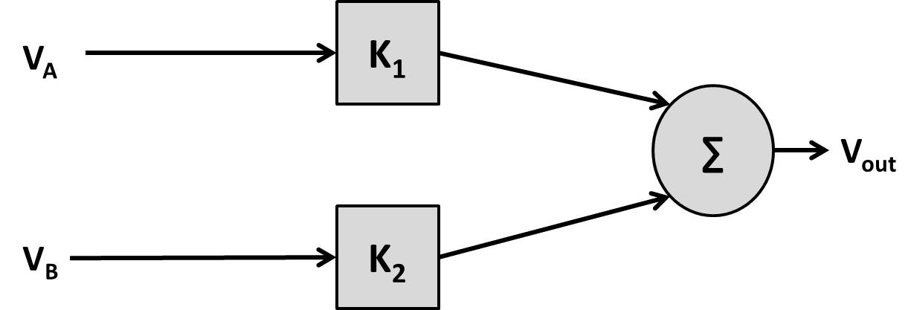
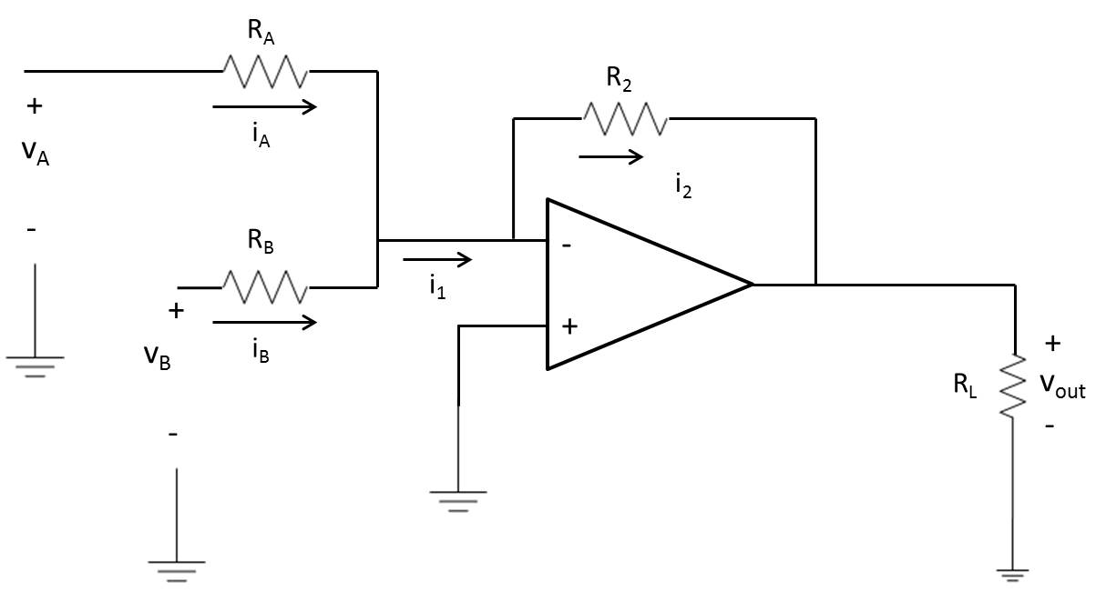
Summer
inverter

Slide 5
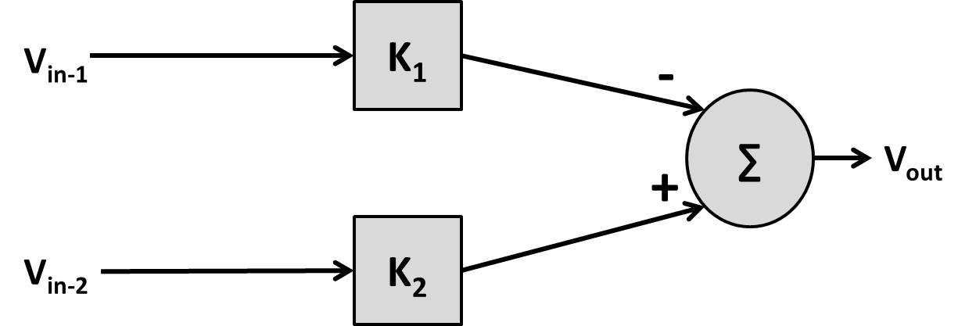
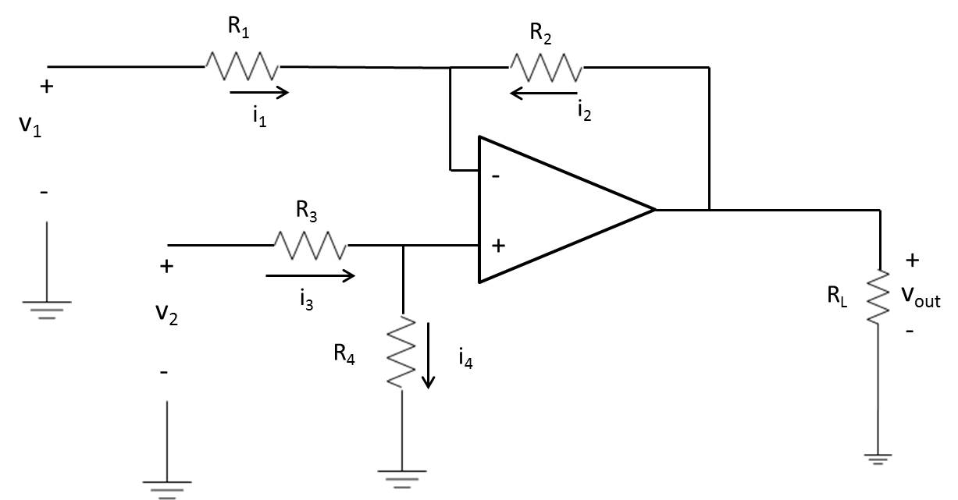
Differential Amp (Subtractor)
A
WARNING: there is not always a solution to this problem! DO NOT use on a quiz or GR!!!!!!
B

Slide 6
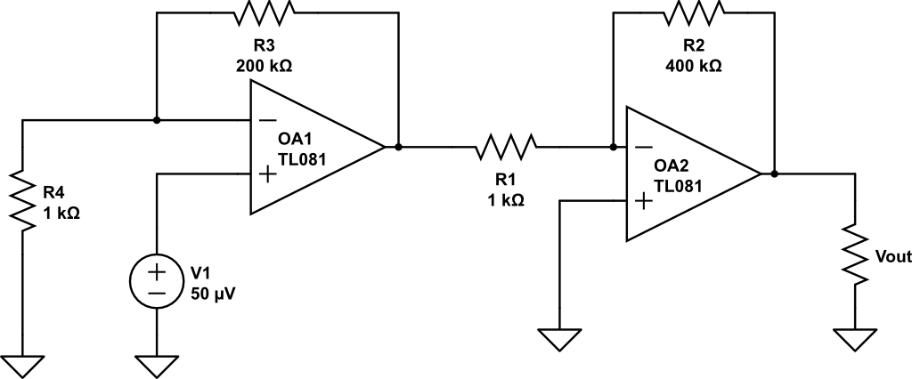
Find V_{out}
+
V_{B}
-
Non-inverting
Inverting

Slide 7
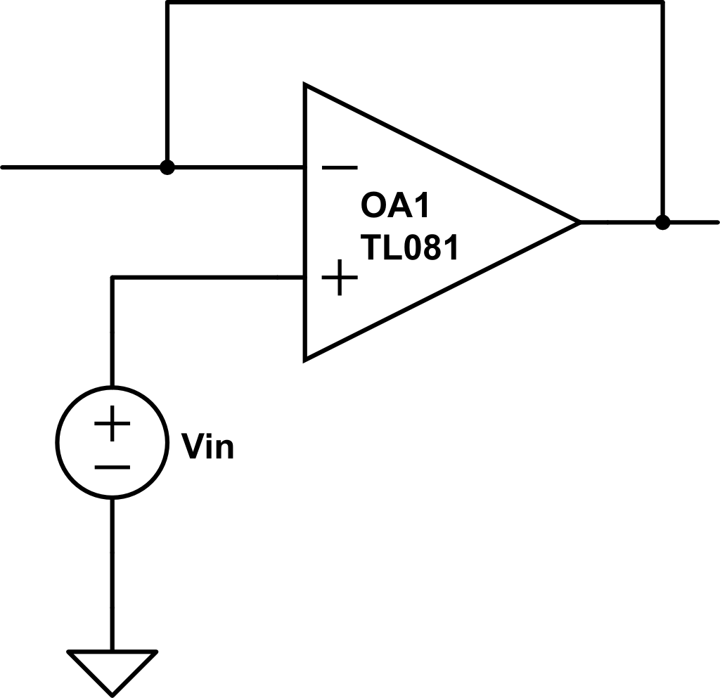

Buffer
Short
Open
circuit
+
V_{out}
+
-
V_{out}
-
Looking at the non-inverting op amp
Buffers help circuits with different impedances work correctly without overloading one another or effecting operation

Slide 8
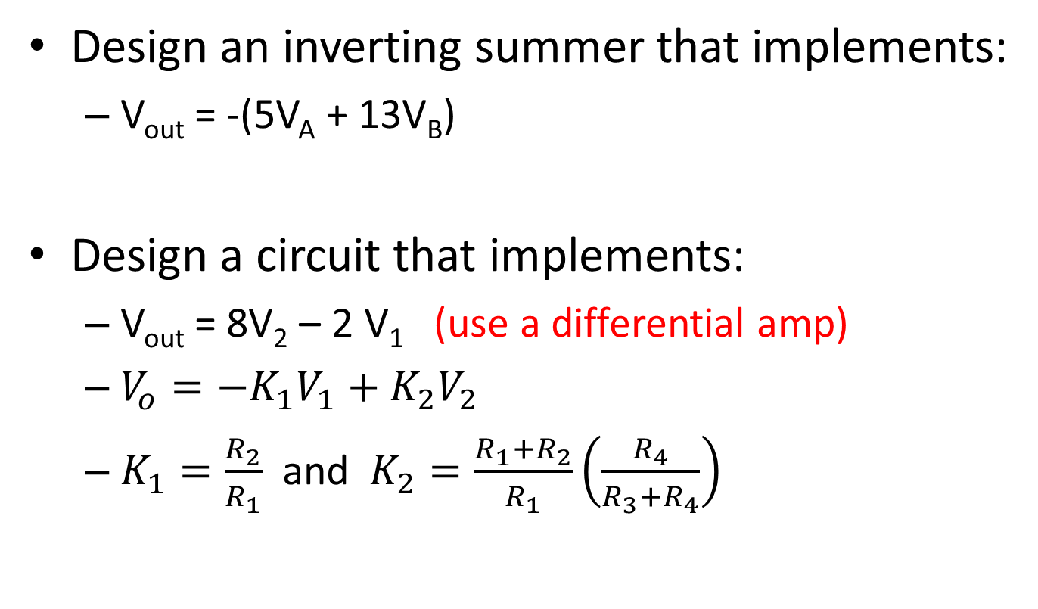
Examples
Design an inverting summer that implements:
V_{out} = -(5V_{A} + 13V_{B})
Design a circuit that implements:
V_{out} = 8V₂ – 2 V₁ (use a differential amp)
$V_{o}=−K_{1}V_{1}+K_{2}V_{2}$
$K_{1}=\frac{R_{2}}{R_{1}}$ and $K_{2}=\frac{R_{1}+R_{2}}{R_{1}}\left(\frac{R_{4}}{R_{3}+R_{4}}\right)$

Slide 9
Backups

Slide 10
Example
(a) Find the transfer characteristics of a differential amplifier if:
R1 = 10k Ω
R2 = 40k Ω
R3 = 10k Ω
R4 = 15k Ω
(b) If Vcc is ± 15 V and V1 = 3V, what is the allowable range of V2 for linear ops?
Vo = -4V1 + 3V2
-1 V ≤ V2 ≤ 9 V

Slide 11
Examples
Design an inverting summer that implements:
V_{out} = -(5V_{A} + 13V_{B})
Using the above gains, find V_{out} if V_{A} = 2V and V_{B} = -.5V
Using the above and V_{A} = 500 mV, V_{cc} = 15V, what is the maximum value of V_{B} and still have it be linear?
Design a circuit that implements:
V_{out} = 8V₂ – 4 V₁ (use a differential amp)

