Slide 1
ECE231 Op Amps IV
Maj Kevin Walchko

Slide 2
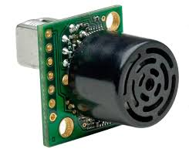
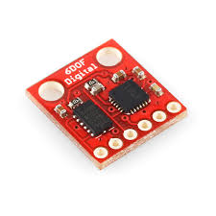
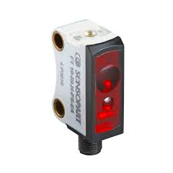
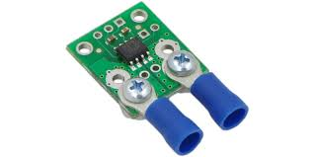
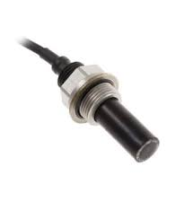
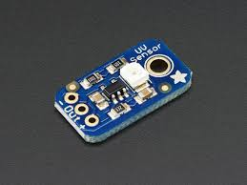
Instrumentation Systems
Transducer: converts physical phenomenon into an electrical signal or visa versa
Sensor
(input transducer)
Output
transducer
K
+
B
This doesn’t have to be a transducer, it could be anything
Sensor
Signal Conditioning
Filter
ADC

Slide 3
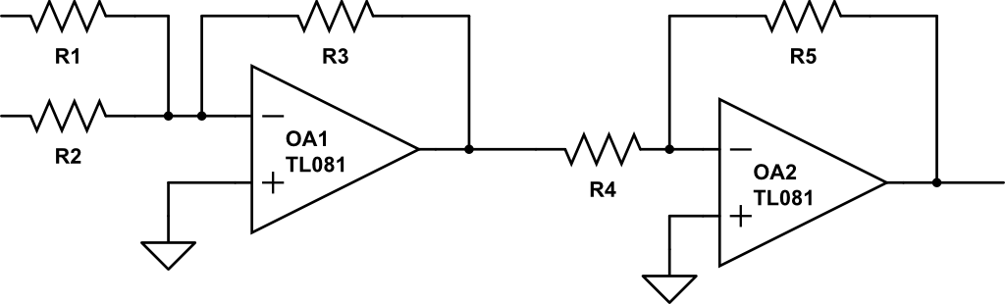
Example
Say we have a simple temperature measurement system and you only have access to USB’s +5V:
100°C
Thermocouple
12V
5V
Computer
K
+
-70°C
-12V
0V
B
V_{in}
-0.2083
+
-1
V_{out}
5V
-0.5
Vin
5V
Vout

Slide 4
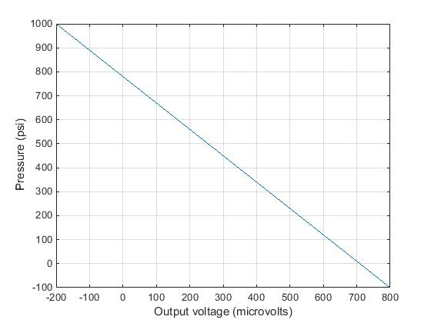
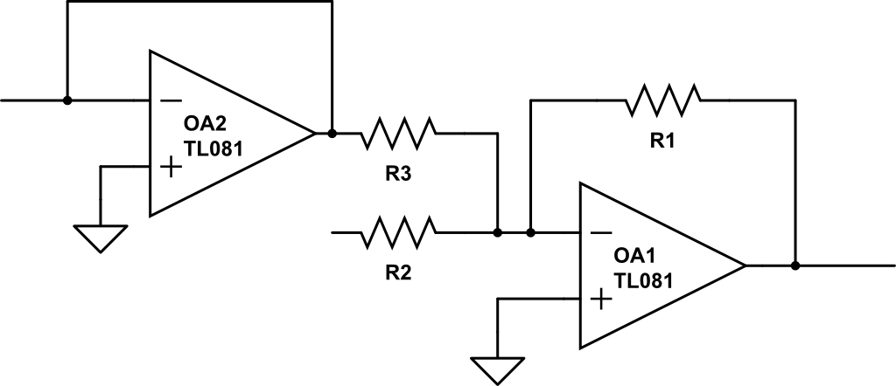

Example
Given a pressure sensor with the following performance design the interface for it to work with a display that operates at: -5V, -100 psi and 5V, 1000 psi. Also note it has a Thevenin resistance (R_{T}=1k). User resistors between 1KΩ-1MΩ.
Pressure
sensor
-200uV
5V
Display
K
+
800uV
-5V
B
Pressure
sensor
Display
-10k
+
-3
-1
V_{in}
$$V_{o}=−10kV_{in}+3$$
-3V
V_{out}

Slide 5
Try Again!!
Pressure
sensor
Display
100
-100
+
Non-invert
-3
-1
summer

Slide 6

Desk Work
2.5mV
Design an interface to match a load sensor (performance given on the left) to a monitor designed to read 1000 lbs @ 10V and 0 lbs at -5V. Your circuit only has access to ±5V.
-2.5mV
0lbs
1000lbs
load
sensor
2.5mV
10V
Monitor
R_{T} = 10kΩ
K
+
-2.5mV
-5V
B
V_{in}
Buffer
-100
-30
+
V_{out}
-5V
-0.5

Slide 7
Backups

Slide 8
Summary
V_{in}
K
V_{out}=KV_{in}
Non-inverting Op Amp
V_{in}
-K
V_{out}=-KV_{in}
Inverting Op Amp
V_{in1}
-K1
V_{in2}
-K2
+
V_{out}=-K1*V_{in1}-K2*V_{in2}-…-K_{n}*V_{inn}
Summing Op Amp
…
V_{inn}
-Kn
V_{in}
1
V_{out}=V_{in}
Buffer
V_{in1}
K1
+
V_{out}=K1*V_{in1}-K2*V_{in2}
Differential Op Amp
V_{in2}
-K2
More than one way to draw these, Fig 4-48, pg 188 is different

Slide 9
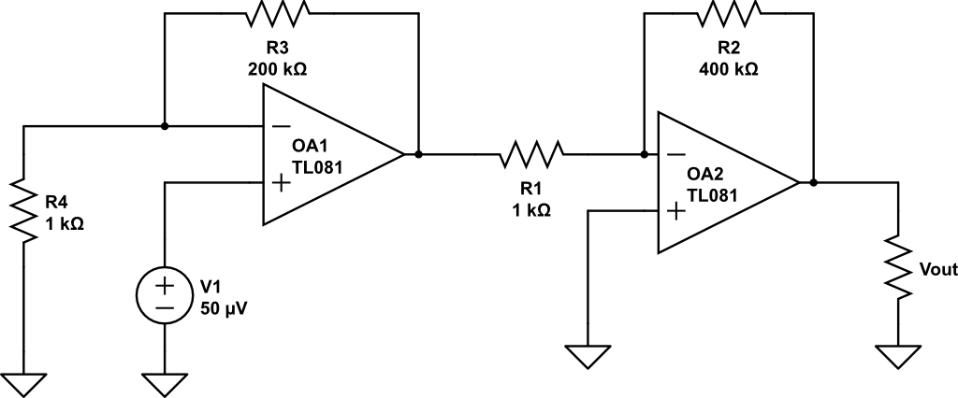
Find V_{out}
+
V_{B}
-
Non-inverting
Inverting

Slide 10
Examples
Design a circuit that implements:
V_{out} = 8V₂ – 4 V₁ (use a differential amp)

