Slide 1
ECE231 Basics
Maj Kevin Walchko

Slide 2
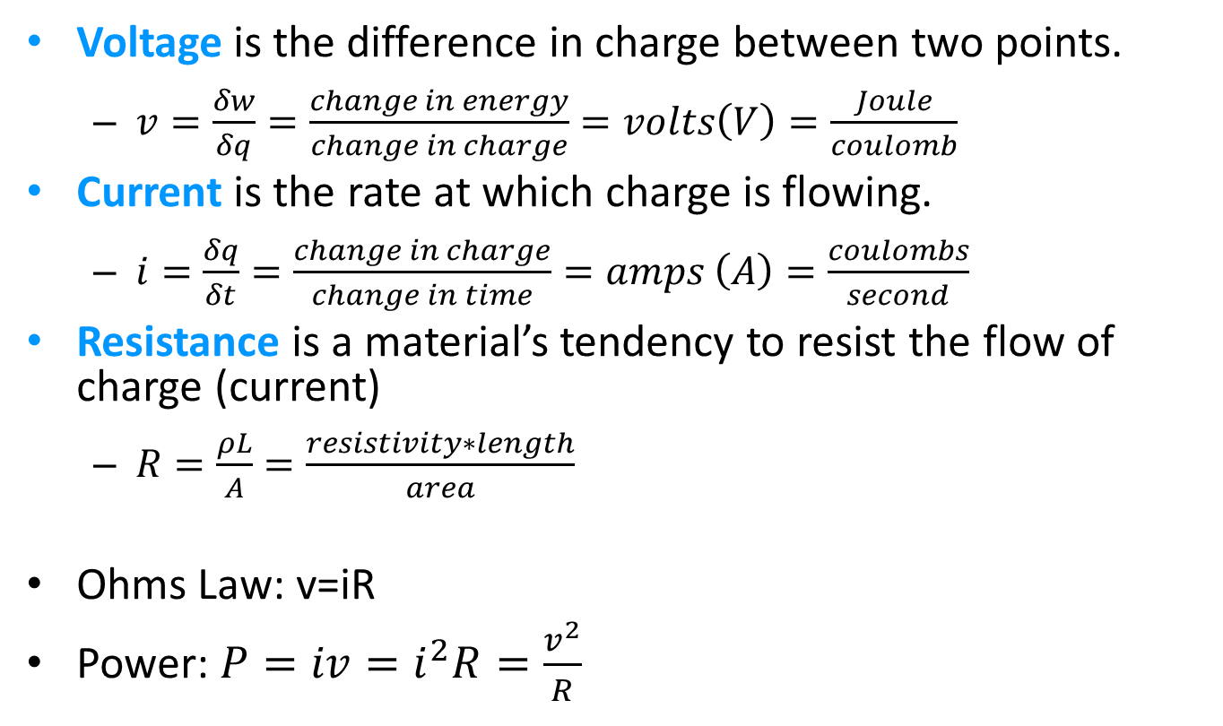
Electric Charge & Voltage
Voltage is the difference in charge between two points.
$v=\frac{δw}{δq}=\frac{change in energy}{change in charge}=volts\left(V\right)=\frac{Joule}{coulomb}$
Current is the rate at which charge is flowing.
$i=\frac{δq}{δt}=\frac{change in charge}{change in time}=amps \left(A\right)=\frac{coulombs}{second}$
Resistance is a material’s tendency to resist the flow of charge (current)
$R=\frac{ρL}{A}=\frac{resistivity∗length}{area}$
Ohms Law: v=iR
Power: $P=iv=i^{2}R=\frac{v^{2}}{R}$

Slide 3
Electricity … the lie!
e⁻
e⁻
1827: Ohms Law
1897: Electron discovered
Circuit
Battery
-
+
repel
+
e⁻
-
repel
-
+
attract
-
+
e⁻
e⁻
Passive Sign Convention: we are going to say current flows from positive to negative

Slide 4
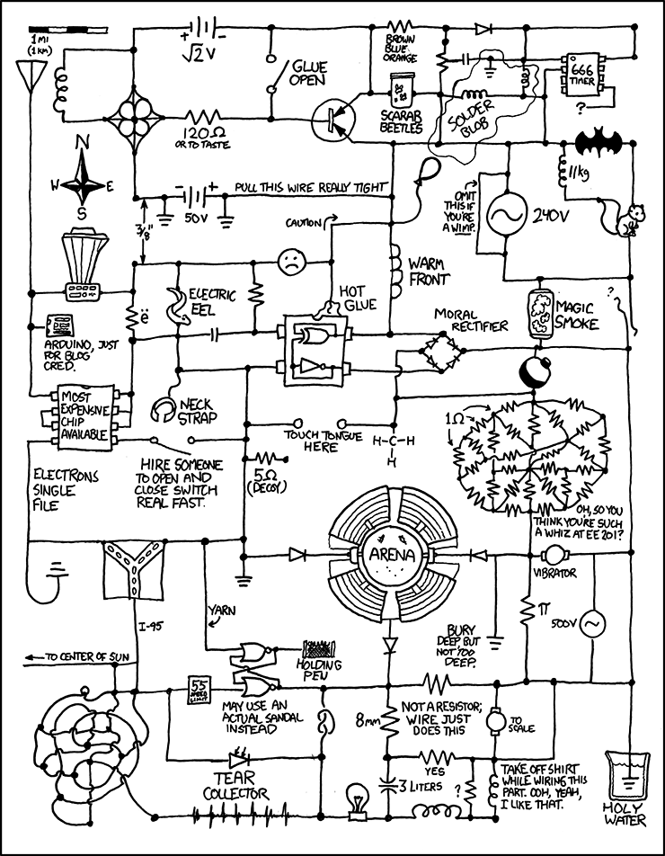
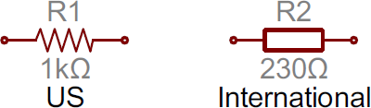
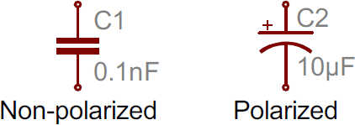

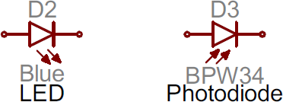
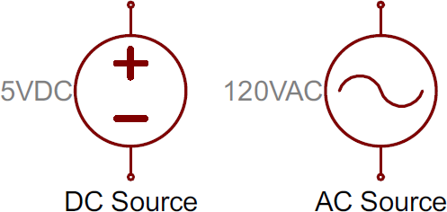
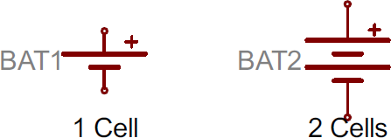
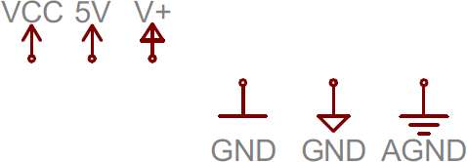
Some Common Circuit Symbols
Loads
Sources/Sinks
+
-
https://xkcd.com/730/

Slide 5
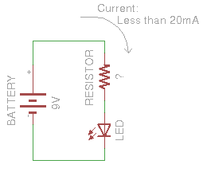


Simple DC Circuit
(-) ground
(+) hot
Electrons (negative) really flow from (-) to (+), but due to convention (Ben Franklin) we say current (positive) flows from (+) to (-).
What is the resistor value if I = 18 mA?
What is the LED power consumption?
P = IV or P = I(IR) = I²R
P = (0.018 A)(9V) P = (0.018)*(0.018)*(500Ω)
P = 0.162 W P = 0.162 W
P = 162 mW

Slide 6
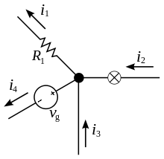

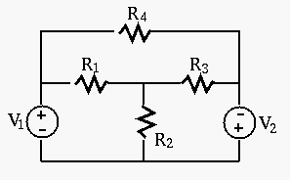
Kirchhoff's Current Law (KCL)
The principle of conservation of electric charge implies:
At any node (junction) in an electrical circuit, the sum of currents flowing into that node is equal to the sum of currents flowing out of that node
How many nodes below?
The current entering any junction is equal to the current leaving that junction. i₂ + i₃ = i₁ + i₄
#1
#3
#2
When you cut out the components, everything left is a node
#4

Slide 7
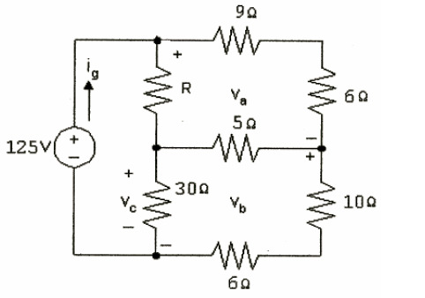
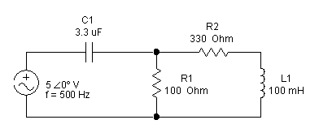
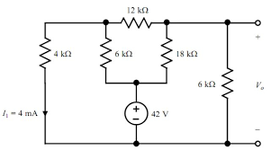
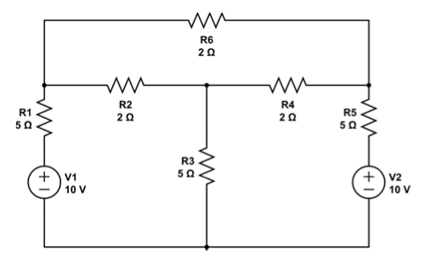
How Many Nodes?
4
1.
2.
6
3.
4.
4
6

Slide 8
KCL Eqns
Remember, we define current flows from positive (+) to negative (-)
i_{R4}
+
-
i_{R3}
#1
i_{R1}
i_{R1}
#2
#1
#3
-
+
#2
+
-
i_{v1}
i_{R2}
-
#1: i_{v1}+i_{R4}= i_{R1}
#2: i_{R1}+i_{R3}= i_{R2}
+
i_{R2}
#4
i_{R4}
i_{v2}
#3
i_{v1}
i_{R3}
i_{v2}
#4
Write eqns: current out = current in
We typically reverse the direction for voltage sources
#3: 0= i_{R4}+i_{R3}+i_{v2}
#4: i_{v2}+i_{R2}= i_{v1}

Slide 9
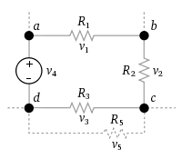

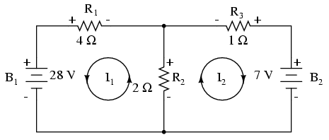
Kirchhoff's Voltage Law (KVL)
The principle of conservation of energy implies that
The directed sum of the electrical potential differences (voltage) around any closed network is zero.
The sum of all the voltages around a mesh is equal to zero.
v₁ + v₂ + v₃ - v₄ = 0
Can use these equations and Ohms Law (V=IR) to solve help solve for other things.
Mesh 1: -B₁ + R₁ + R₂ = 0
Mesh 2: R₂ + R₃ – B₂ = 0

Slide 10
How Many Meshes?
2
1.
2.
3
3.
4.
3
3

Slide 11
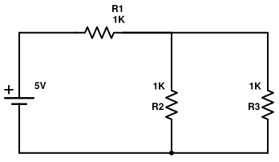
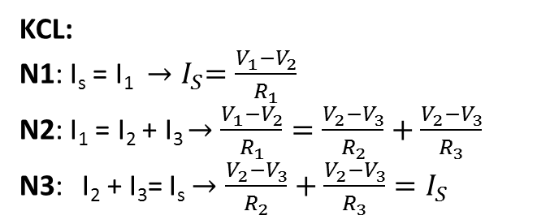
Simple Example
N1
N2
+
-
KCL:
N1: I_{s} = I₁ ${→I}_{S}=\frac{V_{1}−V_{2}}{R_{1}}$
N2: I₁ = I₂ + I₃ $→\frac{V_{1}−V_{2}}{R_{1}}=\frac{V_{2}−V_{3}}{R_{2}}+\frac{V_{2}−V_{3}}{R_{3}}$
N3: I₂ + I₃= I_{s} $→\frac{V_{2}−V_{3}}{R_{2}}+\frac{V_{2}−V_{3}}{R_{3}}=I_{S}$
A
+
B
+
Vs
-
-
N3
3 eqns, 3 unknowns … we can solve
KVL:
Mesh A: V_{S} - V₁-V₂ = 0
5V - I₁ ∗ 1000 Ω - I₂ ∗ 1000 Ω = 0
5V = I₁ ∗ 1000 Ω + I₂ ∗ 1000 Ω
Mesh B: V₂ – V₃ = 0
I₂∗1000 Ω – I₃∗1000 Ω = 0
We will fix this when we do mesh analysis
2 eqns, 3 unknowns …??

Slide 12
Backups

Slide 13
Simple Example
1
2
+
-
KCL:
J1: I_{s} = I₁ J2: I₁ = I₂ + I₃ J3: I₂ + I₃= I_{s}
A
+
B
+
Vs
-
KVL:
Mesh A: V_{S} - V₁-V₂ = 0
5V - I₁ ∗ 1000 Ω - I₂ ∗ 1000 Ω = 0
5V = I₁ ∗ 1000 Ω + I₂ ∗ 1000 Ω
Mesh B: V₂ – V₃ = 0
I₂∗1000 Ω – I₃∗1000 Ω = 0
-
3
Put into terms for 2 & 3:
5V = I₁ ∗ 1000 Ω + I₂ ∗ 1000 Ω
5V = (I₂ + I₃) ∗ 1000 Ω + I₂ ∗ 1000 Ω
5V = I₂ ∗ 2000 Ω + I₃ ∗ 1000 Ω
Add Eqns:
5V = I₂ ∗ 2000 Ω + I₃ ∗ 1000 Ω
0 = I₂∗1000 Ω – I₃∗1000 Ω
5V = I₂ ∗ 3000 Ω
I₂ = 1.67 mA
I₃ = I₂ = 1.67 mA
I_{s} = 3.33 mA

