Slide 1
ECE231 Capacitors and Inductors
Maj Kevin Walchko

Slide 2
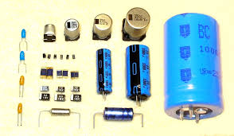
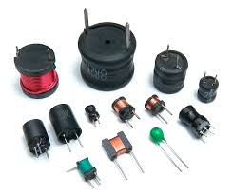
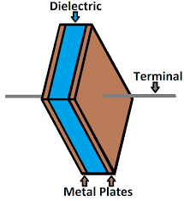
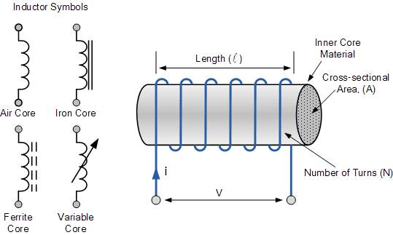
Parts
Capacitors
Inductors
Reading goes into more detail

Slide 3
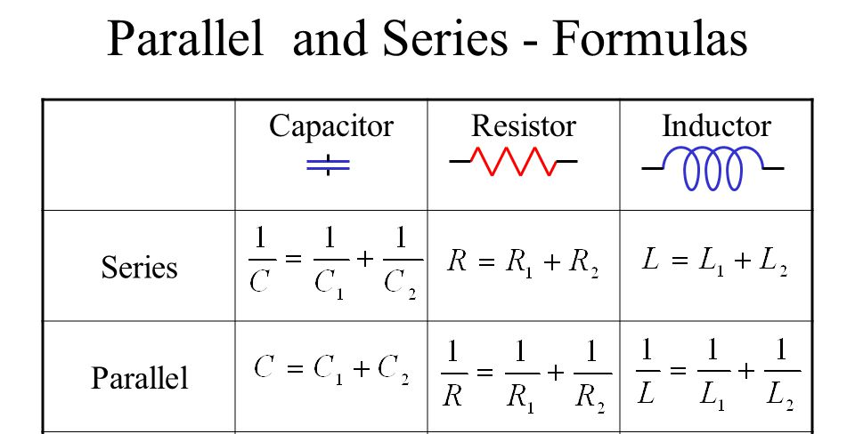
Networks

Slide 4
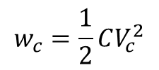
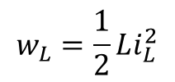
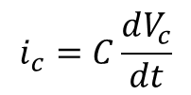
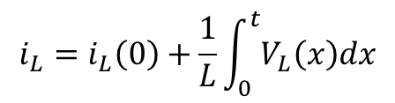
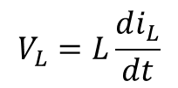
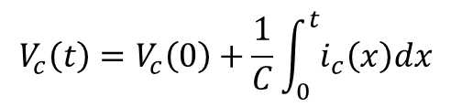
Parts
Capacitors
(voltage)
Inductors
(current)
Time varying voltage will create current through a capacitor
DC voltage makes the current 0A (open circuit)
Energy stored in an electric field in farads (J/V²)
Range from 10 mF – 1 pF
Time varying current will create voltage across an inductor
DC current makes the voltage 0V (short circuit)
Energy stored in a magnetic field in henry (J/A²)
Range from 1 H – 1 pH
$$i_{c}=C\frac{dV_{c}}{dt}$$
$$V_{L}=L\frac{di_{L}}{dt}$$
$$V_{c}\left(t\right)=V_{c}\left(0\right)+\frac{1}{C}\int_{0}^{t}{i_{c}\left(x\right)dx}$$
$$i_{L}=i_{L}\left(0\right)+\frac{1}{L}\int_{0}^{t}{V_{L}\left(x\right)dx}$$
$$w_{c}=\frac{1}{2}CV_{c}^{2}$$
$$w_{L}=\frac{1}{2}Li_{L}^{2}$$
Energy Stored:

Slide 5
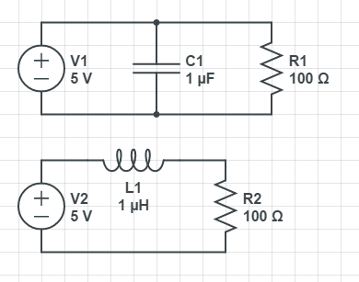
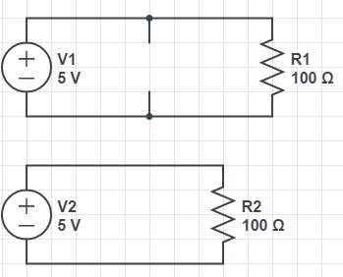
Steady State
For caps and inductors, without a changing voltage or current (respectively), the parts have no effect on the circuit
When exposed to DC sources, caps turn into open circuits and inductors turn into shorts

Slide 6
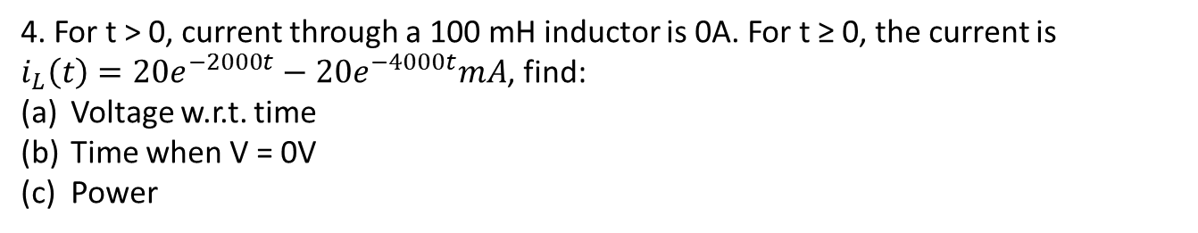
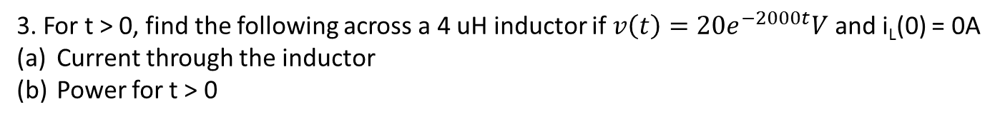
Examples
i, uA
i_{c}=2u(t)-3u(t-2)+u(t-4) uA
2
1. What is the voltage of a 1 uF capacitor for the following current profile?
0
2
4
t, sec
-1
2. The voltage across a 10 uF capacitor is Vc = 25 sin(2000t)u(t)V, find:
i_{c}
Power
At t = 1 sec, is the capacitor storing or delivering power?
3. For t > 0, find the following across a 4 uH inductor if $v\left(t\right)=20e^{−2000t}V$ and i_{L}(0) = 0A
Current through the inductor
Power for t > 0
4. For t > 0, current through a 100 mH inductor is 0A. For t ≥ 0, the current is $i_{L}\left(t\right)=20e^{−2000t}−20e^{−4000t}mA$, find:
Voltage w.r.t. time
Time when V = 0V
Power

Slide 7
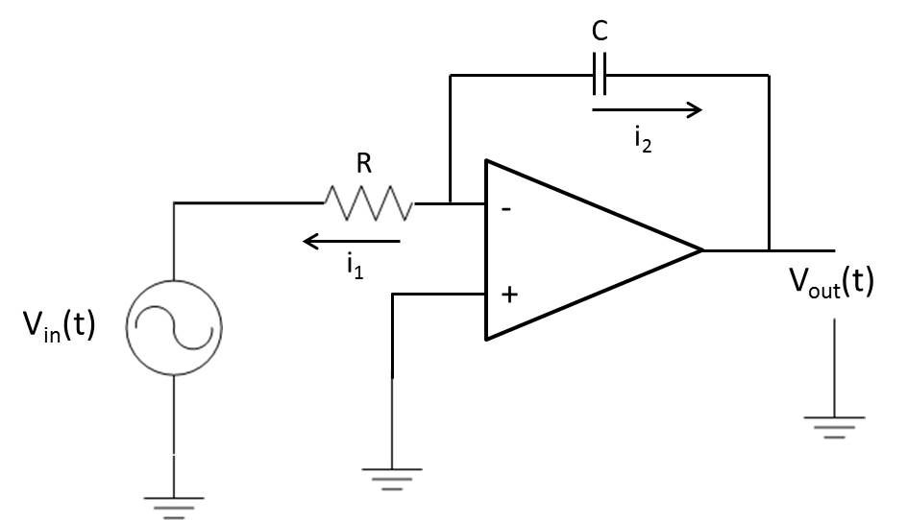
What is V_{out}?
A
Integrator – maybe takes in a car speedometer (velocity) signal and turns it into position travelled.

Slide 8
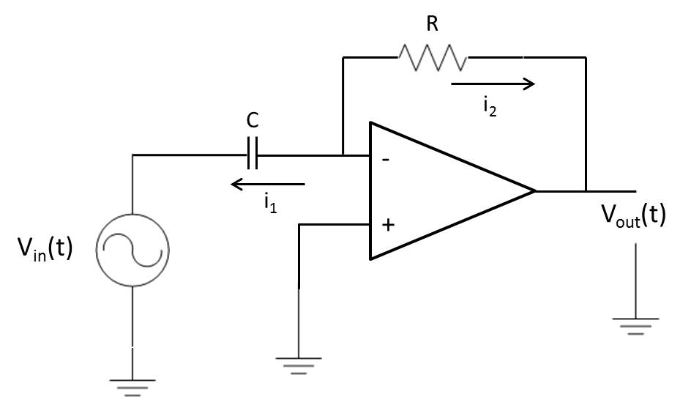
What is V_{out}?
A

Slide 9
Backups

Slide 10
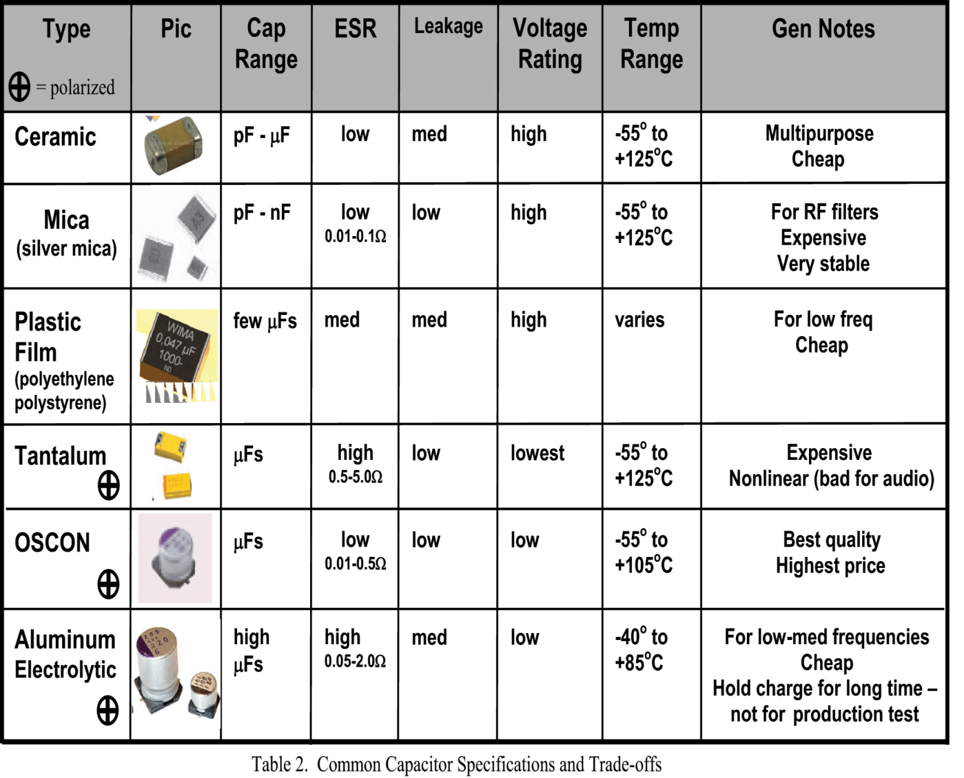
Types of Capacitors
Non-polarized, AC/DC, small
Good for high freqs
Non-polarized, AC/DC
Durable, catastrophic failure mode if voltage exceeded
Polarized, high reliability
Common, polarized

Slide 11
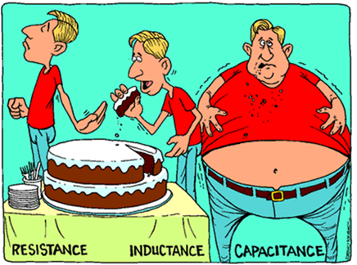

Slide 12
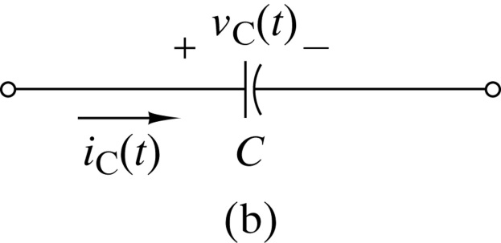
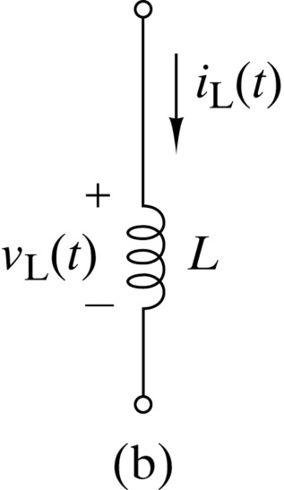
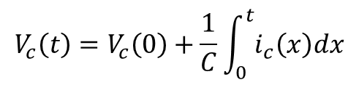
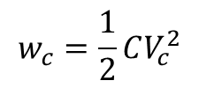
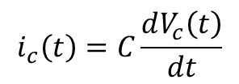
Capacitors
Inductors
$$i_{c}\left(t\right)=C\frac{dV_{c}\left(t\right)}{dt}$$
$$V_{c}\left(t\right)=V_{c}\left(0\right)+\frac{1}{C}\int_{0}^{t}{i_{c}\left(x\right)dx}$$
$$w_{c}=\frac{1}{2}CV_{c}^{2}$$

